Slide 1
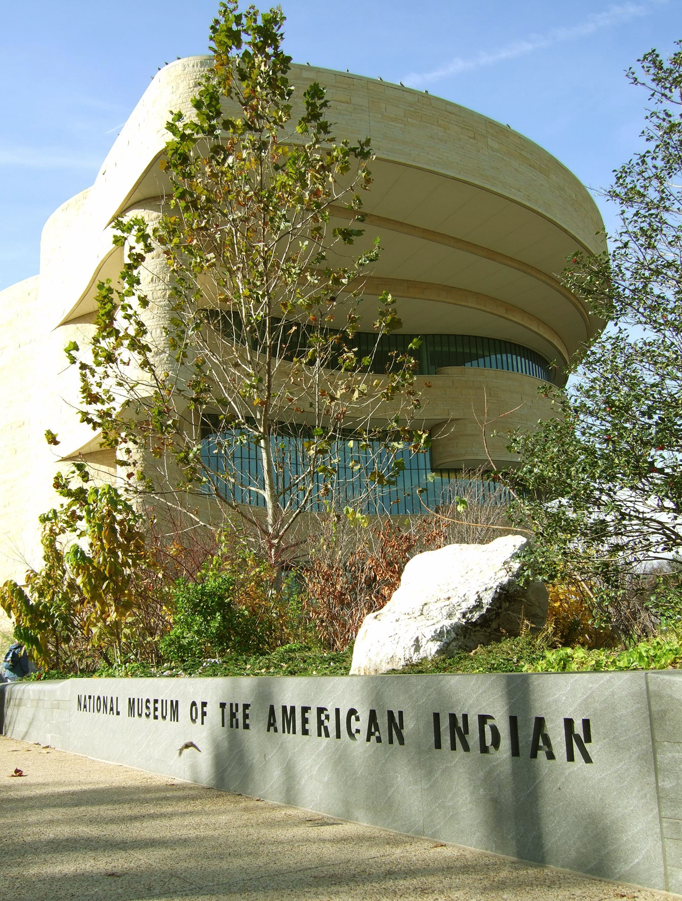
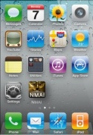

Barron, Bates, Huff, Phillips, Wu
Augmented Reality Based Mobile Application:
Enhancing the Museum Visitor Experience
Spring 2012
Final Presentation, Group 1
EDIT 752, Dr. Brenda Bannan
1
Notes:
20-25 minutes
1-15 Gloria 4
16-27 Katherine 4
28-41 Ying 3
42-59 Tangier 4
60-69 – Ying 3
70-73 – Heath 3
Questions = Heath 4

Slide 2
Development Team
Heath Huff (hhuff@gmu.edu)
  Responsibilities: Research Project Management Plan Team Lead
Katherine Phillips (kphillib@masonlive.gmu.edu)
  Responsibilities: Round 1 Team Lead
Tangier Bates (tbates@gmu.edu)
  Responsibilities: Round 2 Team Lead
Ying Wu (ywud@gmu.edu).
  Responsibilities: Prototype Design Team Lead
Gloria Barron (gbarron2@gmu.edu).
  Responsibilities: Prototype Design, Final Presentation Team Lead

Slide 3
Problem
Visitor reviews from popular social networking websites for local searches and user reviews revealed that many visitors leave the NMAI without understanding the museum’s overall desired intent.
  “Overall, visitors have only a cursory familiarity with Native philosophy, history or current conditions. Very few express strongly held beliefs or positions about Native Americans (Smithsonian Institutional Studies Office, 1998). “

Slide 4
Background
The needs, audience, and task analysis confirmed the suspected problem of visitor disconnection with the American Indian culture and exhibits while visiting the National Museum of the American Indian located at the National Mall in Washington D.C.
Even though the museum was built with the purpose of making the visiting experience different from traditional museums, the research shows a wide gap between visitor’s expectations and the knowledge/experience the museum is actually providing.

Slide 5
Goal
Create an opportunity for visitors to increase their understanding of Native Indian culture by implementing an augmented reality application for Smartphones that provides additional Native Indian perspectives; thus providing interactive details to deepen visitor understanding regarding their traditions, plight, artifacts and other important cultural values.

Slide 6
Strategic Goals
Engage audiences where they are
Open access to data, collections, and research
Create new opportunities for learning
Transcend disciplinary boundaries by making connections

Slide 7
Instructional Goals
Deepen visitor’s understanding of the cultural context of the exhibits and artifacts
Help visitors make connections between Native philosophies, beliefs, and practices with their own
Give visitors “Paths of Discovery” through a less linear path by creating their own personal tour

Slide 8
Refined Objective
Develop a mobile application with augmented reality features to provide visitors the opportunity to make direct connections with Native American cultures by exploring objects and artifacts.

Slide 9
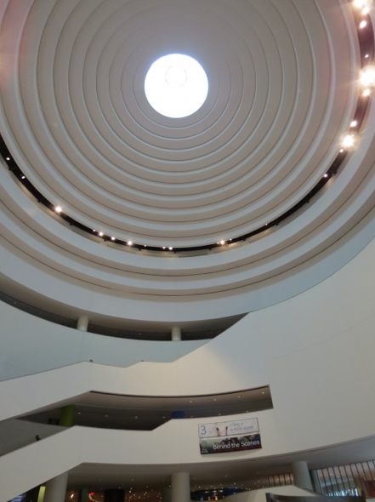
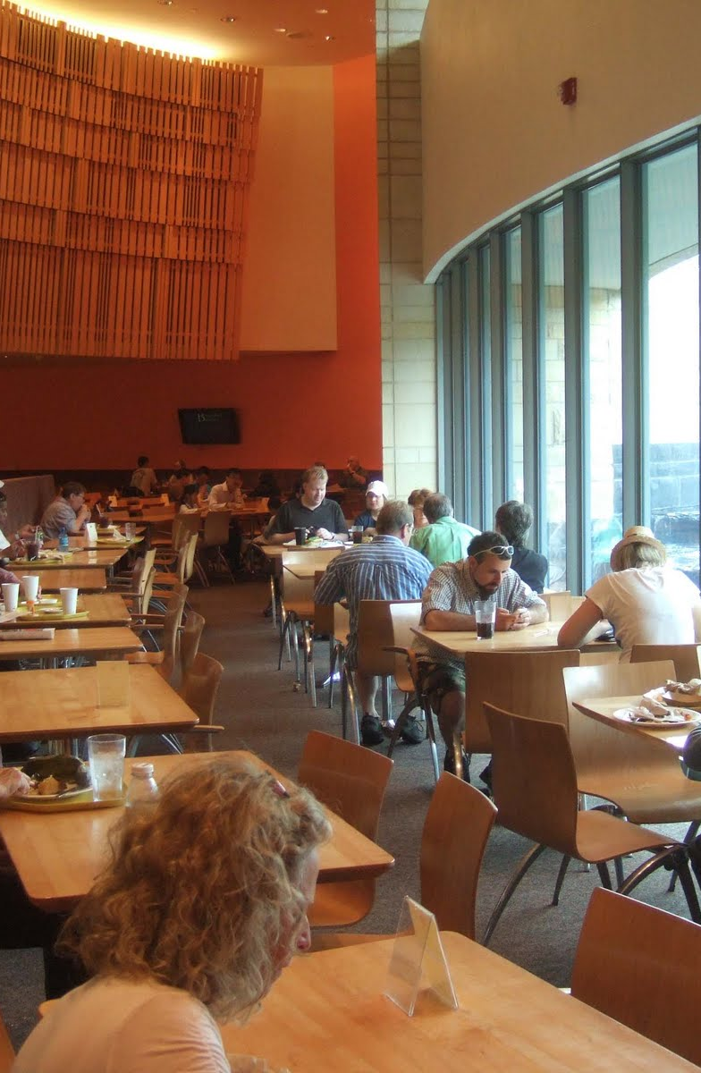
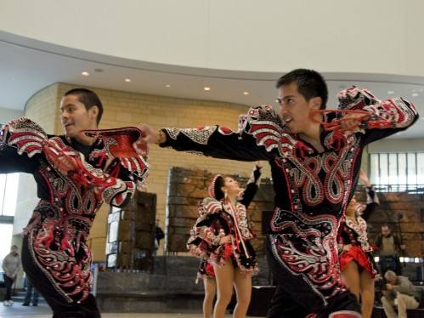
NMAI Opportunities
The Architecture
The Food Court
Special Events

Slide 10
Original Prototype

Slide 11
Fall 2011
Original Prototype Sitemap

Slide 12
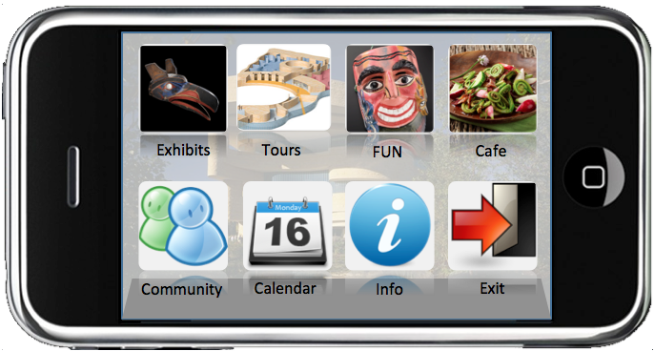
Original Prototype Interface

Slide 13
User Research Plan

Slide 14
Iterative Development
Design Research Process
Round 1: Usability Test
Round 2:
Focus Group Test
Final Product

Slide 15
Evaluation Method
Morrison, Ross, and Kemp’s Formative Evaluation
EDIT 732
EDIT 752

Slide 16
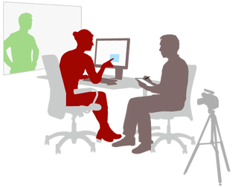
Round 1
Usability Test

Slide 17

Round 1 - Goals
Focus of the Testing
Usability and Clarity
  Test app’s navigational features
Effective Learning
  Test user’s ability to create a personal tour

Slide 18
Round 1-Research Questions
  Navigation
  Are navigational features of the mobile application prototype intuitive?
  Tours
  Are users able to create and launch a tour with minor difficulty?

Slide 19
Round 1- Methodology
Recruited participants who represented our previously developed personas
Directed potential participants to a screener survey (in the form of a blog) where they were introduced to the usability test and were given an overview of the screener process.
Surveys were reviewed for demographic and motivational characteristics to ensure participants fit the target audience and recruited only those participants represented in previously developed personas
A script was written to guide each session and ensure consistency.
Prior to the test, participants were asked to sign a human testing informed consent form
Tests were performed in person, via web-conferencing, and via conference call.
Notes, audio recordings, video recordings, and interviewer’s overviews were collected for further analysis

Slide 20
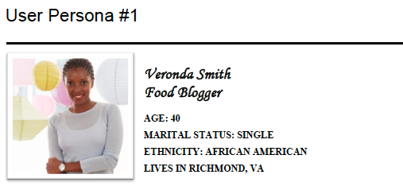
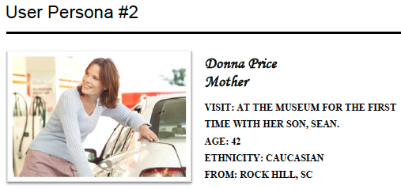
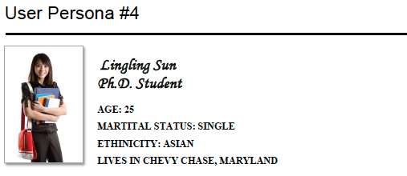
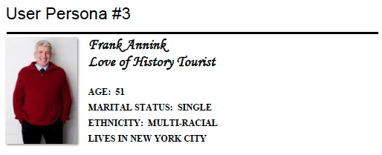
Round 1 - Target Personas

Slide 21
Round 1 - Results

Slide 22
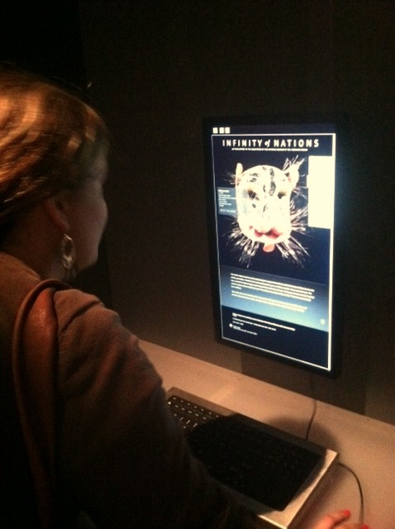
"I would never think to look at or use a mobile application about a museum before I attended.
I would be doing my trip planning and research on a PC."
-Marcie
Using a phone app to tour a museum is a new concept for some users. Those new to it, appreciated the convenience of an app to access information about objects and artifacts.

Slide 23
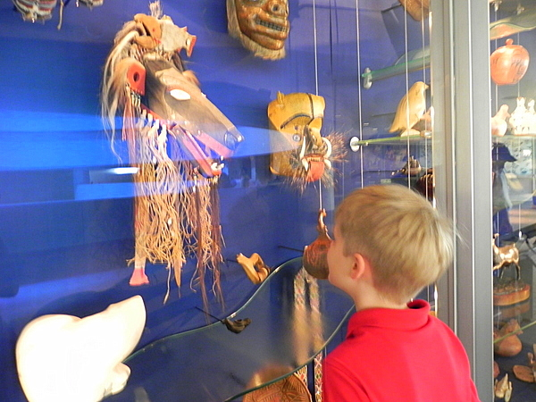

"If I wanna share something (such as a museum object), I want to (be able to ) Share it, not click Like."
-Charles
Users found the application’s ability to ‘Like’ an item very limiting. Users expect to be able to ‘Share’ museum information with others on their favorite social networks.

Slide 24
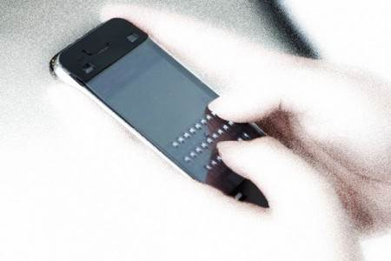
"I don't like typing on a touch screen."
-Catherine
Results shows that users dislike having to input information on their mobile devices which confirms that this prototype is more conducive for touch screens.

Slide 25
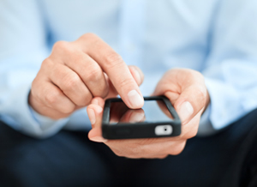
The App is “easy to navigate and grabs your attention”
-Robert
Confirms that the prototype is visually pleasing and users find navigational features of the mobile app intuitive

Slide 26
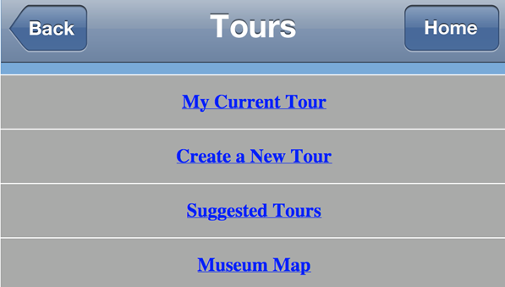
I think I’ve put everything in my tour, but I am not sure how to get to what I created.
-Marcie
This feature was well received by participants. Many felt the process was intuitive. However, some participants were unclear on how to launch the tour once it was created.

Slide 27
Round 1-Recommendations
Improve uniformity of page layouts
Provide uniformity across pages
Provide wider access to functions and features
Context menu needs to be more obviously labeled
Minimize links to external web sites
Make Object pages consistent
Display items on the same level
Provide the option to Share Objects on a social network
Improve the visibility of Objects by Region link from the Café regional menus
Conceptualize or create a true item search and customize tour capabilities for customized visitor experience
Notes:
Due to the limited screen space available, UD decided to leave the link to Objects by Region in place.
(Improve the visibility of Objects by Region link from the Café regional menus)

Slide 28
Round 1
Prototype Changes

Slide 29
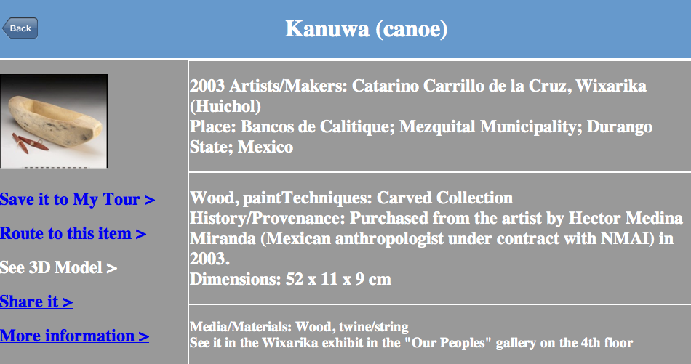
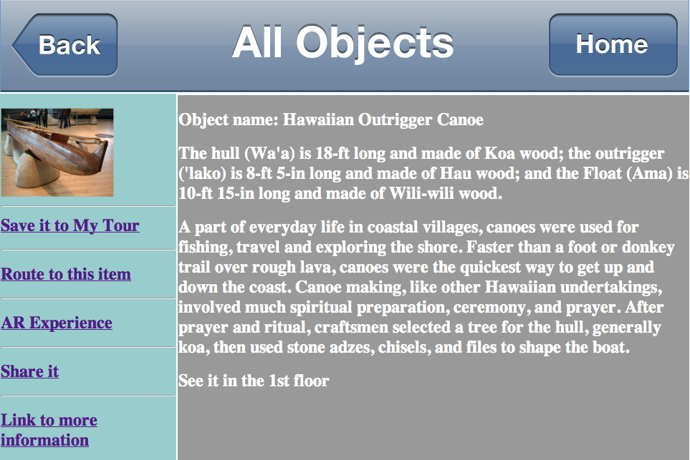
Prototype Changes
Revision: Edited all object pages to display a uniform page layout
Before
After

Slide 30
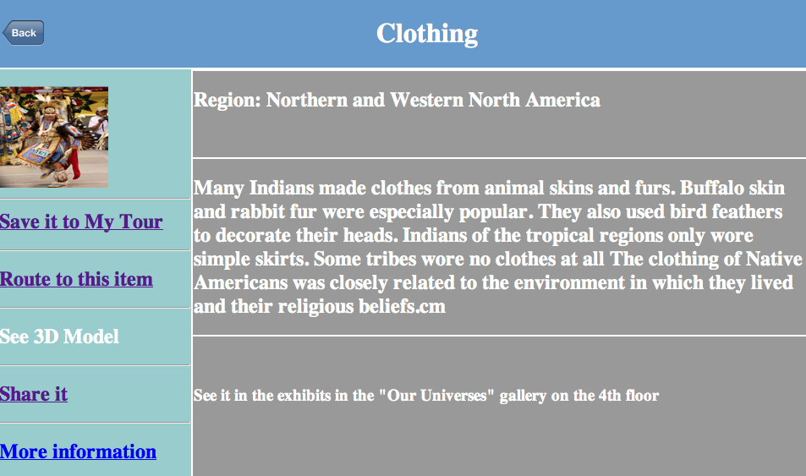
Prototype Changes
Revision: a Home button was added to all pages
Before
After

Slide 31
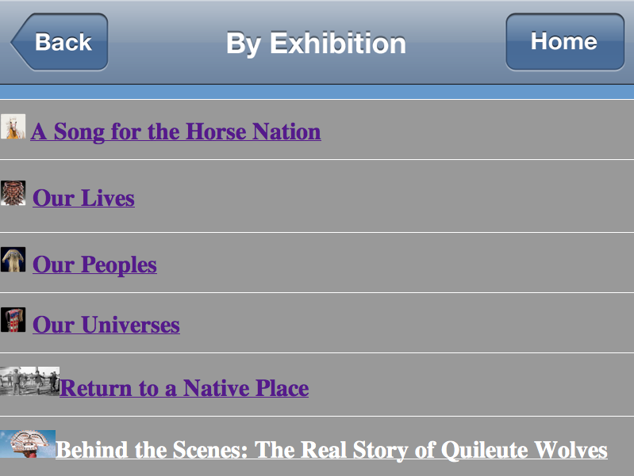
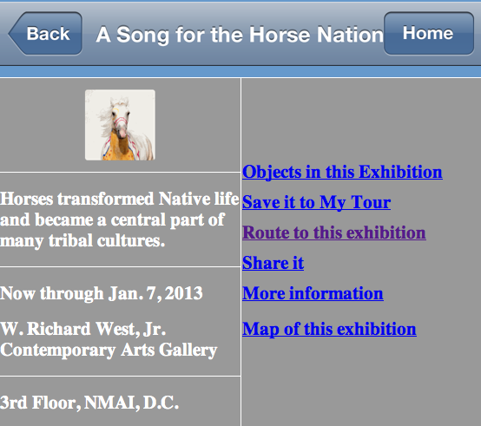
Prototype Changes
Revision: Removed links to external sites and replaced with new app content

Slide 32
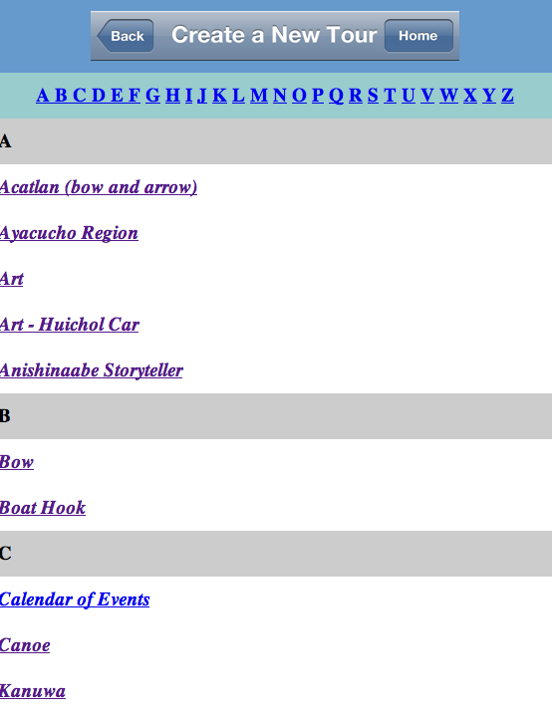
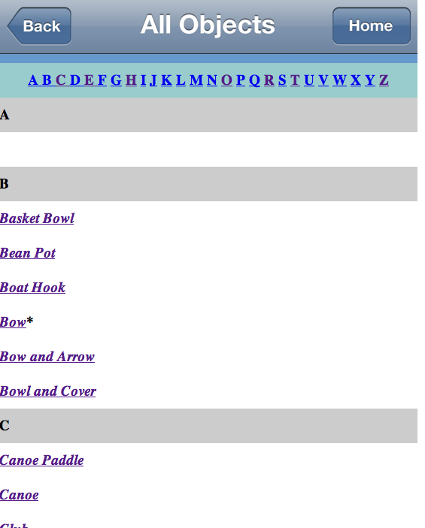
Prototype Changes
Revision: All Objects pages lists only items that are on the object level.
Before
After
Removed items that did not belong at the object level

Slide 33
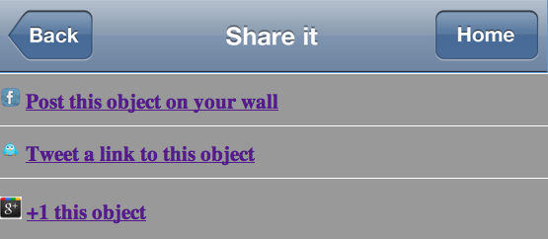
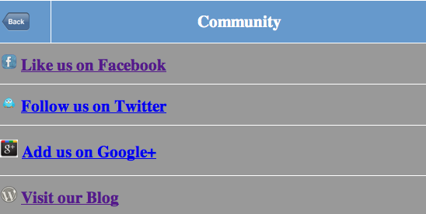
Prototype Changes
Revision: Users are now able to ‘Share’ an item or event on social networks.
Before
After

Slide 34
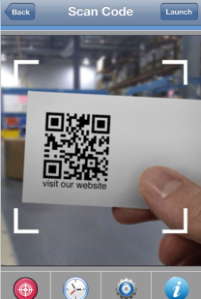
Prototype Changes
Revision: Added minimal instructions for selected features when used for the first time, with the user having the option to dismiss them thereafter
Before
After

Slide 35
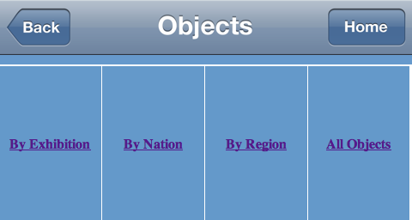
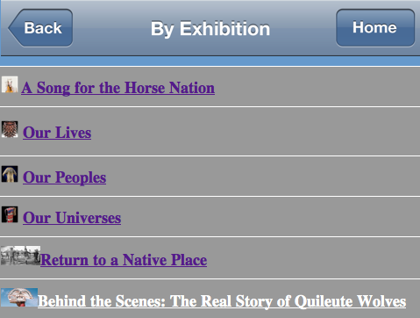
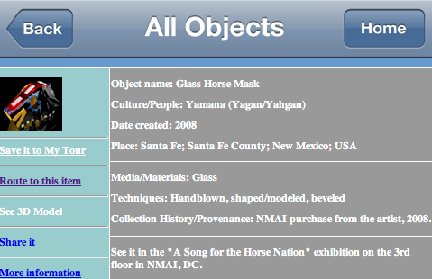
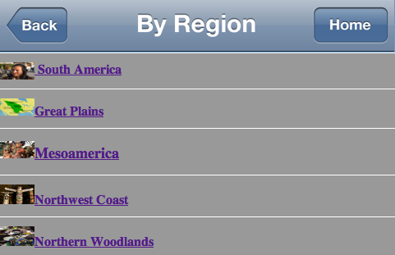
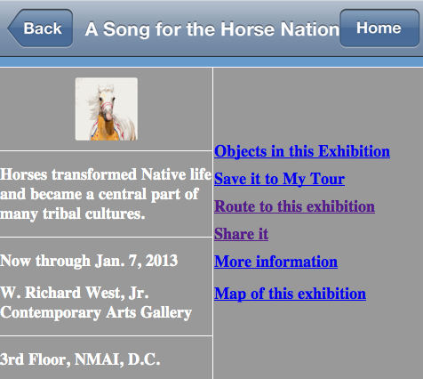
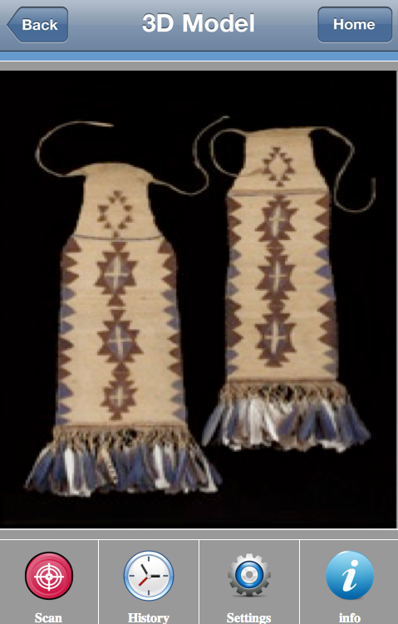
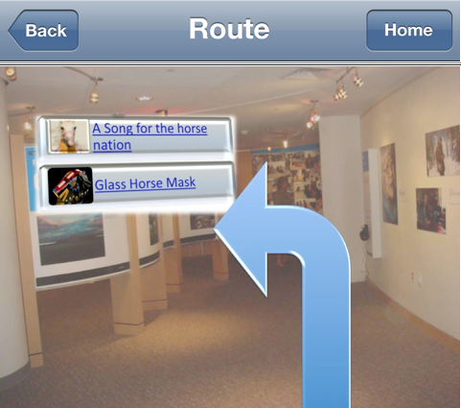
Prototype Changes
Revision: Improved navigation by adding uniform labels across all pages

Slide 36
Prototype Changes
Revision: enhanced object searching and tour building capabilities for customized visitor experience

Slide 37
Round 1 - Limitations
Working with HTML
Limited pool of available participants
Non-interactive prototype
Not being able to provide full functionality of augmented reality features
Not conducted on location

Slide 38
Round 1
Revised Prototype Design

Slide 39
Fall 2011
Original Prototype Sitemap

Slide 40
Spring 2012
Round 1 -Original Sitemap

Slide 41

Round 1 -Revised Sitemap

Slide 42
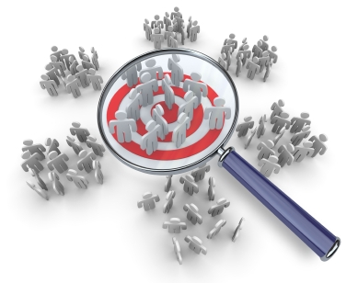
Round 2
Focus Group

Slide 43

Round 2 - Goals/Objectives
Understand what attracts (potential) museum visitors to try Augmented Reality features
Understand what makes using Augmented Reality features more compelling than the alternative (museum‐provided visuals and information)
Understand users' attitudes toward proposed Augmented Reality features
Understand how users would expect to access an Augmented Reality experience

Slide 44
Round 2 - Themes and Hypothesis
Implementation of technology related to augmented reality
Purpose and use of QR Codes
Motivation for using augmented reality in a mobile app
Purpose for Augmented Reality features: fun vs. education
Attitude towards existing augmented reality features on the prototype
Exploration, using directions to navigate your way in space
Preference of augmented reality features

Slide 45
Round 2 - Methodology
A pre-survey was sent to potential focus group participants to ensure a homogenous representation of our target persona, an international student (25-35 years old), with familiarity with AR and a minimal comfort level using mobile devices
A feature prioritization/exploratory focus group was created to find out which proposed AR features people perceive to be valuable, what motivates them to use AR applications, how they would expect to access an AR experience and their attitude towards these features
A script was written to guide the session.
Prior to the test, participants were asked to sign a human testing informed consent form
Tests were performed
Notes, audio recordings, and interviewer’s overviews were collected for further analysis

Slide 46
Round 2 -Target Persona
Conducting Research
Owns a mobile device
Motivation is to locate items in the museum related to the research
Assistance in locating resources outside the museum

Slide 47
Round 2 - Procedure
Part 1
  Introduction and discussion - Augmented Reality
  Introduction and discussion – Quick Response (QR) Codes – with an event experience
  Introduction and discussion – Quick Response (QR) Codes – with 3D model
  Introduction and discussion - Image Recognition
Part 2
  Prototype integration of QR Codes and discussion
  Prototype integration of QR codes – with an event experience and discussion
  Prototype integration of Image Recognition and discussion
  Prototype integration of QR Codes – with 3D Models of Objects and discussion
Part 3
  Brainstorming discussion

Slide 48
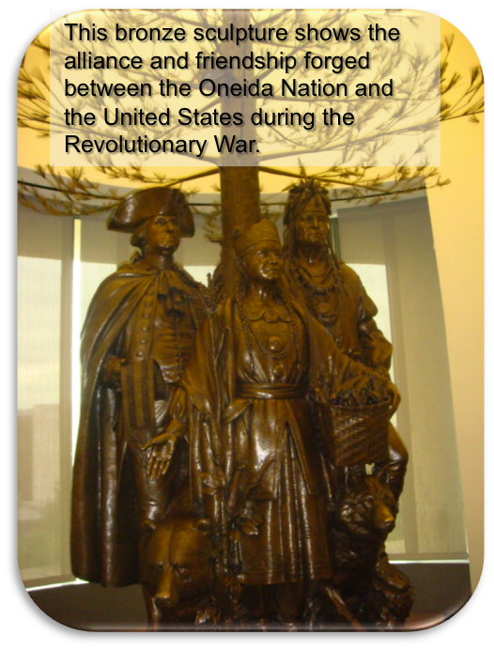
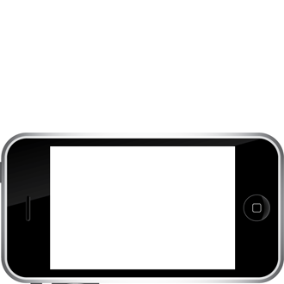
AR Technology
Image Recognition
Used to overlay information

Slide 49
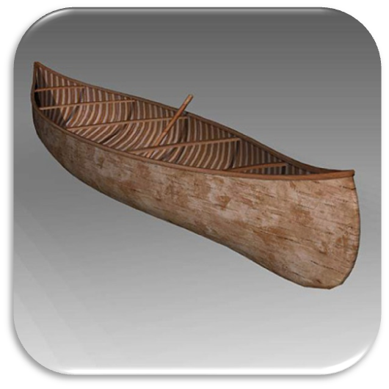
AR Technology
3-D models of objects - to produce the best possible experiences for users

Slide 50
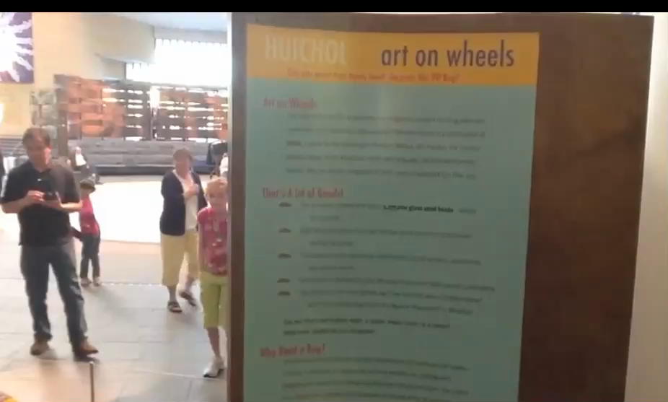
AR Technology
Event Experience - Provides the opportunity to relive an experience that happened in the same space you occupy but at a different time

Slide 51
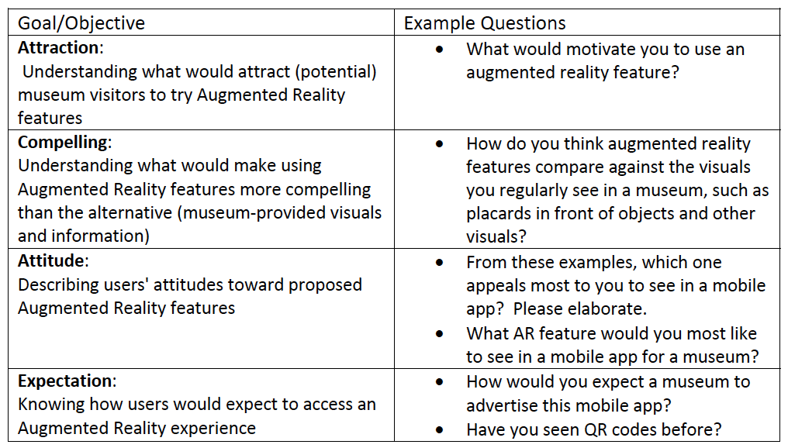
Focus Group
Mapping Objectives to Protocol Questions

Slide 52
Results

Slide 53
Themes Identified
Supports Initial Goals
Expectation: The implementation of AR technology falls under the expectation goal of users knowing how to access augmented reality features.
Attraction: The participants’ interest in the implementation of QR codes gave Unified Designs insight on how people perceive these codes if seen in the museum.
Attitude: The theme, motivation for using AR in an app, provides insight into understanding what attracts museum visitors to use an AR feature.
Compelling: Fun vs. education with AR and attitudes toward the existing AR features were two prevalent themes. The ideas that came out from these themes will help Unified Designs in understanding what makes AR more compelling than the standard museum features.
Expectation: Using directions to navigate was a theme that participants had awareness of. They were interested in using AR technology to make navigating the museum and outside world easier.

Slide 54
Recognized Trends:
Attraction
“Maybe for fun”
“If it’s free, I would use it definitely”
“For directions, it looks very useful”
The feedback supports augmented
reality as an appealing way to
enhance user experience; purposeful,
fun and free.
40% of participants preferred access to 3-D models of objects

Slide 55
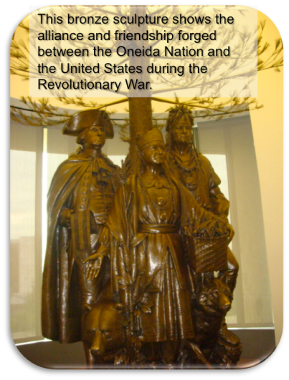
Recognized Trends:
Compelling
“If I want to learn more about something, I definitely want to receive more information because you know when I go to the museum and see the real item there and attach some words…instruction, that is very limited.”
“I definitely like the image recognition to help me know the background of this art”
This feedback supports the idea that augmented reality is more compelling than the current museum experience.
40% of participants preferred to have access to image recognition

Slide 56
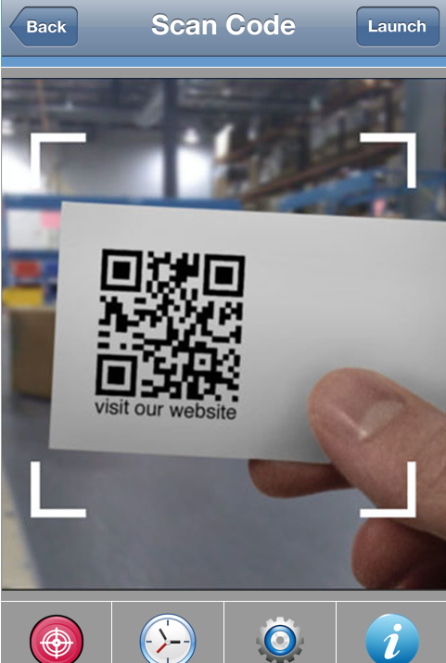
Recognized Trends:
Attitude
“I think the 3D image function is amazing because I think I don’t need to spend time to go to the museum. If I want to see something, if I want to know something I use the code to print it out and use the computer and you can see the 3 dimensions of the thing, something so that’s cool.”
This feedback provides information on the general attitudes towards augmented reality helping Unified Designs understand how this product may be valued by the general community.

Slide 57
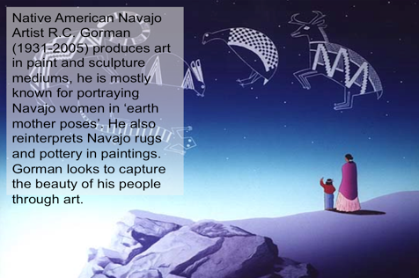
Identified Trends:
Expectation
“In seeing image recognition, is it really necessary here? Because we can just give it a QR code.”
This feedback provided Unified Designs with insight into how users would expect to access the augmented reality features.

Slide 58
Recommendations
“Maybe you can add the search function”
“If I am a user, I would prefer a ‘map’ function in it. I would like to know the location of each item and how to find them. Furthermore, if I am lost in the museum, I hope this app can help me to find where I want to go.”
“Maybe we could combine 3D and Image recognition together to increase the attraction of app. because 3D and image recognition provide different user experience.”
“Its more like a combination of several kinds of applications so probably I would add some other features to it, and ‘save it for later use’ or add more links that use(rs) may be interested.”

Slide 59
Round 2 - Recommendations
Add a link to the tours featuring augmented reality elements to the “Tours” section of the prototype.
Remove the “Community” page and replace with a page to access all augmented reality features within the mobile application.
Add a 2D map of where to find augmented reality opportunities in the museum.
Remove QR Scan Code page to allow the user to click ‘3D image’ and see the requested information so they can view this content directly in the mobile application.
Tie information to QR codes that can be accessed anywhere and also QR codes that can only be found in the museum.

Slide 60
Round 2
Prototype Changes

Slide 61
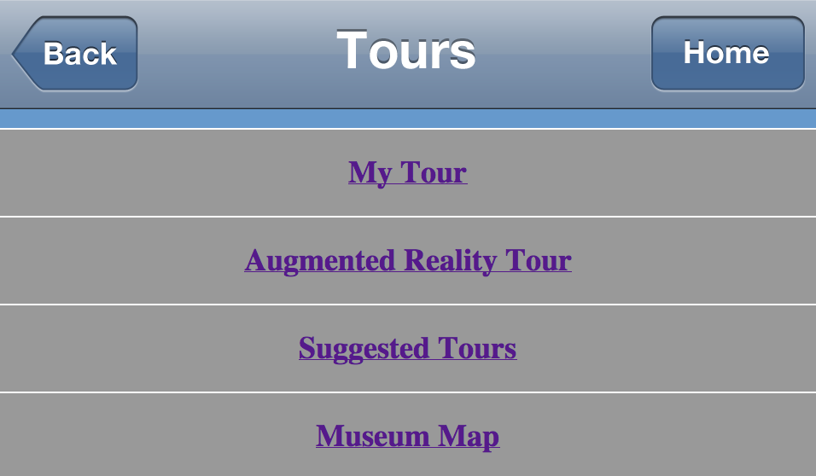
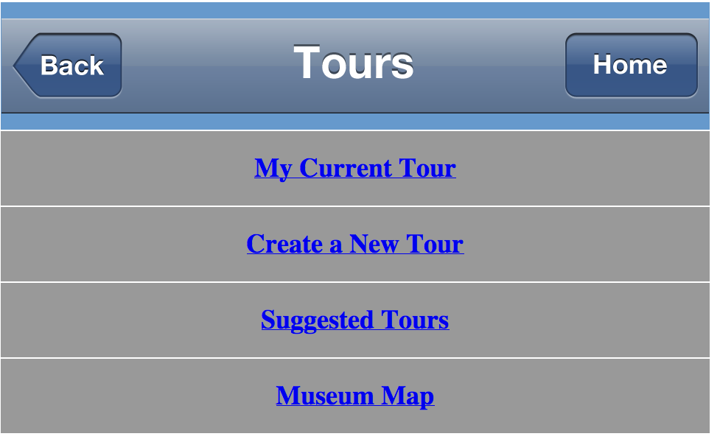
Prototype Changes
Revision: Added a link to the ‘Tours’ featuring AR elements
Before
After

Slide 62
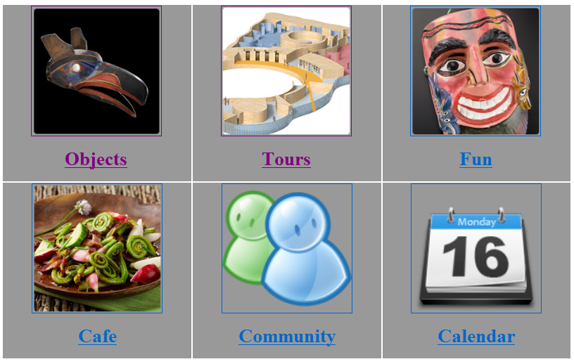
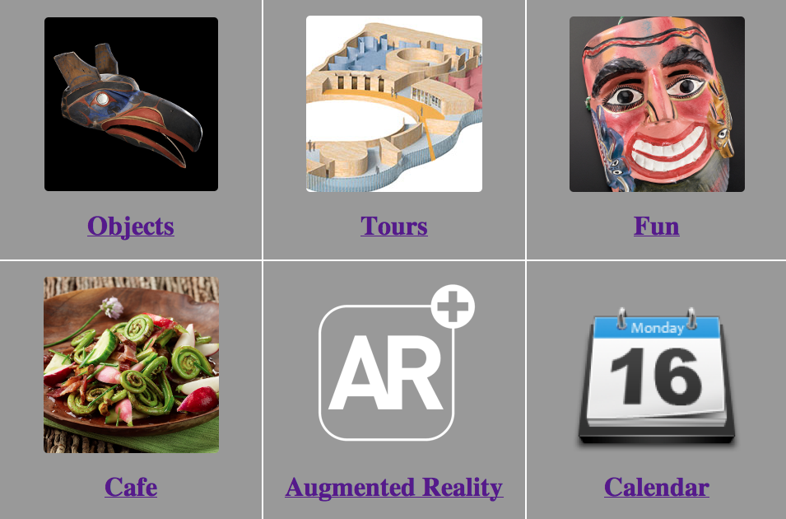
Prototype Changes
Revision: Removed the “Community” page and replaced with a page to access all AR features
Before
After

Slide 63
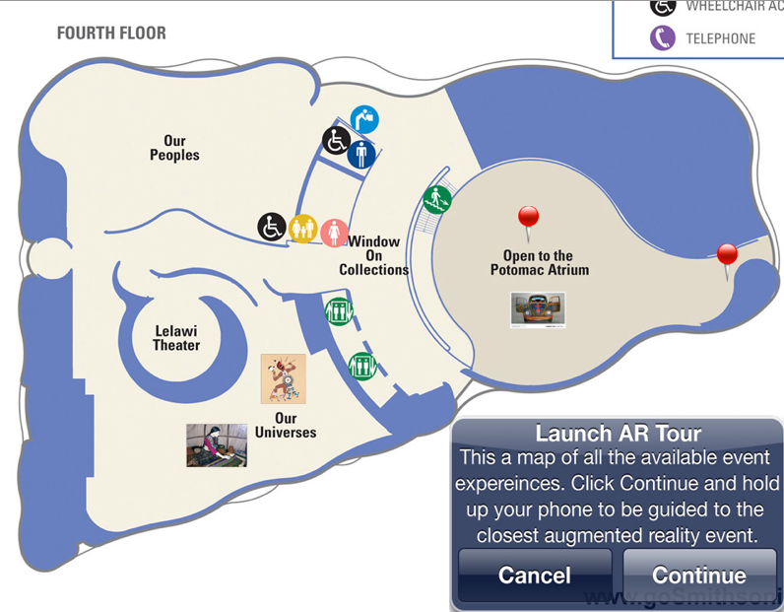
Prototype Changes
Revision: Added a 2D map to locate AR opportunities in the museum.

Slide 64
Prototype Changes
Revision: Removed QR Scan Code page to allow the user to click ‘3D image’ and view content directly in the mobile application.

Slide 65
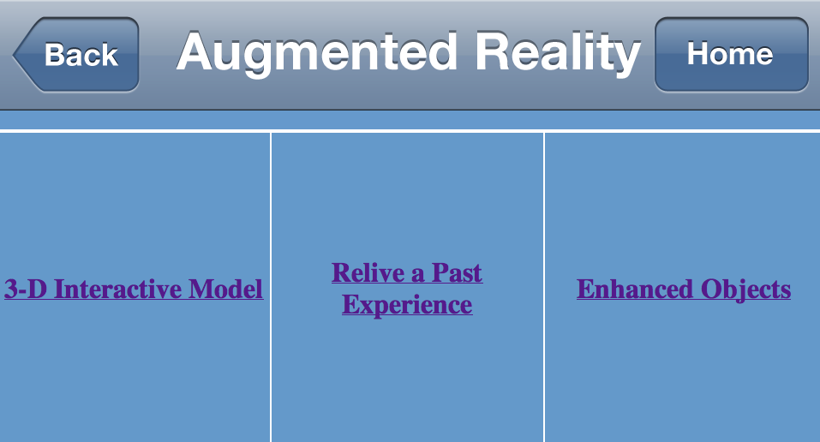
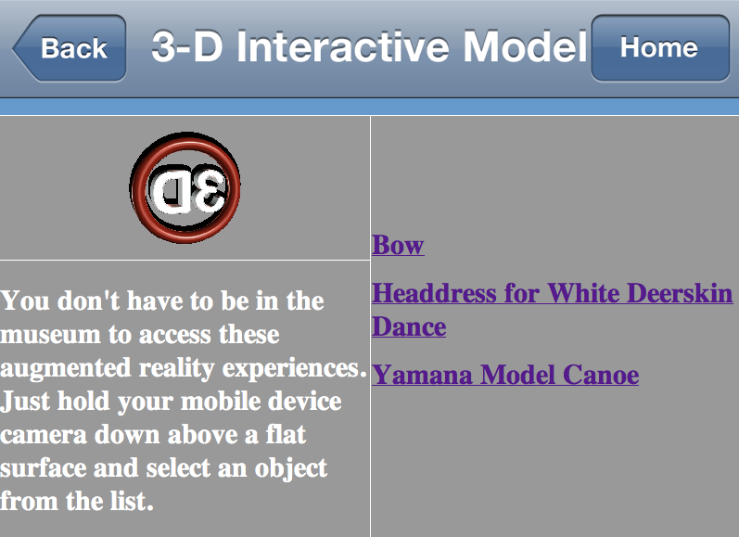
Prototype Changes
Revision: Tied information to QR codes to: 1.provide access to 3D Objects from any location
2.locate experiences that can only be found in the museum.

Slide 66
Limitations
Unified Designs was unable to conduct additional focus group testing due to schedule constraints.
Without a second focus group testing, UD was unable to compare results and confirm trends and themes.
Malfunction of the pre‐group survey.
Participants’ prior acquaintance with a Unified Designs group member.
Inexperience of the team as focus group facilitators.

Slide 67
Round 2
Revised Prototype Design

Slide 68
Round 2 – Sitemap from R1

Slide 69
Round 2 – Revised Sitemap

Slide 70
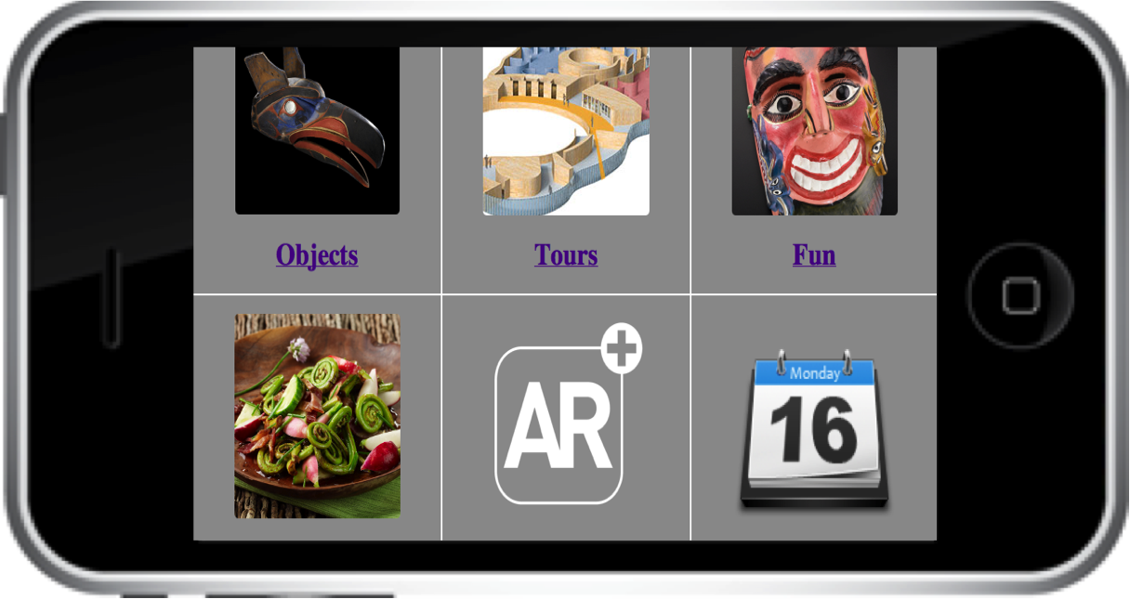
Final Prototype
Home Page
http://mason.gmu.edu/~ywud/nmai/menu.html

Slide 71
Conclusions

Slide 72
Round 1 and Round 2
Conclusions
UD met their objective to develop a mobile application with augmented reality features to provide visitors the opportunity to make direct connections with Native American cultures by exploring objects and artifacts.
  UD was able to provide usability and clarity by creating a prototype with intuitive navigational features
  UD was able to provide effective learning by providing users the ability to create and launch their own tour
  UD discovered that augmented reality is an appealing technology to enhance user experience
  UD confirmed that using augmented reality technology for touring the museum is more compelling than the current museum experience.
  UD discovered that museum visitors value the use of an app with augmented reality features to enhance their knowledge and understanding of objects and artifacts
  UD discovered that app users have predetermined expectation on how to access augmented reality features.

Slide 73
What worked well
Users were very receptive to the idea of using AR technology to tour a museum
Users found the application intuitive
What did not work so well
Every device displayed the app a little differently
Since the prototype was only a mock up, users did not get to enjoy the AR experience as intended.

Slide 74

Thank You
Questions

