Slide 1
An evaluation of accessible solutions for the adapt clubhouse
December 7th, 2011
EDSE 610 – Fall 2011
Aseel Alsuhaibani, Diana Jurist, Thang Ho,
Eileen Oviatt, Ying Wu
Notes:
I alphabetized.

Slide 2
In support of

Slide 3
Goals and Objectives
EDSE 610, Designing Adaptive Environments
Graduate level course taught at George Mason University
Five students, divided into three teams, looking at three aspects of accessible solutions
Provide research-based recommendations

Slide 4
Our Processes
Accessibility concerns at the Clubhouse
Group Observations
Individual interviews
Measurements
Evaluation, analysis and research
Collection of data and synthesis
Collaboration on report and presentation

Slide 5
Topics To Be Discussed
Lighting and Physical Accessibility
Computer Access within the Business Unit
Other Assistive Technology Solutions

Slide 6
Lighting and Physical Accessibility
Thang Ho
Eileen Oviatt

Slide 7
Lighting and Physical Accessibility
Furniture
Physical/
Structural
Lighting
Cubbies/
Lockers
Ramps
Task Lighting
Desk
Floors, Doors, and Hallways
Overall Lighting
Chairs
Area-Specific Lighting

Slide 8
Introduction
Focus on addressing two main issues
Overall Lighting
Overall physical accessibility
Individuals with TBI may experience a reduction in vision and be physically handicapped.
Environment should be barrier-free and adapted to fulfill the varying abilities and disabilities.

Slide 9
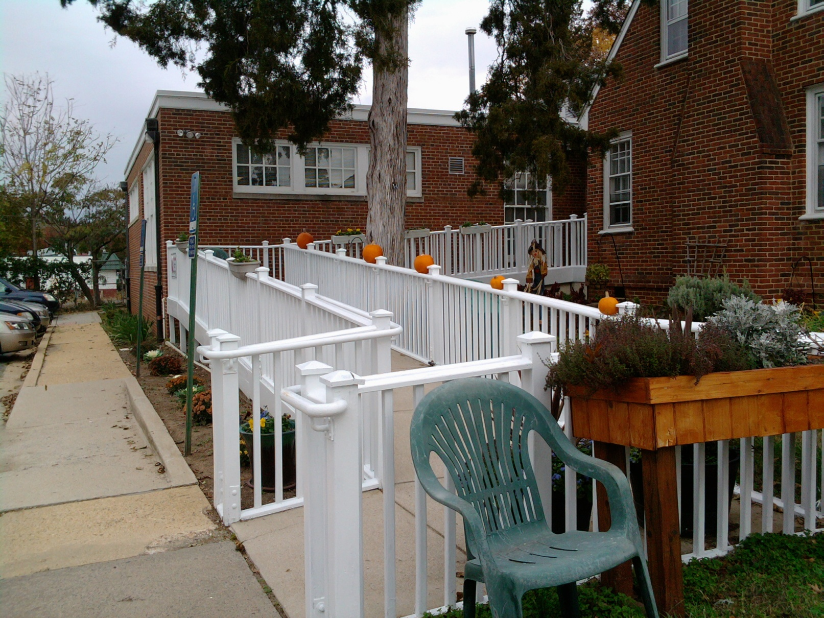
Exterior
Accessible parking spaces
Garden with flowers and vegetables
Notes:
I think this slide should be taken out – we are not making any recommendations for improvement here…

Slide 10
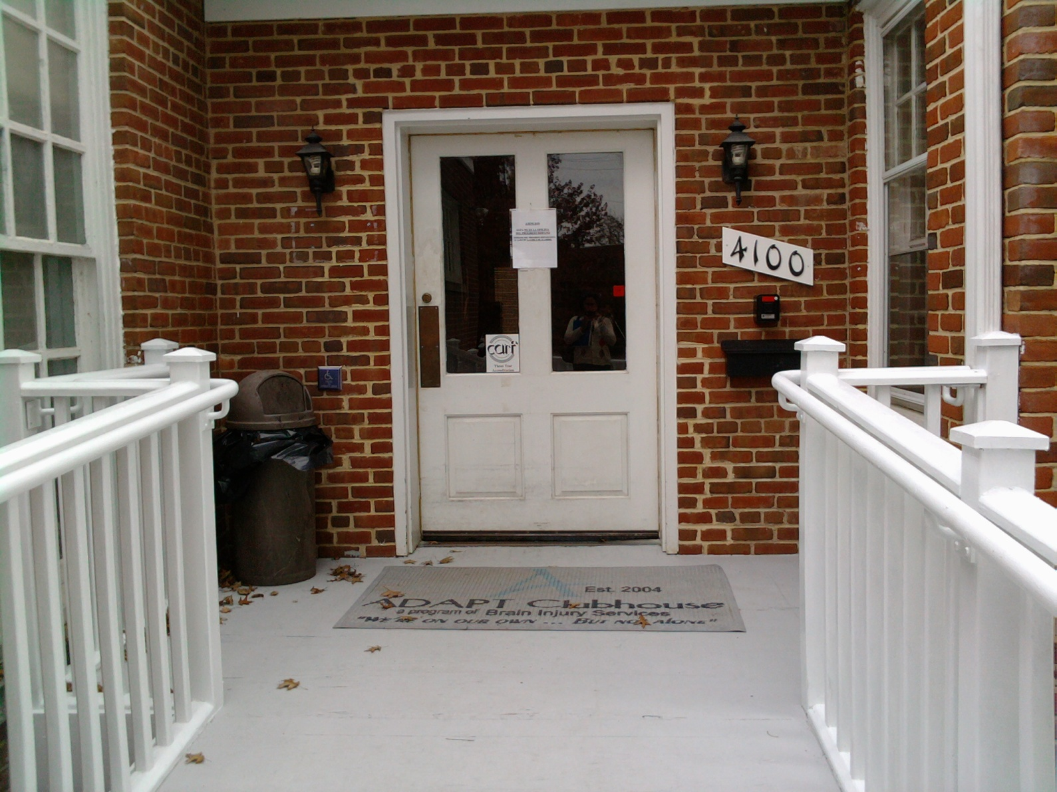
Main Entrance
Push button be more prominent
Wide ramp for wheelchair accessibility

Slide 11
Overall Floor Plan of Clubhouse

Slide 12
Recommendations/Rationale Furniture
Cubbies/Lockers
Refurnish built-in shelving and cabinets
Replace with new ones
Desks
Chairs

Slide 13
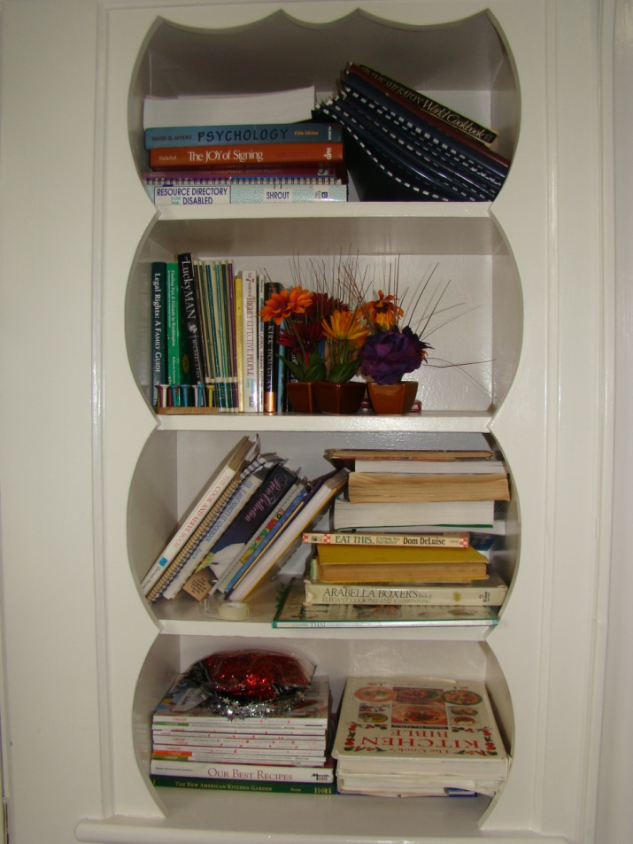
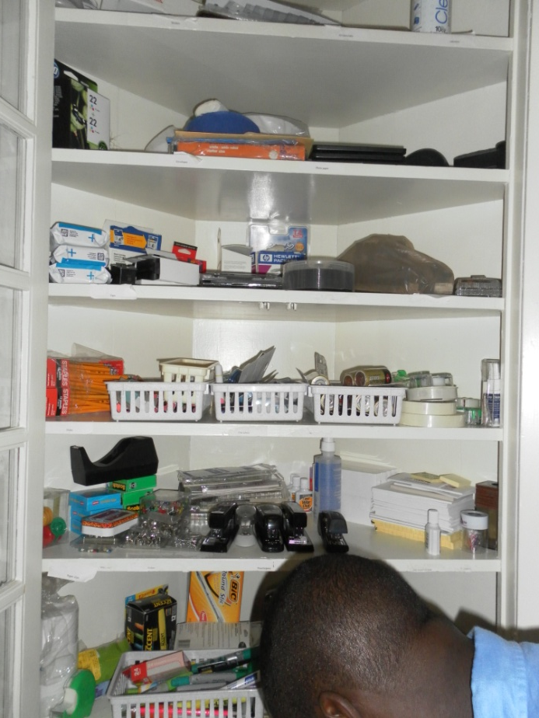
Refinish Shelving and Cabinets
Business unit
Lunch room
Built-in drawers and cabinets difficult to open
decorative finishes/trims barriers

Slide 14
Guest Space at Clubhouse
Clutter
Space Issues

Slide 15
Heavy-Duty Ventilated Lockers
Single tier--$209.95
Double tier—234.99

Slide 16
Coat Cubby
Wall-mounted--$96.99
Standard--$308.22

Slide 17
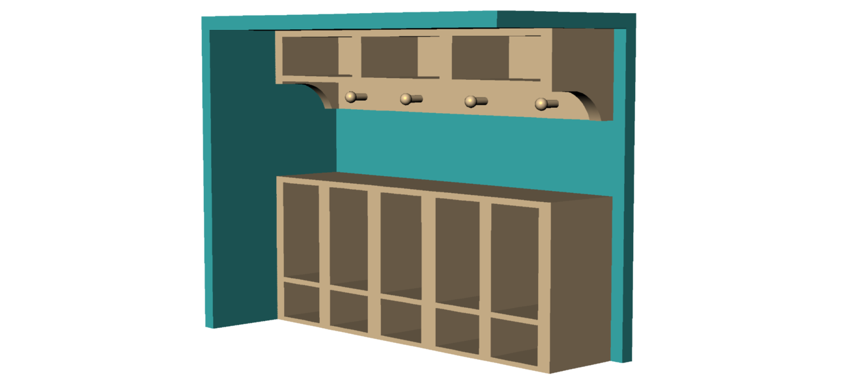
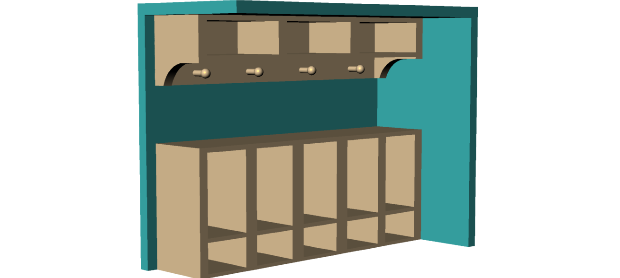
Example of Space Saving
Right Side View
Left Side View

Slide 18
Desks at Clubhouse

Slide 19
Universal designed desks
Adjustable workstation--$1,009
One Less desk--$749

Slide 20
Chairs at Clubhouse

Slide 21
Ergonomic Chairs
Comfort-flex--$129.99
Raynor apollo--$215

Slide 22
Recommendations/Rationale Physical/Structual
Ramps
Floors, Doors and Hallways
Fall prevention
Reducing congestion

Slide 23
Rear Entrance
emergency exit/trash out pass
unstable hand rails
slippery surface
lack of an adequate landing and curb cut

Slide 24
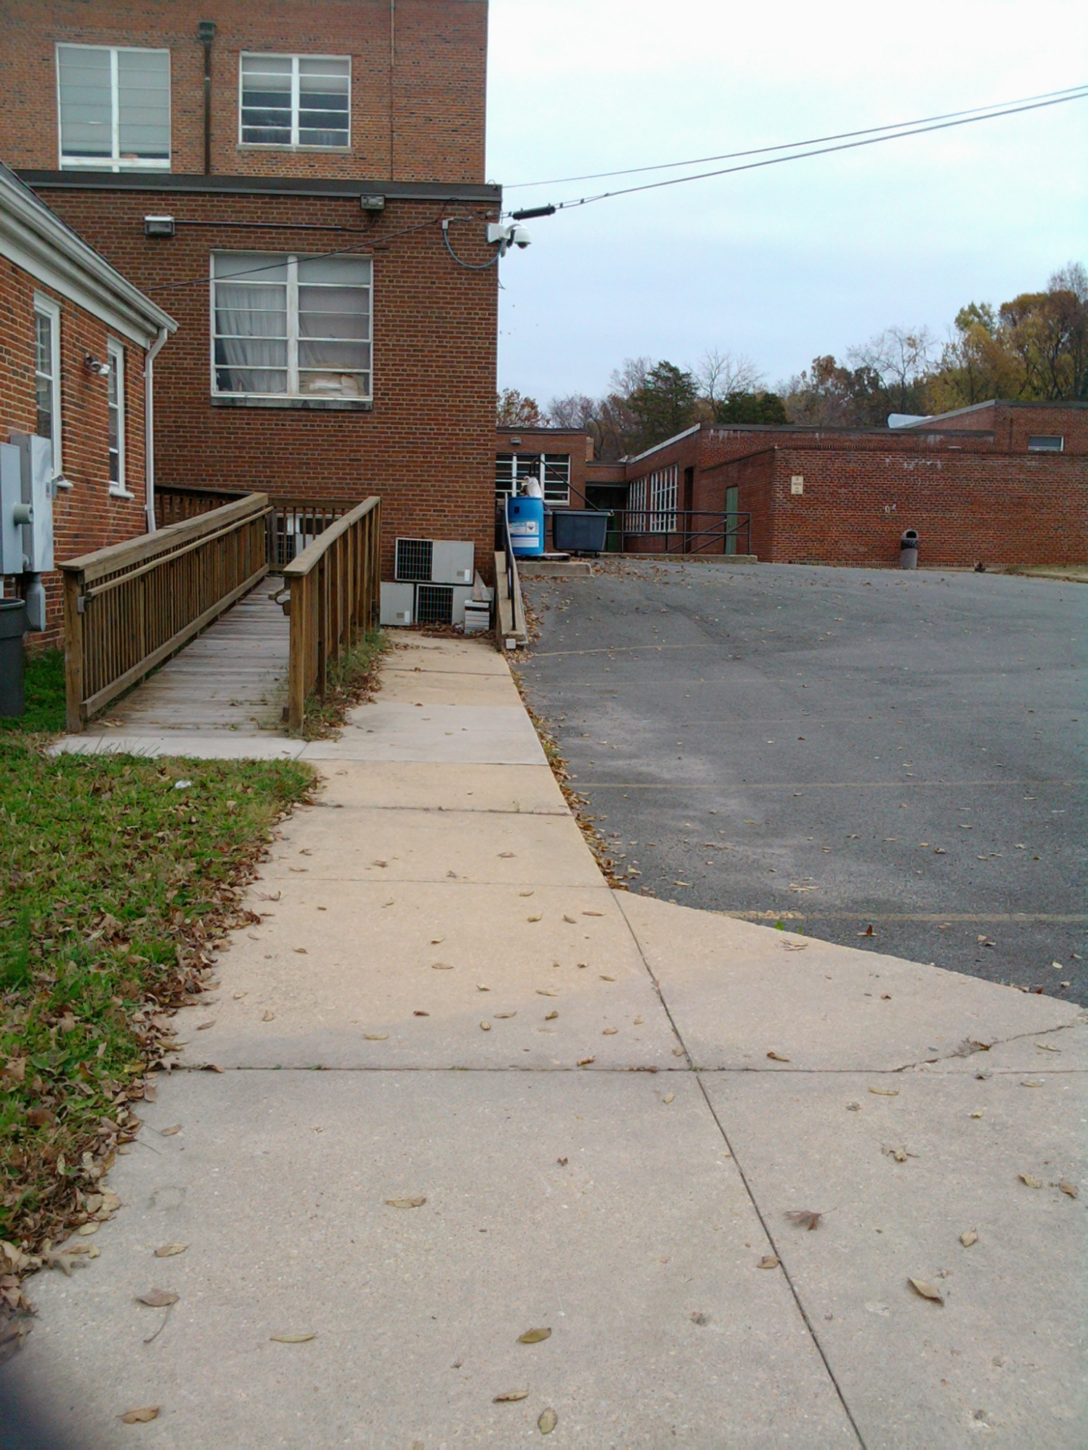
Re-Construction Plan
Wider Width for Turns
5’ x 5’ Landing Zone
Curb Cut
Notes:
Improve landing at the base
ADA require a 5’x5’ landing with a curb ramp
Consult with building owners and qualified engineer with ADA compliance experience

Slide 25
Fall Prevention
install lightings at transition zones
other visual cues
unify floor materials
alert transition zones

Slide 26
Reducing Congestion
improve lighting
narrow doorways
Paint door frames in different colors

Slide 27
Lighting at Clubhouse
dim lighting system
lack of natural daylight
tripping hazard due to poor lighting at transition points

Slide 28
Recommendations/Rationale Lighting
Office lighting
Task lighting
Motion light sensor
Consult with a licensed electrician

Slide 29
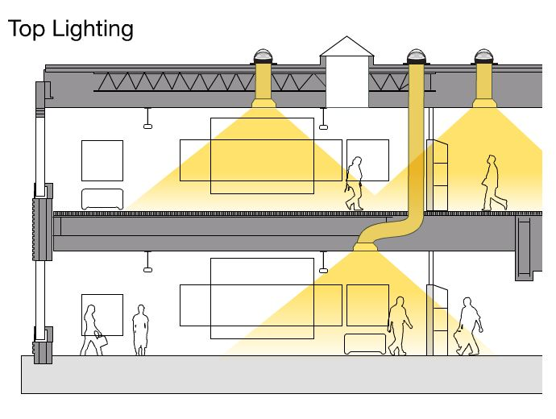
Office Lighting
Florescent
Natural lighting
Energy efficient
Greater long-term cost saving
Potential health risks
Solatube
Notes:
Note: I took out the incandescent light because we did not mention that In our report. If Eileen have include it after all the edits, then we can add it back in.

Slide 30
Task Lighting
OttLite task/magnifier lamp
$43.50
Natural spectrum desk lamp
$59.95

Slide 31
Motion Light Sensors
Stick Anywhere Night Lights
$39.99/3-pack
LED light without wiring
LED Motion Activated Guideway Lighting Kit
$99.99
Customizable length time up to 1 minute.

Slide 32
Motion Light Sensors
Indoor/outdoor
$34.99
Wireless Insteon Motion/Occupancy Sensor
Dual voltage passive infrared sensor
$56.90
Hubbell Occupancy-sensing Wall Switch

Slide 33
References
http://www.un.org/esa/socdev/enable/designm/intro.htm
http://www.sdrc.org/publications/EnvironInterventions.pdf
http://www.bartenbach.com/fileadmin/user_upload/pics/Folder_Aladin_english.pdf
http://www.access-board.gov/ada-aba/final.cfm
http://windows.lbl.gov/daylighting/designguide/section7.pdf
http://dps.missouri.edu/resources/Handbook/Tbi-drft.pdf
www.lcdisability.org/download.php?id=345
http://www.facs.gov.au/sa/disability/pubs/policy/Documents/cds/bpa/p4.htm
http://askjan.org/media/Braininjury.html
http://www.cdc.gov/niosh/docs/2012-103/pdfs/2012-103.pdf
http://www.ccohs.ca/oshanswers/ergonomics/lighting_flicker.html

Slide 34
Computer Access
Thang Ho
Diana Jurist
Ying Wu

Slide 35
Computer Access
Hardware
Software
Keyboards
Reading
Mouse
Listening
Converting to Accessible
Format
Joysticks

Slide 36
Introduction
People with TBI may experience cognitive deficit in information processing, memory and perceptual skills
Computer usage can increase the cognitive endurance, spatial analysis and synthesis of people with TBI.

Slide 37
Observation of Business Unit at Clubhouse
Activities of members are writing daily newsletter, updating social network page
Software used includes Microsoft Word, Excel, PowerPoint
A few assistive technologies such as ZoomText Express.

Slide 38
Six work stations with computer, printers and internet connection

Slide 39
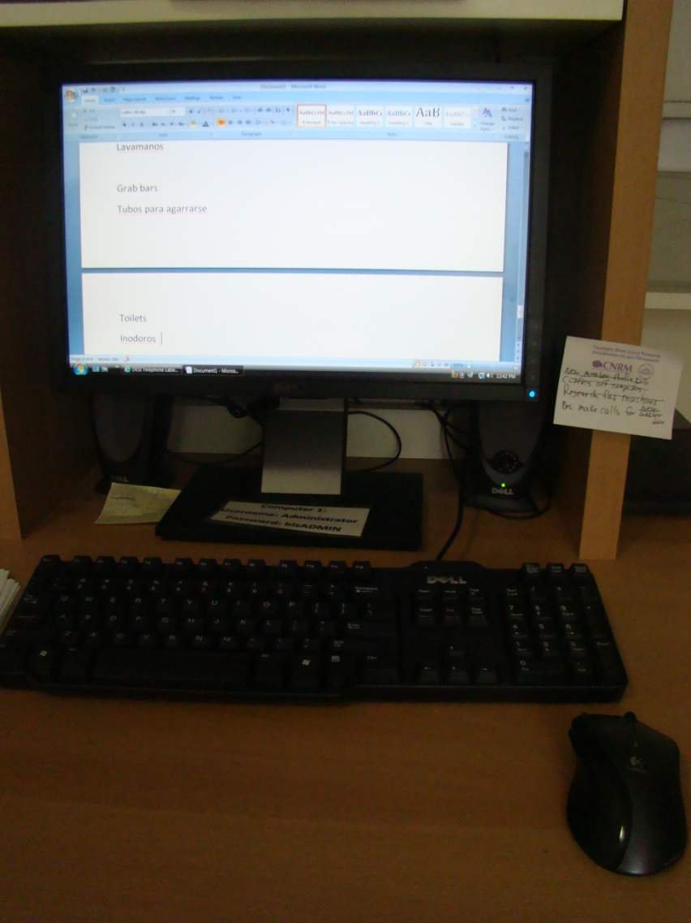
One color coded keyboard, wireless mice

Slide 40
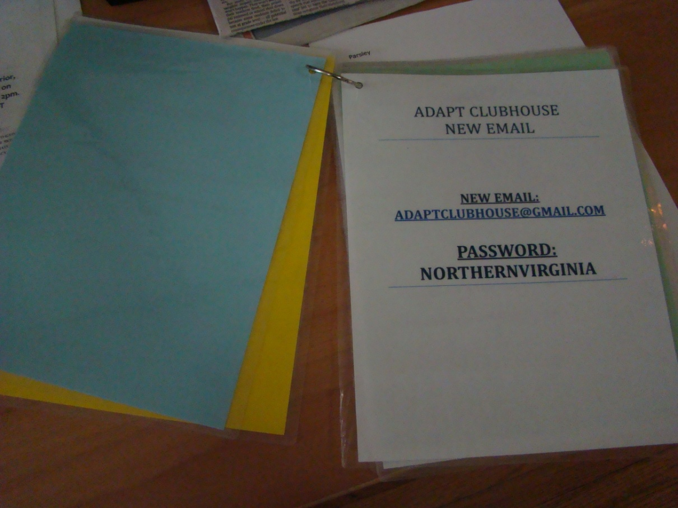
Instructional booklets
Yahoo email
Twitter
YouTube
Web: FreeWebs.com/adaptclubhouse
Calendar: OfficeZilla.com
Statcounter.com
Facebook
Evite.com
Skype

Slide 41
Shared thumb drives
Hang by the PC station
Each has shared documents, marked by the color
4GB each

Slide 42
Recommendations/Rationale
Software:
Synchronicity of all work stations with updated software and accessible options
Hardware:
Equip each station with appropriate assistive technologies
Use un-used laptop to act as server for multiple software

Slide 43
Screen Readers
JAWS
$895.00
read the screen either with a text-to-speech output or by a Refreshable Braille display
Dolphin Products
Easy Reader: $55.00
Super Nova: $795.00
NVDA
free
support for over 20 languages and the ability to run entirely from a USB drive with no installation
Natural Reader
Free
Text to Speech software with natural sounding voices

Slide 44
Reading and Writing Assistance
Zoom Text &Reader
$599-999
enlarge, enhance, and read aloud everything that is displayed on the computer screen
ClaroRead
$195.00
visual tools that color, highlight, and focus on difficult to read text as it is spoken by the computer
Read Write and Gold
$195.00
reads electronic text such as from e-books, websites, and documents created in word-processing programs.

Slide 45
Reading and Writing Assistance (cont’d)
Ginger Software
$89.00
automatically corrects spelling and grammatical errors
Kurzweil
$1395.00
includes “firefly”-Anytime, anywhere access to digital, text-based content

Slide 46
Free Software
Magnifier
free
enlarges part of the screen
IVONA MiniReader
Free
user-friendly text reader

Slide 47
Trackballs
Bigtrack
$169.00
allows for a simultaneous connection with a second mouse for better participation
SAM
$74.50
ambidextrous features

Slide 48
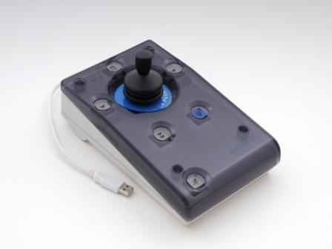
Roller Plus Joystick
$395.00
speed control key, latching drag switch and buttons that allow only up/down or left/right movements of the cursor

Slide 49
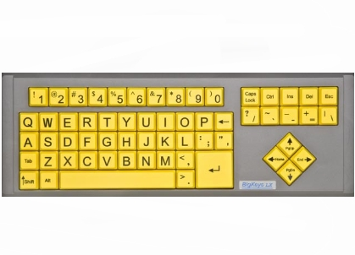
BigKeys LX Keyboard
$119.95
large, one inch squared keys built with rugged design that works with any Windows-based PC

Slide 50
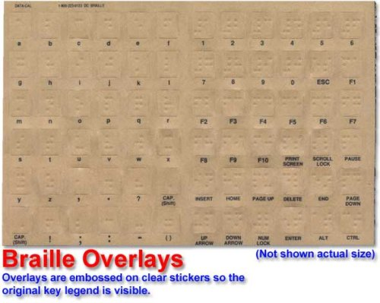
Clear Braille sticker
$19.95
printed on clear Lexan to allow the original key legend to show through – making the existing keyboard to become a bilingual keyboard

Slide 51
References
http://www.brain-train.com/articles/computer.htm
http://www.brain-injury-law-center.com/2010/11/30/computer-mediated-communication-after-traumatic-brain-injury/
http://www.neuroskills.com/tbi/injury.shtml

Slide 52
Other Technology
Aseel Alsuhaibani
Eileen Oviatt
Diana Jurist

Slide 53
Other Technology
Cell Phone
(iPhone/Android)
Tablets
(iPad/ePad)
Software &Hardware for the Following Aspects:
Speech Recognition
Organization
Communication
Memory and Logic
Letter Recognition

Slide 54
Introduction
Individuals with brain injury may have trouble with remembering things, communication and organization.
Those difficulties may lead to social limitation
Features and applications in iPad or portable devices may help

Slide 55
Observations at Clubhouse
Three iPads available for member use
Currently not in use
Should be customized according to needs
Need for training, visual support by way of a manual, and training for staff who can monitor and assist with set up

Slide 56
Recommendations/Rationale
Memory and logic
Letter recognition
Speech recognition
Communication
Organizing

Slide 57
Memory and Logic
Brain Exercise with Dr. Kawashima
$1.99
French, German, Italian, Japanese, Spanish
Memory Loss
$0.99
Contains 10 levels of smartly created scenarios
Brain Trainer
Free
Has 35 sessions and each session has 3 games.
Brain Challenge® HD
$4.99
Compatible with iPad only

Slide 58
Letter Recognition
WritePad
$3.99
Recognizes handwriting and converts it to text
Speak it! Text to Speech
$1.99
For individuals with low motor skills
WritePad for Android
$9.99
Supports four other languages
Writing Prompts
$1.99
Provides a simple text writing prompt by shaking or swiping

Slide 59
Speech Recognition
Dragon Dictation
Free.
Converts spoken words to text
Vlingo
Free
Similar functions as Siri Assistant
Voice Search​
Free
Search internet and phone through using voice only
My Motospeak
Free
Write text with the voice hands-free

Slide 60
Picture/Text-based AAC
Proloquo2go
$199.99
Provides natural sounding text- to-speech voices
Sono Flex
$99.99
Turns symbols into clear speech
TouchChat HD
$299.99
For individuals with Autism, Down Syndrome, ALS, apraxia, stroke, or other conditions that affect a person's ability to use natural speech

Slide 61
Text-based AAC
Verbally Premium
$109.99
Assistive Chat
$25.99
For people with difficulty in speech

Slide 62
Low-tech AAC
Boardmaker
$299.00
Double pocket size communication book
$6.00-10.00
For people with difficulty in speech
Program to used to “design” low tech AAC
GoTalk Series
$159.00- 599.00
For people with difficulty in speech

Slide 63
Organization
Pocket Informant HD
$14.99
Schedule tasks and appointments, organize contacts, sync photos and other attachments with events and contacts, and set alarms
Picture Scheduler
$2.99
Create and store tasks with visual and auditory cues attached
Pictello
$18.99
Create talking photo albums and talking books
To Do
Free
Create simple to-do list

Slide 64
Organization (cont’d)
Corkulous
$4.99
collect, organize, and share ideas on a cork board
Take Note
$2.99
Have your notes through your voice

Slide 65
Organization (cont’d)
Story Sequencer
WatchMinder
$69.00
Programmable vibrating alarm and a display that tells the wearer why the alarm is going off
Go Talk Button
$12.00
records one 10-second message
$32.62
each display window speaks a recorded message when touched

Slide 66
References
Connor, K., Dettmer, J., Dise-lewis, J. E., Murphy, M., Santistevan, B., & Seckinger, B. (2001). Brain injury: a manual for educators. Colorado: Colorado Department of Education.
Depompei, R., Gillette, Y., Goetz, E., Xenopoulos- Oddsson, A., Bryen, D., & Dowds, M., (2008). P ractical applications for use of PDAs and smartphones with children and adolescents who have traumatic brain injury. NeuroRehabilitation, 23(6), 487-99.
Fraas, M., & Balz, M. A. (2008). Expressive electronic journal writing: freedom of communication for survivors of acquired brain injury. Journal of Psycholinguistic Research, 37, 115-124. doi: 10.1007/s10936-007-9062-y

Slide 67
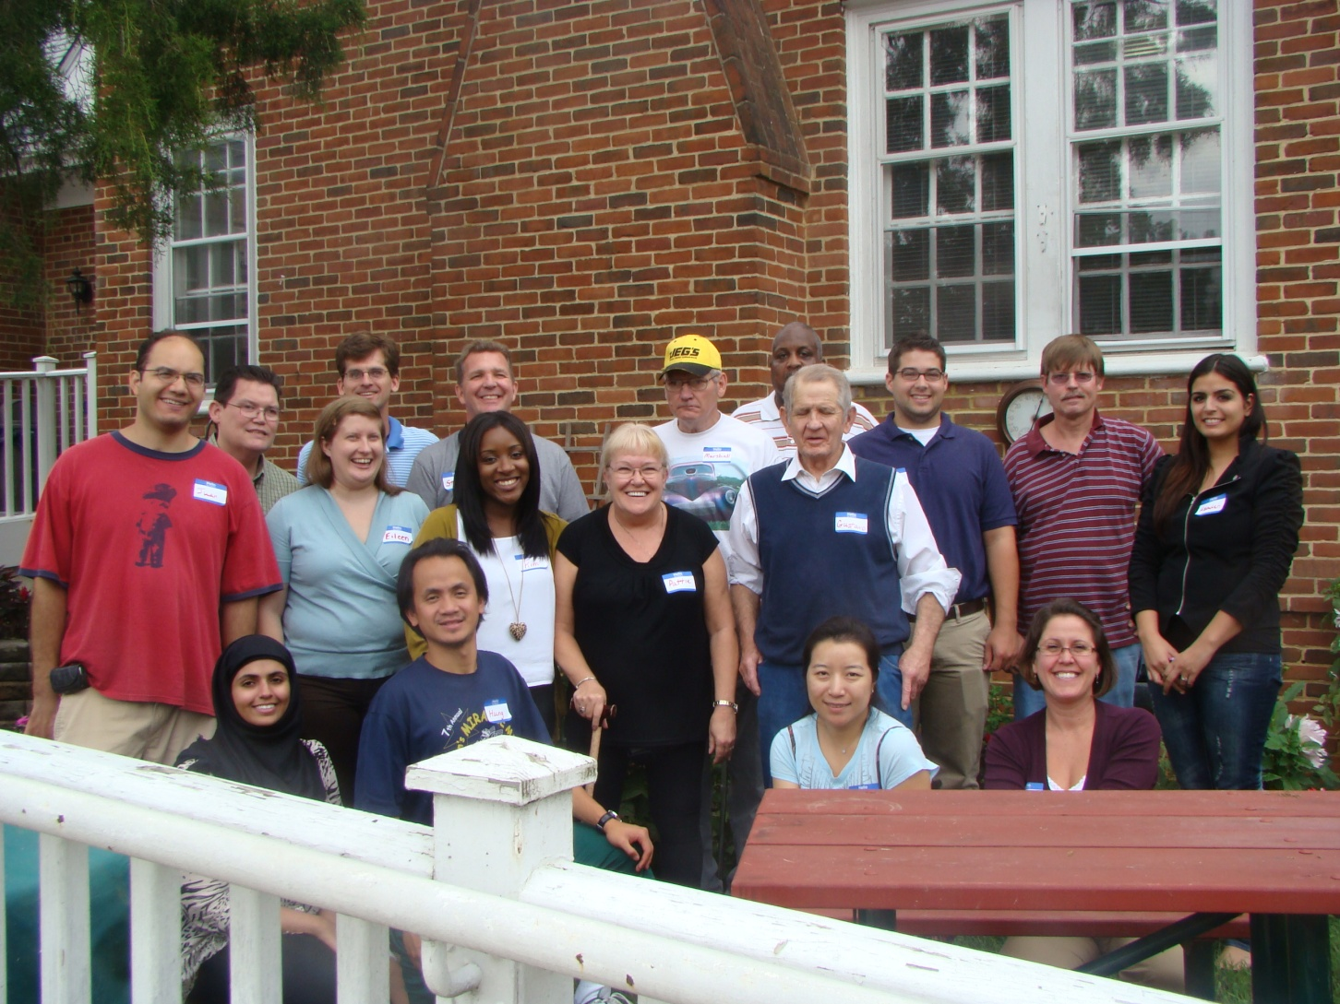
Thank You!

Slide 68
Any Question?

