Slide 1
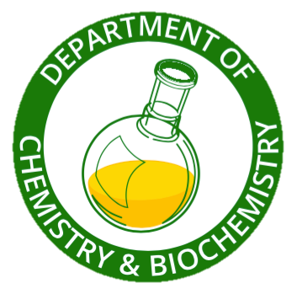
Ir Spectroscopy Review

Slide 2
Spectroscopy & Structure
All spectroscopic techniques are used in two ways:
To prove that two compounds are identical
A compound’s spectra are unique to that compound
To help establish the structure of a new compound
Each spectroscopic technique provides different, important information about structure
Notes:
Fundamental principles:
Spectra are like a compound’s “fingerprint”. They are unique to the compound and thus can be used for comparison and identification
Similar structures have similar spectral features. You have been introduced to the structure of organic functional groups by now and this introduction to MS and IR complement the lecture. If two compounds contain the same functional group, they will have similar spectra, and in this way, a new compound’s functional groups can be deduced.

Slide 3
Infrared Spectroscopy
Infrared
almost all organic compounds absorb in this region between the visible and radio waves
800 nm to 10⁷ nm
Area of greatest interest in organic chemistry is the vibrational portion
2,500 nm (4,000 cm⁻¹) to 15,000 nm (~700 cm⁻¹)
Notes:
Cm⁻¹ is spoken “reciprocal centimeters”. It is a frequency, so the higher the frequency, the higher the energy absorbed.

Slide 4
Infrared Spectroscopy
Radiation in the vibrational infrared region is expressed in frequency units called wave numbers, which are the reciprocal of the wavelength (λ) expressed in centimeters.
(cm⁻¹) = 1 / λ (cm) (cm⁻¹) = (nm⁻¹) x 10⁷
Wave numbers can be converted to energy by multiplying by hc. Thus, wave numbers are proportional to energy.
Notes:
Cm-1 is spoken “reciprocal centimeters”. It is a frequency, so the higher the frequency, the higher the energy absorbed.

Slide 5
Infrared Spectroscopy
Two uses for IR
IR spectra can be used to distinguish one compound from another (“fingerprint”)
Information about the functional groups present in a compound
Molecular Vibrations
Absorption of infrared radiation corresponds to energy changes on the order of 8-40 KJ/mole (2-10 kcal/mol)
The frequencies in this energy range correspond to the stretching and bending frequencies of covalent bonds, that is, changes in bond length and bond angle.

Slide 6
Infrared (IR) Spectroscopy
Notes:
Stretches are important; these involve changes in bond length, and so requires a bit of energy. More energy than angle changes, the last four of the animations shown. When referring to the spectrum, try to consistently say higher energy (higher freq., higher wave numbers)
from http://en.wikipedia.org/wiki/Infrared_spectroscopy

Slide 7
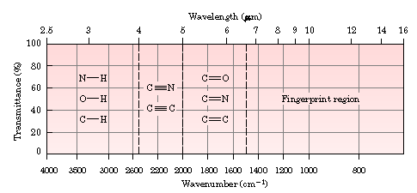
Infrared Spectroscopy
Notes:
This is a rudimentary structure-correlation chart for IR.
Things to note: even though we speak of “energy absorption”, the IR’s we typically see are set for %Transmittance
Transmittance = I/I₀ where I₀ is the power of the incident light and I is the power of the transmitted light.
Absorbance A=-log(I/I₀) Beer-Lambert Law.
In Chem 318 for the bromination of toluene experiment we will set the IR to absorbance mode so that we can make a quantitative measurement.
The overall idea for IR is to identify the Functional groups present in a sample. It is not feasible to analyze it to the extent that an NMR can be analyzed. When a substance is identified, though, an IR of an authentic sample in the literature can be used to match the as a “fingerprint”.
There is as much information to be gained by what peaks are present as by what peaks are absent.
Mohrig has an excellent logical scheme that you should recommend to students beginning in section 21.9 Students have a tendency to over-analyze, wanting to ID every peak. Can’t be done.
The chart is divided roughly in half. Are principally concerned with information from 1500-4000 cm-1. Only a couple of relevant peaks around 800.

Slide 8
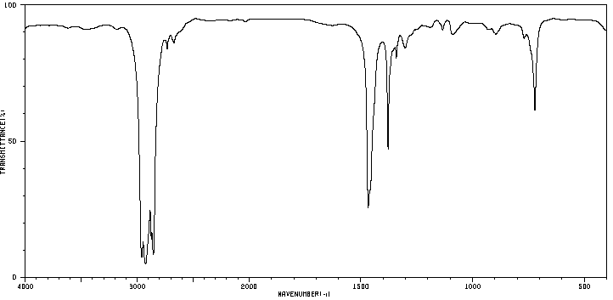
Alkane: Decane
CH₃(CH₂)₈CH₃
Notes:
This begins a systematic discussion of the correlation between IR absorptions and structure. Although Mohrig begins with deciding whether or not there is a carbonyl (C=O), another way to start is with a basic hydrocarbon structure.
This is a typical saturated aliphatic hydrocarbon. There is not much going on. Immediately remind them of fingerprint (1500-800) vs. functional group (4000-1500) region.
What is present in fg region? Look at exactly 3000. The absorption just to the right is due to the C-H bond stretching (make motion with your hands!).
The peaks in the fp region are due to bending, wagging, and rocking, in that order. Not important for students to know – just other “vibrations” as seen in the gif files.
Branched and cyclic alkanes are similar. Differences in appearance do not matter. Only that there is a fairly strong absorption just to the right of 3000.

Slide 9
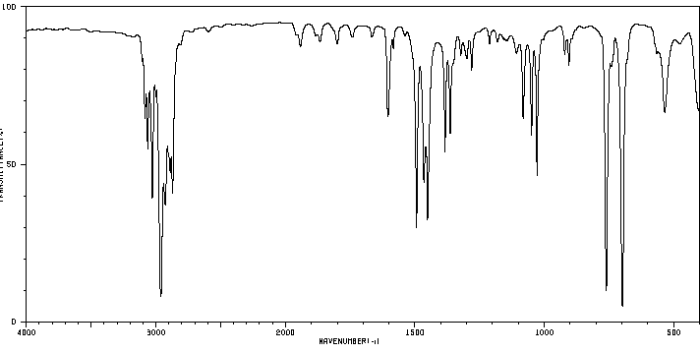
Aromatic: Isopropylbenzene
Notes:
No slide on alkenes. Can compare with this spectrum that is typical of monosubstituted benzenes, next.
Again, look at exactly 3000. To the right is an absorption showing there are saturated C-H bonds.
Now, look just to the left of 3000. This shows there is an H attached to a =C, that is, =C-H stretch. Intensity and appearance don’t matter. The intensity can be quite small here – position matters.
Note isopropyl split at 1400-1450 – a little snake tongue.
For an alkene, there would not be too much more to say.
For the benzenes, we add on this information:
Look at the region 1600-2000. All those little peaks (overtone bands to the =C-H stretch) are very diagnostic for substituted benzenes. The grouping here is the pattern typical of mono-substituted benzene. See Mohrig. You really can tell the substitution by these bands.
Finally, the one or two OOP peaks (out-of-plane bending – H’s on ring carbons are moving above and below the ring plane) between 690-900. Usually quite prominent). These and the overtones reveal the substitution pattern on the aromatic ring. Mono- and meta di-substituted have two OOPs.
So, for aromatic there are 3 checks: the =C-H, the overtones, and the OOPs. (overtones and oops absent in alkenes)

Slide 10
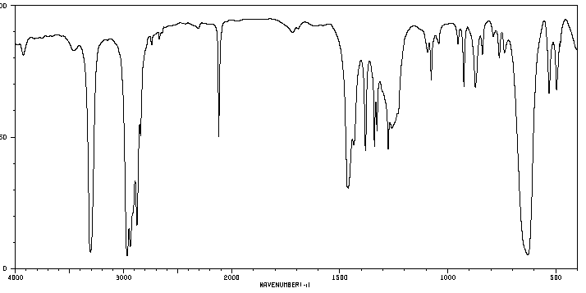
Alkyne: 1-pentyne
Notes:
Terminal alkyne. The triple bond C-H stretch is ~3300. Can be intense. Important that it is sharp (to be contrasted later with OH).
Note the progression from the left of 3000: sp3, sp2, sp C-H stretching. It takes more energy to stretch the shorter, stronger spC-H bond.
The CC triple bond stretch is at ~2100. Always sharp. Can be very small with disubstitution or symmetrically substituted triple bonds. (And the C-H would be absent.) This is a very clear area, and so a sharp, even small, single peak is CC or CN triple bond.

Slide 11
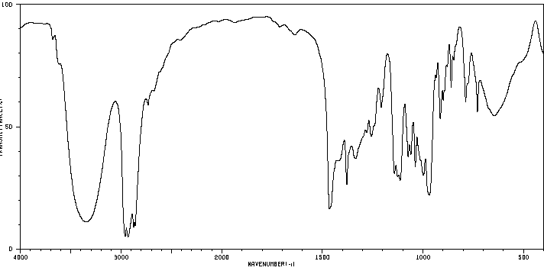
Alcohol: 3-heptanol
Notes:
We’ve now covered all the possible C-H stretches. What about other atoms bonded to H?
Here is saturated O-H of an alcohol. Very typical – strong and broad at 3500-3600. Consistently so for alcohols.
Compare with terminal alkyne. Very different appearance.
In this aliphatic alcohol, notice the saturated C-H stretches to the right of 3000 and the lack of peaks to the left.
So absence can be significant. Know there are not =CH bonds.
C-O stretching around 1000-1200. (this is in the fp, but it is good confirmation when an alcohol is suspected).

Slide 12
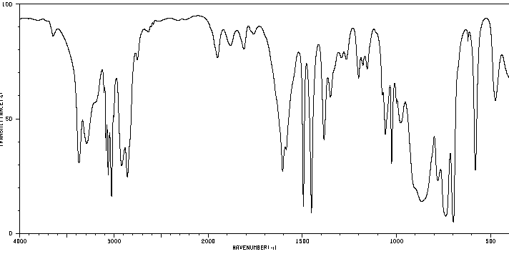
Amine: Benzylamine
Notes:
Here is saturated N-H of primary amine. Peak at ~3400 and another at ~3500. Due to symmetric and asymmetric H-N-H stretching.
Look at left and right of 3000. See saturated and unsaturated CH stretches. Aromatic overtones and oops. Some of the latter obscured by the broad peaks that are N- bond vibrations of various kinds.
A secondary amine, N-H near 3300 but weak and not easy to detect (refer to text).
Tertiary amines don’t have N-H and are not easily identified at our level here.

Slide 13
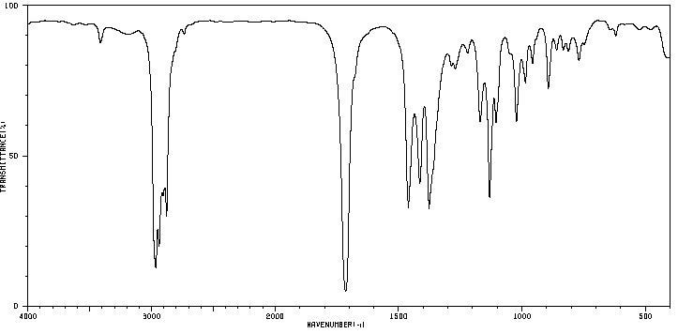
Ketone: 3-hexanone
Notes:
“If there is a C=O in your compound you will see a strong peak >1600-1800; if there is no strong peak between >1600-1800, there is no C=O.” Period.
The exact absorption position helps distinguish aldehyde, ketone, ester, amide. See text. It is sufficient at first that it is present or absent.
Ketones are distinguished from aldehydes and carboxylic acid derivatives by having no other distinguishing features besides the C=O.

Slide 14
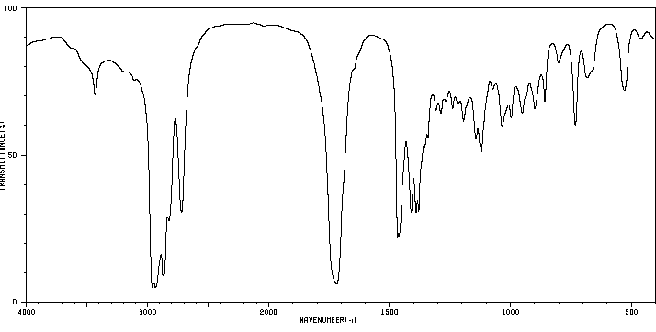
Aldehyde: hexanal
Notes:
Aldehydes are distinguished from ketones by the peak(s) at about 2900 and 2700 caused by the O=C-H stretch, at a lower frequency than the C=C-H stretch.
The 2900 is superimposed on the sat’d. C-H stretches here, but the one at ~2700 is visible. It is usually visible.

Slide 15
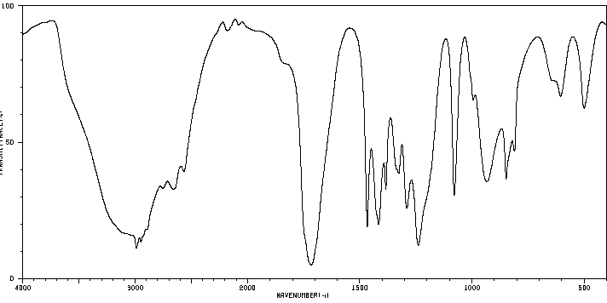
Carboxylic Acid: propionic acid
Notes:
Carboxyl groups are a combination of OH and C=O, so it is not surprising to see both absorptions in the spectrum. Rarely, would our unknowns or problems have both an OH and C=O separated from each other in the actual structure. However, a trained eye could discern the difference. Notice how the OH “takes over” the CH’s around 3000.
As with alcohols, note some broad peaks in the fingerprint region.

Slide 16
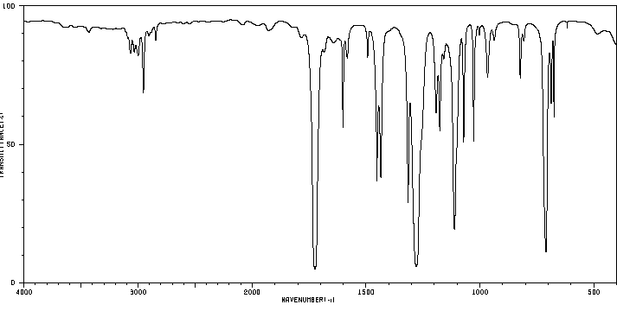
Ester: methyl benzoate
Notes:
Notice saturated and unsat’d C-H’s. Aromatic overtones not too prominent (they are usually less so with polar substituents), but an oop is there.
Notice the C=O at 1720.
The C-O single bond stretches are 1100-1300, depending on the ester. Usually strong.

Slide 17
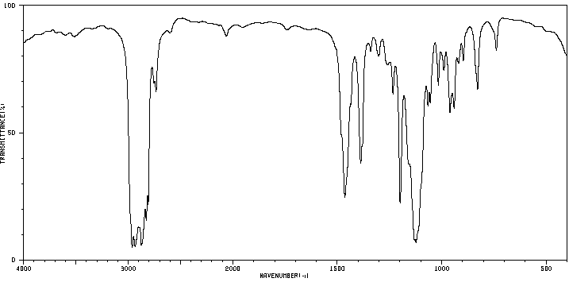
Ether: butyl methyl ether
Notes:
C-O-C stretching at 1000 – 1300.
Aliphatic ethers have a strong stretch around 1100. (vinyl and aryl ethers have a second stretch at ~1040.
A quiz question could be to differentiate related alcohol, ether, and ester. All will have a C-O in the fingerprint. The OH at 3500, the C=O at ~1700 and neither of these differentiate the three of them. (And aldehydes and ketones don’t have the C-O.)

Slide 18
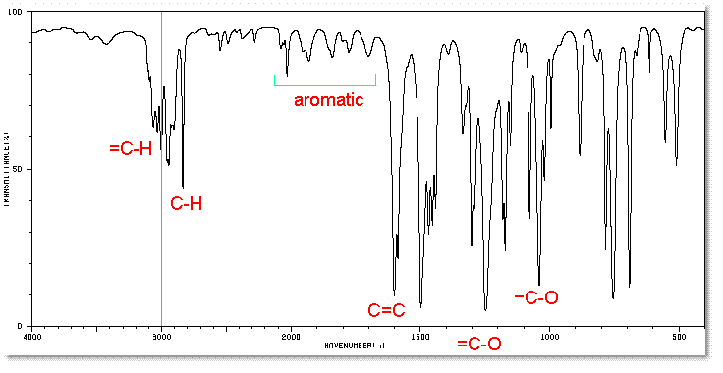
Ether: methyl phenyl ether
Notes:
Hidden slide
C-O-C at 1000 – 1300.
Again, this is in the fp region, but Mohrig does a fairly good job of sorting these out after other functional groups have been eliminated from consideration. Notice the =C-O is higher energy than –C-O, again showing differences in stretching freq. bet. Sat’d and unsat’d.
Aromaticity makes this a bit complicated by having two C-O stretches. Also, right at 1600 is a peak that students would confuse with C=O but it’s energy is a bit less. This is right at the edge of a C=C bond in aromatics.

Slide 19
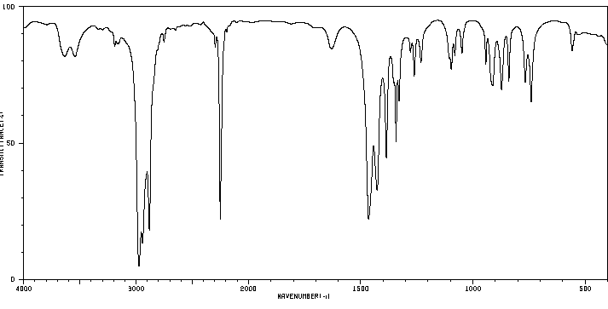
Nitrile: butyronitrile
Notes:
Very diagnostic for nitrile group ~2250. Sharp. Weak to strong.
Could be confused with internal alkyne (mass spec would tell the difference, as would C-13 NMR in Chem 318).

Slide 20
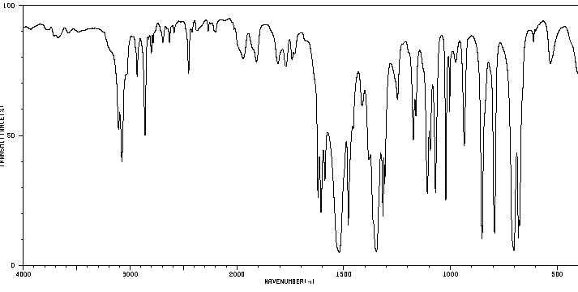
Nitro compound: nitro benzene
Notes:
Two peaks due to symmetric and asymmetric N-O stretching:
1500-1600 and 1300-1400, here at 1350 (symmetric) and 1530 (antisymmetric).
Try aliphatic nitros. Is it less complicated? Yes, but doesn’t show antisym. very well. Much stronger in aromatics.

