Slide 1
Characterizing the Impact of Horizontal Heat
Transfer on the Linear Relation of Heat Flow
and Heat Production
Ronald G. Resmini
Department of Geography and GeoInformation Science
College of Science
George Mason University
4400 University Drive, MSN 6C3
Fairfax, VA 22030-4444
v: 703-470-3022 · e: rresmini@gmu.edu

Slide 2
Introduction
Horizontal heat transfer impacts the linear relation between heat flow and heat production
Derived reduced heat flow and heat production depth values do not match actual values
Reduced heat flows are higher; depth values are lower
A method for characterizing the impact of horizontal heat transfer is presented here
It is applicable to the uniform heat production model for two-dimensional heat transfer
The method suggests an approach for correcting the effects of horizontal heat transfer

Slide 3
Procedure (1 of 6)
Construct a two-dimensional heat transfer model implementing the uniform heat production distribution
The depth of the uniform heat production domains is constant across the two- dimensional heat transfer model space
E.g., a model with five heat production domains is shown:

Slide 4
Procedure (2 of 6)
Obtain the steady-state temperature field for the model
This is done analytically and numerically (see next slide)
For every model, basal heat flow, Q_{f}, is always 25.0 mW/m²
Thermal conductivity, k_{T}, is always 2.85 W/m.°C
Calculate the linear heat flow/heat production (intercept and slope) parameters
Note that they will not match the parameters of the forward model
Repeat the previous steps...but decrease the depth to the base of the heat production domains...keeping the same heat production values and their spatial distribution
I.e., construct another two-dimensional heat transfer model implementing the uniform heat production distribution but with a depth to the base of the heat production domains 1 km less than the previous model
As before, the depth of the uniform heat production domains is still constant across the two-dimensional heat transfer model space

Slide 5
The Problem Space
and
T = 0
y = 0
A₁
μW/m³
A₂
μW/m³
A₃
μW/m³
A₄
μW/m³
A₅
μW/m³
y = b
35 km
0.00
μW/m³
125 km
y = H
x = 0
x = L
Other models in this study are 250 kilometers in width (x-direction).

Slide 6
Procedure (3 of 6)
This model with five heat production domains is shown overlain on the first model:
10 km
9 km

Slide 7
Procedure (4 of 6)
Repeat... decrease the depth to the base of the heat production domains... keeping the same heat production values and their spatial distribution
I.e., construct yet another two-dimensional heat transfer model implementing the uniform heat production distribution but with a depth to the base of the heat production domains 1 km less than the previous model
The depth of the uniform heat production domains is kept the same across the two-dimensional heat transfer model space
Repeat until the heat production domain depths are zero.
And as always, basal heat flow, Q_{f}, is 25.0 mW/m²
See next slide:

Slide 8
Procedure (5 of 6)

Slide 9
Procedure (6 of 6)
Thirteen (13) such two-dimensional models were calculated and from which 13 pairs of heat flow/heat production linear parameters were derived:
Depth to base of heat production region: 10, 9, 8, 7, 6, 5, 4, 3, 2, 1, 0.5, 0.1, 0 km
A plot of intercept values (reduced heat flow), Y-axis, vs. values of true depth to the base of the heat production domains minus the slope (true depth – slope), X-axis, is constructed
The plot has 13 points
The plot has two linear portions
A line is fit to the predominant linear portion (see next slides)
The slope has the units of heat production, μW/m³
The intercept has the units of heat flow, mW/m²

Slide 10
Measuring Surface Heat Flow, Q
Surface heat flow, Q, was calculated with the eq. below where T_{s} is the surface temperature (T = 0 °C at y = 0), T_{d} is the temperature at a depth of 1 km, k_{T} is thermal conductivity, and d is a depth equal to 1 km:
This method is used to maintain an internally consistent method of analyzing the results from both the analytical and numerical models and to simulate an actual field-measured thermal gradient and surface heat flux.

Slide 11
Tools
Pencil-’n-paper ☺ for analytical calculations
Subsequently implemented in C and Pascal(!)
www.freepascal.org
The FlexPDE© finite element software system
www.pdesolutions.com
MS Excel©

Slide 12
Results
Model 1a (Mod1a) is comprised of five heat flow domains and is shown below:
Model 1a (Mod1a)
4.35 μW/m³
3.75 μW/m³
3.75 μW/m³
1.00 μW/m³
4.35 μW/m³
2.25 μW/m³
6.50 μW/m³
6.50 μW/m³
Heat Production, A, μW/m³
2.25 μW/m³
1.00 μW/m³
Distance , x direction, kilometers

Slide 13
I.e., Model 1a is:
125 km
3.75
μW/m³
1.00
μW/m³
4.35
μW/m³
2.25
μW/m³
6.50
μW/m³
35 km
0.00
μW/m³

Slide 14
Temperature at a depth of 1 km – Model 1a
Analytical and Numerical Solutions
Temperature (C)
Distance in the x-Direction (Km)
Analytical and numerical solutions are identical.

Slide 15
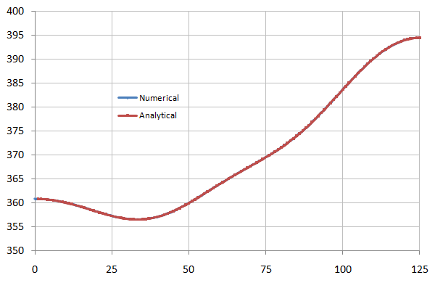
Temperature at a depth of 35 km – Model 1a
Analytical and Numerical Solutions
Temperature (C)
Distance in the x-Direction (Km)
Analytical and numerical solutions are identical.

Slide 16
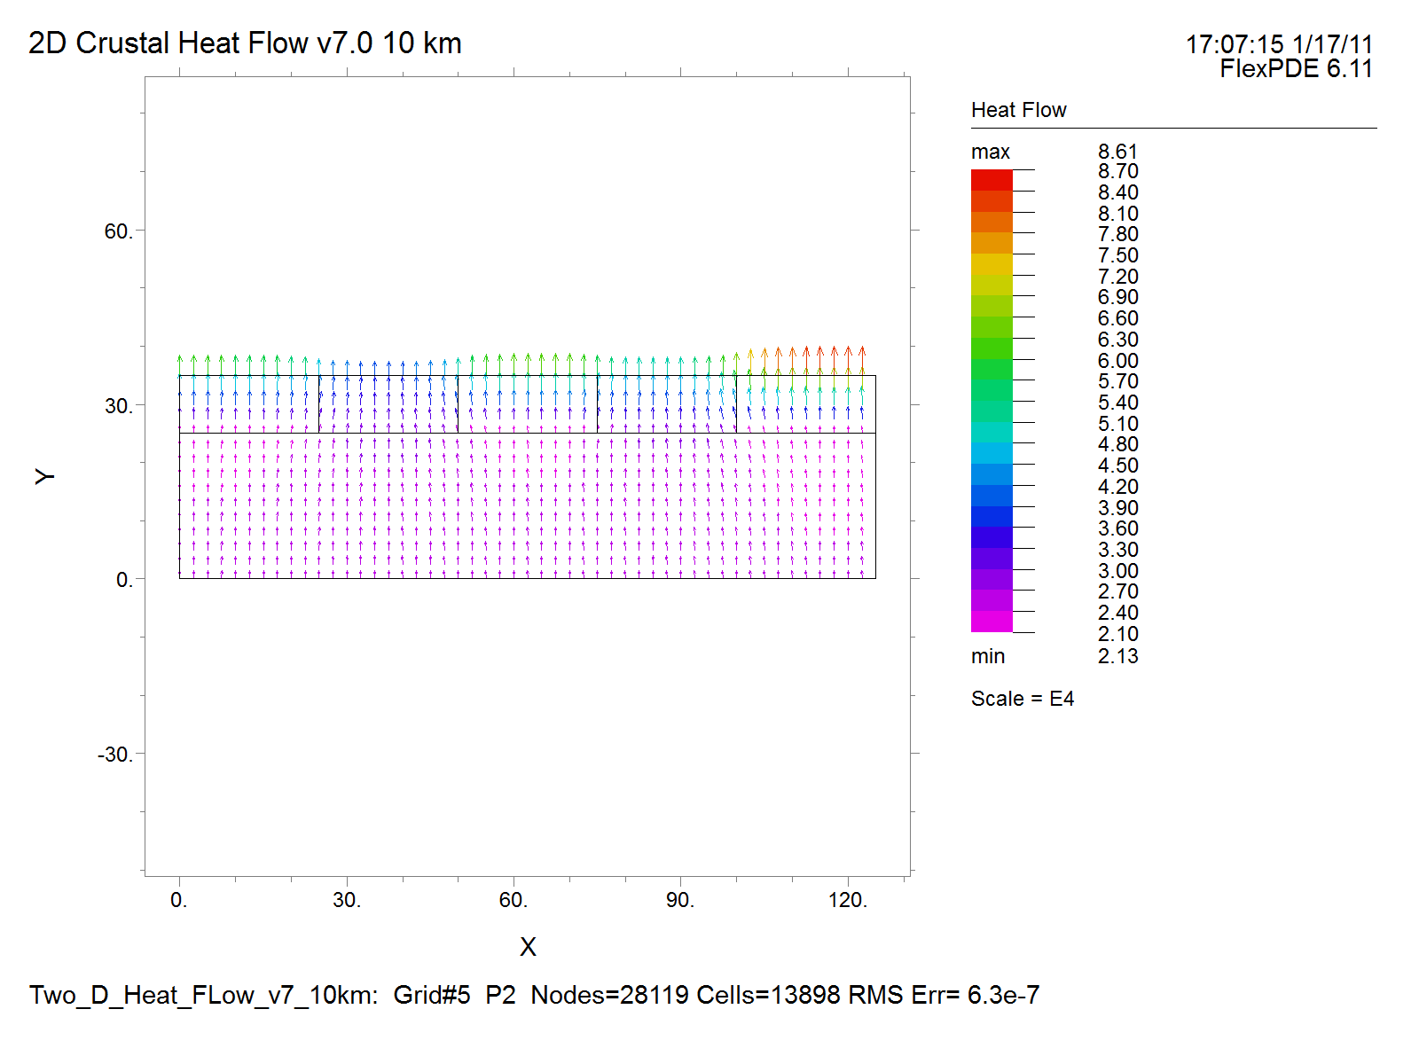
Mod1a Heat Flow Vectors

Slide 17
Model 1a (Mod 1a)
The linear relation between surface heat flow (Q) and the heat production (A)
of rocks exposed at the surface for Model 1a:
True depth: 10 km; true basal heat flow, Q, 25.0 mW/m²
Surface heat Flow, Q, mW/m²
Radiogenic Heat Production, A, μW/m³
Note that retrieved depth (slope) is <10 km (7.04 km) and the
retrieved reduced heat flow (intercept) is >25.0 mW/m² (33.85 mW/m²)

Slide 18
Model 1a (Mod 1a)
There are 12 more such plots for Model 1a...
There are 13 pairs of Q-A depth and reduced heat flow values
They are shown in the table below along with the calculation of (true depth, b – slope):
...on plot on
next slide
X-axis
Y-axis
Note
Intercept values converge to 25.0 mW/m²

Slide 19
Model 1a (Mod 1a)
Ten (10) points form a sloping linear segment.
Intercept, Reduced Heat Flow, Q, mW/m²
The linear regression is based
on the 10 points
True Depth – Slope (km)
The slope of the linear portion is 3.59 μW/m³ – remarkably close to 3.57 μW/m³
The intercept is also close to the true basal heat flux of 25.0 mW/m²

Slide 20
What is 3.57 μW/m³?
It’s a distance-weighted average of the
heat production values in the problem space:
HPE = Heat Producing Element
One only needs to know the HPE values along the surface of the problem space.
(Readily obtainable from field and laboratory analyses.)

Slide 21
This Intercept vs. Depth – Slope relationship
is general; i.e., as will be shown next, it
obtains when applied to several different models
each with an average heat production value of
3.57 μW/m³. Models with other average
heat production values are shown, too.

Slide 22
More Analyses
Eleven (11) sets of 13 two-dimensional model calculations were completed in the present study
The problem domains are 125 km and 250 km in width
All problem domains are 35 km in depth (y direction)
The model configurations are given in the next several slides
Many of the models were configured so that the average heat production value is 3.57 μW/m³
One model has unphysical heat production values to purposely yield an average of 0.0 μW/m³
The heat production domain widths are varied
Q_{f}, applied basal heat flow, is always 25.0 mW/m²
The linear heat flow vs. (true depth – slope) relation is obtained

Slide 23
HPE = Heat Producing Element

Slide 24
Model 1 (Mod1)
4.35 μW/m³
3.75 μW/m³
3.75 μW/m³
1.00 μW/m³
4.35 μW/m³
2.25 μW/m³
6.50 μW/m³
6.50 μW/m³
Heat Production, A, μW/m³
2.25 μW/m³
1.00 μW/m³
Distance , x direction, kilometers
...similar to Mod1a except
the problem space is longer
in the horizontal direction

Slide 25
Model 1 (Mod1)
The linear relation between surface heat flow (Q) and the heat production (A)
of rocks exposed at the surface for Model 1:
True depth: 10 km; true basal heat flow, Q_{f}, 25.0 mW/m²
Surface heat Flow, Q, mW/m²
Radiogenic Heat Production, A, μW/m³

Slide 26
Model 1 (Mod1)
30.0
y = 3.57x + 23.215
28.0
R² = 1
26.0
Intercept, mW/m²
24.0
22.0
20.0
0.00
0.25
0.50
0.75
1.00
1.25
1.50
1.75
2.00
Depth – Slope, km

Slide 27
Model 2 (Mod2)
3.75 μW/m³
1.00 μW/m³
4.35 μW/m³
2.25 μW/m³
6.50 μW/m³
3.75 μW/m³
1.00 μW/m³
4.35 μW/m³
2.25 μW/m³
6.50 μW/m³
4.35 μW/m³
6.50 μW/m³
4.35 μW/m³
6.50 μW/m³
3.75 μW/m³
3.75 μW/m³
Heat Production, A, μW/m³
2.25 μW/m³
2.25 μW/m³
1.00 μW/m³
1.00 μW/m³
Distance , x direction, kilometers

Slide 28
Model 2 (Mod2)
The linear relation between surface heat flow (Q) and the heat production (A)
of rocks exposed at the surface for Model 2:
True depth: 10 km; true basal heat flow, Q_{f}, 25.0 mW/m²
Surface heat Flow, Q, mW/m²
Radiogenic Heat Production, A, μW/m³

Slide 29
Model 2 (Mod2)
36.0
34.0
y = 3.5789x + 23.211
R² = 1
32.0
30.0
Intercept, mW/m²
28.0
26.0
24.0
22.0
20.0
0.00
0.50
1.00
1.50
2.00
2.50
3.00
3.50
Depth – Slope, km

Slide 30
Model 3 (Mod3)
3.50 μW/m³
3.50 μW/m³
2.75 μW/m³
6.50 μW/m³
1.25 μW/m³
4.65 μW/m³
2.75 μW/m³
6.50 μW/m³
Heat Production, A, μW/m³
1.25 μW/m³
4.65 μW/m³
Distance , x direction, kilometers

Slide 31
Model 3 (Mod3)
40.0
38.0
y = 3.7344x + 23.134
36.0
R² = 1
34.0
32.0
Intercept, mW/m²
30.0
28.0
26.0
24.0
22.0
20.0
0.00
0.50
1.00
1.50
2.00
2.50
3.00
3.50
4.00
Depth – Slope, km

Slide 32
Model 4 (Mod4)
3.50 μW/m³
0.00 μW/m³
3.50 μW/m³
2.75 μW/m³
0.00 μW/m³
-2.75 μW/m³
-3.50 μW/m³
2.75 μW/m³
Heat Production, A, μW/m³
-2.75 μW/m³
-3.50 μW/m³
Distance , x direction, kilometers

Slide 33
Model 4 (Mod4)
30.0
y =
-
0.1122x + 25.037
27.5
R² = 0.8657
Intercept, mW/m²
25.0
22.5
20.0
0.00
0.20
0.40
0.60
0.80
1.00
1.20
1.40
1.60
Depth – Slope, km

Slide 34
Model 5 (Mod5)
6.50 μW/m³
3.25 μW/m³
6.50 μW/m³
1.00 μW/m³
3.25 μW/m³
2.75 μW/m³
2.75 μW/m³
Heat Production, A, μW/m³
1.00 μW/m³
Distance , x direction, kilometers

Slide 35
Model 5 (Mod5)
30.0
y = 2.5101x + 23.744
28.0
R² = 1
26.0
Intercept, mW/m²
24.0
22.0
20.0
0.00
0.50
1.00
1.50
2.00
2.50
Depth – Slope, km

Slide 36
Model 6 (Mod6)
0.70 μW/m³
1.50 μW/m³
2.90 μW/m³
3.85 μW/m³
2.00 μW/m³
5.45 μW/m³
3.65 μW/m³
7.75 μW/m³
5.00 μW/m³
2.90 μW/m³
5.45 μW/m³
7.75 μW/m³
5.00 μW/m³
3.85 μW/m³
3.65 μW/m³
Heat Production, A, μW/m³
2.90 μW/m³
2.90 μW/m³
2.00 μW/m³
1.50 μW/m³
0.70 μW/m³
Distance , x direction, kilometers

Slide 37
Model 6 (Mod6)
The linear relation between surface heat flow (Q) and the heat production (A)
of rocks exposed at the surface for Model 6:
True depth: 10 km; true basal heat flow, Q_{f}, 25.0 mW/m²
Surface heat Flow, Q, mW/m²
Radiogenic Heat Production, A, μW/m³

Slide 38
Model 6 (Mod6)
32.0
30.0
y = 3.5864x + 23.207
R² = 1
28.0
Intercept, mW/m²
26.0
24.0
22.0
20.0
0.00
0.50
1.00
1.50
2.00
2.50
Depth – Slope, km

Slide 39
Model 7 (Mod7)
7.75 μW/m³
3.85 μW/m³
0.70 μW/m³
3.85 μW/m³
7.75 μW/m³
3.20 μW/m³
3.20 μW/m³
Heat Production, A, μW/m³
0.70 μW/m³
Distance , x direction, kilometers

Slide 40
Model 7 (Mod7)
The linear relation between surface heat flow (Q) and the heat production (A)
of rocks exposed at the surface for Model 7:
True depth: 10 km; true basal heat flow, Q_{f}, 25.0 mW/m²
100.0
90.0
y = 8.4601x + 28.797
80.0
R² = 0.9839
70.0
60.0
Surface heat Flow, Q, mW/m²
50.0
40.0
30.0
20.0
10.0
0.0
0.00
2.00
4.00
6.00
8.00
10.00
Radiogenic Heat Production, A, μW/m³

Slide 41
Model 7 (Mod7)
30.0
y = 3.6518x + 23.174
29.0
28.0
R² = 1
27.0
26.0
Intercept, mW/m²
25.0
24.0
23.0
22.0
21.0
20.0
0.00
0.50
1.00
1.50
2.00
Depth – Slope, km

Slide 42
Model 8 (Mod8)
7.50 μW/m³
7.50 μW/m³
0.70 μW/m³
3.85 μW/m³
7.50 μW/m³
0.70 μW/m³
3.20 μW/m³
3.85 μW/m³
0.70 μW/m³
3.85 μW/m³
7.50 μW/m³
3.85 μW/m³
3.85 μW/m³
3.85 μW/m³
3.85 μW/m³
3.85 μW/m³
Heat Production, A, μW/m³
3.20 μW/m³
0.70 μW/m³
0.70 μW/m³
0.70 μW/m³
Distance , x direction, kilometers

Slide 43
Model 8 (Mod8)
The linear relation between surface heat flow (Q) and the heat production (A)
of rocks exposed at the surface for Model 8:
True depth: 10 km; true basal heat flow, Q_{f}, 25.0 mW/m²
Surface heat Flow, Q, mW/m²
Radiogenic Heat Production, A, μW/m³

Slide 44
Model 8 (Mod8)
36.0
34.0
y = 3.582x + 23.209
32.0
R² = 1
30.0
Intercept, mW/m²
28.0
26.0
24.0
22.0
20.0
0.00
0.50
1.00
1.50
2.00
2.50
3.00
3.50
Depth – Slope, km

Slide 45
Model 9 (Mod9)
2.15 μW/m³
6.25 μW/m³
1.60 μW/m³
2.15 μW/m³
6.25 μW/m³
0.50 μW/m³
2.15 μW/m³
6.25 μW/m³
2.15 μW/m³
6.25 μW/m³
6.25 μW/m³
6.25 μW/m³
6.25 μW/m³
6.25 μW/m³
Heat Production, A, μW/m³
2.15 μW/m³
2.15 μW/m³
2.15 μW/m³
2.15 μW/m³
1.60 μW/m³
0.50 μW/m³
Distance , x direction, kilometers

Slide 46
Model 9 (Mod9)
The linear relation between surface heat flow (Q) and the heat production (A)
of rocks exposed at the surface for Model 9:
True depth: 10 km; true basal heat flow, Q_{f}, 25.0 mW/m²
Surface heat Flow, Q, mW/m²
Radiogenic Heat Production, A, μW/m³

Slide 47
Model 9 (Mod9)
38.0
36.0
y = 3.5805x + 23.21
34.0
R² = 1
32.0
30.0
Intercept, mW/m²
28.0
26.0
24.0
22.0
20.0
0.00
0.50
1.00
1.50
2.00
2.50
3.00
3.50
4.00
Depth – Slope, km

Slide 48
Model 10 (Mod10)
6.25 μW/m³
2.15 μW/m³
6.25 μW/m³
1.60 μW/m³
0.50 μW/m³
Heat Production, A, μW/m³
2.15 μW/m³
1.60 μW/m³
0.50 μW/m³
Distance , x direction, kilometers

Slide 49
Model 10 (Mod10)
The linear relation between surface heat flow (Q) and the heat production (A)
of rocks exposed at the surface for Model 10:
True depth: 10 km; true basal heat flow, Q_{f}, 25.0 mW/m²
Surface heat Flow, Q, mW/m²
Radiogenic Heat Production, A, μW/m³

Slide 50
Model 10 (Mod10)
32.0
30.0
y = 3.5596x + 23.22
R² = 1
28.0
Intercept, mW/m²
26.0
24.0
22.0
20.0
0.00
0.25
0.50
0.75
1.00
1.25
1.50
1.75
2.00
Depth – Slope, km

Slide 51
Seven Models Have A Mean A of 3.57 μW/m³
Models: 1, 1a, 2, 6, 8, 9, 10
From plots of Q vs. A for True Depth Equal to 10 km
True basal heat flow, Q_{f}, 25.0 mW/m²

Slide 52
Seven Models Have A Mean A of 3.57 μW/m³
Models: 1, 1a, 2, 6, 8, 9, 10
From plots of Intercept vs. Depth – Slope
True basal heat flow, Q_{f}, 25.0 mW/m²

Slide 53
The Four Additional Models
Models: 3, 4, 5, 7
From plots of Q vs. A for True Depth Equal to 10 km
True basal heat flow, Q_{f}, 25.0 mW/m²

Slide 54
The Four Additional Models
Models: 3, 4, 5, 7
From plots of Intercept vs. Depth – Slope
True basal heat flow, Q_{f}, 25.0 mW/m²

Slide 55
The Intercept vs. Depth – Slope Relationship
Suggests a Method to Correct for or Model
the Impact of Horizontal Heat Transfer on the
Linear Relationship Between Surface Heat Flow
and Heat Production.

Slide 56
Q_{f}=x₁
Q_{f}=x₂
...
Intercept, Reduced Heat Flow, Q, mW/m²
Q_{f}=x_{m}
True Depth, b, – Slope (km)

Slide 57
Symbol Table

Slide 58
A Comment on the Linear Regressions
Linear regressions applied using MS Excel®
The Minitab statistical analysis software package
xfitexy.c from Numerical Recipes in C, Press et al.
The method of York and Evensen (2004)
The last 3 methods attempted but not reported in the present study
Regression method and results require additional investigation

