Slide 1
HySPADE: An Algorithm for
Spatial and Spectral Analysis
of Hyperspectral Information
Ronald G. Resmini
The MITRE Corporation
Alexandria, Virginia 22315
― and ―
Dept. of Geography and Geoinformation Science
George Mason University
Fairfax, Virginia 22030
v: 703-470-3022 • f: 703-983-6989
e₁: rresmini@mitre.org • e₂: rresmini@gmu.edu

Slide 2
This briefing was presented
at the 2004 meeting of the SPIE,
Orlando, FL, April 12-16.
For the accompanying paper, see:
Resmini, R.G., (2004). Hyperspectral/Spatial Detection of Edges (HySPADE): An algorithm for spatial and spectral analysis of hyperspectral information. Proceedings of the SPIE, Algorithms and Technologies for Multispectral, Hyperspectral, and Ultraspectral Imagery X, S.S. Shen and P.E. Lewis, eds., Orlando, Fla., April 12-16, v. 5429, doi: 10.1117/12.541877, pp. 433-442.

Slide 3
HySPADE:
Hyperspectral/Spatial Detection of Edges

Slide 4
The HySPADE Algorithm
Simultaneously Utilizes Spatial
And Spectral Information

Slide 5
HySPADE Applications
Edge detection
Pre-processor for:
LOC extraction
Scene segmentation
Automatic target mensuration
Change detection
Object templating
Other...

Slide 6
Other Spatial/Spectral Strategies
Process one or more bands of MSI/HSI cubes with traditional spatial processing algorithms; combine results
Apply SAM (or other algorithm) in an n-by-n sized window (kernel) (e.g., the method of Smith and Frolov, 1999)

Slide 7
The HySPADE Procedure
The core of the Procedure
Acquire
Spectral
Data
Define an
NxN Sliding
Window
Build the
“SA-Cube”
Find Edges in
“SA-Cube”
Spectra
Show Edges
in an Output
Plane
Slide the
NxN
Window

Slide 8
Building the Spectral Angle (SA) Cube...
The “SA-Cube”
1
2
3
Spatial
Spatial
Spatial
Spatial
Apply SAM with each
pixel (in turn) to each
pixel in the cube (or
sub-cube).
Spectral
SAM
Results
SA-Cube
Start with an image cube
or a sub-cube in an NxN
window
Get an “image” cube
(or sub-cube) for which the
planes contain the SAM
angles of each pixel wrt
every other pixel

Slide 9
In other words, Band 1 of the SA-Cube contains the spectral angle of the
spectrum in (1,1) with every other spectrum in the original cube. Band 2 of the SA-Cube contains the spectral angle of the spectrum in (1,2) with every other
spectrum in the original cube. Band 3 of the SA-Cube contains the spectral angle of the spectrum in (1,3) with every other spectrum in the original cube. And etc...
Pixel (1,1)
Pixel (1,2)
Spatial
Spatial
Spectral
An image cube or
sub-cube in an NxN
window

Slide 10
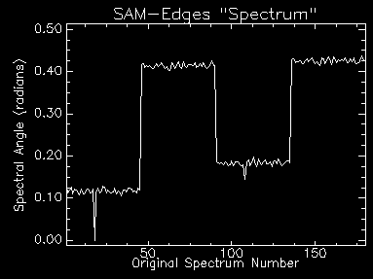
Detecting Edges with the “SA-Cube” Spectra
4
5
6
In turn, extract each
“Spectrum” from the
SA-Cube
On an output plane, indicate the
pixel coordinates at which the
steps occur. Or, generate lists of
coordinates of steps from multiple
SA-Cube “spectra” and use standard
statistical tools to find the steps.
Then record on an output image
plane.
Search for steps in the SAM Spectrum
(see next slide)

Slide 11
Detecting Edges with the “SA-Cube” Spectra
(continued)
7
Apply one-dimensional edge
detector(s) to SA-Cube “spectra.”
Threshold to identify steps.

Slide 12
Steps 2 through 7 are applied twice:
once in the row-wise first direction and
again in the column-wise first
direction.

Slide 13
A post-processing step to exclude the first row and the first column (or last row, last column depending on direction of traversal across the original HSI data) of the N x N window is required to counteract a wrap-around artifact in the basic algorithm. This does not, in any way, hamper the performance of the algorithm. To incorporate excluded data and get the full performance of HySPADE, the sliding window is moved by N-2 pixels. Other strategies are applicable, too.

Slide 14
Benefits of This Technique
Utilizes spectral information to identify edges
Operates on radiance, reflectance, or emissivity data
Requires only the spectral information of the scene data
Facilitates simultaneous use of all spectral information
No endmember finding required
No spectral matching against a library required for edge detection
Generates multiple, independent data points for statistical verification of detected edges
Good when similarly colored objects occur in data
Robust in the presence of noise

Slide 15
A Simulated HSI Data Cube
Build an HSI cube
5 x 48 x 210
Use ENVI®
Four (4) different “patches” of four (4) different materials
Add noise to the spectra
Apply HySPADE

Slide 16
Spectra Used in the Simulated HSI Data Cube
Reflectance
Wavelength (micrometers)

Slide 17
Horizontal Profile
Band 18 (0.46 μm) Grayscale Image
2% Linear Stretch (ENVI)
110
100
90
Reflectance (%)
80
70
60
50
1
5
9
13
17
21
25
29
33
37
41
45
Sample Number

Slide 18
SAM-Based “Spectral Edge Detection” Pre-Results
Analcime
Calcite
Gypsum
Halite
One Plane (Band 76) from the SA-Cube
This is NOT Simple Spectral Matching
with Library Signatures.

Slide 19
Spectrum From (3,8) in “SA-Cube”
Spectral Angle (radians)
“Band Number”

Slide 20
Band 18 (0.46 μm) Grayscale Image
HySPADE Edge Detection Result
HySPADE Edge Detection Result
Wrap-Around Effect Removed
Threshold = 2.25σ

Slide 21
Application of HySPADE to HYDICE HSI Data...

Slide 22
HySPADE Applied to HYDICE Data
HYDICE NIR CC
“Chip”
HySPADE Result
(0.25 σ)
HySPADE Result
(0.50 σ)
HySPADE Result
(0.75 σ)
HySPADE Result
(1.50 σ)
HySPADE Result
(2.00 σ)
HySPADE Result
(2.75 σ)
Roberts Edge
Detection Result

Slide 23
Arbitrary Stretch
2% Linear Stretch
At-Aperture
Radiance Data
SA-Cube
band (b440)
2.30 μm
Grayscale Image
Spectral Angle (radians)
SA-Cube Band Number
“Band” 440; Pixel: (s 25, l 16)

Slide 24
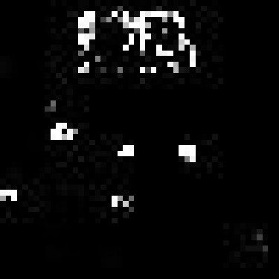
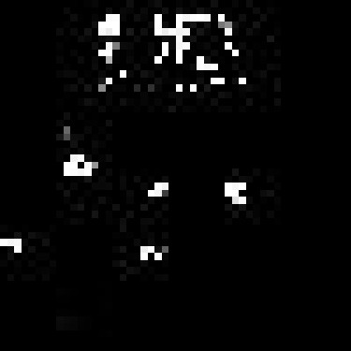
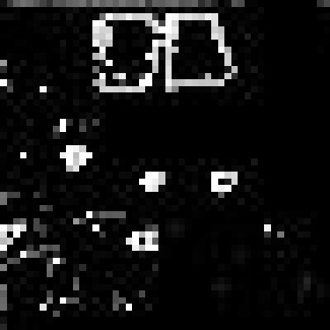
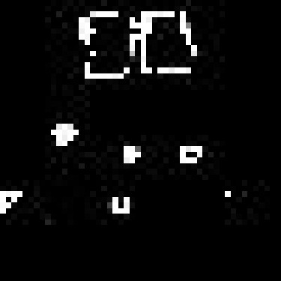
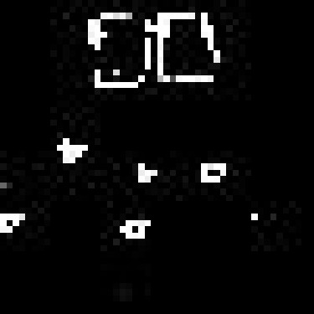
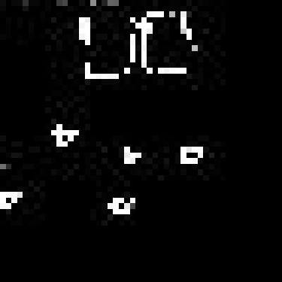
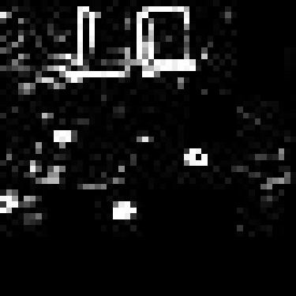
HySPADE Applied to HYDICE Data
HYDICE NIR CC
“Chip”
HySPADE Result
(0.25 σ)
HySPADE Result
(0.50 σ)
HySPADE Result
(1.50 σ)
HySPADE Result
(2.00 σ)
HySPADE Result
(2.25 σ)
HySPADE Result
(2.75 σ)
Roberts Edge
Detection Result

Slide 25
Future Directions
Enhance HySPADE C code (currently designed to operate against 50 x 50 pixel cubes) to operate against HSI cubes of arbitrary size by incorporating a sliding window
Incorporate other algorithms besides SAM (and in combination with SAM) for greater separation of spectral signatures (e.g., Euclidean distance)
Investigate the use of techniques other than the first-order finite-difference for finding edges
Investigate the use of multiple edge detection algorithms (e.g., HySPADE + Canny + Roberts filter + etc...)
Calculate measures of effectiveness (MOEs) or figures of merit (FOMs) for edge detection results

Slide 26
Summary and Conclusions

Slide 27
Benefits of The HySPADE Technique
Utilizes spectral information to identify edges
Operates on radiance, reflectance, or emissivity data
Requires only the spectral information of the scene data
Facilitates simultaneous use of all spectral information
No endmember finding required
No spectral matching against a library required for edge detection
Generates multiple, independent data points for statistical verification of detected edges
Good when similarly colored objects occur in data
Robust in the presence of noise

Slide 28
References Cited
Smith, R.B., and Frolov, D., (1999). Free software for analyzing AVIRIS imagery.
Downloaded from: “makalu.jpl.nasa.gov/docs/workshops/99_docs/55.pdf”.
Feb. 26, 2012: This link is no longer available. The paper may be found, however, at:
http://aviris.jpl.nasa.gov/proceedings/1999_toc.html.
(Last accessed on Feb. 26, 2012.)

Slide 29
Backup Slides

Slide 30
Comparison of HySPADE
with the method of
Smith and Frolov (1999)

Slide 31
X
X’
A
B
C
D
An image cube
Smith and Frolov (1999)
HySPADE
The 1st SA-Cube Spectrum (for pixel 1,1); here
all angles are wrt to material A in pixel (1,1)
Very small angle
between C and D
Much larger angle
between A and D
Spectral Angle
Spectral Angle
X
A|B
B|C
C|D
X’
A
B
C
D
Only one X-X’ traverse available.
Numerous SA-Cube spectra available.

Slide 32
Smith and Frolov (1999)
HySPADE
The 1st SAM-edge Spectrum (for pixel 1,1); here
all angles are wrt to material A in pixel (1,1)
Very small angle
between C and D
Much larger angle
between A and D
Spectral Angle
Spectral Angle
X
A|B
B|C
C|D
X’
A
B
C
D
Only one X-X’ traverse available.
Numerous SAM-edge spectra available.
The edges here are based on angle differences
between the material A pixel in (1,1) with each of
the pixels in the X-X’ traverse. There will be a
similar spectrum for each of the pixels in the X-X’
row. Thus, there will be several traverses to which
edge-detection may be applied. Each traverse will
highlight the differences in angle between the several
materials, minimize influence of mixed boundary pixels,
and incorporate spectral variability information.
The edges here are based only on the two
(or so) pixels which define the boundary
between two materials. These pixels are
likely to be mixed, too, thus reducing the
spectral angle contrast between them. Edges
may be poorly discriminated (i.e., close in
angle) or actually ramps.

