Slide 1
WATER RESOURCE MANAGEMENT ARTICLE REVIEW
By Allison Richards
For EVPP 652: The Hydrosphere Course
April 24, 2012

Slide 2
Article
Integrated water resource management of overexploited hydrogeological systems using Object-Oriented Bayesian Networks
Molina, J. L., Bromley, J., García-Aróstegui, J. L., Sullivan, C., & Benavente, J. (2010). Integrated water resources management of overexploited hydrogeological systems using Object-Oriented Bayesian Networks. Environmental Modelling & Software, 25(4), 383–397. doi:10.1016/j.envsoft.2009.10.007

Slide 3
Background
↑demand = ↑consumption = management
↓ supply = scarcity
Water Framework Directive (EC)
Adopt sustainability
Prepare Water Basin Management Plans by 2009
Complex systems = IWRM
Integrated Water Resource Management
“a process which promotes the coordinated development and management of water, land and related resources in order to maximise economic and social welfare in an equitable manner without compromising the sustainability of vital ecosystems and the environment
(World Water Partners - http://www.gwp.org/en/The-Challenge/What-is-IWRM/)

Slide 4
Aim of Paper
“Show an Object-Oriented Bayesian Network (OBBN) model which was developed to assess the impact of a range of management interventions identified during the study
Present results obtained through its application”

Slide 5
What is a OOBN
Type of Decision Support System (DSS)
Probability theory based on Bayes rule
Involves “nodes that represent random variables that interact with others” – connections
Three main elements
a set of variables that represent the factors relevant to a particular environmental system or problem;
the relationships between these variables that quantify the links between variables and
the set of conditional probability tables (CPTs) that quantify the links between variables and are used to calculate the state of nodes.
The first two elements form a Bayesian Diagram and the addition of the third forms a full network.

Slide 6
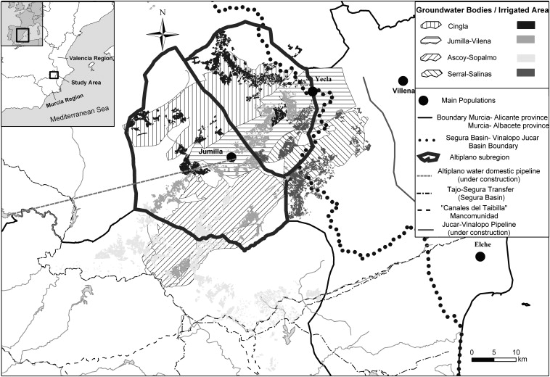
Study Area
Population of 58,000
Economy
Agriculture
Tourism
Summer dry period – low surface water
Exploitation of groundwater
Demand currently exceeds supply

Slide 7
Methodology
Hydrogeological study
Four Aquifers
Annual water budget
Recharge, actual pumping, storage variation, total drawdown since natural regime average water table depletion rate during last ten years (-ve)
Groundwater flux model for each aquifer using MODFLOW
Input for DSS

Slide 8
Methodology (cont’d)
Socio-economic study
Uses and demand for water
Repercussions on local society and economy
Available data
Model of 22 crops developed to assess relationship between agro-economy and groundwater availability
Extraction costs
Stakeholder involvement
Interviews, surveys, questionnaires and general meetings
Develop DSS

Slide 9
Methodology (cont’d) - The Model
Fig. 5. Scheme of the whole model.

Slide 10
Methodology (cont’d) - BN Structure
Fig. 6. Bayesian network structure for every aquifer (full version). Hydrogeological part (1), Socio-economic part (2).
32 variables
Parents, Intervention action, Intermediate nodes, Partial Objectives, Final Objectives

Slide 11
Methodology (cont’d) – DSS Validation
Information from parallel studies
Stakeholders involvement

Slide 12
Results of Simulations
Scenarios
Business as Usual (BAU)
Individual water Management interventions (IWMI)
External water resource income (EWRI)
Purchase of water rights (PWR)
Reduction in water rights (RWR)
Water demand reduction (WDR)

Slide 13
Results (cont’d)
Fig. 8. Object-Oriented Network describing the overall economic behaviour of the whole system (current conditions).
Fig. 7. Example of a single Bn with the results under current conditions (Serral-Salinas aquifer and its related irrigated area).

Slide 14
Results (cont’d)

Slide 15
Conclusion
Under current conditions
Extreme water management interventions most likely to be effective in recovery of aquifers
Set by stakeholders (are targets objective, what was the main factor – the aquifer or way of life)
Impact in socioeconomic variable not strong
Extreme measures not considered
Most crops in the area are trees and not annuals as simulated
Short term - impossible to restore aquifers to natural state
Longer term – full recovery unlikely
Interventions to reduce drawdown will negatively impact agricultural income

Slide 16
THANK YOU
No Questions ?

