Slide 1
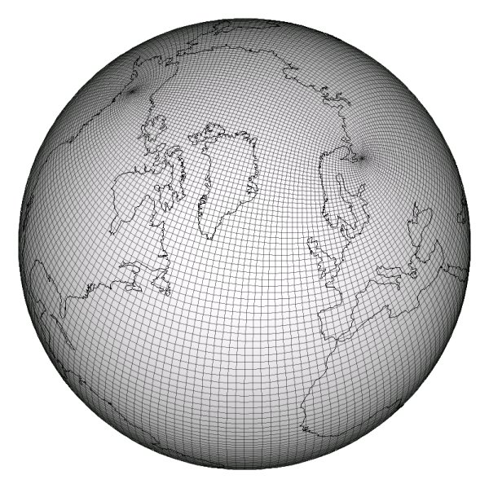
The effect of ocean tides on a climate model simulation Ocean Modelling September, 2010
M. Müller, H. Haak, J.H. Jungclaus,
J. Sündermann, M. Thomas
Erik Tucker
The Hydrosphere
April 3, 2012
http://climate.lanl.gov/Models/POP/images/tripolegrid.jpg

Slide 2
Choosing an Article from Ocean Modelling
The main objective of Ocean Modelling is to provide rapid communication between those interested in ocean modelling… including interactions between physical and biogeochemical or biological phenomena.
Because of the intimate links between ocean and atmosphere, involvement of scientists interested in influences of either medium on the other is welcome. The journal has a wide scope and includes ocean-atmosphere interaction in various forms as well as pure ocean results.

Slide 3
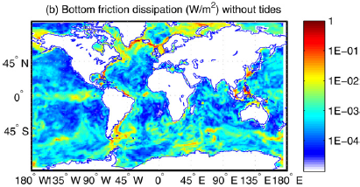
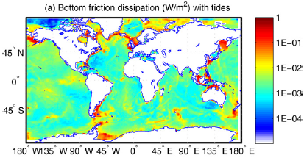
Background
Coupled atmosphere–hydrology–ocean–ice model
Version of an IPCC model (ECHAM5/MPI-OM)
Accounts for GHG forcing
No lunisolar tide forcing: timescale
Model fails in Western Europe
Modified to measure tidal constituents in the OGCM
Constituents sum to total velocity
Bottom friction → vertical mixing
Tides in OGCM improve non-linear interactions
More thorough global energy balance
Accounts better for density changes
Improved flow regimes near the coast
More precise temperature for Oceans and, consequently, Western Europe

Slide 4
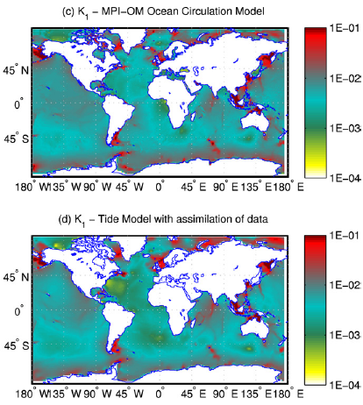
Constituent K1 – With and Without Tidal Forcing
Barotropic tidal velocities [m/s]
High at greater Richardson numbers:
40 vertical layers averaged
Buoyant Frequency
Vertical Velocity Shear

Slide 5
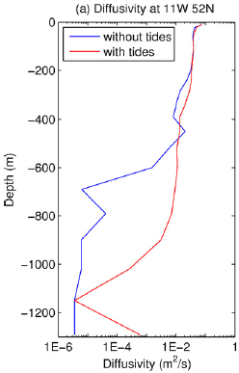
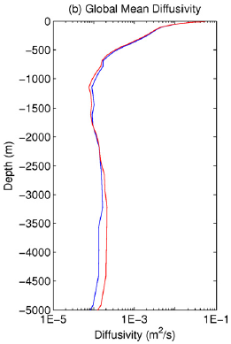
Why Care?
Lets go to the European Shelf…
(About, say, vertical diffusivity depth profiles)
THI S
I S
WHY !
Values shift marginally,
so what’s the big deal?

Slide 6
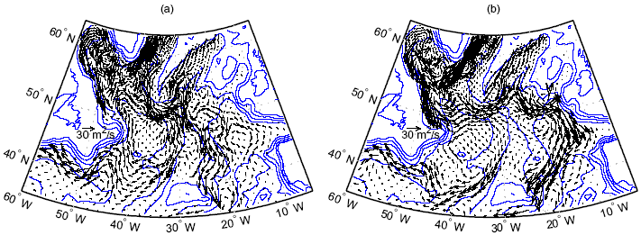
Effect on Water Flow/Convection Labrador Sea Example & North Atlantic Current (NAC)
Some changes are moderate
Some changes are pivotal

Slide 7
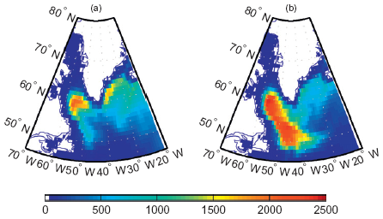
What About Mixing Depth?
With tides: Fresh water mixes more quickly with sea water
Density Changes
Quickly With
Tidal Forcing

Slide 8
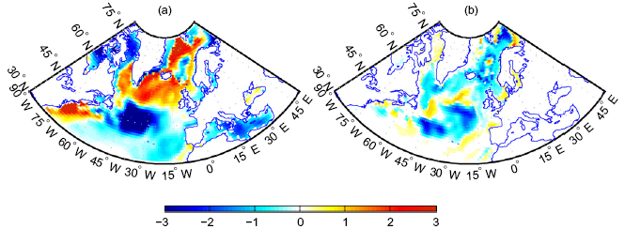
So, how did this help exactly?
Left: ∆T (°C)=
Observed data minus
model data - no tides
Right: Opposite color = improvement from tidal forcing
Improvement
Increased
Model Error

Slide 9
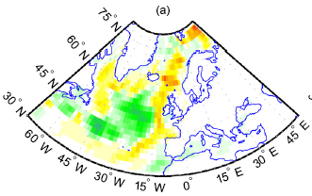
Overall/General Change in Flux
Deep Ocean:
Negative
Coastal Areas:
Positive

Slide 10
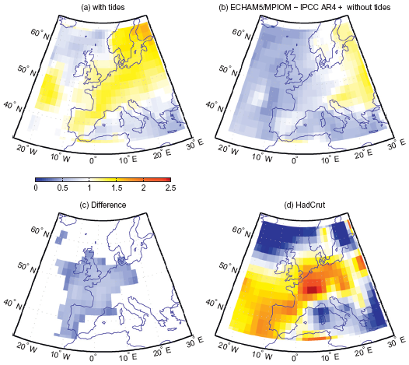
Summing It Up
Quantified a difference
But is it more precise?
Looks like yes: North Atlantic 1950 to 2000 temperature trend modeled more precisely, but…

Slide 11
Some Problems with this article
IPCC uses many models to generate results
Most of the models would not fit the author’s modeling needs
Authors examined only one model from IPCC
Study ignores tidal mixing in deep waters (internal wave breaking)
Only addresses mixing in coastal areas
Skews the energy balance and overall results
Admitted that some results are less precise, even though others are more precise
Discussed only two of the nine constituents in depth, leaving many questions on data quality
Significant typos and other unprofessional mistakes

Slide 12
Questions?
Thanks!
Erik Tucker
The Hydrosphere
April 3, 2012
http://climate.lanl.gov/Models/POP/images/tripolegrid.jpg

