Slide 1
A thermodynamic model for estimating sea and lake ice thickness with optical satellite data
Student presentation for GGS656
Sanmei Li
April 17, 2012

Slide 2
Background
Changes in sea ice significantly affect the exchanges of momentum, heat, and mass between the sea and the atmosphere.
Sea ice extent is an important indicator and effective modulator of regional and global climate change
Sea ice thickness is the more important parameter from a thermodynamic perspective

Slide 3
Problem
Not enough observations on ice thickness data:
  Submarine Upward Looking Sonar
  In situ measurements of ice thickness by the Canadian Ice Service (CIS) starting in 2002
Few numerical ocean sea ice atmosphere models can simulate ice thickness distribution, and the result is generally with low resolution
How to get accurate, consistent ice thickness data with high spatial resolution?

Slide 4
Satellite data
Passive microwave
  EOS/AMSR-E
Radiometers and synthetic aperture radar
  ESA CryoSat-2
ICESat’s laser altimeter (2003)
Optical satellite
  NOAA/AVHRR (long-term data)
  EOS/MODIS
  MSG/SEVIRI

Slide 5
Optical satellites
Advantages of optical satellite data
  Long-term data: TIROS series since 1962
  Continuous observation
  High spatial resolution: 1km
  High temporal resolution
  Large observation network
Problem: only detect surface layer
Can a model be developed based on ice surface energy budget to estimate sea and lake ice thickness with optical satellite data?

Slide 6
OTIM
OTIM (One-Dimension Thermodynamic Ice Model):
α_{s} : ice or snow surface shortwave broadband albedo
F_{r}: downward shortwave radiation flux at the surface
I₀: shortwave radiation flux passing through the ice interior with ice slab transmittance i₀
F_{l}^{up}: upward long-wave radiation flux
F_{l} ^{dn}: downward long-wave radiation flux
F_{s}: sensible heat
F_{e} : latent heat, F_{c} : conductive heat flux within the ice slab;
F_{a} : the residual heat flux, usually assumed as 0

Slide 7

Shortwave Radiation Calculation
α_{s} : ice or snow surface shortwave broadband albedo
  where A, B, C, and D are empirically derived coefficients, and h is the ice thickness (h_{i}) or snow depth (h_{s}) in meter if snow is present over the ice.
I₀: shortwave radiation flux passing through the ice interior with ice slab transmittance i₀

Slide 8


Long-wave Radiation
F_{l}^{up}: upward long-wave radiation flux
F_{l} ^{dn}: downward long-wave radiation flux in clear-sky conditions
F_{l} ^{dn}: downward long-wave radiation flux in cloudy conditions
C is cloud fraction

Slide 9



F_{s}: sensible heat
ρ_{a:} Air density, 1.275kg m-3 at 0 and 1000hpa
C_{p}: specific heat of wet air with humidity q,
C_{s}: bulk transfer coefficient (C_{s} = 0.003 for thin ice, 0.00175 for thick ice, 0.0023 for neutral stratification)
C_{pv} :specific heat of water vapor at constant pressure, 1952JK⁻¹kg⁻¹
C_{pd} :specific heat of dry air at constant pressure, 1004.5JK⁻¹kg⁻¹
u: surface wind speed
T_{a}: surface air temperature
T_{s}: surface skin temperature
P_{a}: surface air pressure
T_{v}: surface virtual air temperature

Slide 10
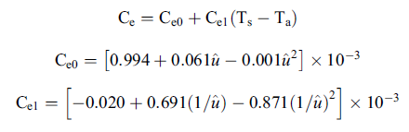

F_{e} : latent heat
L: latent heat of vaporization (2.5*10⁶ J kg⁻¹)
C_{e}: bulk transfer coefficient for heat flux of evaporation
W_{a}: air mixing ratio
W_{sa}: mixing ratio at the surface

Slide 11

F_{c} : conductive heat flux
T_{f}: water freezing temperature
S_{w}: salinity of sea water S_{i}: sea ice salinity
h_{s}: snow depth h_{i}: ice thickness
K_{s}: conductivity of snow K_{i}: conductivity of ice
ρ_{snow} : snow density
T_{snow}: snow temperature T_{i}: ice temperature

Slide 12
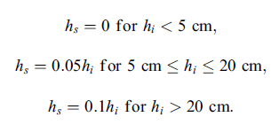
Relationship between snow depth and ice depth
h_{s} is snow depth, h_{i} is ice thickness

Slide 13


Relationship between ice thickness and sea ice salinity
Scheme one:
Scheme two:
Scheme three:

Slide 14

Surface air temperature
T_{a}: air temperature
T_{s}: surface skin temperature
δT: a function of cloud amount,
C_{f}: cloud amount

Slide 15


OTIM in daytime
OTIM in night time

Slide 16
Application of OTIM
Satellite data: AVHRR, MODIS and SEVERI
Input parameters from satellite:
  cloud amount,
  surface skin temperature,
  surface broadband albedo,
  surface downward shortwave radiation fluxes
Other input:
  Air pressure
  Wind speed
  Air humidity
  Snow density, depth, temperature if available
  ………

Slide 17

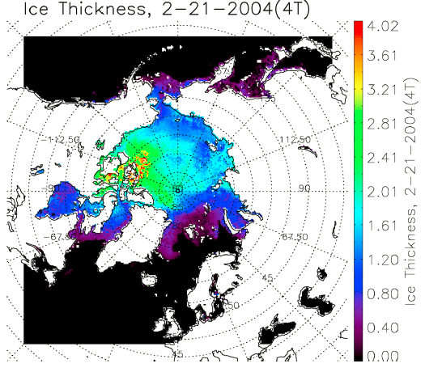

Slide 18
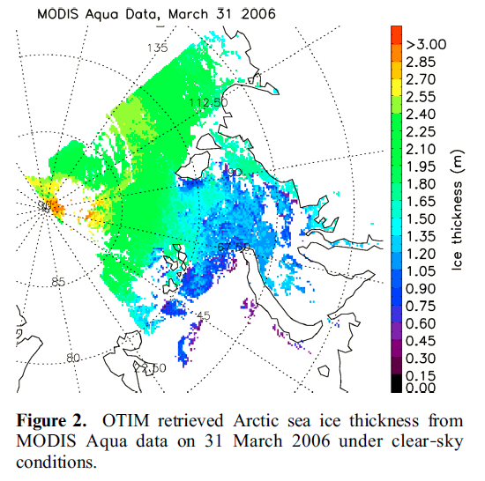
OTIM ice thickness result with MODIS data

Slide 19
Validation
Using the data from:
  Ice thickness from submarine cruises (SCICES)
  Meteorological stations (Canada )
  Mooring sites
  Numerical model simulations (PIOMAS)
Comparison:
  Cumulative frequency
  Point-to-point comparison by spatial matching

Slide 20
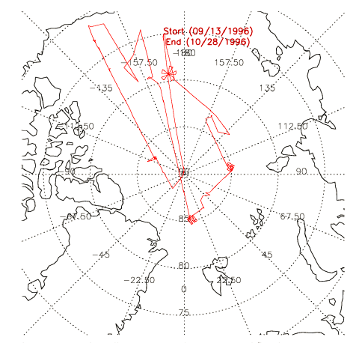
Validation
Using SCICES (Scientific Ice Expeditions) in 1996, 1997 and 1999 ice draft data and Moored ULS Measurements
Submarine trajectories for SCICES 96

Slide 21
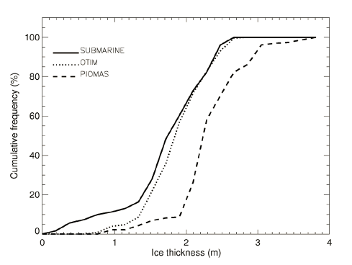
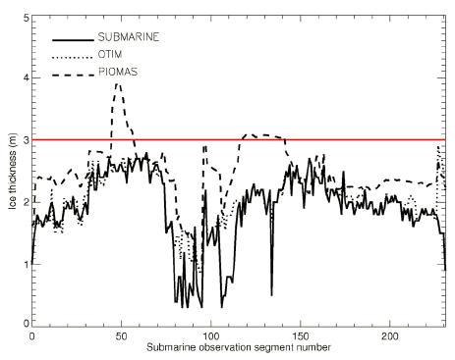
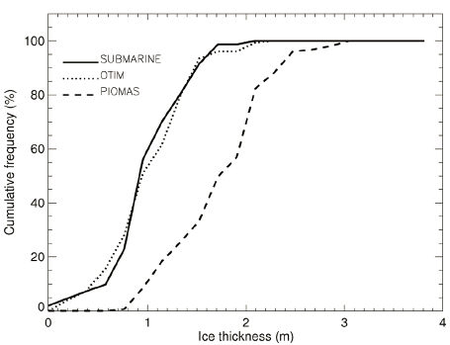
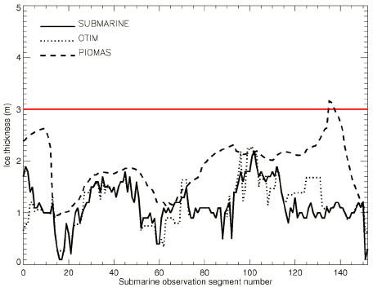
Point to point comparison
Cumulative frequency

Slide 22
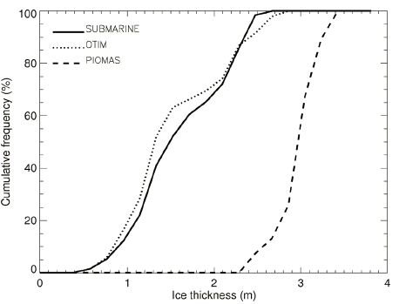
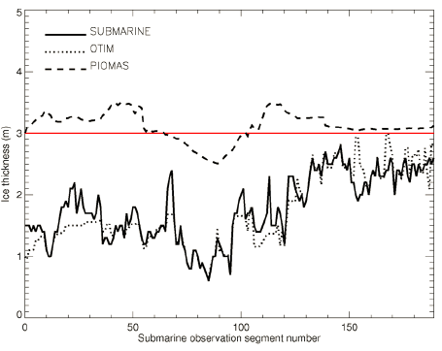
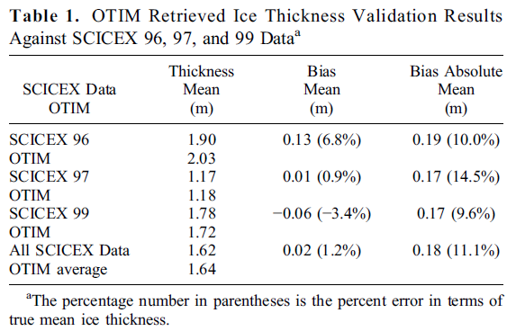
Overall mean absolute bias: 0.18m

Slide 23
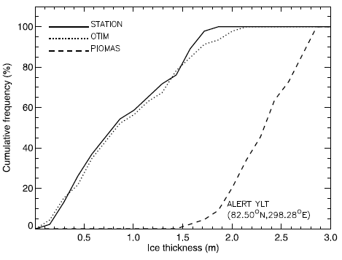
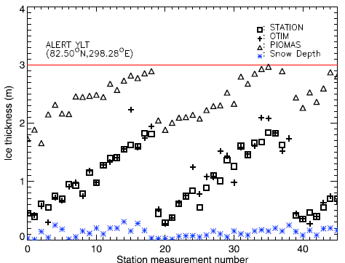
Validation
Comparison with Canadian Meteorological Station measurements, and Moored ULS Measurements

Slide 24
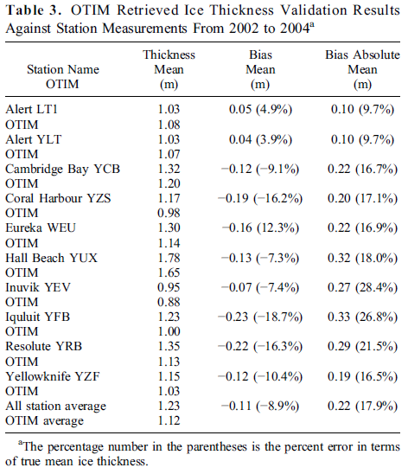

Slide 25

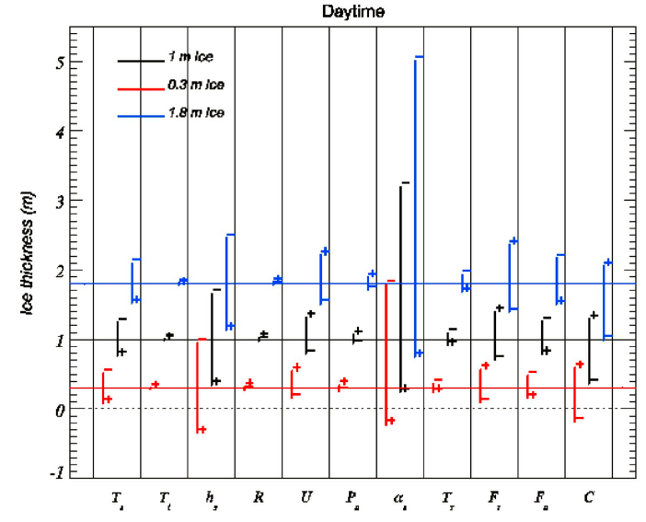
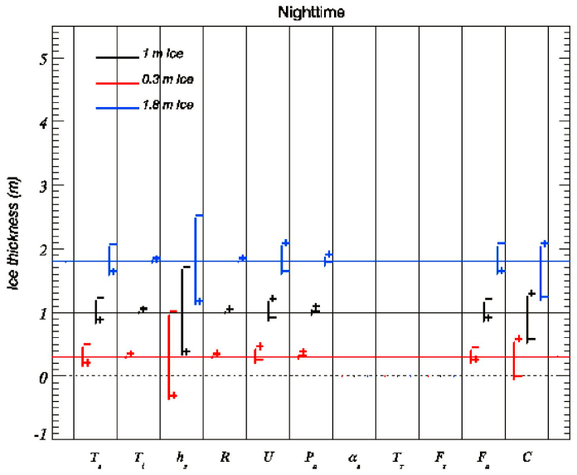
Uncertainty and Sensitivity Analysis

Slide 26
Validation result
OTIM is capable of retrieving ice thickness up to 2.8 meter
With submarine data, the mean absolute error is about 0.18m for samples with a mean ice thickness of 1.62m (11% mean absolute error)
With meteorological stations data, the mean absolute error can be 18%.
With moored ULS measurements, the error is about 15%.

Slide 27
Uncertainty and Sensitivity Analysis
The largest error comes from the surface broadband albedo α_{s} uncertainty, which can cause more than 200% error in ice thickness estimation
Other error sources are uncertainties in snow depth, cloud amount, surface downward
Uncertainties also come from model design structure and parameterization schemes such as the assumed linear vertical temperature profile in the ice slab. solar radiation flux…….

Slide 28
Conclusion
The One-dimensional Thermodynamic Ice Model, OTIM, based on the surface energy budget can instantaneously estimate sea and lake ice thickness with products derived from optical satellite data.
Products or Parameters retrieved from optical satellite data can be used as input in OTIM and obtain good results.

Slide 29
Conclusion
The model can be used for quantitative estimates of ice thickness up to approximately 2.8 m with an correct accuracy of over 80%.
This model is more suitable for nighttime ice thickness estimation. During daytime, in the presence of solar radiation, it is difficult to solve the energy budget equation for ice thickness analytically due to the complex interaction of ice/snow physical properties with solar radiation, which varies considerably with changes in ice/snow clarity, density, chemicals contained, salinity, particle size and shape, and structure. This makes the daytime retrieval with OTIM more complicated.

Slide 30
Thanks!

