Slide 1
Color Theory and Accessibility
Nicole Roth
ENGH 507
Spring 2016

Slide 2
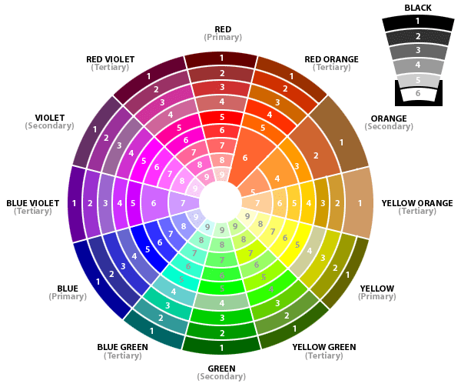
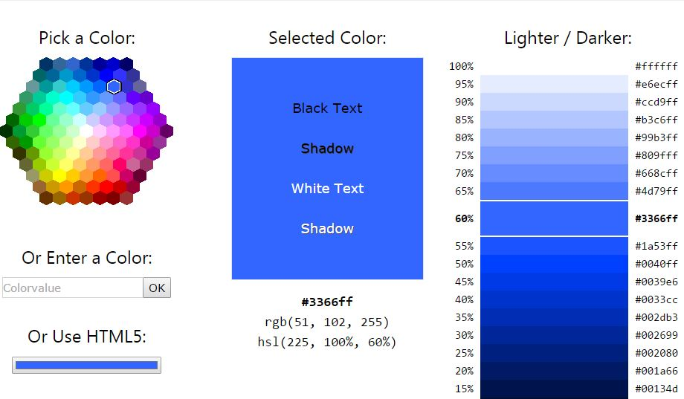
Color and color Theory
Color can be associated with memory, emotions, and can hold several meanings at once
Presenting on the surface plane, the color palette chosen for a site can impact the meaning

Slide 3
Color and Memory
Used in marketing, a color scheme can stay with you for long time particularly when presented in a logo—see Facebook, Pepsi, Coca-Cola, McDonalds, IMDb
Each logo carries a consistent color scheme through its products and websites
High color contrast important

Slide 4
Color Contrast: IBM
“Choosing the right colors is a very important aspect when creating a website, because the colors and the graphics are the first thing your visitor sees. Meaning, the background color, the color of the header, the color of the text, the headlines – all have a psychological impact on the website’s visitor.”
The approach to the IBM site is “very professional” and gives the site a “serious, business aspect, creating an impression of seriousness and professionalism”

Slide 5
IBM Color Report
Testing done through Access Keys shows that the contrast of the centered buttons on the IBM page fail to meet the minimum recommendations from W3C

Slide 6
Module 6 Color choice and underlying theme
Drawing from the film Starship Troopers popular in-film videos
Contrast is too low and the site’s colors, while showing only two errors in WAVE resulted in a failure rate on AccessColor Report

Slide 7
Module 6 Updates PROTAN Perspective
Protan color-blindness involves the lack of or deficiency of the red cone in the eye.
The example shows a slight change in the color scheme of the page.
Comparison of original page and Protan Simulated Color Blindness

Slide 8
Module 6 Updates Deuteran Perspective
Deuteran is the lack of or deficiency of the green cone in the eyes.
As with the protan, the colors have not changed too much, but brightness has decreased.
Comparison of original page and Deuteran Simulated Color Blindness

Slide 9
Module 6 updates Tritan Perspective
Tritan is a lack of or deficient blue cone in the eyes.
Drastically changing the perspective, the Tritan type of colorblindness can actually change the meaning of the page.
Comparison of original page and Tritan Simulated Color Blindness

Slide 10
Takeaways: Pay Attention to color
It is impossible to account for all variations (but that doesn’t mean you shouldn’t try!)
Following basic rules will help those who are visually impaired to better access your site
Use a high contrast color palette
Provide background that also complements your page
Use a monochrome palette—tints of one color with deep contrast—to assist viewers

Slide 11
Works referenced
“A Quick Introduction to Colorblindness.” We are colorblind. N.p., n.d. Web. 30 Mar. 2016.
“Color Psychology in Web Design - Big Websites Case Studies - Pixel77.” N.p., n.d. Web. 23 Feb. 2016.
Garrett, Jesse James. The Elements of User Experience, Second Edition: User-Centered Design for the Web and Beyond. 2nd ed. New Riders, 2010. Safari Books Online. Web. 23 Mar. 2016.
“HTML Color Picker.” N.p., n.d. Web. 30 Mar. 2016.
“The Physics of Color - the Color Wheel and Color Spectrum.” N.p., n.d. Web. 30 Mar. 2016.
“WAI-ARIA 1.0 Authoring Practices.” N.p., n.d. Web. 30 Mar. 2016.

Slide 12
Logo citations
“Coca-Cola Logo - Design and History of Coca-Cola Logo.” N.p., n.d. Web. 30 Mar. 2016.
“Facebook Logo - Design and History of Facebook Logo.” N.p., n.d. Web. 30 Mar. 2016.
“IBM - Smarter Planet - United States.” CT402. N.p., 12 Nov. 2015. Web. 30 Mar. 2016.
“IMDb - Movies, TV and Celebrities.” IMDb. N.p., n.d. Web. 30 Mar. 2016.
“McDonald’s Logo - Design and History of McDonald’s Logo.” N.p., n.d. Web. 30 Mar. 2016.
“Pepsi Logo - Design and History of Pepsi Logo.” N.p., n.d. Web. 30 Mar. 2016.

