Slide 1
How They Interact?
Understanding Cyber and Physical Interactions against Fault Propagation in Smart Grid
Zhuo Lu, University Of South Florida
Mingkui Wei, Sam Houston State University
Xiang Lu, Institute Of Information Engineering

Slide 2
Outline
  Introduction
  Problem statement and model
  Analytical formulation and results
  System level simulation
  Conclusion

Slide 3
Outline
  Introduction
  Problem statement and model
  Analytical formulation and results
  System level simulation
  Conclusion

Slide 4
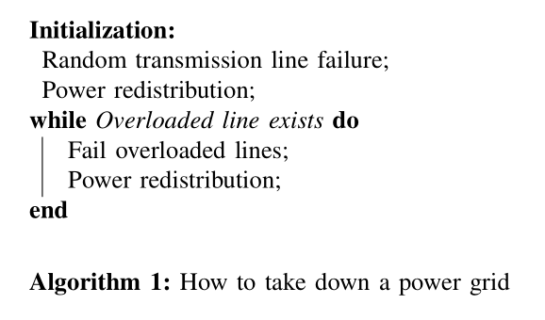
Cascading Failure in the Power Grid
Failure on one transmission line can propagate and cause consecutive overload and failure on a large number of lines.

Slide 5
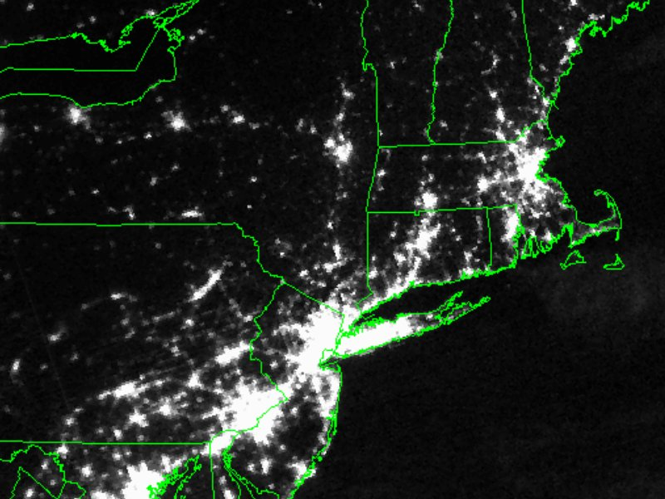
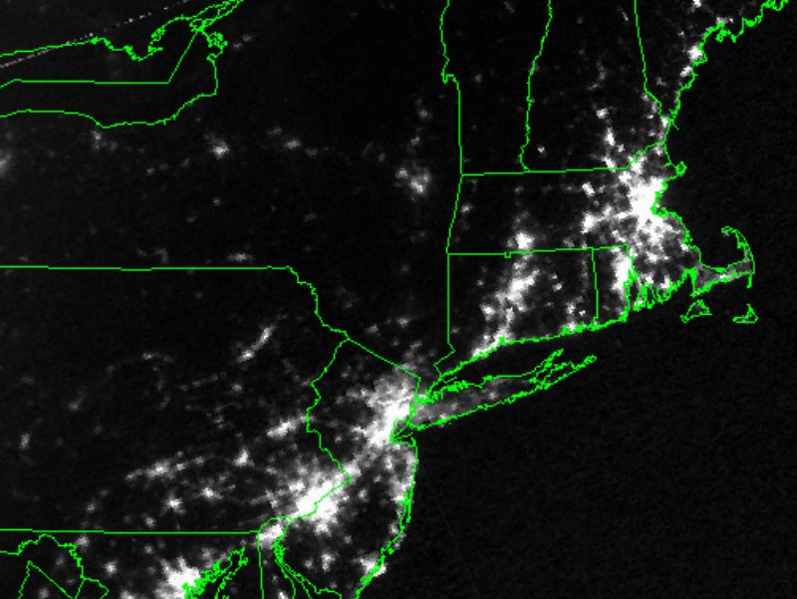
Cascading Failure in the Power Grid
Failure on one transmission line can propagate and cause consecutive overload and failure on a large number of lines.
Figure: 2003 US northeast blackout, before and after the event.

Slide 6
Cascading Failure in the Power Grid
Failure on one transmission line can propagate and cause consecutive overload and failure on a large number of lines.
Load shedding is an effective approach to stop the fault propagation
  Purposefully disconnects load from the system.
  Eliminate overload and thus stop fault propagation.

Slide 7
Load Shedding in a Nutshell
X
X
3
X
1
X
X
2
Legacy power grid approach
  Load is pre-configured with priority
  Load is shed according to priority, rather than its contribution in stopping fault propagation
  Local load shedding

Slide 8
Load Shedding in a Nutshell
-10%
X
X
-10%
-30%
Smart grid approach
  Shed load and eliminate overload with the least cost
  Relies on communication networks
  Global load shedding

Slide 9
Motivation
-10%
X
-10%
Is the fundamental assumption of existing works.
Global load shedding with message delay
  What if the load is shed too late?
  Is communication always a helpful factor?

Slide 10
Outline
  Introduction
  Problem statement and model
  Analytical formulation and results
  System level simulation
  Conclusion

Slide 11
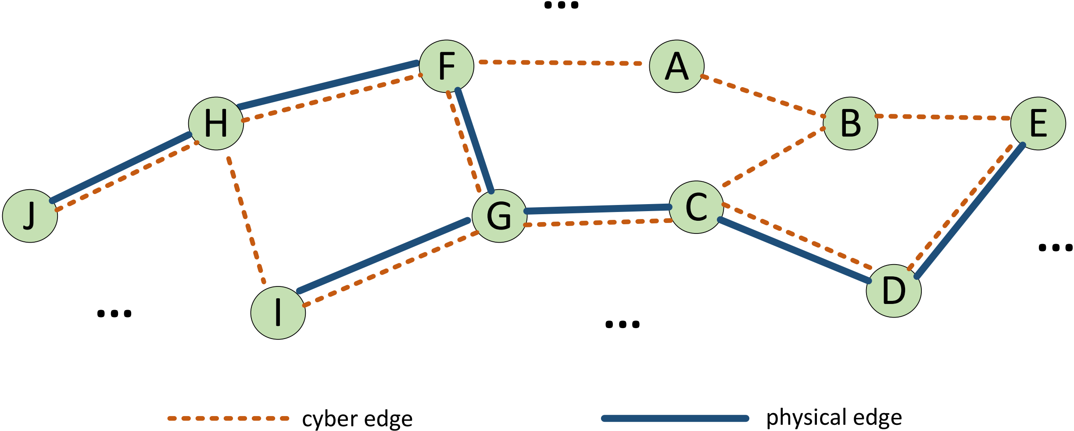

System Model
Smart grid and network architecture
Smart grid as a multigraph: $𝒢=(𝒩, ℰ_{c},ℰ_{p})$
  $𝒩$ is the set of all nodes;
  $ℰ_{c}$ and $ℰ_{p}$ are the set of cyber and physical edges
  Cyber system $𝒢_{c}=(𝒩, ℰ_{c})$, and power system $𝒢_{p}=(𝒩,ℰ_{p})$

Slide 12

System Model
Fault propagation in the physical domain
Definition 1:
  The total number of failed lines, denoted as $\{M\left(t\right);t≥0\}$, is an inhomogeneous counting process with the i-th random counting interval $τ_{i}$ depends on $i$.
t = 0
x
t = τ₁+ τ₂
x
t = τ₁
x

Slide 13

System Model
Fault propagation in the physical domain
Definition 2:
  The failure probability, denoted as $P(M(∞)≥m)$, is the probability that at least $m$ lines eventually fail.
t = 0
x
t = τ₁+ τ₂
x
t = τ₁
x
x
t = τ₁+ τ₂+ τ₃+…

Slide 14

System Model
Fault propagation in the physical domain
Definition 3:
  The delay $d_{i}$ denote the duration between the i-th load shedding procedure starts, and the corresponding load is shed in the physical domain.
t = 0
x
x
t = d₁

Slide 15

Problem Statement
How to formulate and characterize the failure probability $P\left(M\left(∞\right)≥m\right)$?
What are the most important factors to use global and local load shedding to stop fault propagation?

Slide 16
Outline
  Introduction
  Problem statement and model
  Analytical formulation and results
  System level simulation
  Conclusion

Slide 17
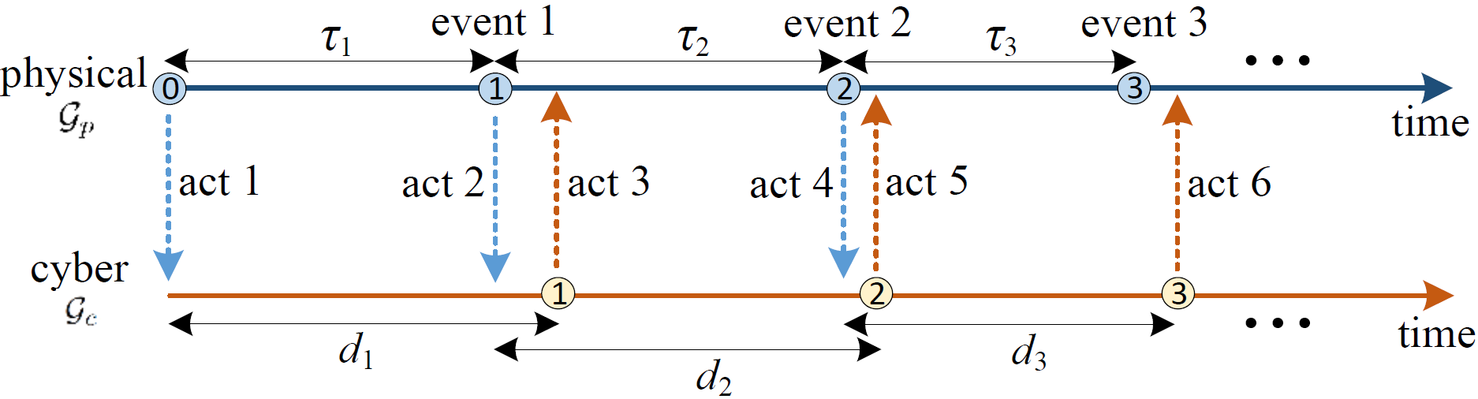
Cyber-Physical Interactions during Fault Propagation
event 0
Why fault propagation won’t be stopped by global load shedding?
act 1: detection of fault in event 0.
act 3: delivering of control message in reaction to fault in event 0.
Problem: act 3 is delivered after new fault (event 1) has been caused.

Slide 18
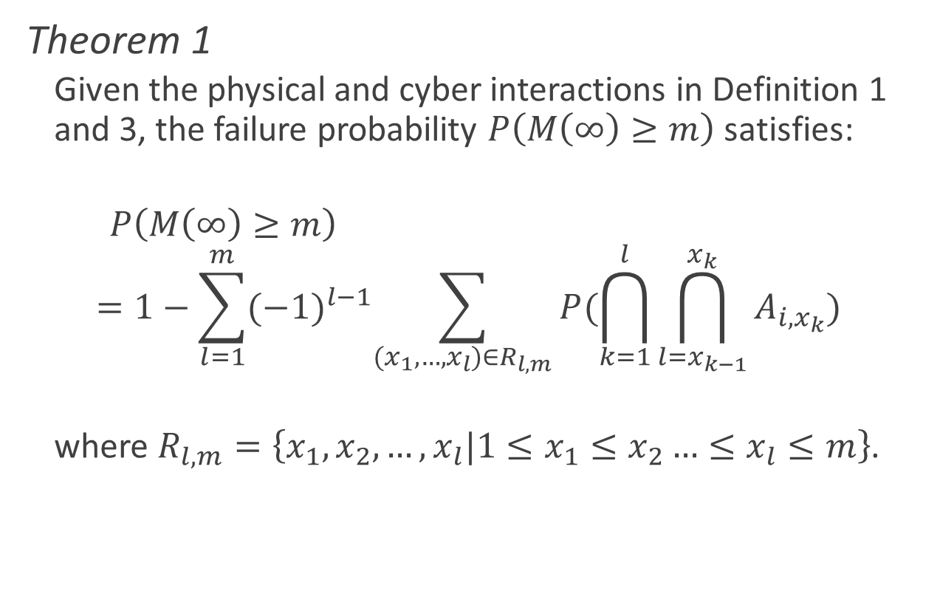
Analytical Results
Theorem 1
  Given the physical and cyber interactions in Definition 1 and 3, the failure probability $P\left(M\left(∞\right)≥m\right)$ satisfies:
  $P\left(M\left(∞\right)≥m\right)$
  $$=1−\sum_{l=1}^{m}{{(−1)}^{l−1}\sum_{(x_{1},…,x_{l})∈R_{l,m}}{P(\bigcap_{k=1}^{l}{\bigcap_{l=x_{k−1}}^{x_{k}}{A_{i, x_{k}}}})}}$$
  where $R_{l,m}=\left\{x_{1},x_{2},…,x_{l}|1≤x_{1}≤x_{2}…≤x_{l}≤m\right\}$.

Slide 19
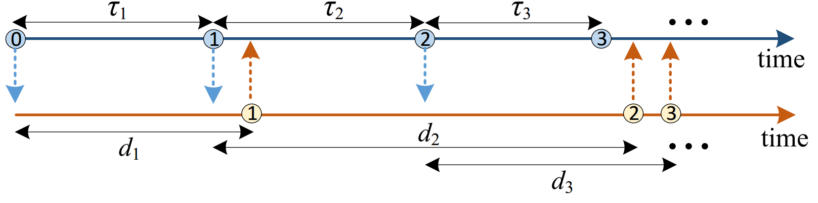
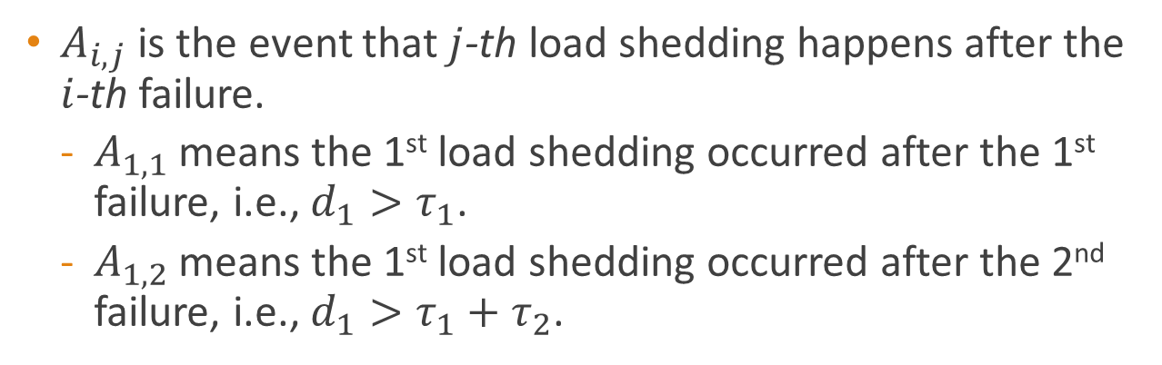
Analytic Results
①
$A_{i,j}$ is the event that $j$-th load shedding happens after the $i$-th failure.
  $A_{1,1}$ means the 1st load shedding occurred after the 1st failure, i.e., $d_{1}>τ_{1}$.
  $A_{1,2}$ means the 1st load shedding occurred after the 2nd failure, i.e., $d_{1}>τ_{1}+τ_{2}$.

Slide 20
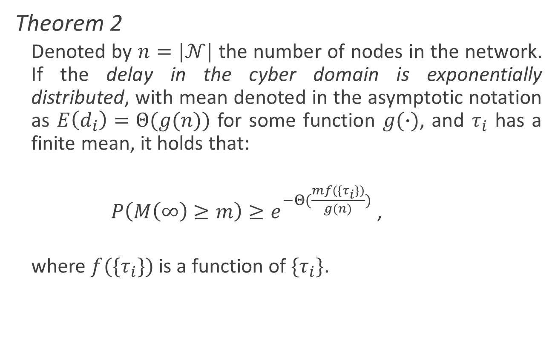
Analytic Result
Theorem 2
  Denoted by $n=|𝒩|$ the number of nodes in the network. If the delay in the cyber domain is exponentially distributed, with mean denoted in the asymptotic notation as $E\left(d_{i}\right)=Θ(g(n))$ for some function $g(∙)$, and $τ_{i}$ has a finite mean, it holds that:
  $P\left(M\left(∞\right)≥m\right)≥e^{−Θ(\frac{mf(\{τ_{i}\})}{g(n)})}$ ,
  where $f(\{τ_{i}\})$ is a function of $\{τ_{i}\}$.

Slide 21
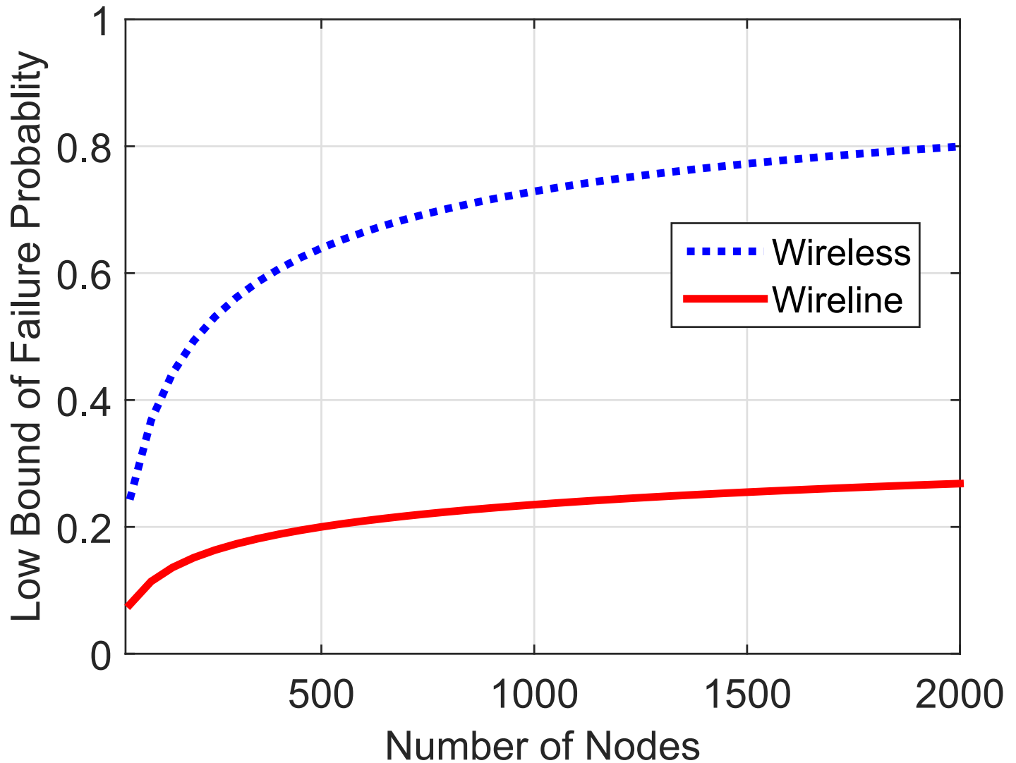
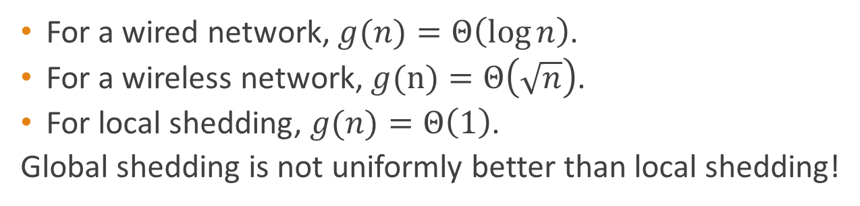
Analytical Result
Figure: a numerical example comparing lower bound of wired and wireless.
For a wired network, $g(n)=Θ\left(\log{n}\right)$.
For a wireless network, $g(n)=Θ\left(\sqrt{n}\right)$.
For local shedding, $g(n)=Θ\left(1\right)$.
Global shedding is not uniformly better than local shedding!

Slide 22
Outline
  Introduction
  Problem statement and model
  Analytical formulation and results
  System level simulation
  Conclusion

Slide 23
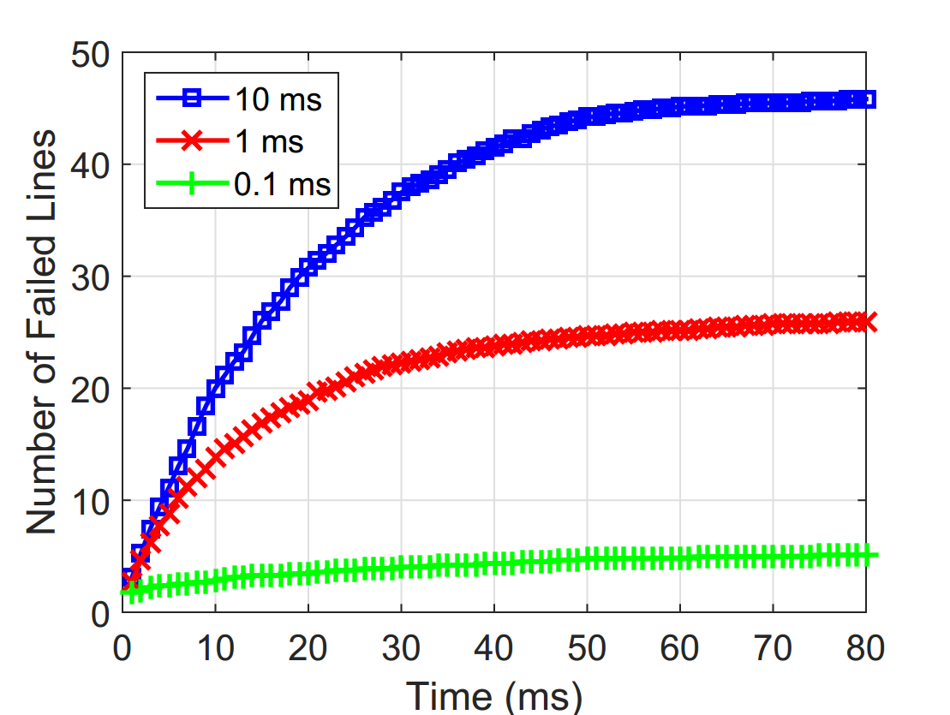
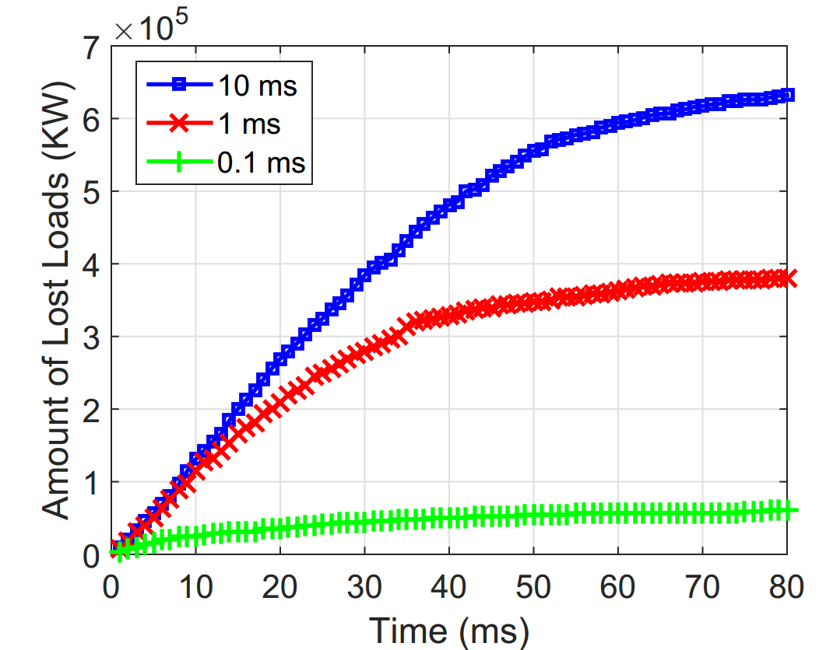
Global Load Shedding with Practical Link Performances
Simulation is conducted on the IEEE 57-Bus system
  57 buses, 80 transmission lines, 1,250,800 Kilowatts load.
Average communication delay is set to be 0.1, 1, and 10 ms.

Slide 24
Global Load Shedding with Practical Link Performances
10 ms delay results in more than half line failure and about half load lost (out of 80 lines and 1,250,800 KW).
Shorter delay brings better result.
Even very small delay can still not completely prevent fault propagation.

Slide 25
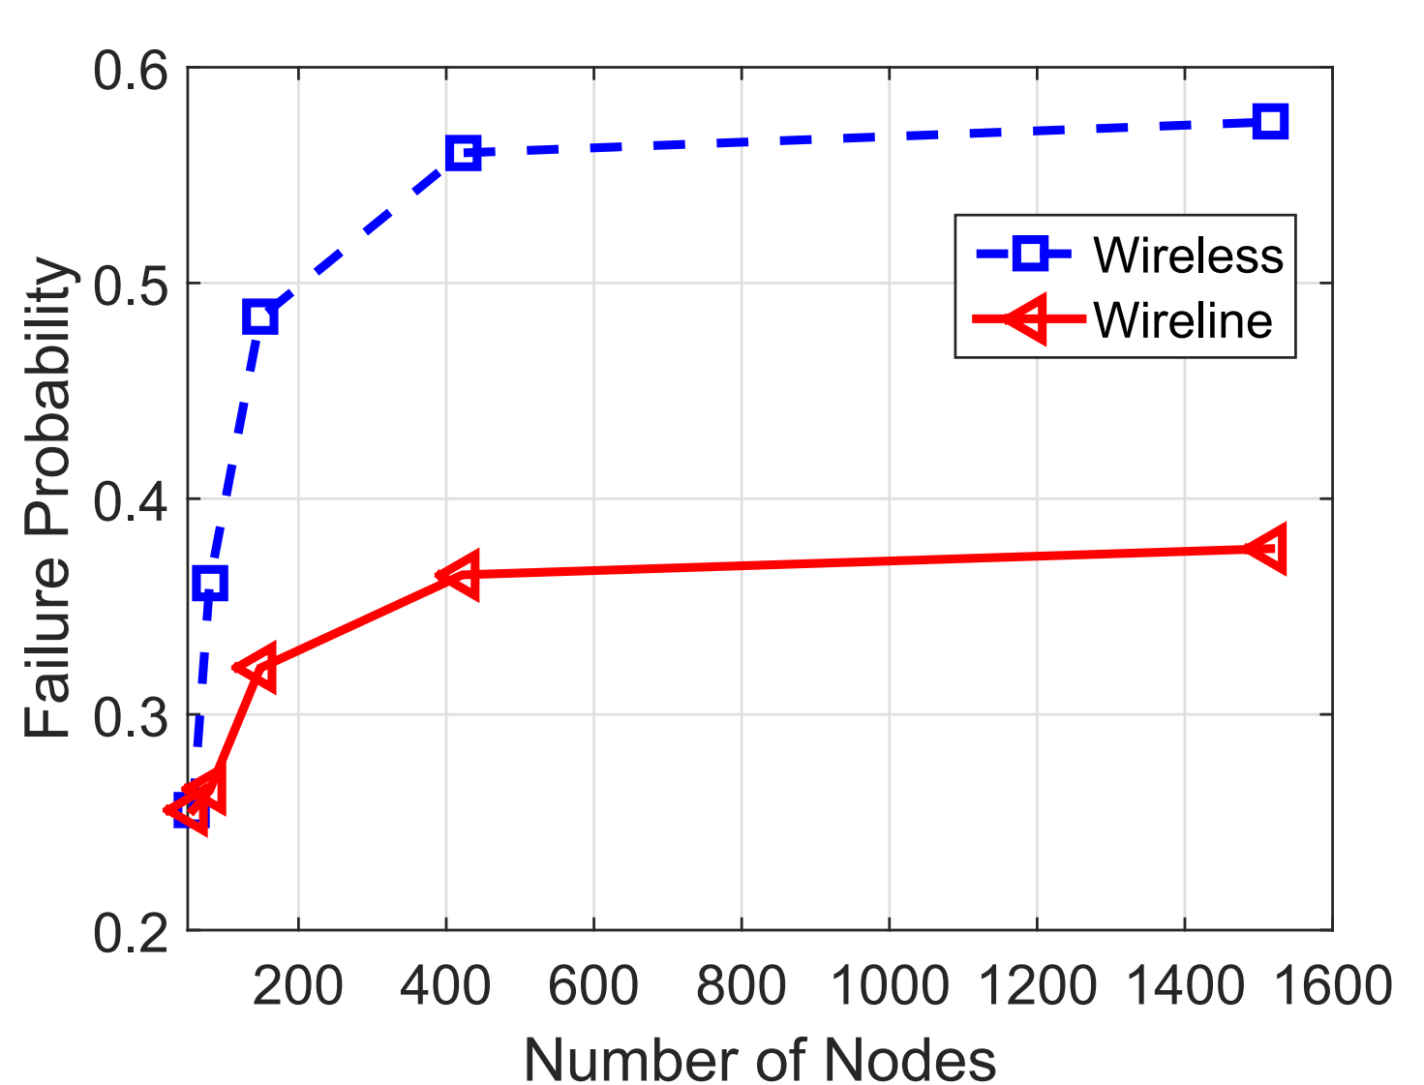
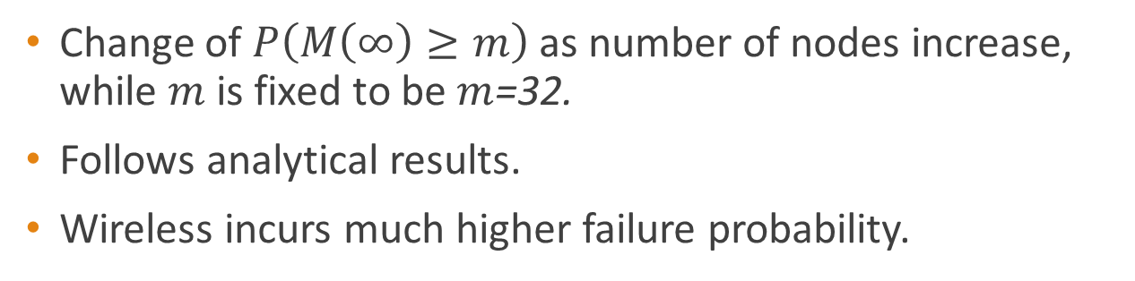
Global Load Shedding in Wired and Wireless Networks
Change of $P\left(M\left(∞\right)≥m\right)$ as number of nodes increase, while $m$is fixed to be $m$=32.
Follows analytical results.
Wireless incurs much higher failure probability.

Slide 26
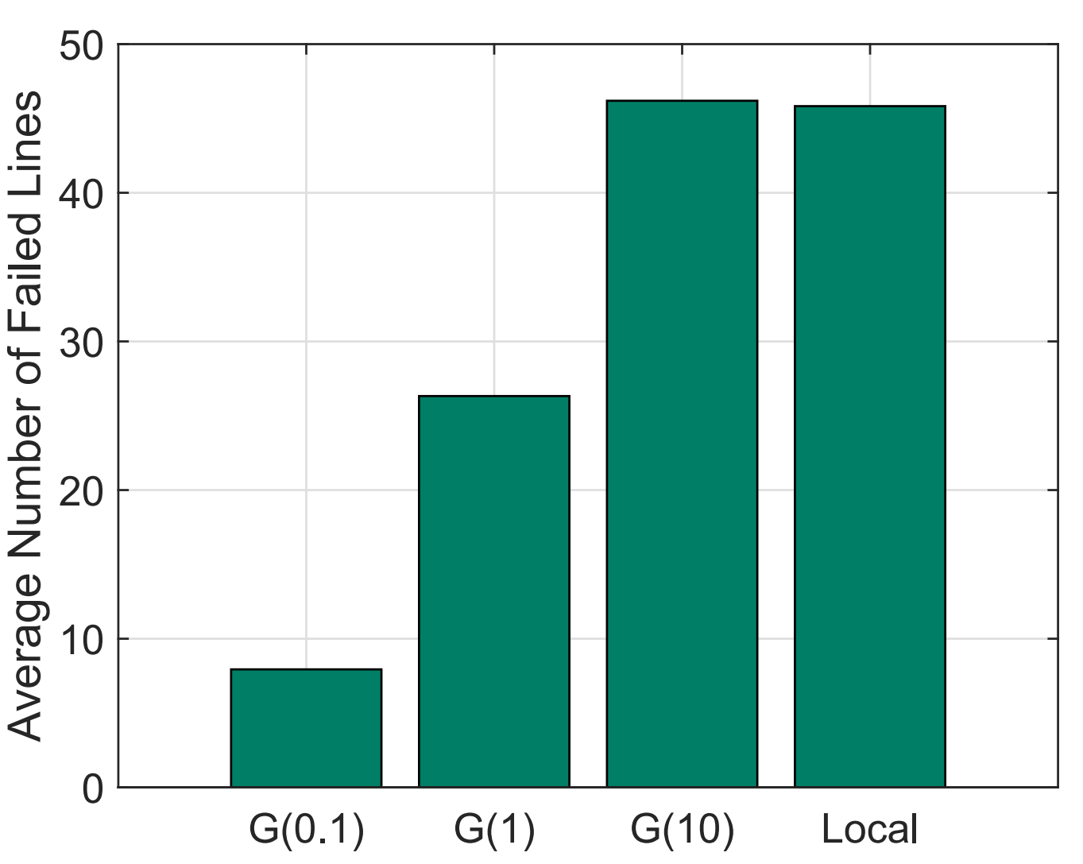
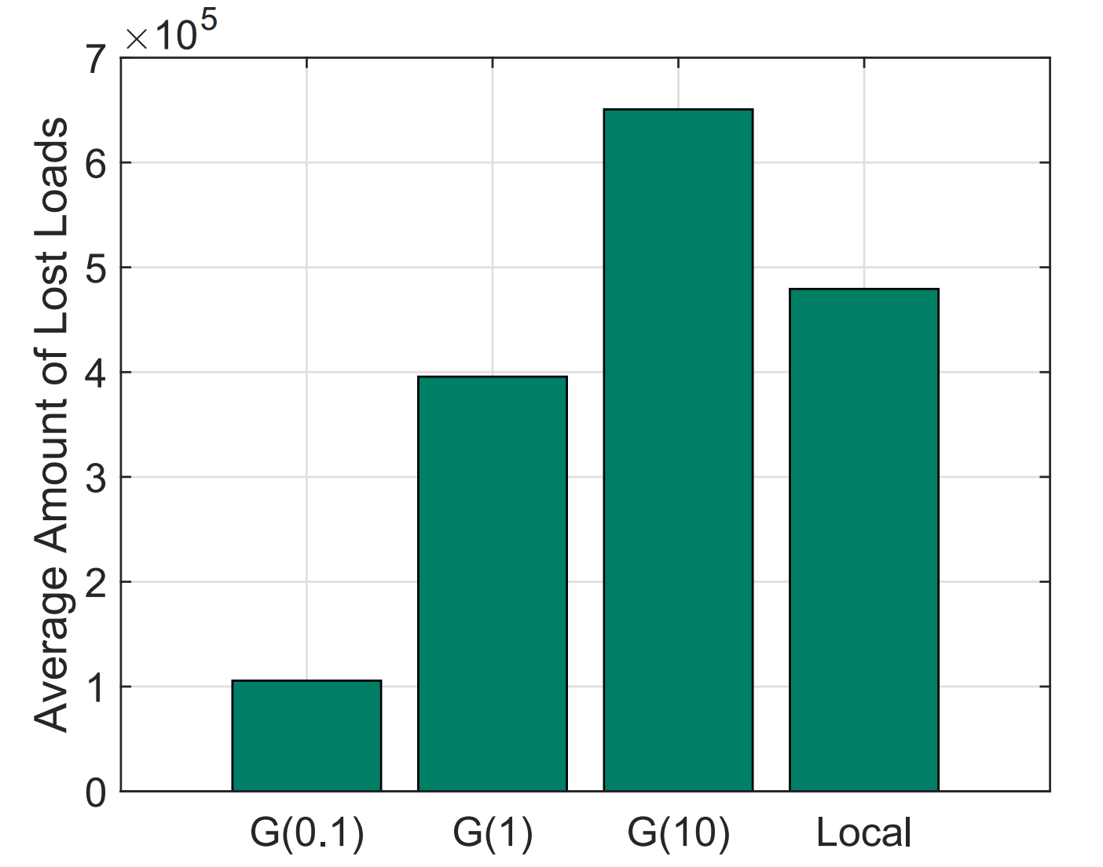
Global v. Local Load Shedding
Delay in Global load shedding is set to 0.1, 1, and 10 ms.
Local load shedding without communication.
Local load shedding outperforms the 10 ms case.

Slide 27
Outline
  Introduction
  Problem statement and model
  Analytical formulation and results
  System level simulation
  Conclusion

Slide 28
Conclusion
Characterized the cyber-physical interaction of fault propagation using both analytical modeling and system-level simulation.
Demonstrated that:
  Global load shedding is sensitive to the performance in the cyber domain;
  Local load shedding may perform better in the presence of an imperfect cyber domain.
Necessitate a joint view for any design in the smart grid.

Slide 29

Thank you!

