Slide 1
On Modeling and Understand Vehicle Evacuation Attacks in VANETs
Mingkui Wei, Sam Houston state university
Zhuo lu, university of south Florida
Wenye wang, north Carolina state university

Slide 2
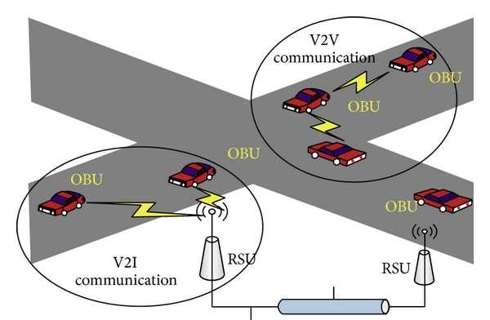
VANET Security
Vehicular Ad-hoc Network
  V2V and V2I network.
  Authentication in partially
  connected, distributed and
  highly dynamic network.
Existing works:
  Secure authentication infrastructure [Li’07, Nowey’06].
  Protocols to preserve user privacy [Zhang’11, Pan’13].
What’s Missing:
  Rely on communications, which are not reliable in VANET.
  Not effective with extreme long delay.

Slide 3
Motivation
Physical character matters!
Inherited from delayed information exchange, and is unavoidable.
Understanding and minimizing the impact are imperative.

Slide 4
Research Question
Research Questions
  How message delay escalates the consequence of cyber-attacks in the physical domain?
Objectives
  Model the vehicle evacuation attack.
  Identify the correlation between delay and security.

Slide 5
Vehicle Evacuation Attack: the Model
A
B
C
When the malicious and benign vehicles are in contact:
  Immune: vehicles that are still connected to RSU.
  Infected: vehicles that are not connected to RSU.
  Evacuated: infected vehicles that has an Exit in front.
Objective:
  Number of infected/evacuated vehicles.
  Correlation between such number and message delay.

Slide 6
Challenges and Approaches
Challenges
  Model the Vehicle Evacuation Attack.
    Connectivity of vehicles.
    Practical distribution of vehicles on the highway.
Approaches
  Obtain a real-world transportation dataset.
  Derive statistical properties of vehicles and clusters.
  Mathematically model and evaluate the attack.

Slide 7
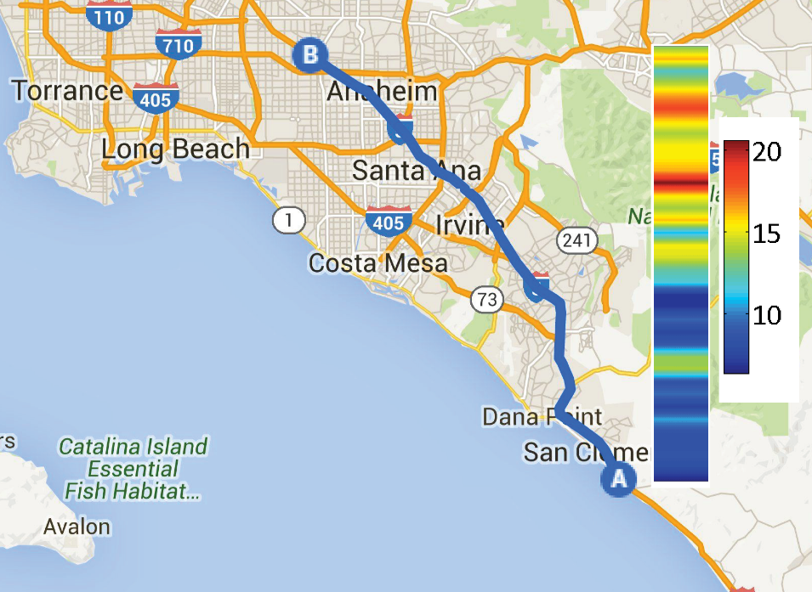
PeMS: the Dataset
Caltrans Performance Measurement System (PeMS).
  Managed and released by the Department of Transportation.
  Chose the section Interstate 5 Northbound (I5-N), CA.
  44.4 miles long.
  333 sensors.

Slide 8
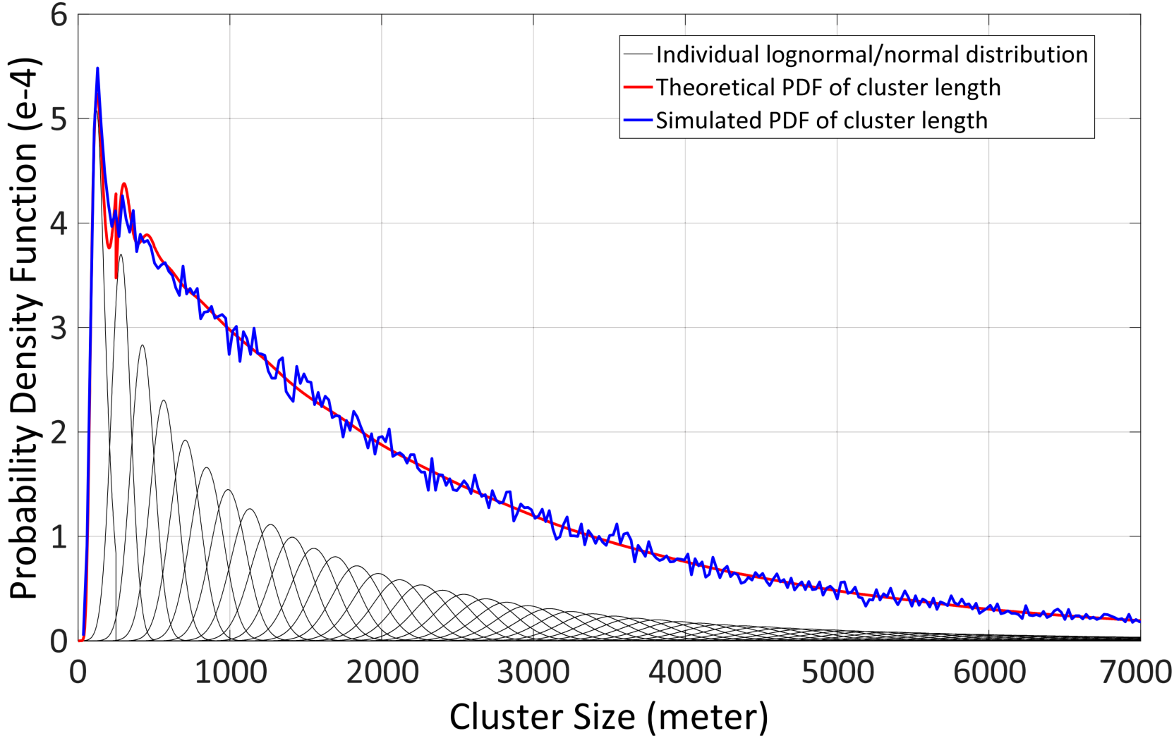
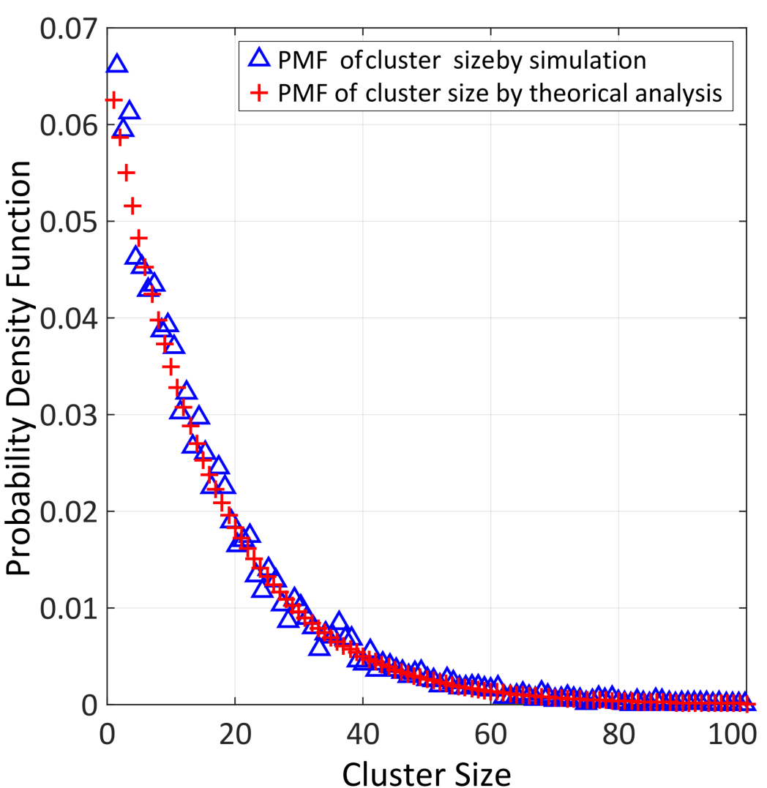
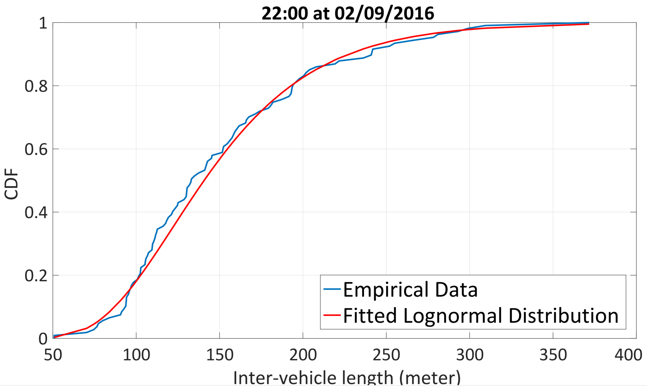
Vehicles’ Statistical Properties
Lemma 1 & 2: dataset analysis.
Lemma 3 & 4: Innovative proposal based on classic theory and simulation observation.

Slide 9
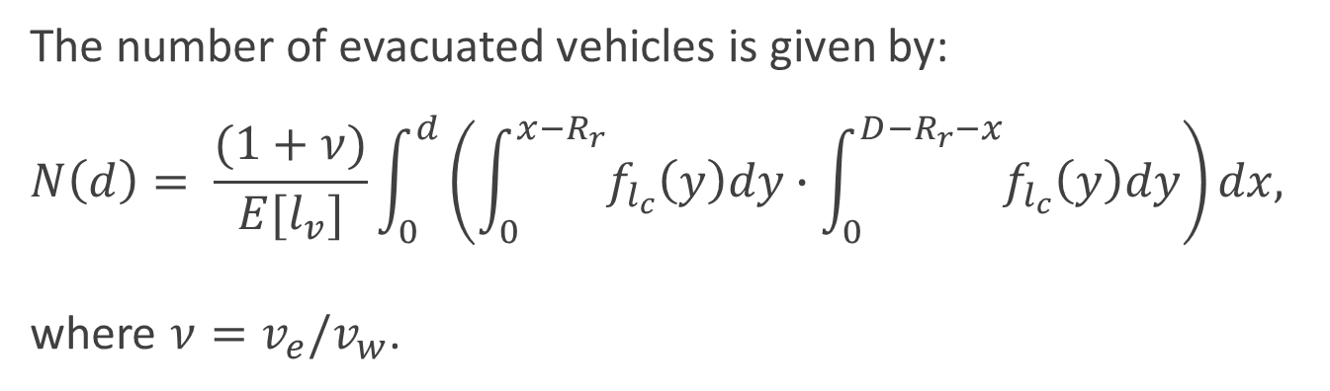
Theorem: Evacuated Vehicles
The number of evacuated vehicles is given by:
$$N\left(d\right)= \frac{(1+ν)}{E[l_{v}]}\int_{0}^{d}{\left(\int_{0}^{x−R_{r}}{f_{l_{c}}\left(y\right)dy}∙\int_{0}^{D−R_{r}−x}{f_{l_{c}}\left(y\right)dy}\right)dx,}$$
where $ν=v_{e}/v_{w}$.

Slide 10
N(d) Increase According to d
5 cars can be evacuated if d = 2000.
d
D = 5 Km

Slide 11
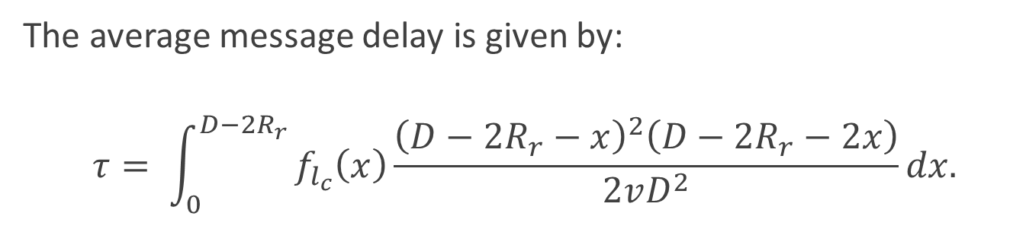
Theorem: Average Message Delay
The average message delay is given by:
$$τ= \int_{0}^{D−2R_{r}}{f_{l_{c}}\left(x\right)\frac{{\left(D−2R_{r}−x\right)}^{2}\left(D−2R_{r}−2x\right)}{2vD^{2}}dx.}$$

Slide 12
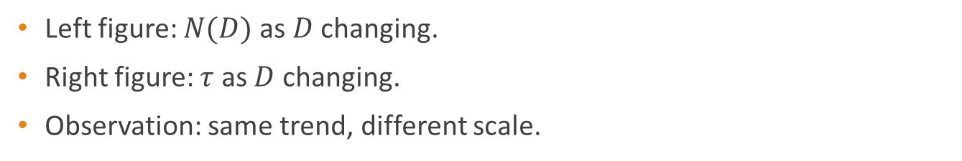

Comparison between $τ$ and $N(d)$
Question: correlation between delay and security?
Left figure: $N(D)$ as $D$ changing.
Right figure: $τ$ as $D$ changing.
Observation: same trend, different scale.

Slide 13
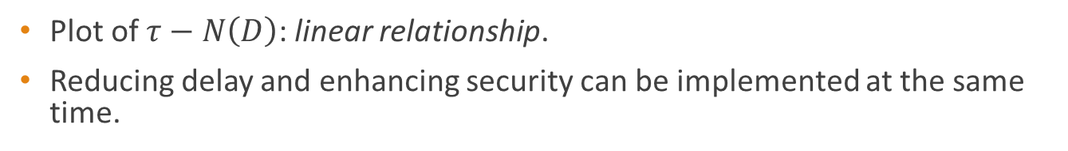

Correlation between $τ$ and $N(d)$
Plot of $τ−N\left(D\right)$: linear relationship.
Reducing delay and enhancing security can be implemented at the same time.

Slide 14
Conclusion
It is critical to study the cyber-system (VANET) in the context of the cyber-physical system (Intelligent Transportation System).
Message delay is linearly related to the significance of vehicle evacuation attack.
Identified statistical characters of vehicles on the highway system.

Slide 15

Thank you!
Please address any of your questions to Mingkui Wei (mwei@shsu.edu).

