Slide 1
On Detection and Concealment of Critical Roles in Tactical Wireless Networks
Zhuo Lu
University of Memphis
Cliff Wang
Army Research Office
Mingkui Wei
NC State University

Slide 2
Introduction
System Models
Role Detection
Role Concealment
Conclusion

Slide 3
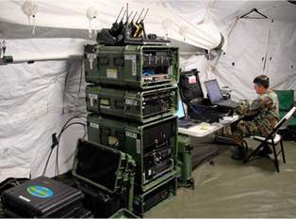
Introduction
Tactical wireless networks:
Mission-critical mobile ad-hoc networks.
Allows two-way communication for warfighters.
Unique challenges due to tactical requirements, e.g., reliability and security in hostile environment.

Slide 4
Introduction
Characters of tactical wireless network:
Nodes in the network are not homogenous.
Commanding and control nodes lead to a one-to-multiple communication model.

Slide 5
Research Question
How to detect and conceal the roles of nodes in tactical wireless networks?
Roles of nodes:
Commanding role: # of active network flow with other nodes exceeds a given threshold (not necessarily real commanders).
Acting role: otherwise.
Two-fold questions:
Whether we can accurately identify commanding nodes in a network from an adversary’s point of view.
Whether we can protect such nodes from being identified from a defender’s point of view.

Slide 6
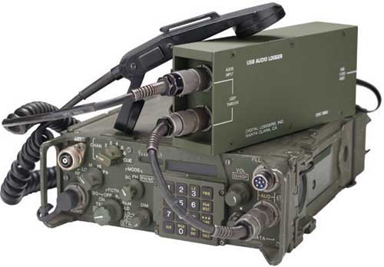
Contributions
Provide an initial study on role detection and concealment, which are important in tactical wireless networks.
Propose role detection and concealment methods and comprehensively evaluate their performance.

Slide 7
Introduction
System Models
Role Detection
Role Concealment
Conclusion

Slide 8
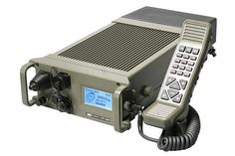
Network Model
Network Model
Consider a network with n nodes distributed on region $Ω={[0, \sqrt{n/λ}]}^{2}$ independently and uniformly.
Node density λ is large enough such that the network is connected.
Two nodes are connected if within each other’s transmission range r.

Slide 9
Roles of Nodes
Commanding and Acting roles:
A node is commanding if it has network flows with rates in rate region Σ to/from at least $n_{c}$ nodes.
For example, $Σ=[500Kbps, +∞)$, $n_{c}=10$.
A node is acting otherwise.
Mathematically representation:
$R_{i}=\left\{\begin{matrix}\begin{matrix}1 & if node i is commanding,\end{matrix} \\ \begin{matrix}0 & if node i is acting. \end{matrix}\end{matrix}\right.$
A role vector $R={\left[R_{1}, R_{2}, …,R_{n}\right]}^{T}$ contains roles of all nodes.

Slide 10
Adversary Model
Goal of attackers
To successfully detect the role of each node, i.e., $R$, within a sufficiently long time period.
Capability of attackers
Can overhear the data transmissions on each link.
Can estimate the transmission rate at each link.
Is aware of the network topology and knows the routing path between any source-destination pair.

Slide 11
Problem Statement
Role detection
The goal of the attacker is to find an estimate $\hat{R}$ which is close to the real role vector $R$.
In the best case, $\left\|\hat{R}−R\right\|$ should be minimized.
Role concealment
The goal of the defender is to make $R$ difficult be estimated.
In the best case, the probability that $\hat{R}=R$ should be 0.5, i.e., a random 0/1 guess.

Slide 12
Introduction
System Models
Role Detection
Role Concealment
Conclusion

Slide 13
Role Detection
Network tomography
A network with $n$ nodes has at most $\frac{n(n−1)}{2}$ undirected flows.
Estimate the real flow vector $x∈ℝ^{\frac{n(n−1)}{2}×1}$, from the observed link rate vector $y∈ℝ^{L×1}$, where $L$ is the p2p links in the network).
Linear relationship exist between $x$ and $y$:
$y=Ax$,
where $a_{i,j}$ is 1 if $i$-th link is on the routing path of flow $j$.

Slide 14
Detection Approach
Flow rate estimation
Make estimation $\hat{x}={[{\hat{x}}_{1},{\hat{x}}_{2},…,{\hat{x}}_{\frac{n(n−1)}{2}}]}^{T}$ to be close to the real value $x$.
Role detection
Estimate role of node $i$,
$\hat{R}=1_{\{\left(Σ_{f∈ℱ_{i}}1_{\{{\hat{x}}_{f}∈Σ_{1}\}}\right)≥σ_{2}\}}$,
where $Σ_{1}$is the rate threshold range, $σ_{2}$ is the threshold for role detection.

Slide 15
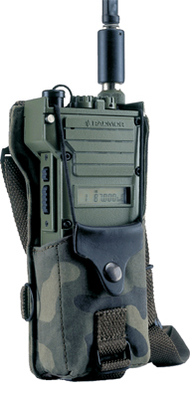
Evaluation
Simulation setup
100-nodes network with density 5;
Transmission range is normalized to 1;
2 commanding nodes and 98 acting nodes;
Commanding nodes communicates to 10 other nodes.
10 random acting to acting communication pairs.
Rate of each flow is random between 1M and 2M bps.

Slide 16
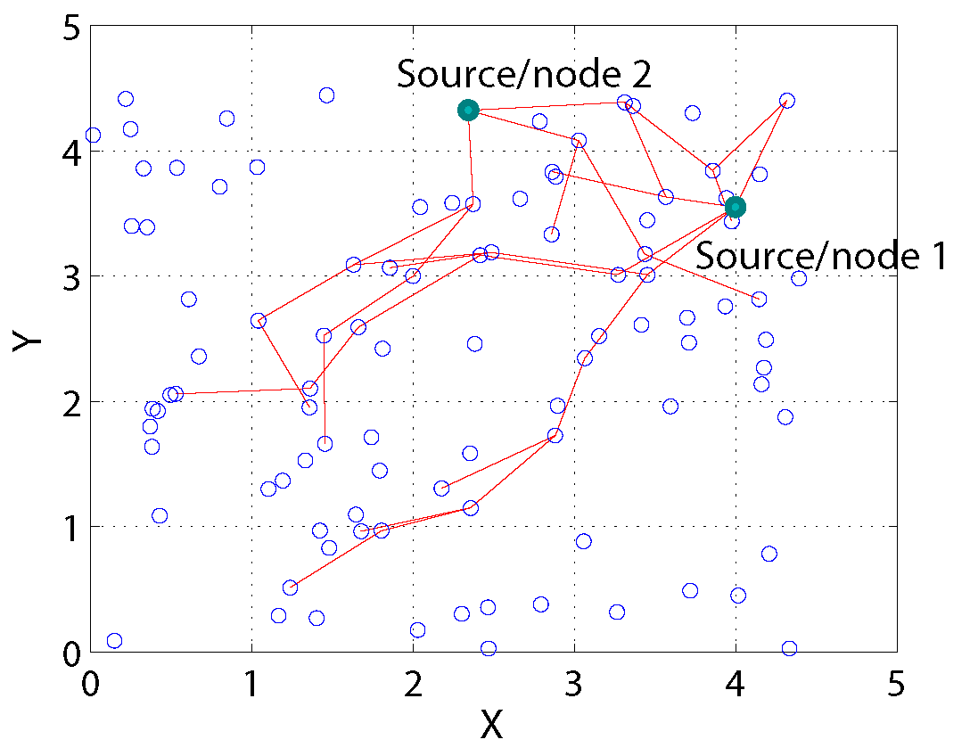
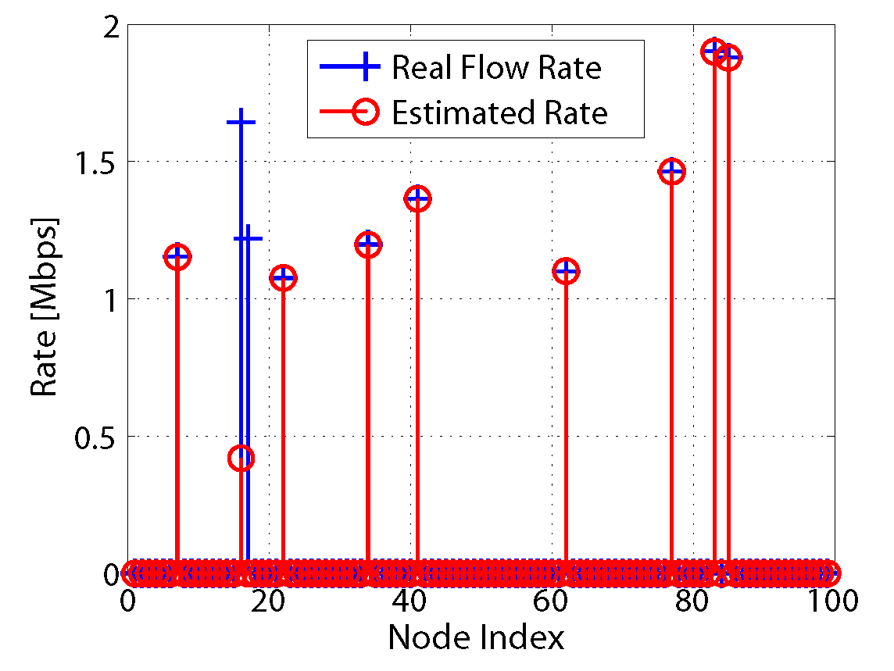
Evaluation
Result of flow rate estimation
Most of flow rates can be accurately estimated.
Proper thresholds can help in role detection.

Slide 17
Evaluation
Result of role detection
$Σ_{1}=[700Kbps, +∞)$, and $σ_{2}=7$.
Metrics:
Flow detection error rate.
Commanding role detection rate.
Commanding role false alarm.
Overall role detection error rate.

Slide 18
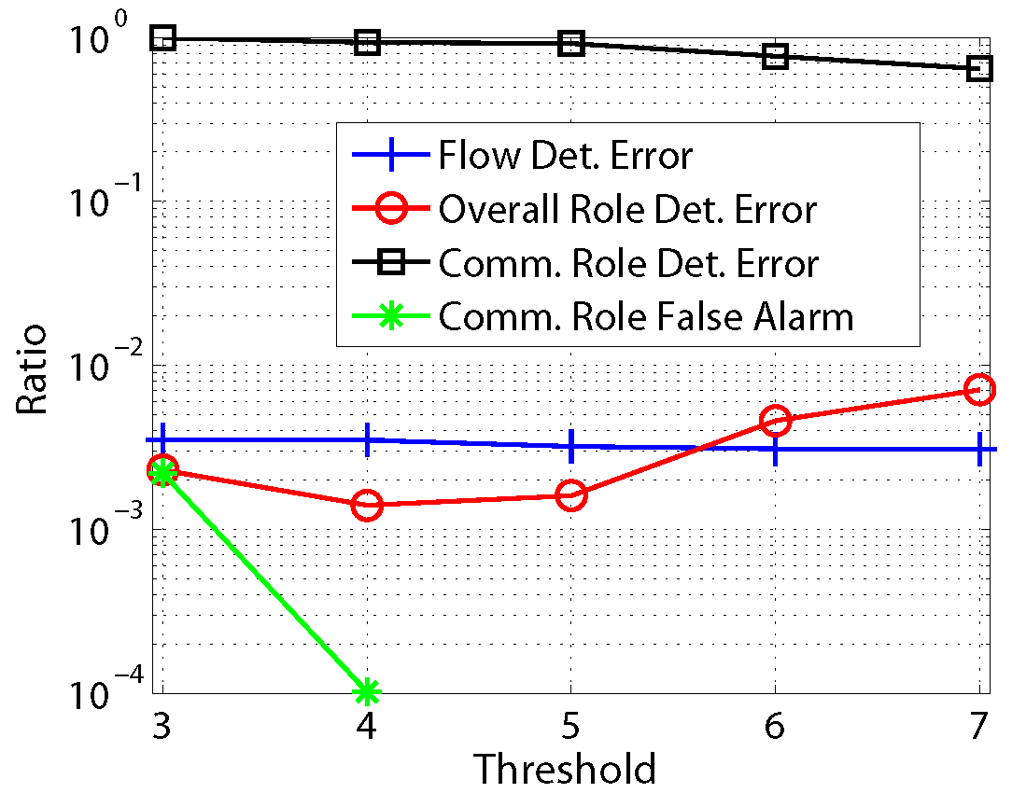

Evaluation
Impact of threshold $σ_{2}$
Keep $Σ_{1}=[700Kbps, +∞)$, and change $σ_{2}$ from 3 to 7.
$σ_{2}=5$ provides good performance (can be application specific as well).

Slide 19
Introduction
System Models
Role Detection
Role Concealment
Conclusion

Slide 20
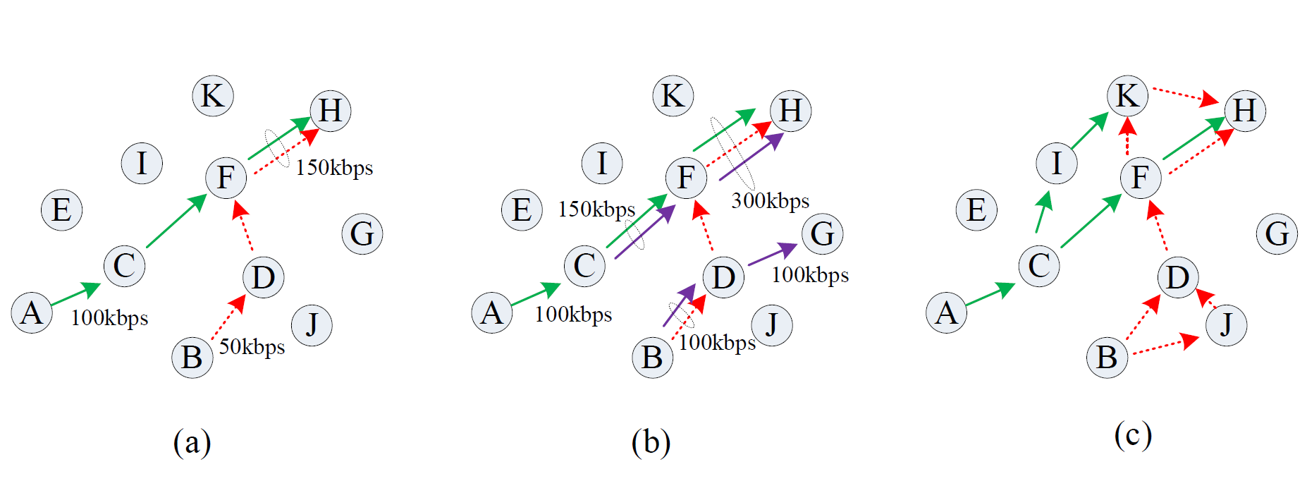
Role Concealment
Flow detection and countermeasure
a: normal network operation.
b: deception traffic.
c: changing routing strategies.

Slide 21
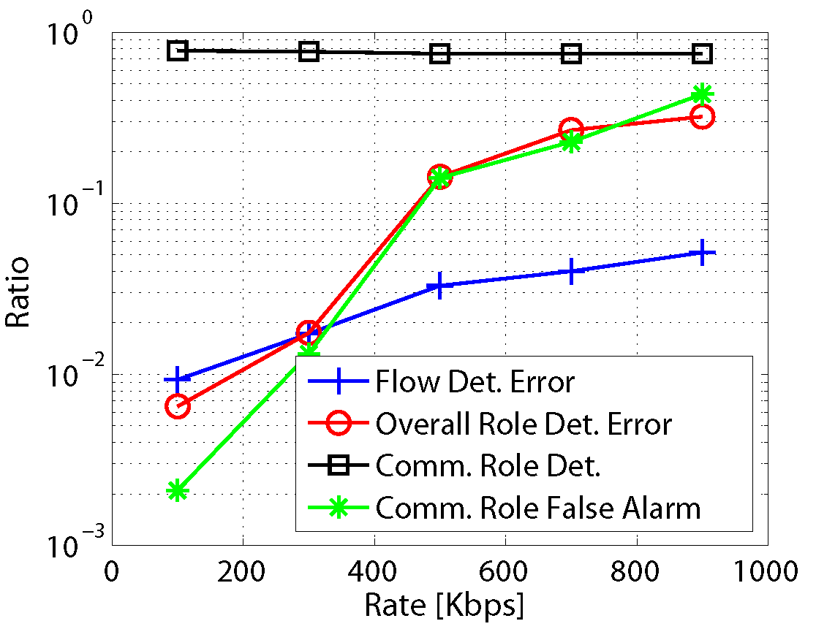
Evaluation
Deception traffic
Commanding role detection ratio ≈ 75%.
Commanding role false alarm rise to 43.5%.
Effective in conceal commanding roles.

Slide 22
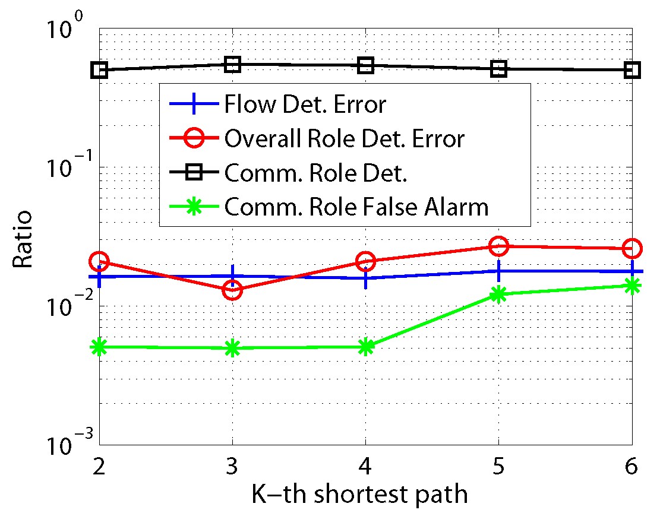
Evaluation
Routing changing
Use k-th shortest path, instead of the shortest path for routing.
Commanding role detection ratio ≈ 50%.
Delay degradation is notecible.

Slide 23
Introduction
System Models
Role Detection
Role Concealment
Conclusion

Slide 24
Conclusion
Role detection in tactical wireless networks
It is possible to identify critical role of nodes accurately.
Role concealment in tactical wireless networks
Deception traffic.
Routing changing.
Both can effectively conceal critical role of nodes with compromise in network performance.

Slide 25
Thank you!

