Slide 1

Greenbench: A Benchmark for Observing Power Grid Vulnerability Under Data-Centric Threats
Mingkui Wei, Wenye Wang
Department of Electrical and Computer Engineering
North Carolina State University
Presented by Mingkui Wei
IEEE INFOCOM 2014

Slide 2
Outline
Problem Statement
Greenbench: the Cross Domain Benchmark
Data-Centric Attacks Simulation and Evaluation
Conclusion

Slide 3
Outline
Problem Statement
Greenbench: the Cross Domain Benchmark
Data-Centric Attacks Simulation and Evaluation
Conclusion

Slide 4


Cyber Security in Smart Grid
Smart grid is susceptible to cyber attacks.
  Smart grid is an integration of communication networks and power grid.

Slide 5

Motivation
Questions 1
  What is the result of a jamming attack?
    Delayed or dropped messages
Question 2
  What is the result of a jamming attack
    ???
DoS? DDoS? Worm? Virus? Trojan? ……
Objective
  How to evaluate physical impacts in smart grid?
  What are the physical impacts caused by cyber attacks?
?
in Smart Grid?

Slide 6
Approach
How: Cross domain simulation
  Physical experiment
    Economically infeasible
    Power system can’t resist any disturbance
  Theoretical modeling
    Difficult to capture system dynamics
What: Data-centric threats
  Attacks focus on manipulate transmitted data
    Meter reading, control message, etc
  Covers most aspect of cyber threats
  Distorted or delayed data brings detrimental impact
    E.g., Critical control message delay < 3ms (IEC61850)

Slide 7
Outline
Problem Statement
Greenbench: the Cross Domain Benchmark
  Design Objectives & Challenges
  Greenbench Implementation
Data-Centric Attacks Simulation and Evaluation
Conclusion

Slide 8
Design Objectives
A Cross-domain simulation platform which is:
  Accurate:
    Accurate power device model (PSCAD)
    Accurate and standard communication protocols (OMNeT++)
  Extensible:
    Fit various system topologies
    Add and remove component with ease
  Efficient:
    As less overheads as possible (no external components)

Slide 9

Design Challenges
Synchronization
Data Exchange
Voltage is 1kV
I’ll send it to CC

Slide 10
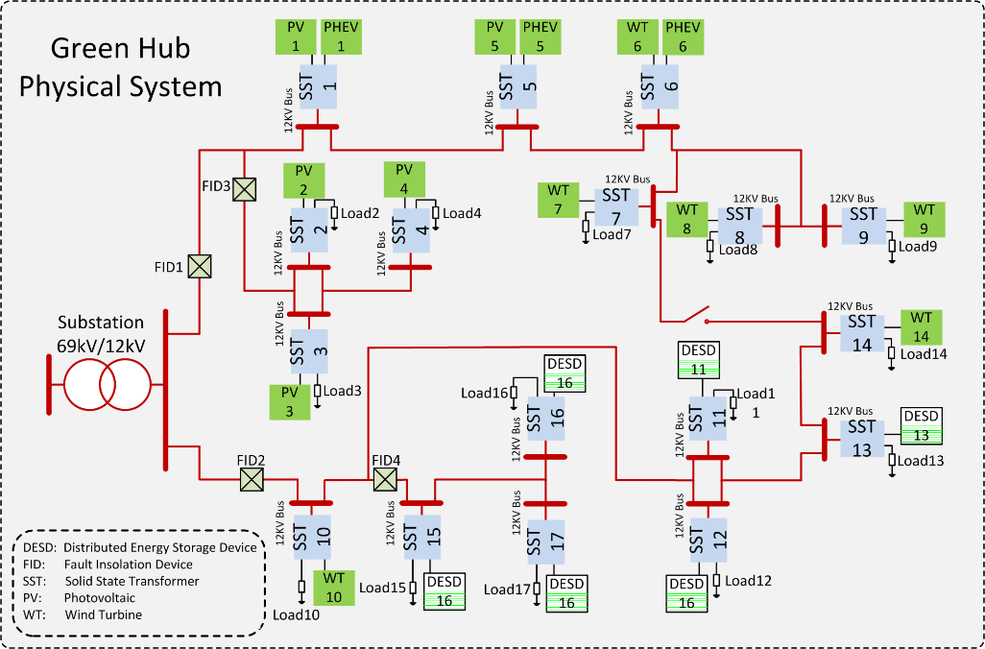
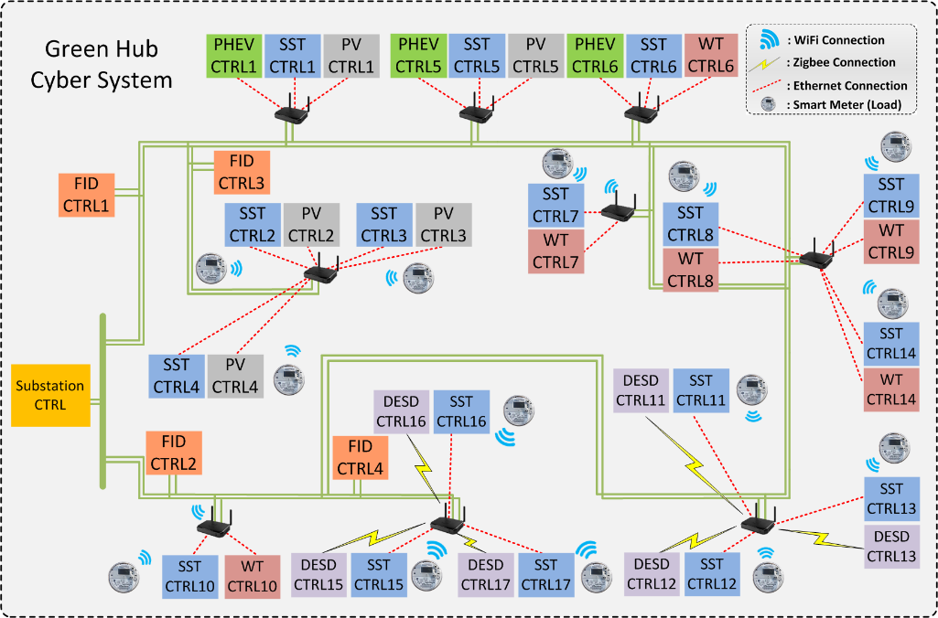

Greenbench Implementation
MSG
Error
C
C++
Distribution level micro-grid abstracted from real system.
17-bus, each bus connects renewable energy resources and loads.
Interactor
Built-in OMNet++
Notes:
Put animations to explain how an attack works(dr wang), need 1 min to explain

Slide 11
Outline
Problem Statement
Greenbench: the Cross Domain Benchmark
Data-Centric Attacks Simulation and Evaluation
    Delayed Price Message
    Forged Load Reading Message
    Overheard and Modified Monitoring Message
Conclusion
Notes:
After this slides, we should explain what is the data centric attack, instead of jumping to cases. (dr wang)
Rethink about the bullets (delayed price information – delayed message/distroed sth)

Slide 12
Data Centric Threats Re-visit
GSM
MSG
MSG
GSM
Eavesdropping /Forging(Confidentiality)
Message modification (Integrity)
Wireless jamming (Availability)
Notes:
Instead of explain cases, reader expected what is a data centric attacks and how it works, put maybe an animation to explain in general (dr wang)

Slide 13



Delayed Price Message
Jamming the price signal attack [Li’11]
  Load consumption is based on price
$
$$$

Slide 14
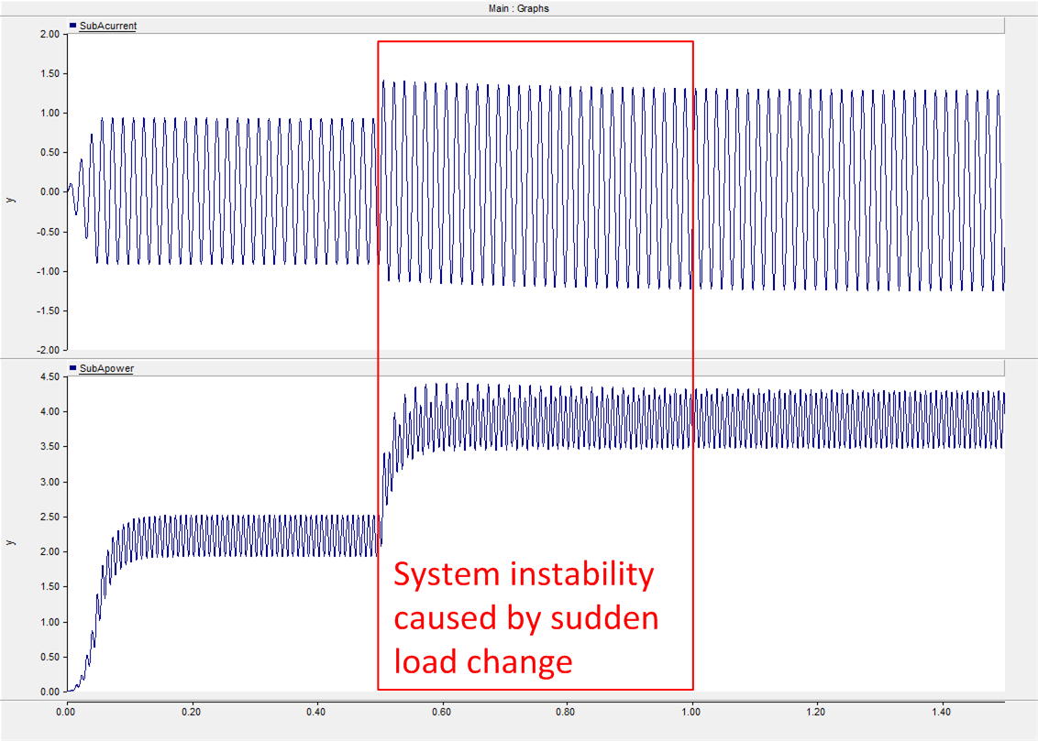
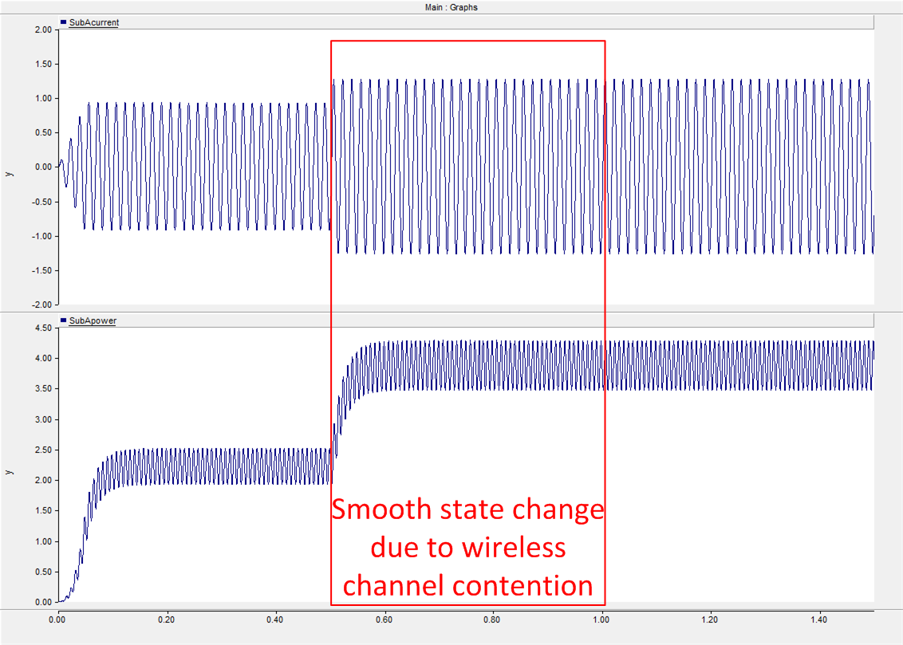
Simulation Result
Notes:
1. Assume there is not power usage when jamming (assume the extreme case)

Slide 15

Observation
It is not easy to impact system stability via compromised smart meters.
  Difficult to manipulate many smart meter at the same time.
  Milliseconds are long enough for power grid to prepare for sudden load change.

Slide 16
Forged Load Reading Message
False Data Injection Attack [Liu’09]
  Attacker is able to modify reading without being detected
Load Redistribution Attack [Yuan’11]
  Modify reading while keep overall power consumption unchanged

Slide 17
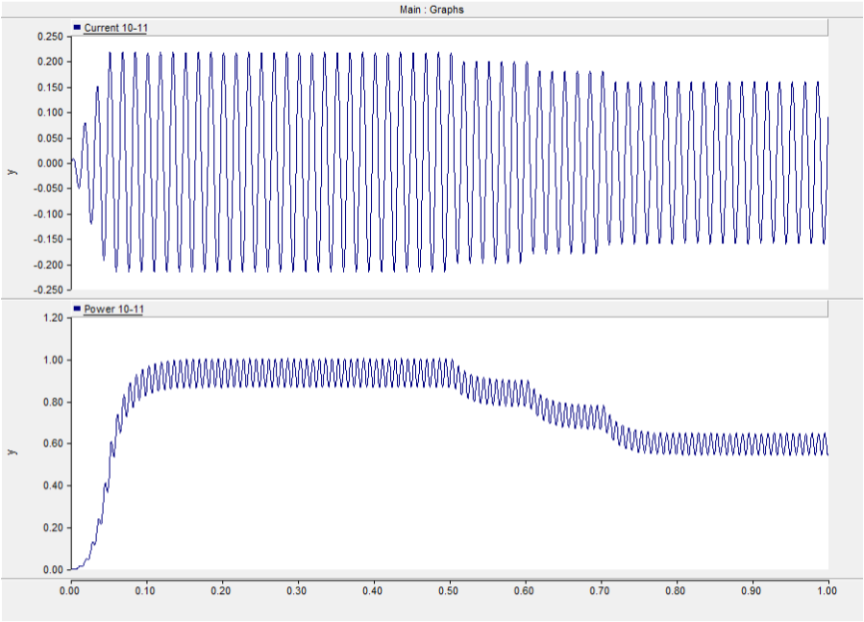
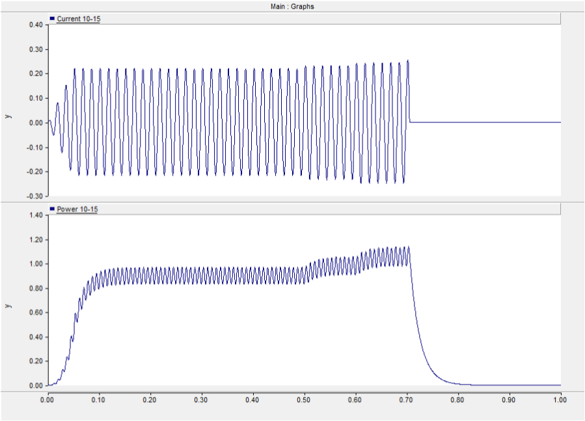
Distorted Load Reading
70%
Trip
Over
current
More
55%
Less
85%
253A
@0.7s
145%
115%
130%

Slide 18

Observation
Modify data is more dangerous than modify actual power consumption
  Modified data confuses the control center
  Data-centric attacks are more dangerous than physical sabotage
Protecting message authenticity is more important than protecting smart meter
  More effort on authenticate message and detect bad data

Slide 19
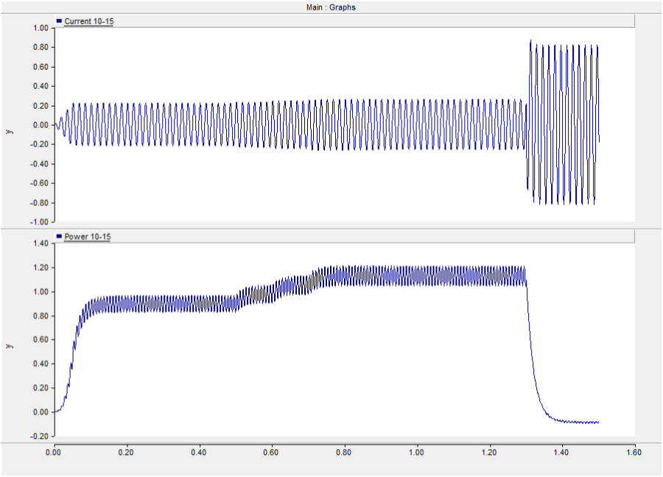
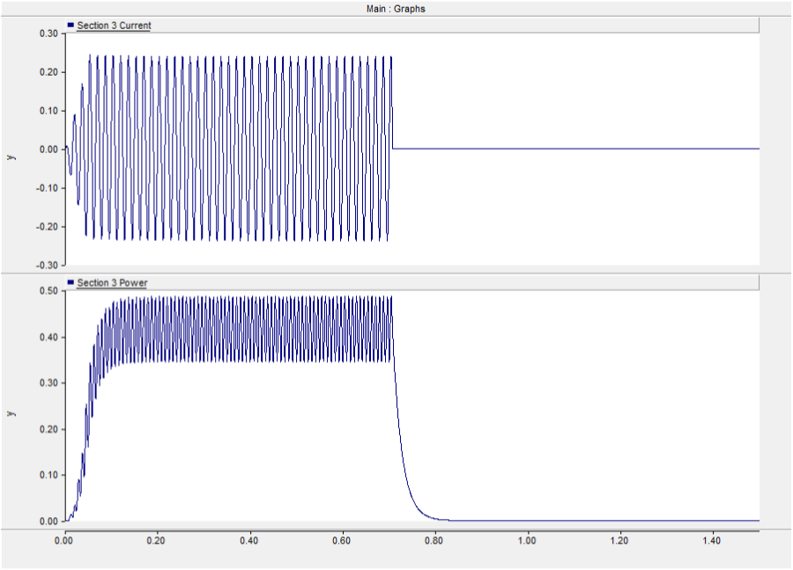
Overheard and Modified Message
Overcurrent
Fault
Trip 4
Over
Current
Trip 3
Circuit breaker tripped

Slide 20
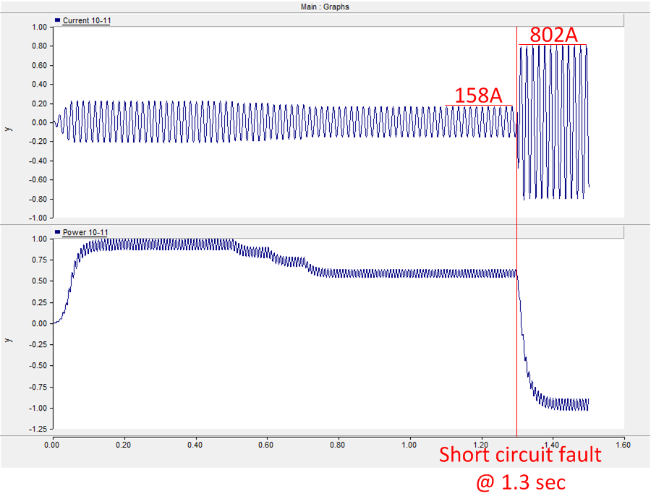
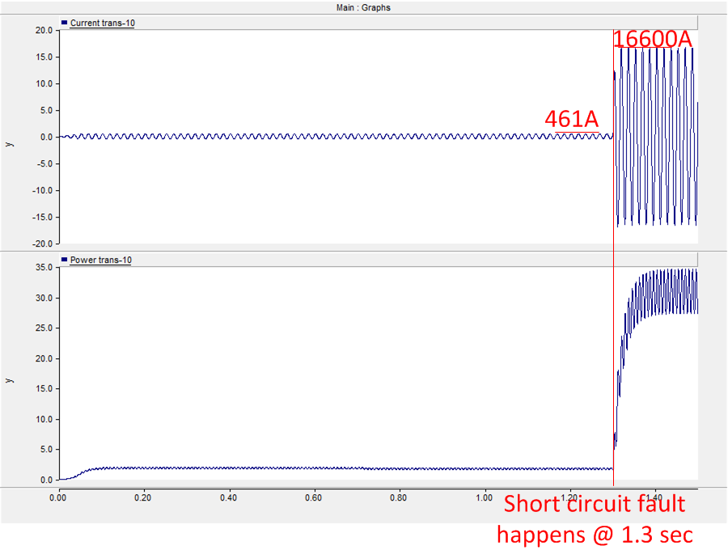
Simulation Result
Fault propagate and causes cascading failure
on other sections

Slide 21

Observation
Composite attack is much more dangerous than any single attack
Extra effort on making combination harder
  Different login/passwd on different devices
    Trivial? NO!
  Hierarchical security policy

Slide 22
Outline
Introduction
Greenbench: System Framework and Design
Delayed and Distorted Data-Centric Attacks
Conclusion

Slide 23



Conclusion
We built Greenbench, the cross domain simulation platform for smart grid cyber security simulation and evaluation.
Based on Greenbench, we use case studies to carry out evaluation of existing security issues and drew in-depth observations.

Slide 24

Thank you!

Slide 26
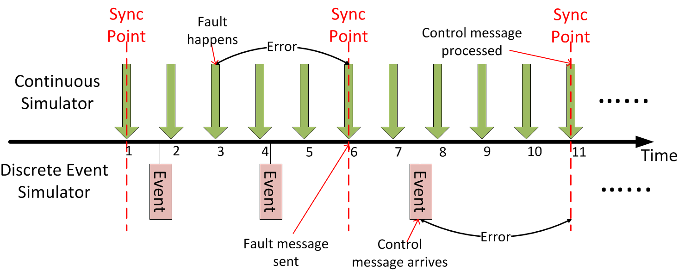
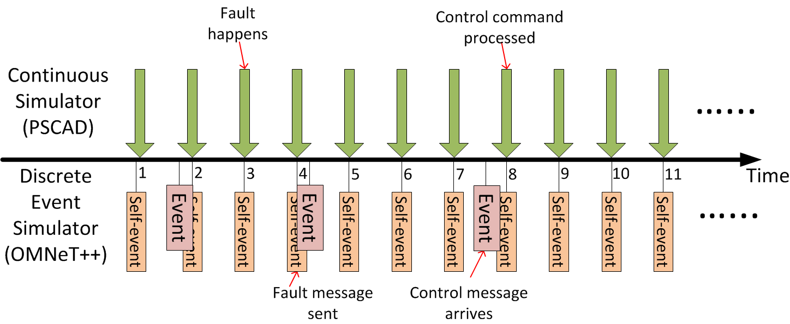
Implementation Challenges
Synchronization
Data Exchange
Voltage is 1kV
I’ll send it to CC

Slide 27
Implementation Challenges
Data Exchange
  C/C++ interface and Bufferfiles
OMNeT++
PSCAD
C
C++
V=110v

Slide 28
MSG
C
C++
Interactor

Slide 29
Forged Load Reading Message
False Data Injection Attack [Liu’09]
  Attacker is able to modify reading without being detected
Load Redistribution Attack [Yuan’11]
  Modify reading while keep overall power consumption unchanged (redistribution)
X+Δ
X
Σ=X+Y
Σ=X+Y
Y
Y-Δ

