Slide 1
Dynamic written corrective feedback: A tool to improve multilingual student writing
Anna S. Habib, Assistant Director of Composition; Term Assistant Professor, English
Paul Michiels, ESL Opt-In Coordinator, GMU Writing Center
Laurie Miller, Composition Course Coordinator, Undergraduate Pathways, INTO Mason

Slide 2
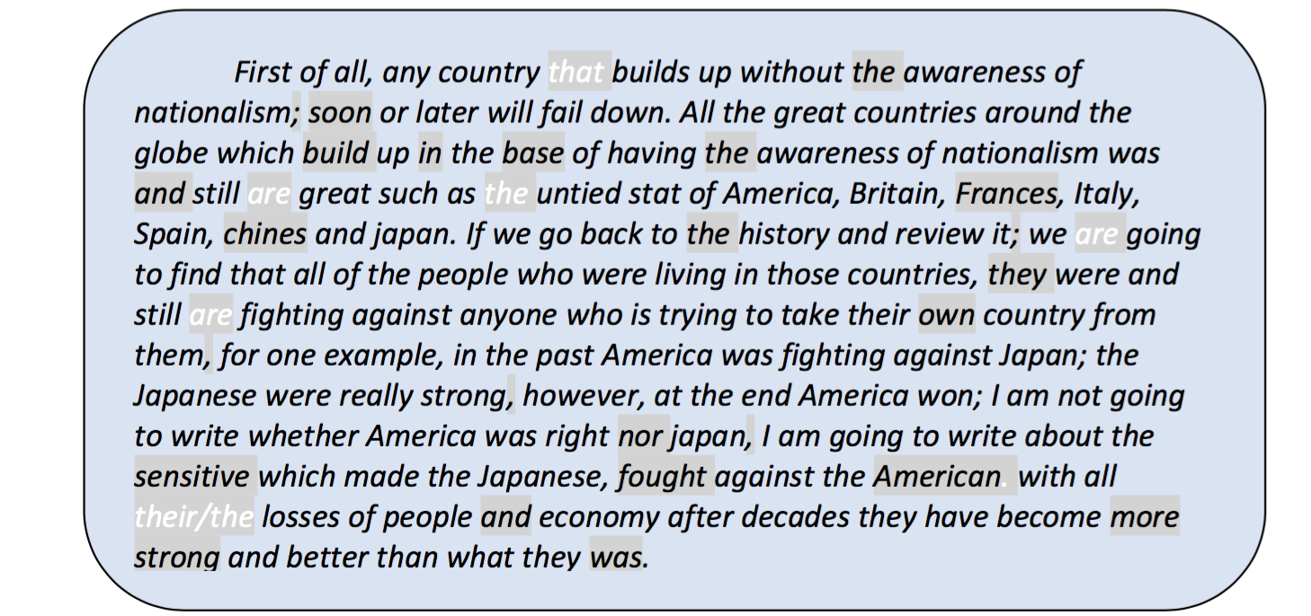
Do we have to correct every error in our multilingual student’s paper?
Notes:
If we ignore issues with writing etiquette (e.g. spelling, capitalization, and non-clausal commas), this paragraph has about 30 grammatical errors or approximately 1 error every 6 words—a fairly typical error rate for our students' proficiency level. Assuming a 750-word assignment, this error rate generalizes to about 125 errors per paper and 2500 errors over 20 papers. If this student spent just 1 minute addressing each error, then he or she would be dealing with accuracy for at least 2 hours. If we spent 10 seconds marking each error in all 20 papers, we would be dealing with errors for at least 6 hours. Both we and the student would be spending all this time to address just one aspect of writing in one assignment.

Slide 3
Dynamic Written Corrective Feedbacklll
(DWCF) - Benefits
Reduces faculty & student workload
Cultivates reflective learners & teachers
Lessens students' cognitive burden
  allowing for faster and longer-lasting uptake of relevant grammatical forms [or course concepts & skills] (Hartshorn et al., 2010)

Slide 4

Skill Acquisition Theory
Three stages of development
Declarative
“I have knowledge about the skill.”
Procedural
“I can act on my knowledge and turn it into behavior.”
Automatic
“I can do this without thinking about it; I am fluent, but sometimes I make errors.”
Practice, practice, practice

Slide 5
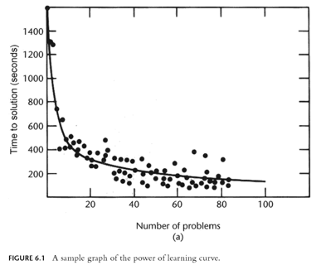
Moving towards skill …
Power law of learning

Slide 6
Traditional
Dynamic Written Corrective Feedback
meaningful
timely
constant
manageable

Slide 7
Not only accuracy ...
content
fluency
adequacy
complexity
concept development
… any discipline specific or independent skill area you want to target

Slide 8

Enacting DWCF
do less
praise with details
look past accuracy
require revision
be regular & frequent

Slide 9
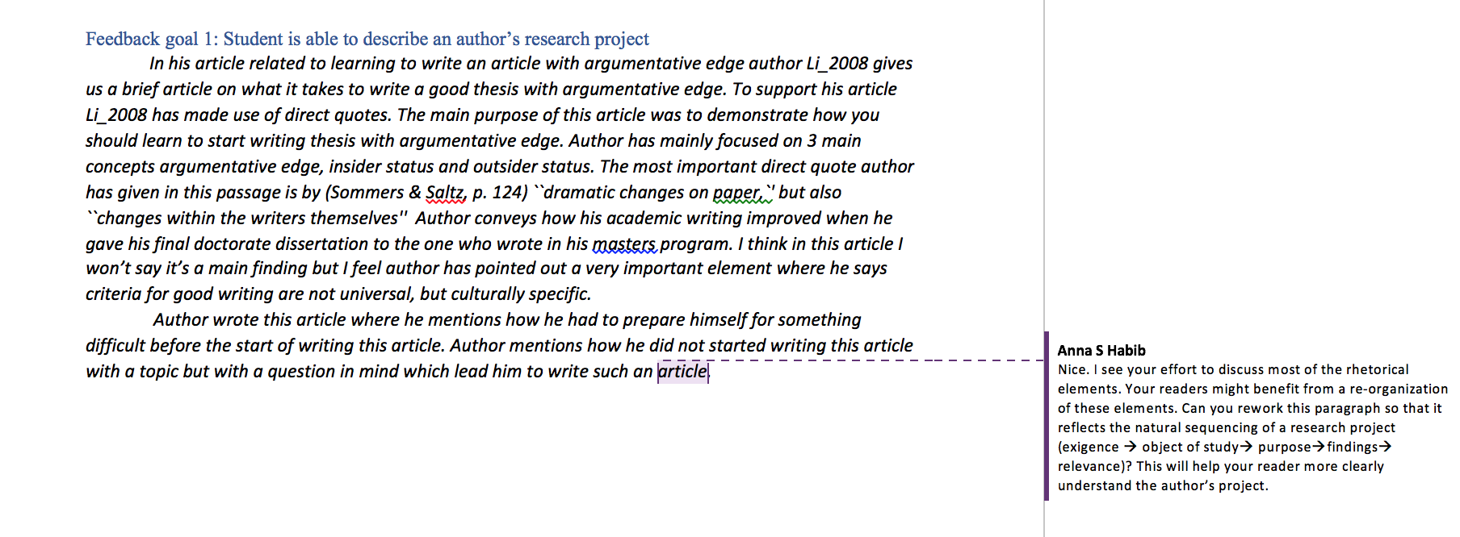
An example …..

Slide 10
Using DWCF in your course
THINK of YOUR MOST IMPORTANT WRITING ASSIGNMENT
What is one skill you would like students to take away from it?
FIT IN FEEDBACK
Think about how you can provide opportunities for students to receive feedback from you before they submit their final work.

Slide 11
“ Learners need endless feedback more than they need endless teaching.”
- Grant Wiggins

Slide 12
Thank you.
Presentation materials available at:
http://mason.gmu.edu/~llmiller/Presentations/2016.html

