Slide 1

Developing Evidence-Based Practitioners:
A Process for Improving a University Pre-Service Training Program
George Mason University
Kelley Regan (PI)
Kim Michaud
kregan@gmu.edu
kmichaud@gmu.edu

Slide 2
Context
325T personnel training improvement grant
  2008 cohort, completed Year 1-III.
Goal: to improve our training program to enable pre-service teachers in the field of SPED to acquire foundational, research, and practical skills through effective field experiences and through the application of current evidence-based practices for students with mild disabilities
Program for Students who Access the General Education Curriculum (mild disabilities); Licensure (33 credits), SPED MED (30 credits), Masters w/ licensure (39 credits)
~ 700 graduates per year
Adjuncts: ~ 30

Slide 3
Phase I: Developing a Process
Non-evaluative approach with a content analysis procedure (iterative analysis)
Sources initially included for Phase I:
    E-mail exchanges with faculty about defining EBPs and infusion of EBPs in Syllabi
    1:1 discussions with course leads of each course (i.e., what does the course cover as far as EBPs? What are the resources you selected and why?)
    Survey to 27 adjuncts (i.e., What degree of awareness do you have on the topic and critical issues of EBPs in the field of education? Your perceptions of our student’s degree of awareness…)
    Project personnel review most current course syllabi identifying threads and core assignments (signature assignments aligned with CEC)
    Review course Blackboard® (on-line) materials and resources maintained by leads
    Project Personnel develop Course summaries to be validated by course leads
    Monthly faculty meetings/discussions with 325T updates/themes which emerge

Slide 4
Challenges
How are you defining Evidence-based practices?
Generating Discussion for this topic.
Autonomy versus a ‘list’ of what works
The “So what?” factor (i.e., is this additive or transformative?)
What IS our goal for our graduates? What knowledge and skills do we prioritize?
Where are the redundancies across course content?
Where are the gaps across the program?
What is covered and to what degree/level is the learning?
Course DRIFT! So many courses, adjuncts, additions to syllabi: management is difficult

Slide 5
“Evidence-based practices are informed by research in which the
characteristics and consequences of environmental variables are empirically
established and the relationship directly informs what a practitioner can do to
produce a desired outcome.” (Dunst, Trivette, & Cupsek, 2002).
An evidence based practice is a decision-making approach that places
emphasis on using evidence to guide decisions about which interventions to
use and to evaluate the effectiveness of the intervention (Dietrich, Keyworth, &
States, 2005).
An evidence-based practitioner: An individual involved in interventions and
supports, Who identifies and uses evidence-based practices, and Deliberately
attends to the empirical basis for the practices they use (Strain, P. S. & Dunlap,
G., 2008).
Identifying practices that are evidence-based for students with disabilities is a
necessary but insufficient step in a process that we hope will culminate in the
consistent implementation of the most effective practices with fidelity, ultimately
resulting in improved outcomes for students with disabilities” (Cook,
Tankersley, & Landrum, 2009).
What is meant by evidence-based practices???!!!

Slide 6
Phase II: Developing Language of EBP
Faculty recommendation to insert on relevant courses, a common language to refine what the program means by evidence-based practices (EBPs)
Example from our Language Development and Reading course:
(Note: the terms in italics in first sentence vary across courses depending on threads of emphasis)
This course will incorporate the evidence-based practices (EBPs) relevant to the five essential elements of reading (i.e. NRP, 2000), language development, and informal literacy assessments. These EBPs are indicated with an asterisk (*) in this syllabus. Evidence for the selected research-based practices is informed by meta-analysis, literature reviews/synthesis, the technical assistance networks which provide web-based resources, and the national organizations whose mission is to support students with disabilities. We address both promising and emerging practices in the field of special education. This course will provide opportunities for students to take an active, decision-making role to thoughtfully select, modify, apply, and evaluate EBPs in order to improve outcomes for students with disabilities.

Slide 7
Phase III: Explicitly identify EBPs
Collected evidence (full citations)
for practices in areas of:
Math
Content Learning: History
Content Learning: Science
Foundational Reading
Secondary Reading
Inclusionary Practices
Assessment Practices
Behavior Practices
Writing Instruction
RESOURCES for Identifying Effective Practices From Technical assistance and dissemination projects; USDOE 1. Regional Resource and Federal Centers – The Federal Resource Center for Special Education (FRC) http://www.rrfcnetwork.org 2. Northeast Regional Resource Center (NERRC) 3. National Research Center on Learning Disabilities (NRCLD) http://www.nrcld.org 4. Technical Assistance Center on Social Emotional Intervention for Young Children (TACSEI) http://challengingbehavior.org 5. Access Center: Improving Outcomes for All Students k-8 http://www.kbaccesscenter.org 6. National Center on Student Progress Monitoring http://studentprogress.org 7. Center for Positive Behavioral Interventions and Supports (PBIS) http://www.pbis.org 8. The National Center on Response to Intervention (RTI) http://www.rti4success.org 9. Center on Instruction http://www.centeroninstruction.org 10. IRIS Center for Faculty Enhancement http://iris.peabody.vanderbilt.edu And…. 11. Current Practice Alerts http://teachingld.org 12. National Comprehensive Center for Teacher Quality – Innovation Configurations www.tqsource.org 13. Narrative reviews/Literature Reviews/Synthesis

Slide 8
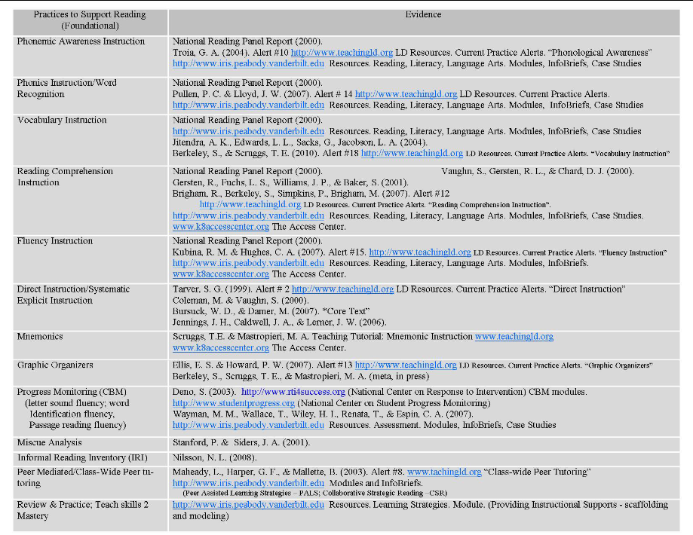

Slide 9
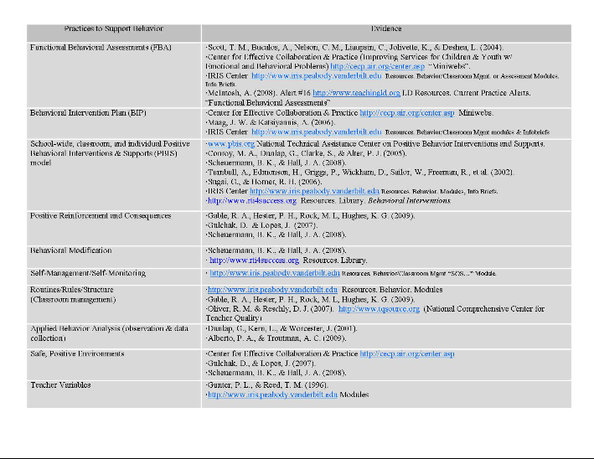

Slide 10
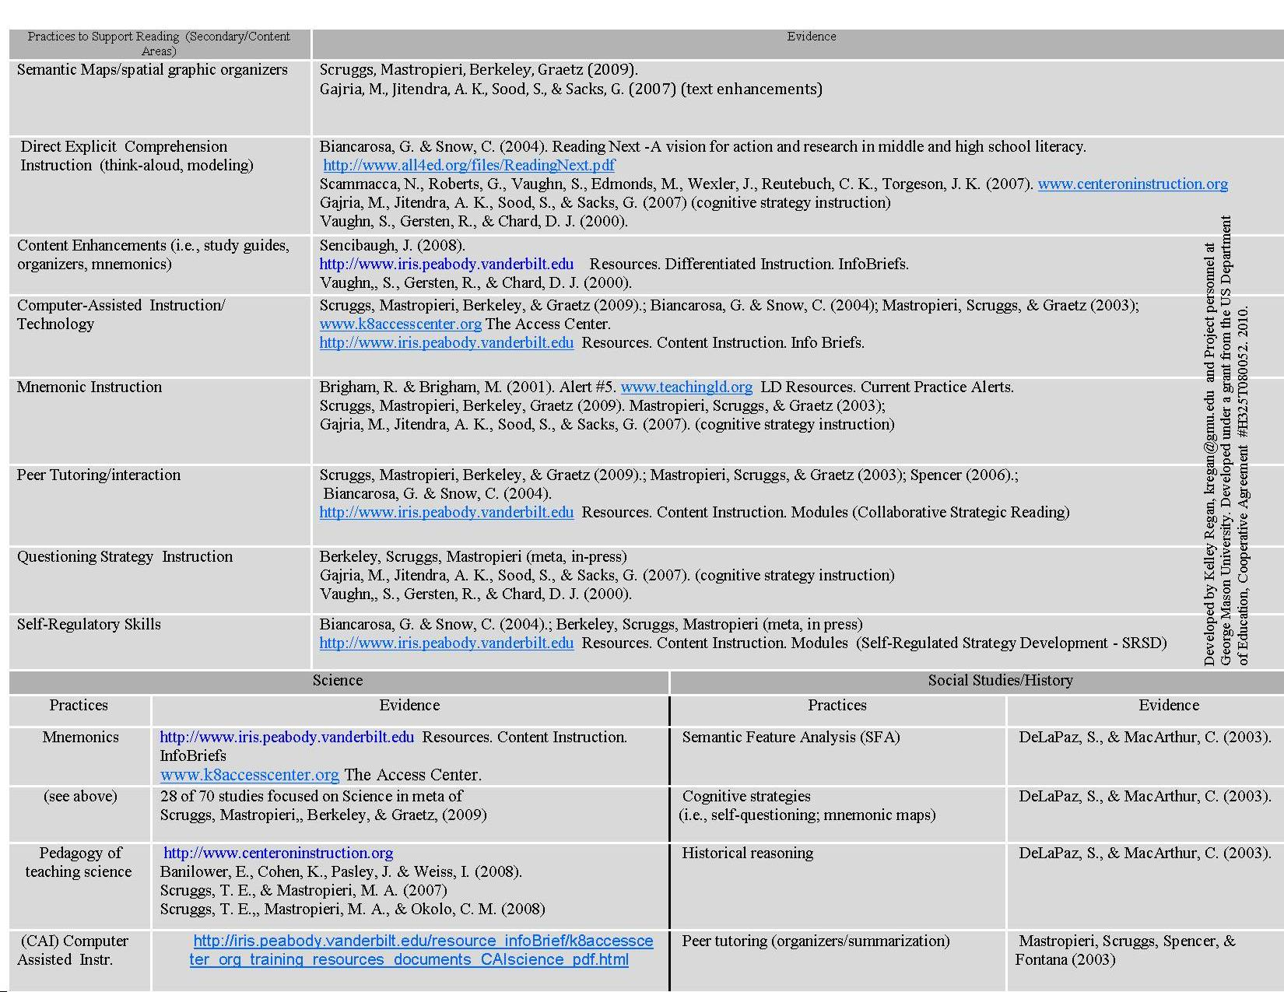

Slide 11
Phase IV: Degree of EBP emphasis
45 Evidence-Based Practices identified across Literacy, Instructional Strategies, Inclusionary Practices, Assessment, and Behavior.
EBPs then ‘fit into’ the relevant course (s)
Course leads of the relevant licensure classes rated the degree of coverage for EBPs:
NOTE: modified scale from Innovation Configuration Tools out of www.ncctq.org
To what degree are the 45 practices/items listed here generally
addressed in the identified course?

Slide 12
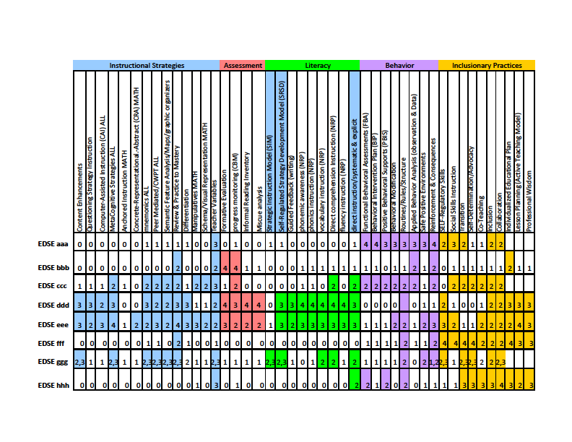

Slide 13
Phase V: Alignment across:
Courses →
Internship →
On the Job
Common language of EBP
Explicitness in course syllabi (citations)
Exposure to varying degrees of learning
Polished field experiences
What practices are not emphasized?
Redundancy??
Common language of EBP
Supervisor’s observation tool includes EBP terms
Are our students using these practices in the classroom?
Are our students evidence-based practitioners?
Common language of EBP
SURVEY of recent grads and alumni
Identify EBPs (knowledge)
What practices do you feel most comfortable identifying?
How well prepared do you think you were to perform as a special educator…..?

Slide 14
Thank you! kregan@gmu.edu kmichaud@gmu.edu
The contents of this power point presentation were developed under a grant from the US Department of Education, Cooperative Agreement #H325T080052. However, those contents do not necessarily represent the policy of the US Department of Education, and you should not assume endorsement by the Federal Government. Project Officer, Kelley S. Regan.

