Slide 1




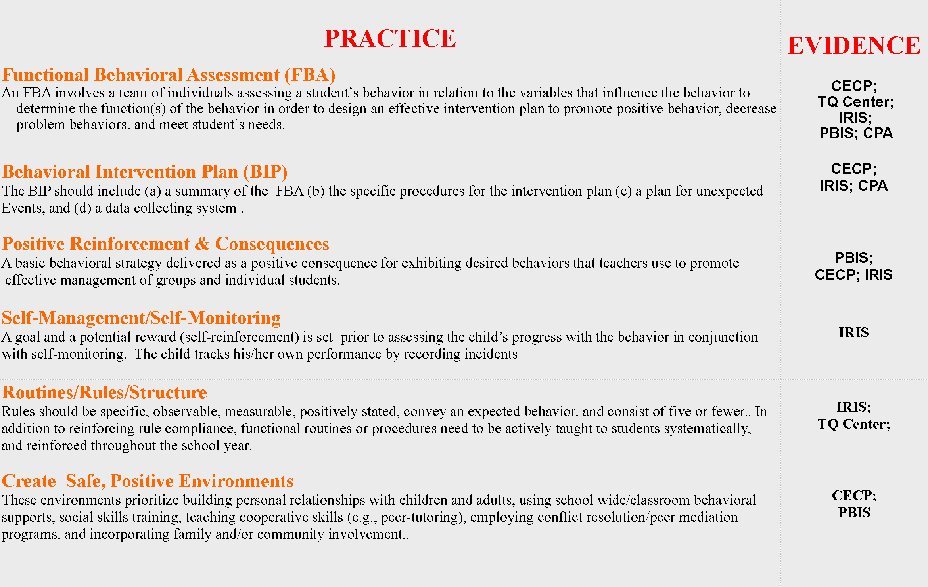



Identifying Best Practices for Managing Student Behaviors
Dr. Kelley Regan, Principal Investigator; Kim Michaud, M.A.
Department of Education 2008 Grant Recipient: 325T080052
CECP http://cecp.air.org/
The Center for Effective Collaboration & Practice:
Provides resources such as on-line discussions with experts in the field, e-mail listservs, fact sheets, national statistics, mini-webs, presentations, and publications from research-based and practitioner journals
Identifies EBPs: Uses ongoing iterative process of expert researchers, practitioners, family members, and consumers to determine EBPs
TQ Center http://www.tqsource.org/
The National Comprehensive Center for Teacher Quality:
Provides online resources, print and electronic products (e.g., research synthesis, innovation configuration (IC) rubrics, PowerPoint presentations, and technical assistance resources.
Identifies EBPs: Uses (a) relevance of research, (b) research participants, (c) research apparatus, (d) research procedure, and (e) research findings and conclusions of either qualitative or quantitative
reports to determine either scientific or rigorous EBPs.
IRIS
http://www.iris.peabody.vanderbilt.edu
The IRIS (IDEA and Research for Inclusive Settings) Center:
Provides free online interactive resources in the form of engaging self-paced modules, case studies, information briefs, activities, and podcasts which translate research into practice for teachers, family members, researchers, mental health professionals, and other educators who work with students with disabilities.
Identifies EBPs: Uses standards that are applicable from four different organizations in order to determine best practice: (a) National Council for Accreditation of Teacher Education (NCATE), (b) State Performance Plan Indicators (SPP), (c) Interstate New Teacher Assessment and Support Consortium (INTASC),
and the (d) Council for Exception Children (CEC).
Current Practice Alerts
http://www.dldcec.org
Teaching LD (learning disabilities) Current Practice Alerts:
One of the first organizations to endorse EBPs, providing the field of special education with evaluative descriptions of professional practices (i.e., Current Practice Alerts) which impact academic and behavioral student performance.
Identifies EBPs: Uses (a) relevance of research, (b) research participants, (c) research apparatus, (d) research procedure, and (e) research findings
and conclusions. To determine either solid justification of
effectiveness or incomplete justification for EBPs.
PBIS http://www.pbis.org
Technical Assistance Center on Positive Behavioral Interventions and Supports
The Center provides topical videos, podcasts, a resource catalogue, training manuals, presentation resources, PBIS Blueprints, and a PBIS State coordinator network. to provide schools with information and technical assistance so that they can better identify, adapt, and sustain effective school-wide disciplinary practices
Identifies EBPs: Utilizes the EBP standards that were defined in the special section of
Exceptional Children (Odom et al., 2005) in order to determine the
appropriateness of interventions
.
Regan, K, & Michaud, K. (in press). Best practices to support student behavior. Beyond Behavior.

