Slide 1
Social Stories
Kim M. Michaud
April 14, 2011

Slide 2
Ten Fundamentals to Include
A Social Story meaningfully shares social information in a patient, reassuring way
For every Social Story which instructs, one should be written to acknowledge/affirm what student does well
A Social Story seeks to support more effective responses, not change behavior

Slide 3
A Social Story has an Introduction that clearly identifies the topic, a Body that adds detail, and a Conclusion that reinforces and summarizes the information
A Social Story answers “wh” questions
When & where the situation occurs
Who is involved
How events are sequenced
What occurs
Why this is expected
* Note: What cues or concepts may the student have missed*

Slide 4
A Social Story is written from a first or third person perspective
In general, write in third person for older students, but that depends
If written in the first person it must be accurate
Can be written like a newspaper article as a Social Article
A Social Story uses positive language
Keeps the student’s self esteem safe
e.g. “Sometimes people make mistakes. That is ok.”

Slide 5
A Social Story always contains descriptive sentences and may include one or more of the five sentence types:

Slide 6
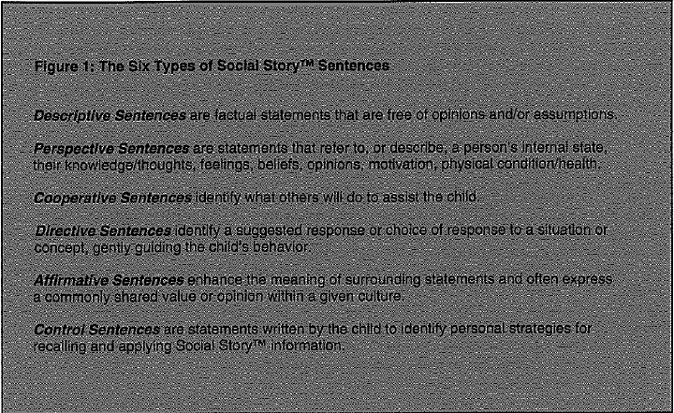

Slide 7
A Social Story describes more than directs following the Social Story Formula :
Describe/Direct ≥ 2

Slide 8
A Social Story has an “individualized fit,” tailored to the interests and abilities of the student
Length
Vocabulary
Sentence structure et al.
A Social Story may have individualized illustrations that enhance the meaning of the text

Slide 9
The Social Story title begins teaching positively identifying the main topic in a style and format consistent with the text and illustrations that follow.
Example: “Sticky Thinking” Handout

Slide 10
References
Grey, C. (2004). Social stories 10.0: The new defining criteria and guidelines. Retrieved from http://www.thegraycenter.org/social-stories/how-to-write-social-stories
Sticky thoughts. Retrieved from http://www.thewatsoninstitute.org/index.jsp

Slide 11
Other Resources
Kansas Instructional Support Network. http://kansasasd.com/node/9
WV Autism Training Center http://www.marshall.edu/atc/content/college-program.php

