Slide 1
Positive Reinforcement
Kim Michaud
April 21, 2011

Slide 2
Positive consequences reinforce desired behavior
Tangible – can see, hold, and understand as a reward
Social – acknowledge appropriate behavior or goal achievement
Activities – privilege earned for desired behavior
Intrinsic – the individual is self-rewarded for meeting a goal/performing behavior

Slide 3
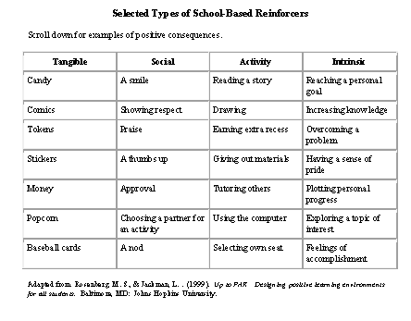

Slide 4
PBIS School-wide Acknowledgement Matrix (Student and Staff!)
TYPE | WHAT | WHEN | WHERE | WHO
Immediate/High Frequency In the moment, predictable (e.g., Gotchas, Paws, High Fives) | KIDS: ADULTS: | High frequency for a short time when first teaching desired behavior or re-teaching identified problem behavior from data |  | ALL KIDS, ALL STAFF
Redemption of high frequency (e.g., school store, drawings) | KIDS: ADULTS: | At least monthly |  | ALL KIDS. ALL STAFF
Intermittent/Unpredictable (e.g., surprise homework completion treat, random use of gotchas in hallway) | KIDS: ADULTS: | Maintaining a taught behavior (fading) |  | ALL KIDS, ALL STAFF
Long-term School-wide Celebrations (school-wide not individually based) FOR: Ex: ODR reduction, school-wide target met for certain setting/behavior area ACTIVITY: (e.g., ice cream social, dance, game day) | BOTH TOGETHER: | At least quarterly |  | ALL KIDS, ALL STAFF

Slide 5
Over time, move from:
Other-delivered to self-delivered (extrinsic vs. intrinsic motivation)
Highly frequent to less frequent
Predictable to unpredictable
Tangible to social
Individualize for students needing greater support systems

Slide 6
Self-Monitoring
Student(s) agrees to keep track
Develop easy tally or tracking system
Instructor and student validate

Slide 7
References
Gable, R., Hester, P., Rock, M., & Hughes, K. (2009). Back to basics: Rules, praise, ignoring, and reprimands revisited. Intervention in School and Clinic, 44(4), 195-205. doi:10.1177/1053451208328831
Gable, R. A., Quinn, M. M., Rutherford, B. B., Howell, K. W., Hoffman, C. C. (2000). Addressing Student Problem Behavior – Part III: Creating Positive Behavioral Intervention Plans and Supports [Monograph]. Retrieved from http://cecp.air.org/fba
The IRIS Center for Training Enhancements. (2009b). Who’s in Charge? Developing a Comprehensive Behavior Management System. Retrieved on February 6, 2011 from http://iris.peabody.vanderbilt.edu/parmod/chalcycle/htm

Slide 8
References
The IRIS Center for Training Enhancements. (2008). SOS: Helping students become independent learners. Retrieved on February 2, 2011 from http://iris.peabody.vanderbilt.edu/sr/chalcycle.htm
Technical Assistance Center on Positive Behavioral Interventions and Supports. http://www.pbis.org
Scheuermann, B. K. & Hall, J. A. (2008). Positive behavioral supports for the classroom. Upper Saddle River, NJ: Pearson Education, Inc.

