Slide 1
Mastery Learning: A Motivation Enhancing Strategy – Pros and Cons
Kim M. Michaud
EDEP 551
April 28, 2010

Slide 2
Cognitive Evaluation Theory
Enhances achievement motivation
Specific nonnormative feedback regarding task performance – informational not controlling
Enhances perceptions of internal control/autonomy
Gives students choices e.g. opportunities to redo/retest
Social Learning Theory
Enhances personal efficacy through self-evaluative goal setting
Sets specific, proximal subgoals

Slide 3
Attribution Theory
Success is changeable and controlled by individual through effort and strategy use
Emphasizes role of effort in achievement and individual progress, not competition with others
Self-Worth Theory
Allows students to approach success and avoid failure to protect self-worth
Opportunities to choose and strive for grade level
by retesting until desired criterion or retesting opportunities are exhausted

Slide 4
Meets Motivational Goal Theories (continued)

Slide 5
Strategy’s goals *from: Block, J.H. (1971)
Student graded solely on the basis of final (summative) examination performance
Student graded on performance based on predetermined standard not relative to peers
All students who attain standard will receive appropriate grade (usually A’s)
Student given series of ungraded (formative) diagnostic –progress tests
Each student given all help necessary to learn – variety of correctives available

Slide 6
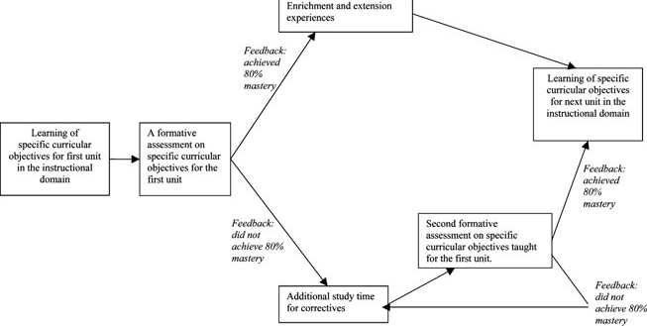
A Flow Diagram of Mastery LearningTests and Adaptive Instruction * Figure 1: Zimmerman B.J. & Dibenedetto (2008)

Slide 7
A Strategy that Meets
Motivational Theory
Goals
* from: Karita, J. & Zarbatany, L. (1991)

Slide 8
Madeleine Hunter’s Lesson Design
(www.raider.muc.edu)
1. Anticipatory Set (focus) - A short activity or prompt that focuses the students' attention
before the actual lesson begins.
2. Purpose (objective) - The purpose of today's lesson, why the students need to learn it,
what they will be able to "do", and how they will show learning as a result are made
clear by the teacher.
3. Input - The vocabulary, skills, and concepts the teacher will impart to the students- the
“stuff" the kids need to know in order to be successful.
4. Modeling (show) - The teacher shows in graphic form or demonstrates what the
finished product looks like - a picture worth a thousand words.
5. Guided Practice (follow me) - The teacher leads the students through the steps
necessary to perform the skill using the trimodal approach - hear/see/do.
6. Checking For Understanding (CFU) - The teacher uses a variety of questioning
strategies to determine "Got it yet?" and to pace the lesson - move forward?/back up?
7. Independent Practice - The teacher releases students to practice on their own based on
#3 - #6.
8. Closure - A review or wrap-up of the lesson - "Tell me/show me what you learned today”

Slide 9
Bloom’s Taxonomy http://www.odu.edu/educ/roverbau/Bloom/blooms_taxonomy.htm
Remembering: can the student recall or remember the information? | define, duplicate, list, memorize, recall, repeat, reproduce state
Understanding: can the student explain ideas or concepts? | classify, describe, discuss, explain, identify, locate, recognize, report, select, translate, paraphrase
Applying: can the student use the information in a new way? | choose, demonstrate, dramatize, employ, illustrate, interpret, operate, schedule, sketch, solve, use, write.
Analyzing: can the student distinguish between the different parts? | appraise, compare, contrast, criticize, differentiate, discriminate, distinguish, examine, experiment, question, test.

Slide 10
Evaluating: can the student justify a stand or decision? | appraise, argue, defend, judge, select, support, value, evaluate
Creating: can the student create new product or point of view? | assemble, construct, create, design, develop, formulate, write.

Slide 11
Bloom’s Mastery Learning Model (1968)
Define Mastery
Plan for Mastery
Teach for Mastery
Grade for Mastery
> 90% students achieve @ top 10%

Slide 12
Type | Support | Limits | Past 10+ | Present 10-
Meta analysis (46 studies) | X |  |  | X
Empirical |  | X |  | X
Empirical | X |  |  | X
Meta analysis(27 studies) | X |  | X
Descriptive (3,000 schools in 15 years) | X |  | X
Descriptive (small school system) | X | X | X
Empirical | X |  |  | X
Critique |  | X |  | X
Descriptive (high Stakes) | X |  |  | X
Descriptive(2 school districts) | X |  | X

Slide 13
Type | Support | Limit | Past 10+ | Present 10-
Descriptive |  | X | X
Empirical | X |  | X
Descriptive | X |  |  | X
Descriptive | X |  | X
Descriptive | X |  | X
Resource | X |  |  | X
Resource | X |  | X
Resource | X |  | X

Slide 14
References
Forthcoming

