Slide 1
Pilot research study
Ernest Solar
EDRS 821 – Spring 2011

Slide 2
Brief overview
John’s Hopkins University conducted an 8-week study to measure the effectiveness of Mindfulness-Based Stress Reduction (MBSR) on 40 middle-school students in a urban setting.
One of the measurement tools was the Teacher Observation of Classroom Adaptation – Checklist (TOCA).
Survey form completed by teachers who observe students in the classroom.
Measures:
Concentration Problems (CP)
Disruptive Behaviors (DB)
Prosocial Behavior (PS)
The TOCA was administered during the pre-treatment, post-treatment, and follow-up phase of the study.

Slide 3
Research Question #1
The researchers seek to determine whether the treatment conditions (Control and Treatment) produced differences in the students performance on a set of behavior skills (CP, DB, PS).
Pearsons correlations suggested that one pair of the three variables was statistically significant.
MANOVA indicated that there is NOT a statistically significant difference between at least two groups on some linear combinations of the three variables.
Wilk’s lambda = .88, F(3,28) = 1.26, p = .307
Box’s M (17,1) was statistically significant indicating that the assumption of equal variance-covariance matrices was not met.
X² (6) = 15.2, p = .018

Slide 4
Research Question #2
The researchers seek to determine if there is a change in questioned behaviors (CP, DB, PS) over time due to the MBSR intervention that was implemented.
ANOVA Repeated Measures indicate:
A slight decrease in Concentration Problems from the post-treatment vs. pre-treatment and follow-up treatment vs. pre-treatment.
There was no difference in Disruptive Behaviors from the post-treatment vs. pre-treatment and follow-up treatment vs. pre-treatment.
There was an increase in Prosocial Behavior from the post-treatment vs. pre-treatment and follow-up treatment vs. pre-treatment.

Slide 5
Research Question #3
The researchers seek to determine the number of factors that underlie the relationships within the TOCA-C survey.
An Exploratory Factor Analysis was conducted to determine the number of factors affected the relationships within the TOCA-C
The results indicate three factors using the principal component analysis with varimax rotation.
The following factors account for the total variance:
First factor = 42% (Concentration Problems)
Second Factor = 19% (Prosocial Behavior)
Third Factor = 9% (Disruptive Behavior)
These factors account for 70% of the total variance

Slide 6
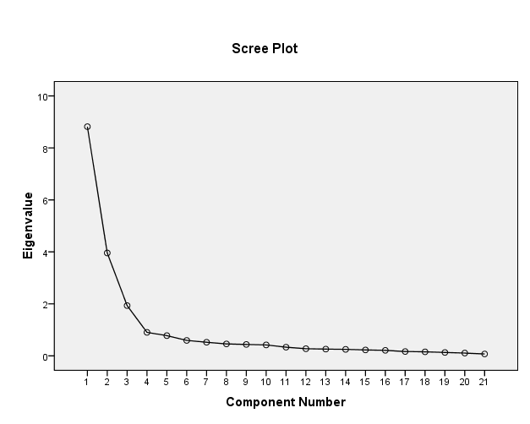
Research Question #3 - Continued
Root ≥ 1 Criteria
Factor 1 = 8.8
Factor 2 = 4.0
Factor 3 = 1.9

Slide 7
????? Questions and comments ?????

