Slide 1
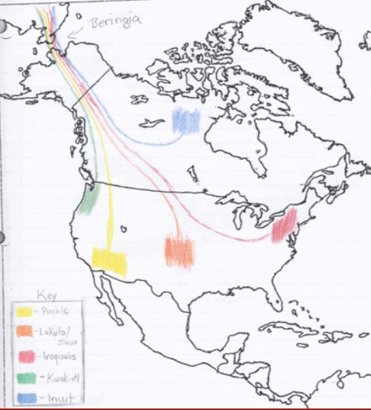
See if you can guess the right First American family. Then click on a color to find out more about the people who lived there

Slide 2
Pueblo
Name the region and describe:
Resource information
Type of house
Back to map

Slide 3
Pueblo
List an example of a:
Natural Resource
Human Resource
Capital Resource
Back to map

Slide 4
Pueblo
Name the type of house this family built and describe it:
Back to map

Slide 5
Back to map

Slide 6
Back to map

Slide 7
Back to map

Slide 8
Back to map

