Slide 1

Can I Copy Google Images?
Please say yes!
Notes:
At a county staff development several years back, (back when there were funds to bring people in) I attended a presentation by John Golden, author of Reading in the Dark. His book makes a great case about using film in teaching literature and reading strategies. A teacher asked “But what about copyright?” He said “Look, we’re English teachers. We are all going to copyright hell anyway.” He was being humorous and did make the point that obviously copyright law needs to be followed. Most of us desire to be law-abiding citizens. But with all the new media and electronic teaching methods, how do I know what the law is. I’m glad you asked, bur first, a story.

Slide 2



First, a story
Notes:
There were 2 neighbors. Both had their own fantastic idea of how they were going to make money.

Slide 3


Notes:
They both worked hard for a whole week. The first man made a beautiful chair. The second man made a beautiful song and recorded it on a CD. Both planned to sell their creations.

Slide 4

Notes:
The first man sold his chair for $100.

Slide 5

Notes:
The second man had a line of people who all were going to pay $5 for his song. However, when the first person bought the CD, she announced to everyone else in line that she would just email them a copy. They didn’t have to spend money on it. The line disappeared and the man only made $5 for all his work. Yet many people got to enjoy the fruits of his work. Was that fair?.

Slide 6


Notes:
The second man didn’t think so. He was mad that he had lost a lot of money. He filed a lawsuit accusing the person of stealing. But did the person really steal? After all, she did pay the $5.

Slide 7

YES
Guilty of stealing
Intellectual Property
Notes:
The judge said Yes! The person was guilty of stealing the profits the person could have made on their intellectual property.

Slide 8
But that is just a story, right?
As teachers, we are EXEMPT from copyright law, right?
Notes:
Thinking twice now about sharing those songs, movies, books? But, wait you say. I can see that point in the commercial market, but this is about computer use in the educational environment. We are exempt. What about Fair Use?

Slide 9
"The fair use doctrine, established in a long line of court cases, provides a limited basis by which people can use a copyrighted work without getting permission from the creator. The essence of the fair use doctrine is that a person is not using the work in such a manner that is, or has the potential of, diverting income from the creator.”
Former copyright attorney Nancy Willard in an interview with Education World web site
Notes:
"The fair use doctrine, established in a long line of court cases, provides a limited basis by which people can use a copyrighted work without getting permission from the creator. The essence of the fair use doctrine is that a person is not using the work in such a manner that is, or has the potential of, diverting income from the creator,” said former copyright attorney Nancy Willard in an interview with the world site Education World. See, Nancy agrees with me, you might say.

Slide 10
So what does that mean?
The legal creation of the Fair Use Doctrine was to allow limited use of copyrighted works for:
criticism and commentary
parody
news reporting
research and scholarship
classroom instruction
So, I’m still exempt from copyright rules, right?
Notes:
Fair Use Doctrine covers specific areas: If you are writing criticism or commentary about something, you are allowed to quote from it. You can parody a work (Just think Saturday Night Live). You can use part of work in news reporting and research. And look the very last entry—in classroom instruction. It’s looking pretty good, you say.

Slide 11
Copyright and FairUseGuidelines for Teachers
This chart was designed to inform teachers of what they may do under the law. Feel free to make copies for teachers in your school or district, or download a PDF version at www.techlearning.com. More detailed information about fair use guidelines and copyright resources is available at www.halldavidson.net.
Notes:
Remember in the movie Pirates of the Caribbean when Keira Knightley as Elizabeth Swann invokes parlay as part of the Pirate Code? Only to be told the code is really more guidelines actually. That is sort of how fair use is. Yes, classroom instruction does fall under the fair use category. But in that category, there are stipulations. Please notice at the very top, this chart was offered on the web and users were free to make copies for teachers in your school. Therefore I have included this chart in your material takeaway that I’ll give out at the end of the presentation.
It looks like I got carried away with the highlighter, but I really did to try and stick with the most important stuff. Let’s start with printed material. Note the guidelines for how much of it you can use. (Read through the specifics highlighted) Note in the fire print that you must have a legally acquired original, only one copy per student, it must be an individual teacher decision, not a county directive and you can’t copy worksheets (unless they specify permission to do so.
As far as archived materials, a librarian con copy in case of loss or damage.
Us of illustrations or photographs can be used BUT no more than 5 per artist. If it is in a collection, no more than 15 images or 10 percent whichever is least.

Slide 12
Notes:
For simply viewing video, teachers may use these without restrictions of length or multiple use. However, note the fine print. You must have a legal copy to begin with and the showing must be dedicated to face to fact instruction. So don’t post it on your web site. Even further, the video must be instructional, NOT for entertainment or reward. Whew, take a deep breath.
If students want to put video in a multimedia or video project, they must have a legally acquire copy, use less than 10% or 3 minutes (whichever is less),and give proper attribution to copyright holder.
In the case of music in a multimedia or video project up to 10% of a musical composition may be used with a maximum of 30 seconds. Note again it can only be used for educational purposes. Students often ask, why can’t I use it if I bought the song? I own it. It’s hard for students (and teachers) to understand that what they bought was the right to listen to the song for personal pleasure.

Slide 13
Sources: United States Copyright Office Circular 21; Sections 107, 108, and 110 of the Copyright Act (1976) and subsequent amendments, including the Digital Millennium Copyright Act; Fair Use Guidelines for Educational Multimedia; cable systems (and their associations); and Copyright Policy and Guidelines for California's School Districts, California Department of Education.
Notes:
With computer software, go straight to the last item in the fine print which says to “Take aggressive action to monitor that copying is not taking place.” So not only does it say not to copy, it says to make sure copying is not taking place. I think the message is clear. Software that is purchased has a license for a certain number of machines and/or users and is to be respected. Most software licenses allow you to make a copy for archival purposes. Some let you install on both your personal desktop and laptop with the understanding you will only be using one or the other. Check with your librarian or TRT.
Now the question that started it all, “Can I download images from Google?” Images can be downloaded for student projects. Again look at the fine print. These cannot be reposted on the Internet (such as your web page) without permission. You can link to the resource, providing it is a legitimate resource. And speaking of legitimate, here is the fine print about those Google images. Any resources you download MUST have been legitimately acquired by the Web site. This means the images you use must contain the copyright information and not just be an instance where the creator of that web site just copied it off of Google images without authorization. See how this gets tricky.
As for television, you can tape show from broadcast tv to use in the classroom, but can only retain the tapes for a minimum of 10 school days. There are some exceptions like Reading Rainbow. Cable channel programs may be used with permission.

Slide 14
What about Public Domain?
works published before January 1, 1923.
works published between 1923 and 1978 that did not contain a valid copyright notice.
works published between 1923 and 1978 for which the copyright was not renewed.
works authored by employees of the federal government.
works that the copyright owner has freely granted to the public domain.
Notes:
But what about works in the public domain, you ask. Yes you can use those. You can quote Shakespeare all you want because his works are in the public domain. However much of the material you might want to use is not. Public domain materials include those published before 1923 or those published between 1923-1978 that don’t have a valid copyright. Works authored by employees of the federal government are in the public domain. You might want to note also that the law says the copyright of work you do on your job is owned by your employer.

Slide 15
What else do I need to know?
When parents or guardians sign that they understand the “Telecommunications
Acceptable Use Practices” of LCPS, they are agreeing that they:
• understand that Internet access is designed for educational purposes;
• recognize that it is impossible for schools to restrict access to all controversial material even with LCPS staff members monitoring students’ access;
• will not hold LCPS responsible for materials acquired on the network;
• give the student permission to access the Internet services in school; and
• understand that this privilege may be revoked if the student violates the
“Telecommunications Acceptable Use Practices.”
HOWEVER,
We shouldn’t just hand over the keys to the Internet without giving guidelines
Notes:
What else do I need to know. Let’s start by looking at our own county’s Acceptable Use Policy that every student signs. Yes, it does say that parents recognize that it is impossible for schools to restrict access to all controversial material EVEN WITH LCPS staff members monitoring students’ access. So the implication is that we are monitoring student access. We would not give a young person the keys to the car the very first day they got their permit and say “You’re on your own. Good Luck.” It is the same thing with the internet.

Slide 16
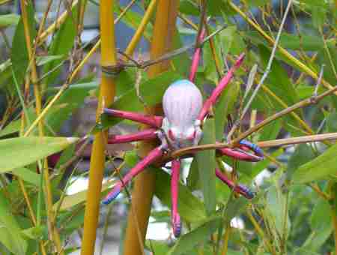
Suggestions:
County purchased resources
Nettracker
Provide safe links
Remind of AUP and consequences
Teachable moment: False Information exists
Notes:
A great way to get around having students purposely or mistakenly arrive at inappropriate web sites is to provide direction for them. The county has purchased many online resources for research which includes not just text information, but also images, audio, and video. Check under your school’s library web page or ask your librarian. She will probably be excited that you are aware of them and happy to help you.
Nettracker is a new resource purchased by the county that serves as a student safe search engine. Think of it as Google: the G rated version. All the material has been vetted for appropriateness ahead of time. Nettracker is also partners with Brainpop and Promethean Planet. You can find resources to use on your Promethean Board on there also.
Perhaps there are sites you have already vetted and found ok for students to use. Why not just provide the links to these in your assignment?
You may want to take a teachable moment and show students that not all the information on the web is true. You can check out the Tree Octopus at http://zapatopi.net/treeoctopus/ as an example. By the way, I checked the chart earlier regarding use of photographs and since this is for educational purposes and I only used one, I feel ok including this picture.
Remind students that they have signed the acceptable use policy agreement and may lose computer privileges if they abuse internet access.

Slide 17
You have great resources:
Librarians
Technology Resource Teachers
Notes:
If you feel overwhelmed of confused, take advantage of the experts in your own building. Your librarians and your technology resource teachers have received training on copyright and fair use. If they don’t know, they can seek out their contacts and find the answer.

Slide 18
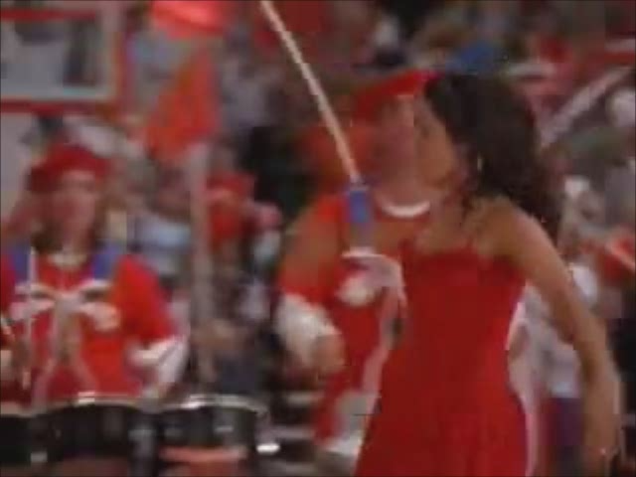
Notes:
. Honestly, we live in too litigious a society to just not care about copyright. And to end on a hokey note, and using less than 10% of the song, I leave you with the message from High School Musical. (Press sound button) We’re all in this together!

