Slide 1
The Politics of Electoral Systems
Alex Tabarrok

Slide 2
Geography and Elections
Many votes are taken by first aggregating individual votes into geographic units and then taking the vote of those units.
E.g. In Britain, Canada and other “Westminster” systems the ruling party is the party that wins the most district seats.
The party that wins the most seats is not necessarily the party that wins the most votes.
E.g. In 2012 House Democrats in the U.S. received 50.59% of the two-party vote but only 46.21% of the total seats in the House.

Slide 3
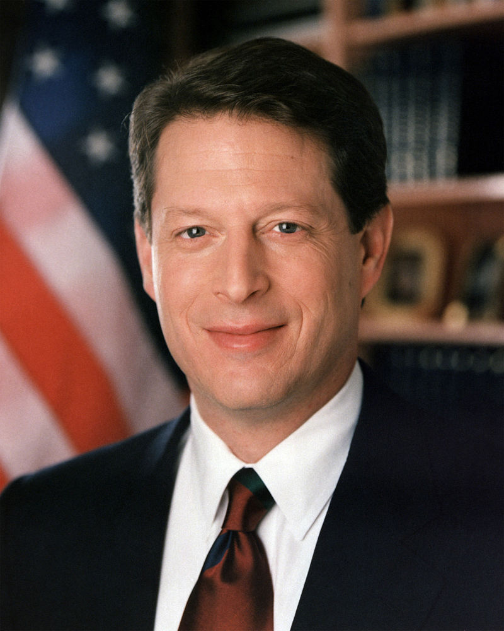
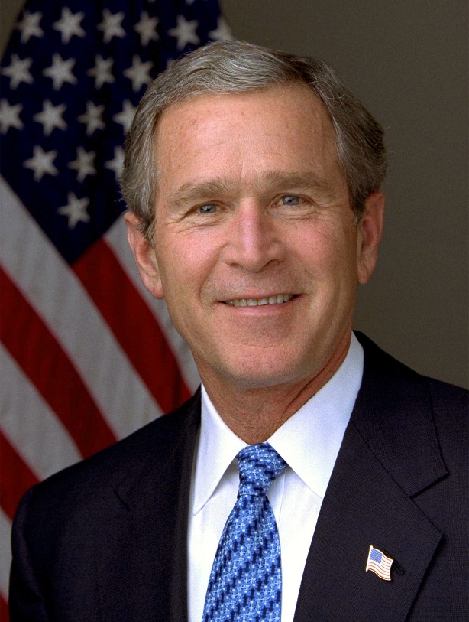
Electoral College
Al Gore
266 electoral college votes
50,999,897 total votes
George W. Bush
271 electoral college votes
50,456,002 total votes
Notes:
It’s possible even in the United States win the electoral college and lose popular vote – happened 4 times. Rare.

Slide 4
At-large versus District voting
In a district system a geographic area, say a town, is split into N districts and each district elects one person to the town council.
In an at-large system each voter has N votes which he can give to any N candidates.
In general terms both systems are equally democratic and fair. When we introduce into the town a geographically distinct permanent minority, however, the systems have very different political consequences.

Slide 5
At-large versus District voting
Under district voting the minority will be able to elect one council member of their choosing. The town council will thus have close to proportional representation, 1 minority-elected member and 3 majority-elected members.
Under at-large voting the minority group is unlikely to have any candidates elected.
E.g. each voter gets 4 votes. If 4 majority and 1 minority candidate run in the election each of the 4 majority candidates will out-poll the minority candidate by at least 3:1.
Notes:
At-large elections are often combined with anti single-shot provisions. These provisions require that all of a voters votes be allocated, otherwise the ballot will be considered spoiled. Anti single-shot laws force minority voters to vote for at least some majority candidates thereby raising the poll rates of majoirty candidates and further diluting the minority vote. In the example given in the text it was assumed that minority voters need not use each of their four votes (i.e. no anti single-shot provision). If the voting system were to include an anti single-shot provision, the majority candidates will outpoll the minority candidate by more than 3:1.

Slide 6
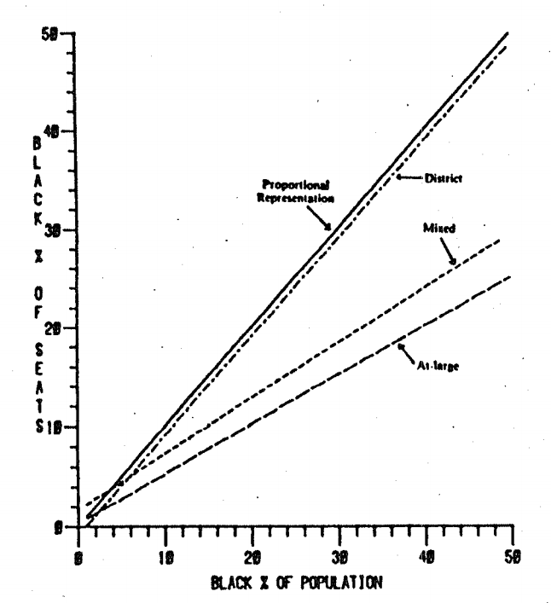
At-large versus District voting
Engstrom and McDonald (1981) use data on 239 US cities in 1976 to examine the relationship between the Black Pop % and the Black Seat %.
As the Black Pop % increases so does Black Seat % but the extent of the increase varies with the electoral system.
In district systems blacks are represented nearly proportionally to their population percentage.
In at-large systems blacks are consistently under-represented, a 40% black population translates into only an approximately 20% black representation on the city council.
Note that district systems are better at representing minorities only if the minority is concentrated geographically.

Slide 7
At-large versus District voting
Maybe at-large voting is correlated with other factors such as age or education that reduce black representation on city councils.
To test, Karnig and Welch (1982) look at districts that have mixed systems.
Representation of Blacks in Cities using both District and At-large Electoral Systems
 | Rep. Ratio | Seats with no black council members %)
District seats | 0.952 | 14%
At-large seats | 0.499 | 72%
Source: Karnig and Welch (1982, p.105)
Rep. Ratio is the percentage of blacks on the city council divided by the percentage of blacks in the population.

Slide 8
At-large versus District voting
Heilig and Mundt (1983) further support the electoral impact theory by comparing representation ratios before and after a city switched from at-large to district or at-large to mixed systems.
Representation Ratio for Southern Cities, 1970's and 1980
 | 1970's | 1980 | Difference
At-Large (N=122) | 0.31 | 0.37 | 0.06
Mixed (N=10) | 0.44 | 0.57 | 0.13
Districts (N=13) | 0.45 | 0.74 | 0.29
At Large⇒Mixed (N=19) | 0.16 | 0.7 | 0.54
At Large⇒District (N=25) | 0.15 | 0.87 | 0.72
Source: Heilig and Mundt (1983)
Although representation ratios increased for all southern cities over the 1970's, probably because of increased black political organization, the increase in representation in cities which switched from at-large to mixed or district systems is dramatic and convincing evidence that at-large systems reduce minority representation.

Slide 9
At-large elections – No Accident
At-large elections are/were more common in the US south than in other parts of the country, although they are not uncommon elsewhere.
A number of southern cities and school boards switched from district to at-large voting just as the 1964 Voting Rights Act was making other forms of minority dilution, like poll taxes, illegal.
The Mississippi legislature passed legislation immediately following the passage of the federal Voting Rights Act which let county boards of supervisor and school boards switch to at-large elections and in some cases they required the boards to switch (Davidson, 1984).

Slide 10
At-large elections – No Accident
The constitution does not require that members of the house be elected from single member districts.
As late as the 88th Congress (early 1960's) 22 of 435 members of Congress were elected at-large.
In 1967 that Congress prohibited multi-member districts from states with more than one representative, largely because it was feared that southern states might respond to the Voting Rights Act of 1965 by switching to at-large voting in order to dilute minority votes (Mast, 1998).
Many Federal court cases found that at-large elections violated the Voting Rights Act and they have become less common over time.

Slide 11
In Defense of At-large Elections
The evidence indicates that at-large elections have been successfully and purposively used to dilute the political power of minorities. Yet there is a defensible argument for at-large elections.
Compare the incentives of the President, elected at-large, with the incentives of house members elected by district. House members represent only 1/435 of the country. Since district residents pay only a fraction of a project's total cost, a project can be locally beneficial even if its total costs far exceed its total benefits.
Voters will gladly reelect a pork producing congressperson. Residents of every other district won't be happy, but their preferences don't count since they don't have the right to vote in districts other than their own.
The President is elected "at-large," i.e. by the nation as a whole. Since every citizen has an equal Presidential vote, projects which cost more than they produce in benefits will tend to be vote losers.
Presidents, therefore, have fewer incentives to support pork barrel spending than do members of the house of representatives.
Notes:
In practice, of course, Presidents will often support pork barrel projects because it's more important to have the support of some citizens than others. It's more important, for example, to have the support of citizens who are more likely to vote, who are more informed, give greater campaign donations, live in "swing" states or states which have more votes in the electoral college etc. Nevertheless, holding all else equal, the greater the percentage of the polity that a politician represents the greater the incentives to take into account the general interest as opposed to the special interest. Thus the President has more incentive to support the general interest than do senators who in turn have more incentive to support the general interest than do representatives.

Slide 12
In Defense of At-large Elections
Since they are elected from the town as a whole, at-large council members have a greater incentive to weigh all the costs as well as the benefits of spending.
District representatives will tend to support more pork barrel spending because they count the local benefits of spending but underweight costs which are spread across all districts.
Southwick (1997) tests this proposition with data on spending for a large sample of cities. He finds, consistent with the theory, that spending and taxes are lower the greater the proportion of at-large council members in a city.

Slide 13
In Defense of At-large Elections
How can we tell when at-large elections are being used to dilute minority votes and when they are being used to increase economic efficiency?
We probably can’t.
Notice that "minority rights" and "special interest" are just two ways of naming the same thing. We cannot protect one without unwittingly protecting the other.
At-large voting increases the incentive to serve the general interest but it also increases the incentive to serve the majority - we cannot increase the incentive to serve one without increasing the incentive to serve the other - but the majority and the general interest are not at all the same thing.

Slide 14
In Defense of At-large Elections
If a city were perfectly homogeneous, everyone would prefer at-large elections to district elections because, even in a homogeneous city, district elections will result in higher than optimal spending and taxation.
Once we introduce permanent majorities and minorities, however, the situation becomes opaque and complex.
The theorist can help us to understand the trade-offs among the various systems but must be silent on how to weigh those trade-offs - that decision is forever political.

