Slide 1
The Homicide Clearance Rate
Cook, Philip J., and Ashley Mancik. 2024. “The Sixty-Year Trajectory of Homicide Clearance Rates: Toward a Better Understanding of the Great Decline,” January. https://doi.org/10.1146/annurev-criminol-022422-122744.
Alex Tabarrok

Slide 2
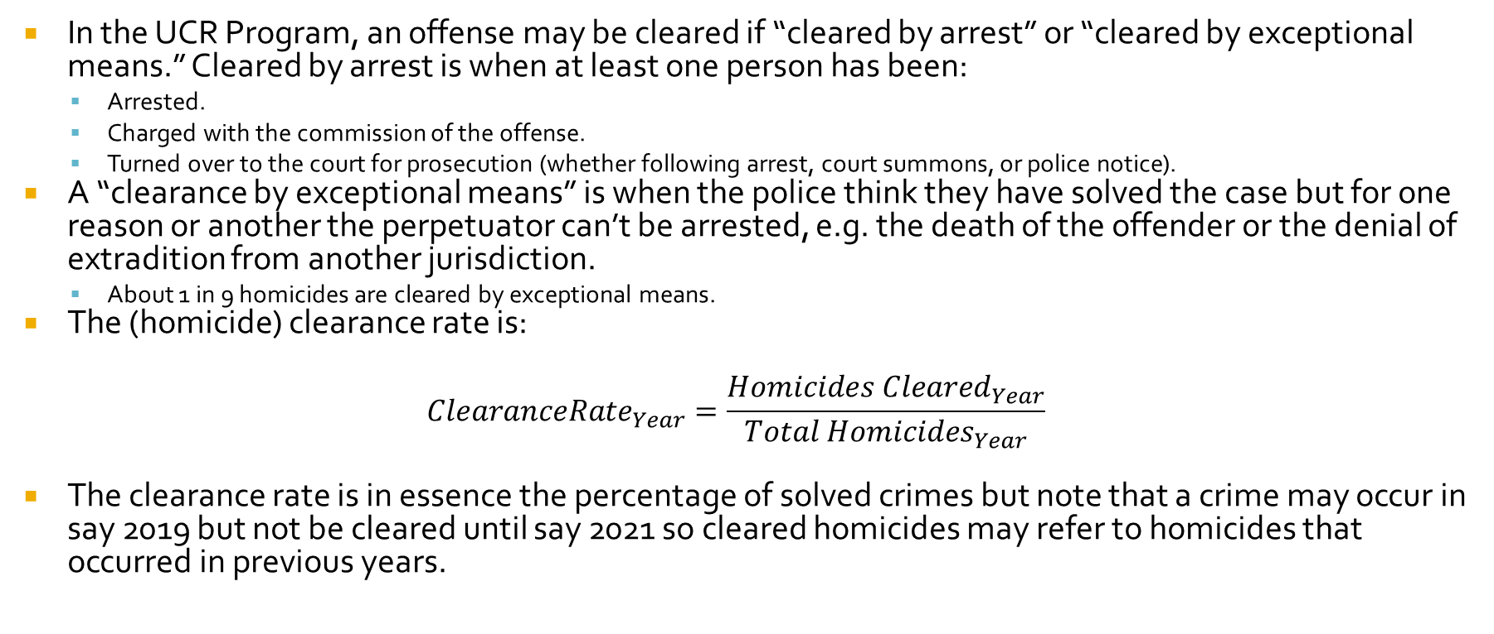
The (Homicide) Clearance Rate
In the UCR Program, an offense may be cleared if “cleared by arrest” or “cleared by exceptional means.” Cleared by arrest is when at least one person has been:
  Arrested.
  Charged with the commission of the offense.
  Turned over to the court for prosecution (whether following arrest, court summons, or police notice).
A “clearance by exceptional means” is when the police think they have solved the case but for one reason or another the perpetuator can’t be arrested, e.g. the death of the offender or the denial of extradition from another jurisdiction.
  About 1 in 9 homicides are cleared by exceptional means.
The (homicide) clearance rate is:
$${ClearanceRate}_{Year}=\frac{{Homicides Cleared}_{Year}}{{Total Homicides}_{Year}}$$
The clearance rate is in essence the percentage of solved crimes but note that a crime may occur in say 2019 but not be cleared until say 2021 so cleared homicides may refer to homicides that occurred in previous years.

Slide 3
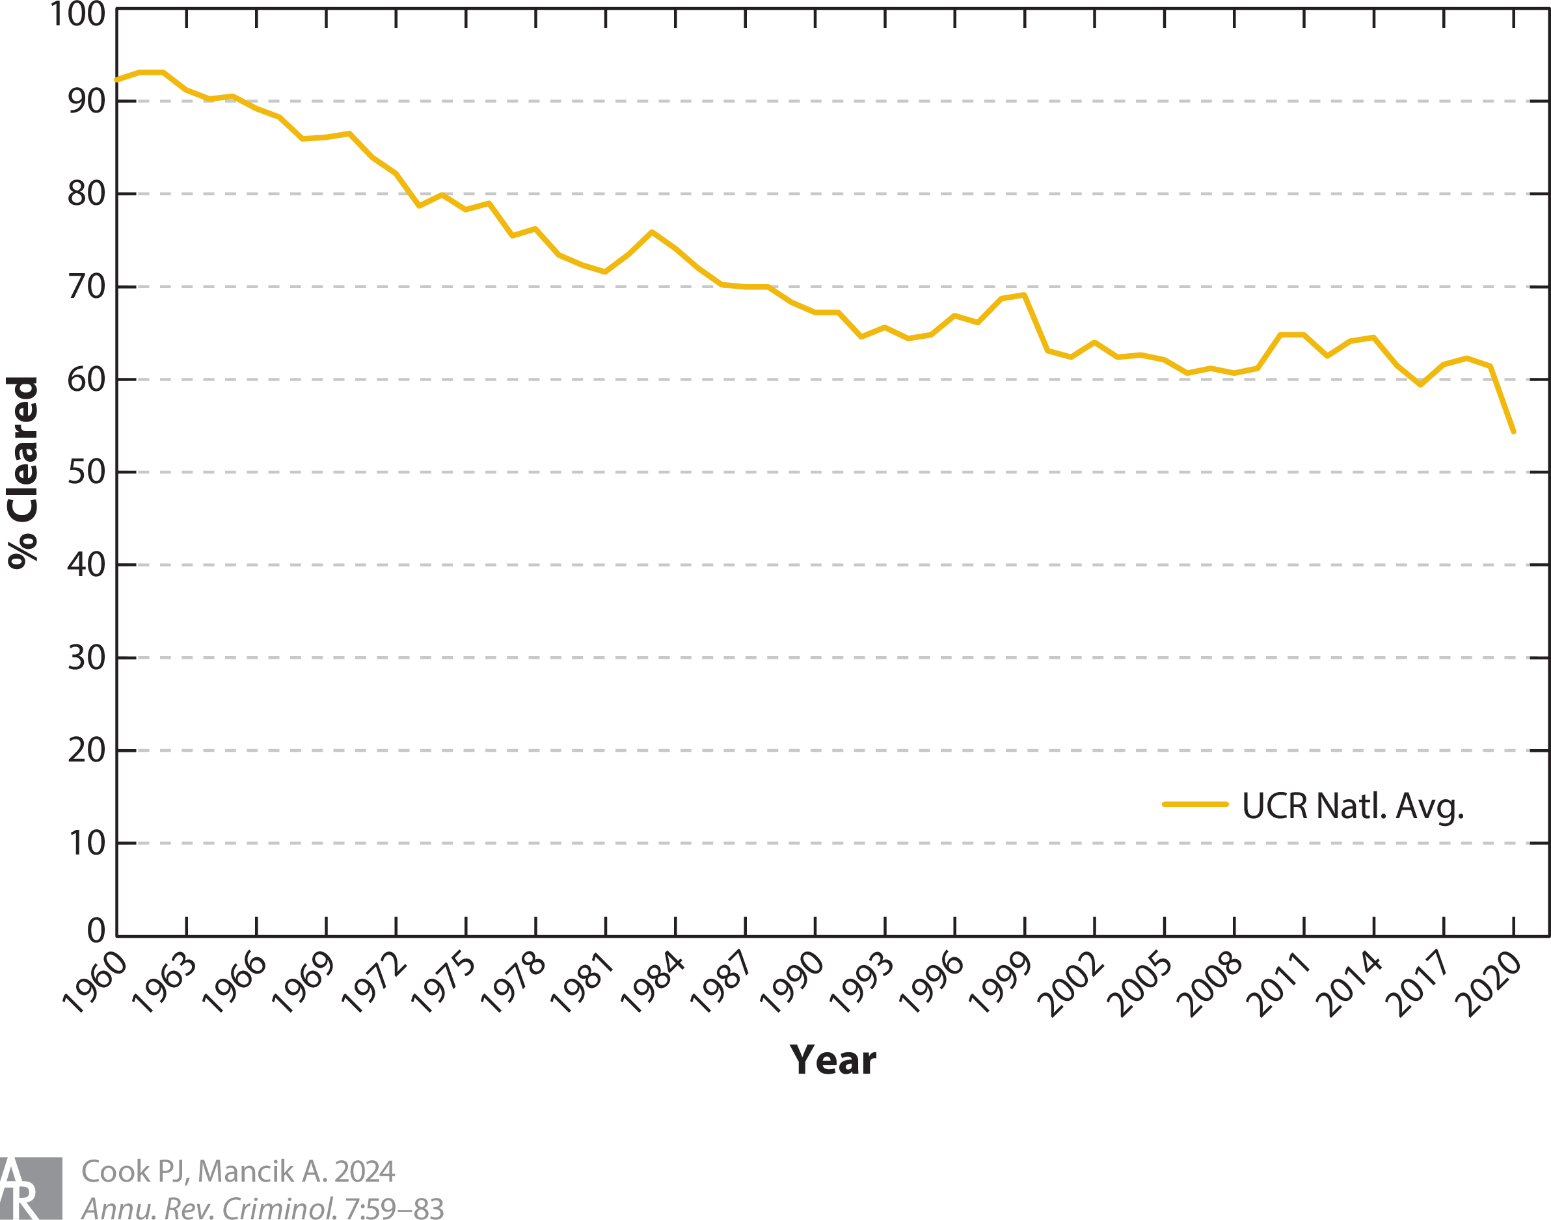
The Homicide Clearance Rates Is Declining
In the 1960’s over 90% of homicides were cleared!
Today, only about 50-60% of homicides are cleared.
Why?
  Data Mirage?
  Overworked, Less Effective, Police?
  Less Witness Cooperation?
  Case Composition/Harder to Solve Cases?
  Higher Arrest Standards?

Slide 4
Why Has the Homicide Clearance Rate Declined? Some Theories
independent datasets, such as the Chicago Homicide Data Set, which show similar declines. The text also highlights the consistency of the decline across different regions and city sizes, further supporting its validity
Data mirage?
  Not all agencies report and the number that do report has increased over time, so we have to check the data.
  Cook and Mancik argue that the consistency of the decline across different regions and city sizes and independent datasets, such as the Chicago Homicide Data Set, which show similar declines all suggest that the decline is real.
Overworked, less effective police
  If anything, the number of police has increased relative to the number of crimes.
Less Witness Cooperation
  Snitches get stitches but this doesn’t seem to have increased over time.

Slide 5
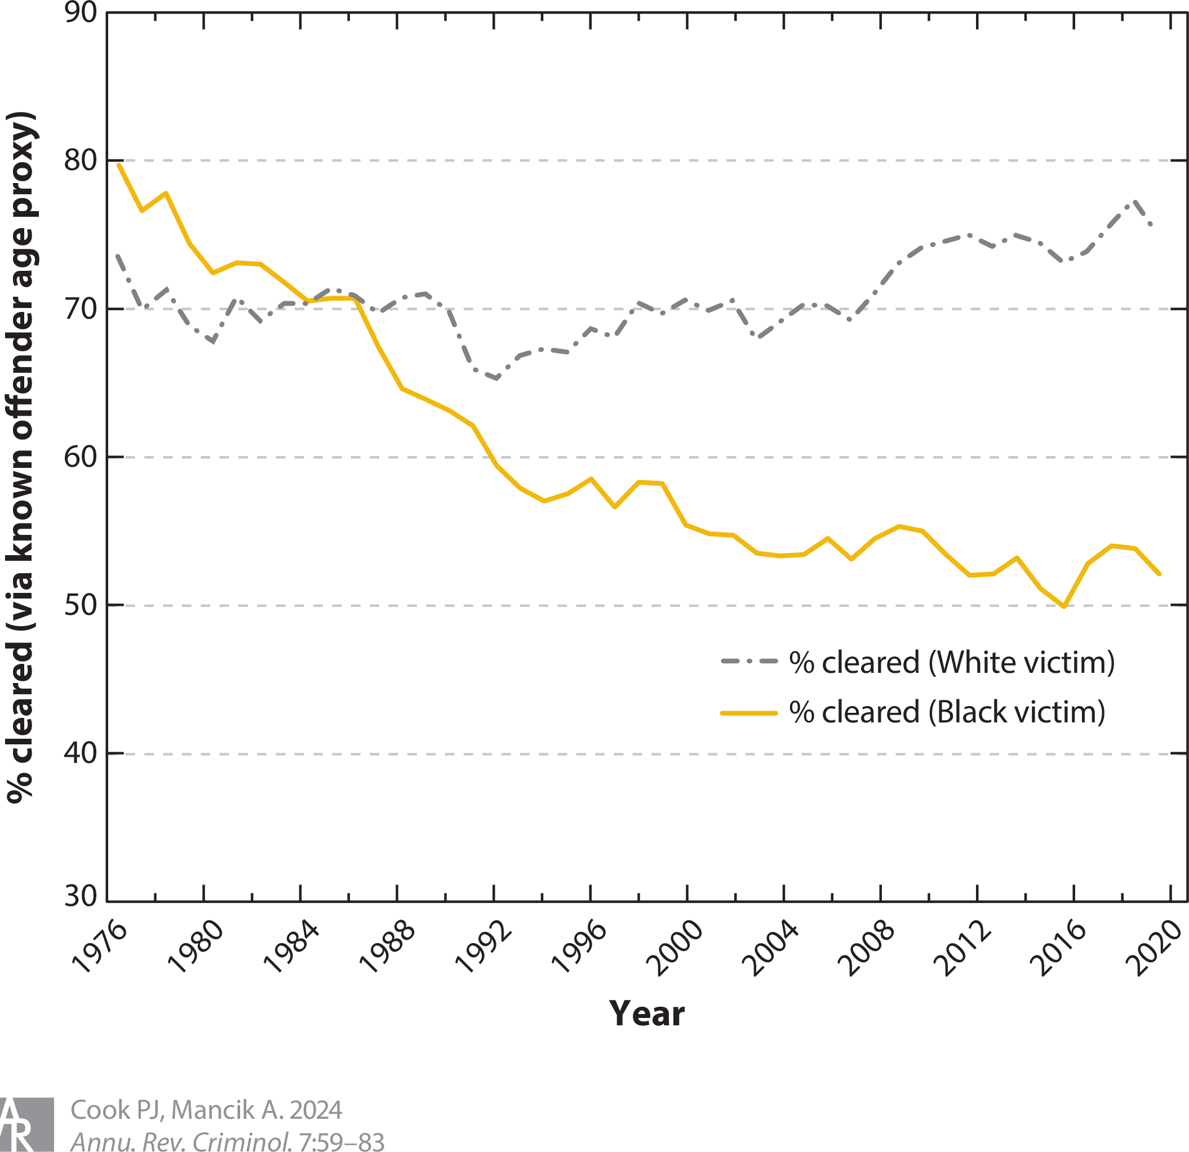
Case Composition/Harder to Solve Cases
Case Composition/Harder cases
  Cook and Mancik show something surprising. The decline in the clearance rate appears to be driven by a decline in homicide clearance when the victim was black.
  Note this uses data from the SHR which doesn’t have clearance rates but does have a proxy, the percentage of homicides for which there is a suspect of known age. The correlation between the actual clearance rate and the proxy clearance rate is 0.91.

Slide 6
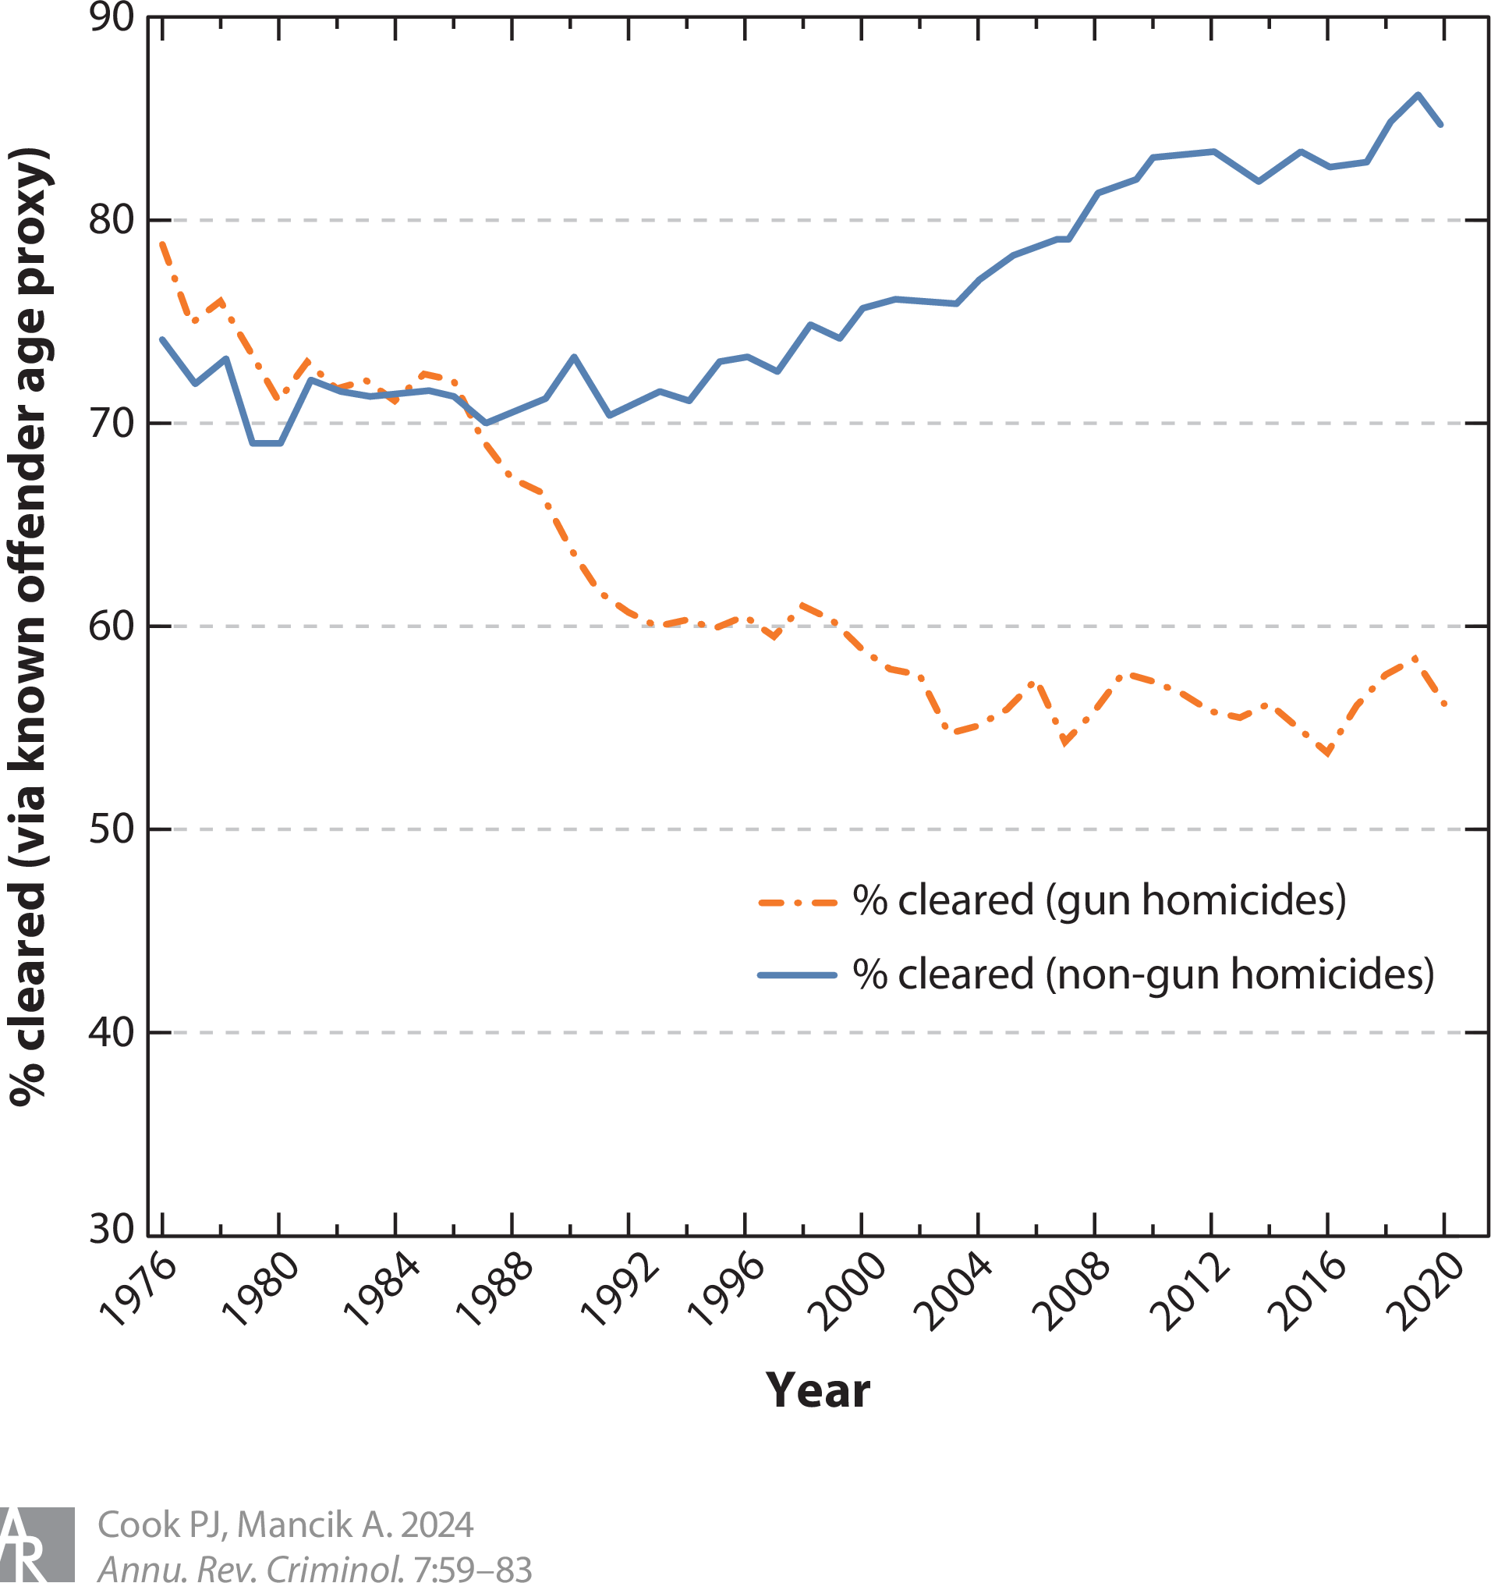
Case Composition/Harder to Solve Cases
Similarly, the big decline in homicide clearance is cases involving a gun.
  Non-gun homicide clearance rates have increased!
  Again this is using the proxy from the SHR of when the suspect has a known age.

Slide 7
Case Composition/Harder to Solve Cases
Similarly, the big decline in homicide clearance is cases involving a gun.
  Non-gun homicide clearance rates have increased!
  Again this is using the proxy from the SHR of when the suspect has a known age.

Slide 8
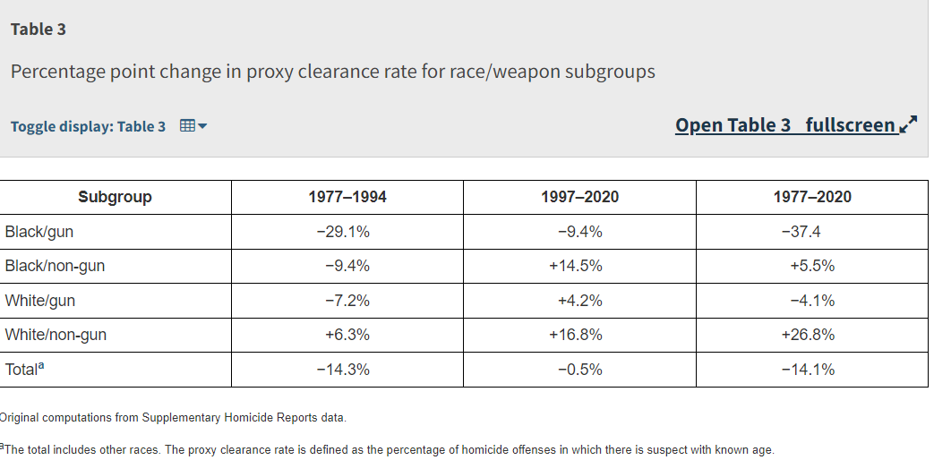
Case Composition/Harder to Solve Cases
Not surprisingly then, the clearance rate for black homicide victims of guns has fallen while that of compositions (black/non-gun, white-gun etc.) has not.

Slide 9
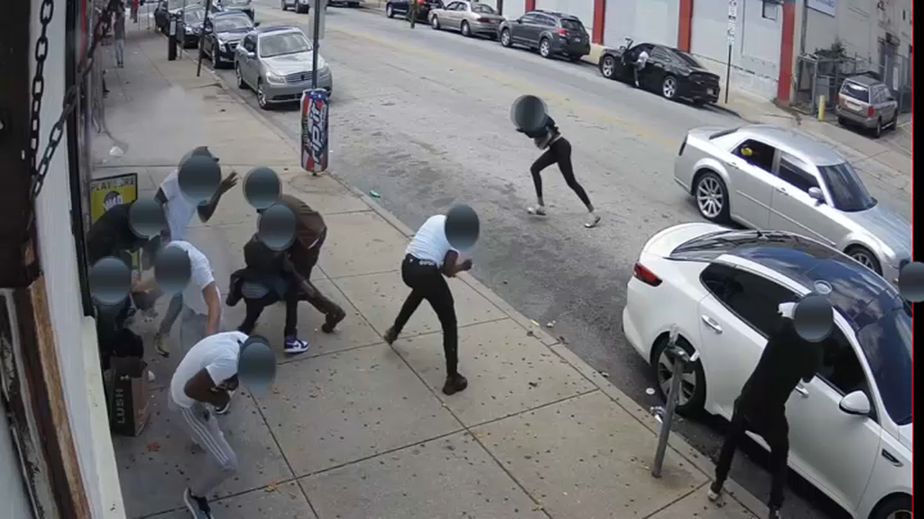
Case Composition/Harder to Solve Cases
The clearance rate for black homicide victims from guns may be especially low because these are often drive-by shootings and ‘stranger’ killings.
These killings may be the most difficult to solve because there isn’t much victim-offender relationship, not much to witness, and no close contact between victim and offender (no DNA or fingerprints for example).

Slide 10
Higher Arrest Standards
During the 1960s the SC introduced a lot of new “defendant’s rights” law including:
  Mapp v. Ohio (1961)—cannot use evidence from an illegal search.
  Miranda v. Arizona (1966)—confession can’t be used unless defendant has been read their rights
  Gideon v. Wainwright (1963)—defendant has a right to counsel
The idea is that these laws changed police practice to make arrests more selective, i.e. less common but more meaningful when they do happen.

Slide 11
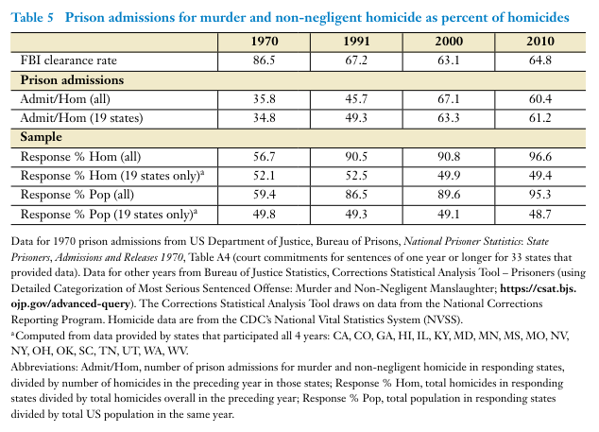
Higher Arrest Standards
Cook and Mancik emphasize a relatively new fact consistent with the idea that arrests became more selective: Although clearance rates (which remember is mostly arrests relative to total offenses) fell the number of prison admissions for homicide relative to total homicides increased.
  In other words, the number of arrests fell but the number of people convicted conditional on arrest increased. (see next page)

Slide 12
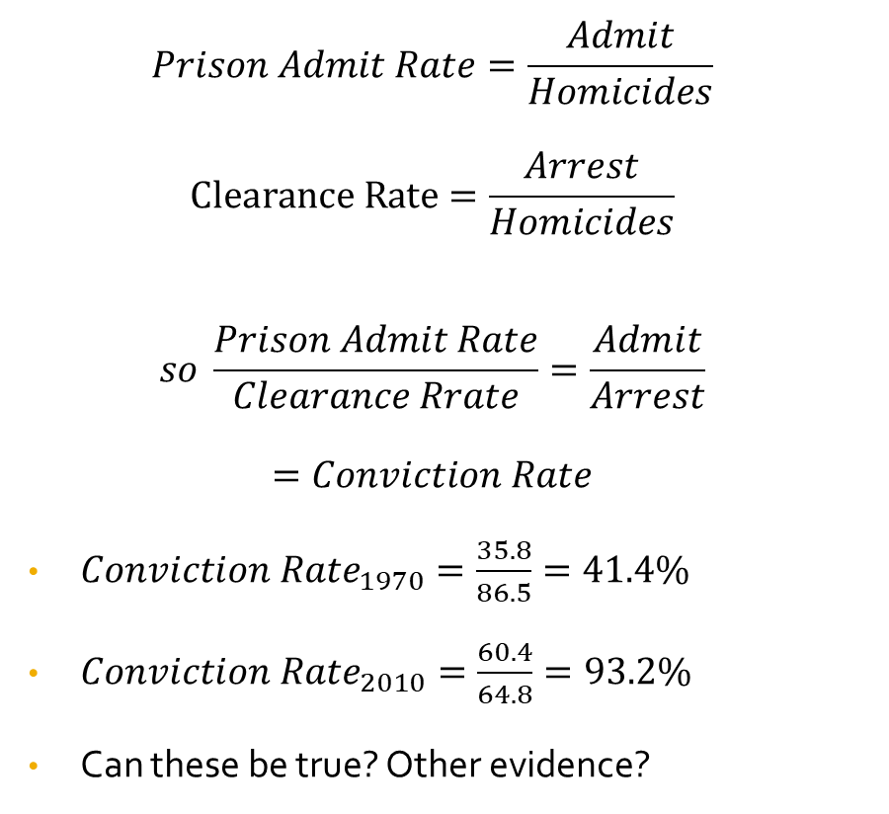
Higher Arrest Standards
$$Prison Admit Rate=\frac{Admit}{Homicides}$$
$$Clearance Rate=\frac{Arrest}{Homicides}$$
$$so \frac{Prison Admit Rate}{Clearance Rrate}=\frac{Admit}{Arrest}$$
$$=Conviction Rate$$
${Conviction Rate}_{1970}=\frac{35.8}{86.5}=41.4\%$
${Conviction Rate}_{2010}=\frac{60.4}{64.8}=93.2\%$
Can these be true? Other evidence?

Slide 13
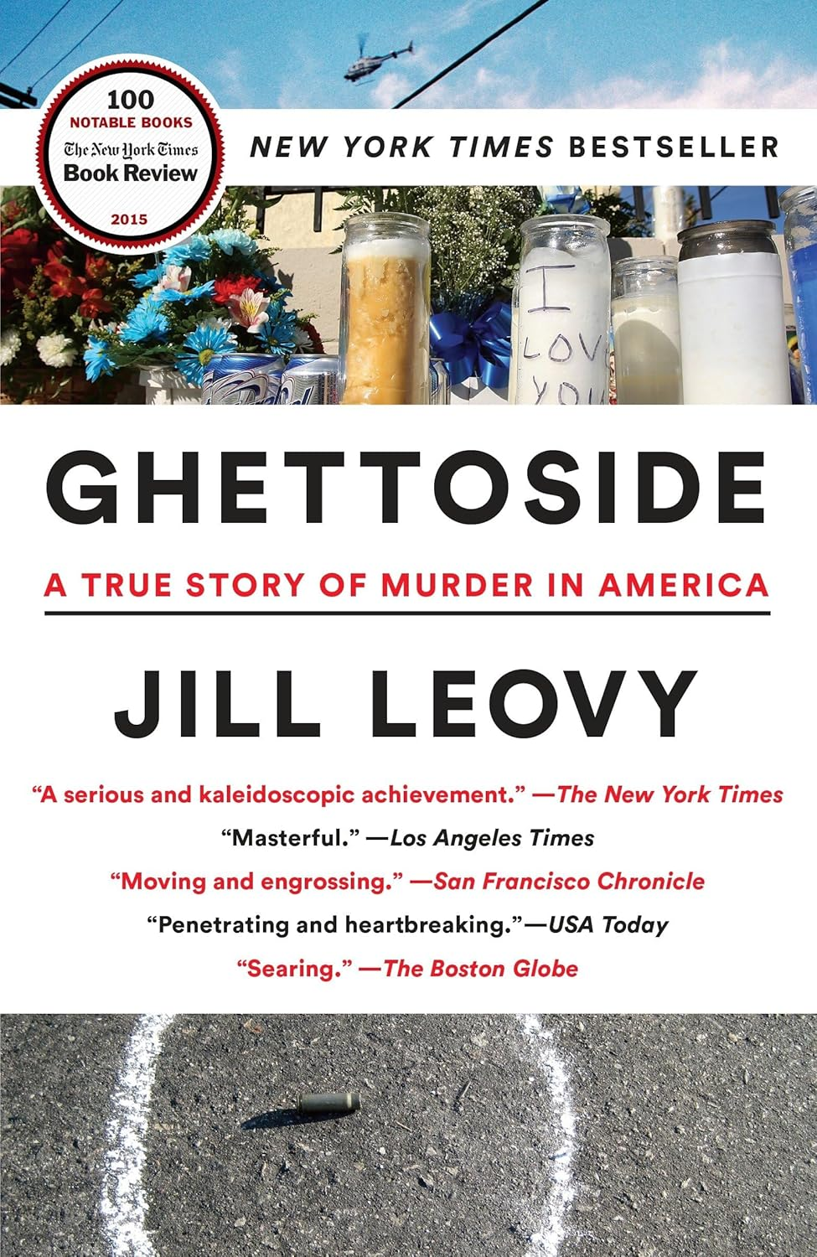
The Homicide Clearance Rate
More work needs to be done on how effective the police are. What determines effectiveness?
How to increase clearance/conviction rates?
What is a hard case?
How have clearance and conviction rates changed over time and for different types of case?

