Slide 1
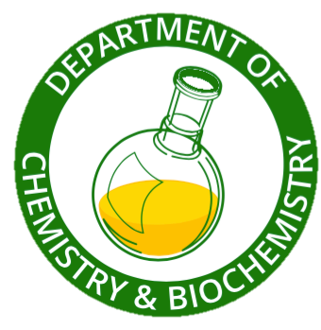
Interpreting NMR Spectra
Chemistry 318
Week 2
Fall 2018

Slide 2
Today
You will meet in a recitation room for the NMR Spectroscopy lecture.
Tuesday (9/4/18): Merten Hall 3300
Wednesday (9/5/18): Planetary Hall 312
Thursday (9/6/18): Research Hall 301
Friday (9/7/18): Planetary Hall 312

Slide 3
Today
This presentation will focus on interpreting ¹H- and ¹³C-NMR spectra to deduce the structure of organic compounds.
You can either print the spectra slides (4-6/page) or bring a device to view this PPT file.
There will be a quiz that covers concepts and terminology on NMR from the reading assignment.
There will not be interpretation of NMR spectra this week.

Slide 4
Next Week…
Lecture on Mass Spec and IR Spectroscopy (see the IR PowerPoint).
Bromination of Toluene experiment.
Be sure to prepare for the experiment in your notebook as explained in the Lab Manual pp. 4-8.
Pay particular attention to the Safety Information you present in the Chemical Property Table.
The quiz will include questions about the experiment and simple interpretation of NMR spectra.

Slide 5
Introduction – Atomic Spin
Just as electrons have a spin quantum number of ½, protons and neutrons (nucleons) also have a spin of ½.
The nucleus has a spin (I) that is the resultant of the spins of the nucleons.
Atomic nuclei with either an odd number of protons or neutrons in their nucleus have a half-integral nuclear spin.
¹H, ¹³C, and ¹⁵N but not ¹²C or ¹⁶O

Slide 6
Introduction – Atomic Spin
The positively charged spinning nucleus generates a small electric current and thus also generates an associated magnetic field.
When the nuclei are placed in an external magnetic field, their magnetic spins align either with the external magnetic field (lower energy) or against it (higher energy).
The energy difference between the two spin states is directly proportional to the strength of the applied magnetic field.
A very strong magnetic field is required for an energy separation that will be ultimately detected.

Slide 7
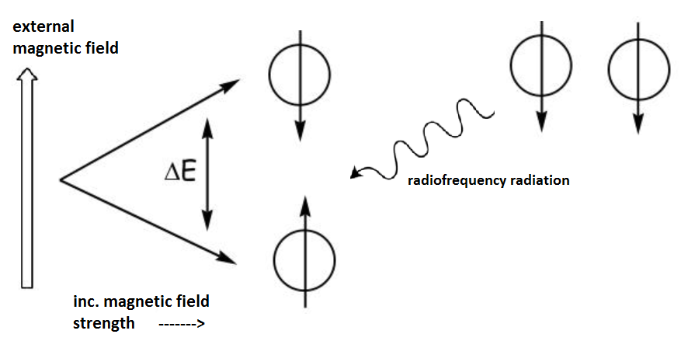
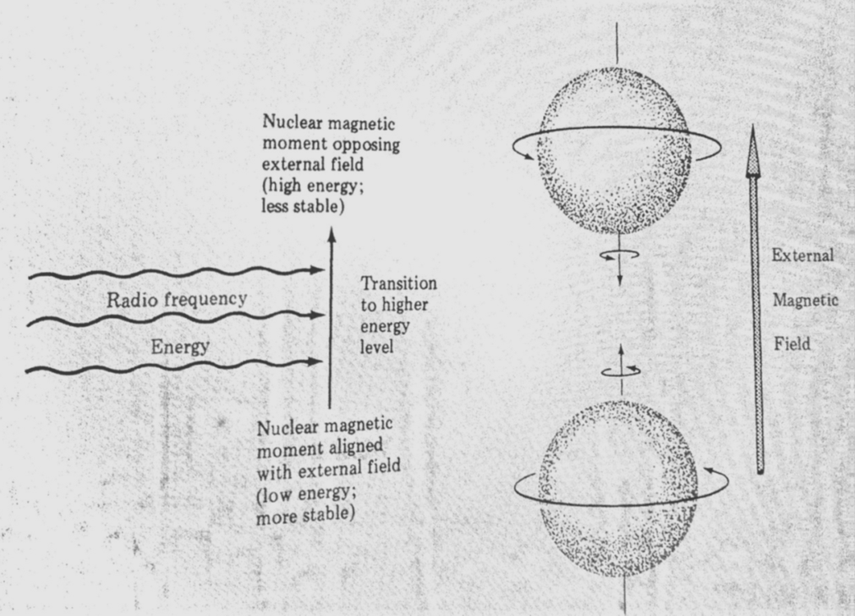
Introduction – Change in Nuclear Magnetic Moment
The energy difference between the two spin states is in the radiofrequency range of the electromagnetic spectrum.
When the irradiation energy equals the spin energy difference, the nucleus in the lower energy spin state absorbs the energy and is excited to the higher spin energy state (against the external field).

Slide 8
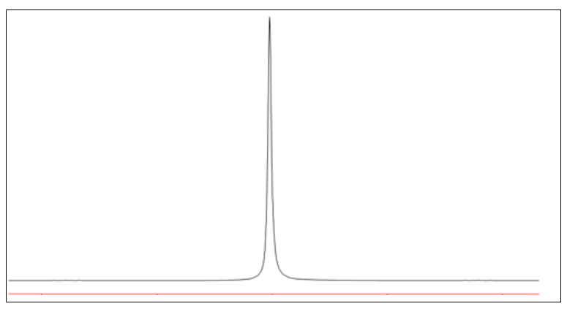
Introduction
The magnetic “spin-flip” transition is in "resonance" with the applied radiation.
The energy absorption is detected in the NMR spectrometer and the output is the NMR spectrum.
The horizontal scale is measured in ppm, parts per million (see Note).
Notes:
The derivation of ppm is complex and doesn’t affect the interpretation of structure from the spectrum.

Slide 9
Introduction
Nuclear magnetic resonance is useful for determining the structure of organic compounds because both the ¹³C-isotope of carbon and the ¹H-isotope of hydrogen produce NMR signals.
Although most carbons are the ¹²C isotope ,~ 1.1% of carbons are the ¹³C isotope with an extra neutron. Modern instrumentation is sensitive enough to detect signals from these isotopes.
Most hydrogens are the ¹H-isotope – 1 proton in the nucleus and no neutrons.
For nuclei in different bonding environments, the resonance energy is different and appears at different ppm in the spectrum. Most carbons and hydrogens in organic compounds are in different bonding environments.

Slide 11
¹³C-NMR Spectroscopy
Information obtained from a ¹³C NMR spectrum:
the number of resonance signals denotes the number of different (non-equivalent) carbon atoms present
the chemical shift reveals the electronic bonding environment of the carbons
signal splitting (singlet, doublet, triplet, etc.) gives the number of hydrogens bonded to each carbon

Slide 12
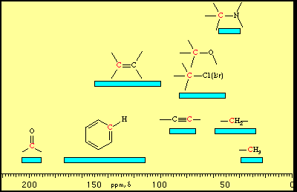
¹³C-NMR Spectroscopy
The range of chemical shifts is about 0-220 ppm.
Saturated carbon atoms absorb upfield (smaller ppm) relative to unsaturated carbons (downfield).
Electron-withdrawing atoms cause a downfield shift.
Compare –CH₂– with –CH-O– and compare C=C with C=O
Notes:
It is important for the organic compound structures that will be shown on the following slides that you draw in all carbon and hydrogen atoms.
See Figure 23.4 and Table 23.3 in Mohrig.

Slide 13
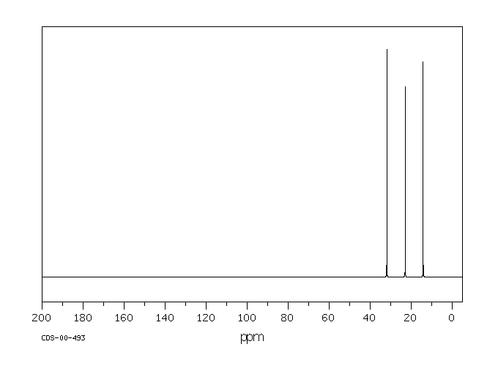
Hexane
ppm
14.16 q
22.89 t
31.87 t
Please view the slide with Notes underneath.
Notes:
It is important for the organic compound structures that will be shown on the following slides that you draw in all carbon and hydrogen atoms.
The signal peak intensity has no meaning, except that carbons bonded to no protons may be disproportionately smaller.
1st: Look at the spectrum. There are three resonance peaks. If no peaks are overlapping (not likely), then there are three different kinds of C’s in the molecule. Note that hexane has 2 identical methyl groups; 2 identical methylene groups adjacent to the methyl groups; and 2 identical methylene groups in the middle of the molecule.
2nd: Look at the chemical shift chart on a previous slide. All the peaks in this spectrum are in the upfield area expected for saturated carbons (0-40 ppm). Generally, methyls absorb upfield from methylenes. (quaternary > tertiary > secondary > primary, as long as there are no nearby electronegative atoms).
3rd:Look at the molecular structure. How many _different_ carbons are there in the molecule? There are 3: the two equivalent Me’s, the two equivalent methylenes (C2 and C5), and the two equivalent methylenes in the center (C3 and C4).
Are there any electronegative atoms in the molecule? No.
It is helpful to have the proton coupled spectrum, and these are usually available. See next slide for explanation.

Slide 14
Carbon-Hydrogen Spin Splitting
A spectrum can be obtained that “couples” the spin of a carbon and the hydrogens that are bonded to it.
The resulting “splitting” pattern shows the number of hydrogens bonded to the carbon.
Number of H’s attached to C = n-1 where n is the number of split peaks.
n n-1
Quartet (q) 3 H’s -CH₃ methyl
Triplet (t) 2 H’s -CH2- methylene
Doublet (d) 1 H >CH- methine
Singlet (s) 0 H
Notes:
The split peaks are not usually shown. Rather, the abbreviations q, t, d, and s are printed on the spectrum.

Slide 15
Hexane
ppm
14.16 q
22.89 t
31.87 t
q = quartet n=4 n-1=3 CH₃
t = triplet n=3 n-1=2 CH₂
Notes:
Now it can be seen that the upfield resonance, which is a quartet, must belong to the terminal methyl groups (C attached to 3 H’s). Splitting would still not differentiate between the two sets of methylenes.

Slide 16
2,2-Dimethylbutane
8.88 q
28.96 q
30.42 s
36.49 t
Notes:
1st: Look at the spectrum. There are four resonance peaks. If no peaks are overlapping (not likely), then there are four different kinds of C’s in the molecule.
2nd: look at the chemical shift chart on a previous slide. All the peaks in this spectrum are in the area expected for saturated carbons (0-40 ppm). quaternary > tertiary > secondary > primary, as long as there are no nearby electronegative atoms).
3rd:Look at the molecular structure (draw in the missing C’s and H’s. How many _different_ carbons are there in the molecule? There are 4: the three equivalent Me’s, the non-equivalent Me, the methylene, and the quaternary C.
Are there any electronegative atoms in the molecule? No.
4th: Can tell the difference between the CH3, CH2, and quaternary C with the proton-coupled spectrum – see results in box. However, you can’t tell the difference between the three equivalent CH3’s bonded to the quaternary C and the CH3 bonded to CH2. More experience reveals the three equivalent CH3’s are downfield at 28.96 ppm.
The singlet (s) shows there are n-1=0 hydrogens attached to the C.
Might expect that the quaternary is the most downfield resonance. However, this is the assignment:
36.49 (-CH2-) 30.42 (quaternary) 28.96 (3 equiv. Me’s) 8.88 (single Me)
Might also have guessed because the quaternary signal is disproportionately smaller (no protons attached to C).

Slide 17
Acetaldehyde
Notes:
1st: Look at the spectrum. There are two signals and thus two different C’s.
2nd: Look at the chemical shift chart. One peak is in the upfield area expected for saturated carbons. The other peak downfield at 200 ppm is exactly where we expect to find a carbonyl C (nothing else absorbs this far downfield).
3rd: Look at the molecule. How many _different_ carbons are there in the molecule? There are 2: the Me carbon and the carbonyl C.
4th: The proton coupled spectrum would give what kind of splitting?
Answer: q for CH3 and d for carbonyl C bonded to aldehyde H.

Slide 18
Ethyl propionate
ppm
171.40 s
60.26 t
27.71 t 14.32 q 9.19 q
Notes:
Proceed analyzing spectra as previously.
In the ethyl proprionate molecule, there are two non-equivalent Me’s and two non-equivalent methylenes and a C=O. The CH3CH2 carbons bonded closer to O are expected to absorb further downfield than the CH3CH2 carbons bonded to the less electronegative C of C=O.
Again, almost any methylene will be further downfield than any methyl, so the two upfield peaks are CH3’s (q) and the next two are –CH2-’s and the furthest downfield is the carbon of the carbonyl, C=O.
Note that the C=O in esters absorbs upfield from aldehydes and ketones. Unless you have access to the correlation chart, and if the structure were unknown, it might not be obvious which C=O functional group is present (ester, amide, for example).

Slide 19
ortho-Xylene (1,2-dimethylbenzene)
ppm
134.66 s
129.21 d
128.97 d 20.90 q
Notes:
The two methyls are equivalent. C1 and C2 of the ring are equiv., C3 and C6 of the ring are equiv., and C4 and C5 are equivalent.
Spectrum shows two markedly different environments: upfield for saturated C’s and near-middle for unsaturated.
How to tell aromatic from vinyl? Usually there will be other info such as IR, ¹H-NMR and M.W. Also, if there are several peaks, chances are it is an aromatic ring. If the problem gives a molecular formula, can calculate the index of hydrogen deficiency, which would most likely reveal the aromatic ring.
When actually solving problems, may have to double the number of carbons to fit the M.W., as in this example. 4 peaks but 8 C’s.
Which peaks correspond to which aromatic ring carbon? Can differentiate C1 and C2 because they will be singlet and the others doublets. Also, the ring C bonded to the CH3 is smaller than the others. Other than that, it doesn’t really matter. [The ortho C is downfield from the meta C.]

Slide 20
Isopropylbenzene (cumene)
Notes:
Two equivalent Me’s; one methine; 4 different types of ring carbons: C bonded to iPr (known as the ipso carbon); two equiv. ortho C’s; two equiv. meta C’s; one para C.
No electronegative atoms.
Clearly two areas of the spectrum: saturated and unsaturated.
Furthest downfield is the substituted ring C, the smallest. Could partly differentiate with proton-coupled spectrum. Meta > ortho > para downfield order. We will not emphasize how to sort these out.
What is the predicted splitting of each of these signals?

Slide 21
¹H-NMR Spectroscopy
Information obtained from a ¹H NMR spectrum:
the number of resonance signals denotes the number of different (non-equivalent) hydrogen atoms present
Integration of the peak areas gives the relative number of hydrogens causing the resonance
the chemical shift reveals the electronic bonding environment of the hydrogens
signal splitting (singlet, doublet, triplet, etc.) gives the number of hydrogens bonded to the adjacent atom(s)
Notes:
With the exception of integration of peak area, this is the same information gained from ¹³C-NMR with respect to C atoms.

Slide 22
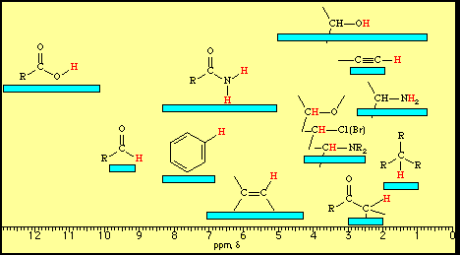
¹H-NMR Spectroscopy
Chemical shift range is about 0-12 ppm.
Hydrogens bonded to saturated carbons absorb up-field relative to hydrogens on unsaturated carbons (downfield).
Electron-withdrawing atoms cause a downfield shift.
compare >CH – with >CH-O– and compare C=CH with HC=O
Notes:
See Table 22.3 in Mohrig.

Slide 23
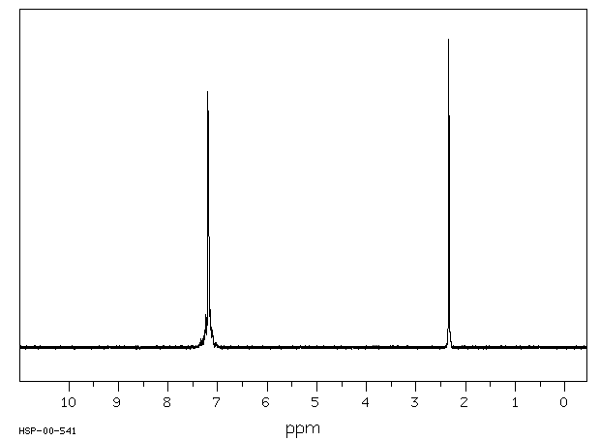
¹H-NMR Spectroscopy
Chemical shift: There are two resonance peaks, indicating two different kinds of H’s. The upfield signal is in the saturated C region; the downfield signal is in the unsaturated C region.

Slide 24
¹H-NMR Spectroscopy
Integration: The area under the peak is proportional to the number of hydrogens causing the absorbance.
After integration and rounding to small whole numbers, the peak area ratio is 5:3.

Slide 25
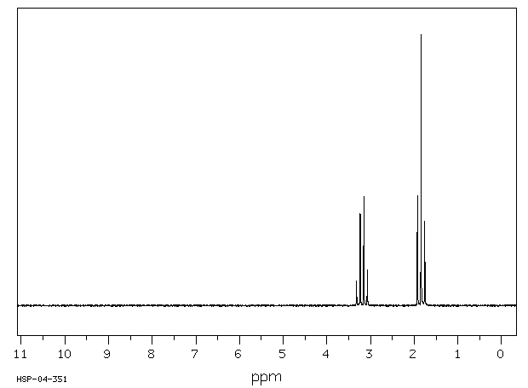
¹H-NMR Spectroscopy
Spin-spin splitting: A resonance peak is split into n+1 peaks by n H atoms on adjacent atoms.
The CH₃ resonance is split by the neighboring CH₂.
There are n=2 neighboring H’s and so the resonance is split into n+1=3 peaks – a triplet.
Integration: 2:3
Notes:
For a molecule such as ethyl iodide, CH₃CH₂I, two types of protons would be predicted to appear in the NMR spectrum; a 'simple' CH₃ in the area of δ 1, and a CH₂ shifted down to about d 3 by the electronegative iodine. The NMR spectrum, however, displays seven peaks due to spin coupling of the protons on adjacent carbons.
CH3 is upfield and is a triplet and integrates for 3 protons. CH2 is downfield and is a quartet and integrates for 2 protons.
It is unfortunate, and coincidental, that this triplet integrates for 3 protons!
The ppm is reported as the center of the multiplet.
Refer to textbook for reasons the splitting occurs.
Equivalent Hydrogens on the same atom do not interact with/split each other. Only hydrogens on adjacent atoms H-X-Y-H.
It gets complicated though, with enantiotrophs and diasteromeric protons. We will not discuss these!

Slide 26
¹H-NMR Spectroscopy
Spin-spin splitting: A resonance peak is split into n+1 peaks by n adjacent H atoms.
The CH₂ resonance is split by the neighboring CH₃.
There are n=3 neighboring H’s and so the resonance is split into n+1=4 peaks – a quartet.
Integration: 2:3

Slide 27
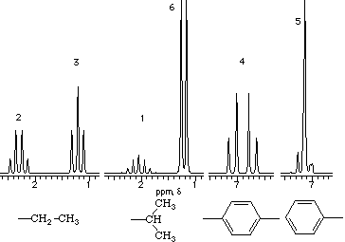
¹H-NMR Spectroscopy
Spin-spin splitting: A resonance peak is split into n+1 peaks by n adjacent H atoms.
These are some simple, common splitting patterns:
Ethyl group is a quartet-triplet, integration 2:3
Isopropyl group is a septet (hard to see) and a doublet, integration 6:1
Para-disubstituted benzenes give this symmetrical splitting; other substituted benzenes are not well-resolved. Relative integrations are shown.
Notes:
What would a tert-butyl give? (CH₃)₃C-X where X is not H?
Answer: A singlet integrating for 9 protons.
Split peak height ratios:
1:1 1:2:1 1:3:3:1 1:4:6:4:1 etc (Pascal’s triangle)
But they will be a bit off. Resonances that split each other, “cant” toward each other. Draw a slope line from the slightly lower to the slightly higher outside peaks.
The high points will be pointing at each other. / \

Slide 28
Isopropylbenzene (cumene)
Notes:
1. Look at spectrum. Learn to see _groups_ of peaks, unlike in C-13. There are 3 groups, so three different types of H’s. Learn to look for and recognize peaks for aromatic ring – a monosubstituted ring is typical, and shown above. Here you can see the suggestion of non-equivalent aromatic protons splitting each other.
Upfield, there are two different kinds of Hydrogens bonded to saturated C’s.
2. Confirm this so far by looking at the structure given (DRAW IN ALL HYDROGEN ATOMS). Two equivalent sets of H’s on Me’s; one H on methine; 3 non-equiv. types of ring hydrogens.
No electronegative atoms.
3. Back to spectrum and splitting. Learn to recognize the (almost) septet/doublet combination of an isopropyl group. Confirm that integration is 1:6. The benzene’s 5 hydrogens are not equiv. but for mono-substituted, the resonance “always” looks like this, just downfield from 7 ppm. Integrates for 5 protons.

Slide 29
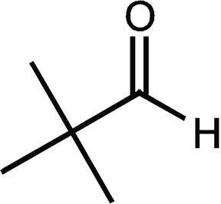
Pivaldehyde (dimethylpropanal)
A: I = 1, s B: I = 9, s
Notes:
The three methyl groups are equivalent. The C’s of the methyl groups are bonded to a C that is not bonded to any H’s. Therefore, the three Me group hydrogen resonances (upfield) are not split and appear as a singlet. This tert-butyl group integrates for 9 protons, which is usually a give-away for its presence.
The H bonded to the carbonyl appears as a singlet (downfield) because the carbon of C=O is not bonded to a C that is bonded to H’s.

Slide 30
3-Hydroxy-2-butanone (acetoin)
Notes:
This example illustrates an OH group. It will integrate for 1 H (at 3.6 ppm). It is usually a bit broad, and since it exchanges in the solvent, it does not split and is not split.
There is a singlet integrating for 3 H’s, a doublet integrating for 3 H’s, and a quartet integrating for 1 H.
The singlet must be a CH3 that is next to a non-H bearing atom. Since it is in the region for methyls bonded to C=O (look at many examples), we have the substructure CH3-C=O.
The remaining two signals are split, and so they must be splitting each other and so must be adjacent to each other. Because of the integration, the substructure is CH-CH3. Now confirm the splitting pattern. The CH is split into n+1 = 3+1 = 4 peaks by the adjacent methyl. The CH3 signal is split into n+1 = 1+1 = 2 doublet by the adjacent methine.
Even if you don’t have the integration, the splitting pattern tells the story. The only way to get a quartet signal is if a proton-producing signal is adjacent to a methyl. So there is a CH3 next to that proton(s). And the only way to get a doublet is if the proton(s) producing the signal are next to a methine. So the combination has to be CH-CH3.

Slide 31
Propanoic acid
Notes:
Singlet for the acidic proton – there are no H’s on adjacent atoms.

Slide 32
para-Methoxybenzoic acid
Notes:
This spectrum illustrates a sad fact. The absorbance of the acidic H on O is vanishingly small, but you can see a suggestion of it at about 12.5. Compare with an aliphatic acid, propanoic acid, previous slide.
This also illustrates how a para-disubstituted benzene has a more-or-less symmetrically split signal at 7 and downfield. The multiplet between 7 and 8 belong to the 4 ring H’s. A very common pattern.
The singlet, pulled very far downfield, is for the methoxy CH3.

Slide 33
trans-2-Butenal
Notes:
Aldehyde H very far downfield at 9.5, not as far down as carboxylic acid. It is split into a doublet because of the vinyl H on the adjacent C.
The upfield methyl is pulled somewhat downfield because of the inductive effect of the double bond and aldehyde group. It also is a doublet because of splitting by the one H on the adjacent carbon.
The resonances between 6-7 are in the approximate range for vinyl H’s. Note they are not quite as far downfield as aromatic protons. So this resembles the symmetrical para splitting, but it is not. It also would not integrate for the 4 H’s in a disubstituted benzene. The splitting here is very complex because of all the adjacent H’s. It suffices to say “multiplet” between 6-7 ppm.

Slide 34
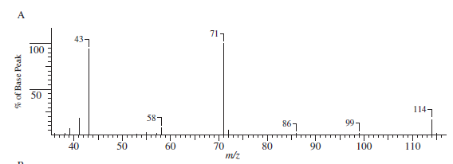
Practice #1
%C = 73.75%
%H = 12.40%
Notes:
Practice problem for use next week in review of MS and IR.

Slide 35
Practice #1, Continued
Notes:
In addition to the MS and IR from last semester, we now add on the two NMR spectra.

Slide 36
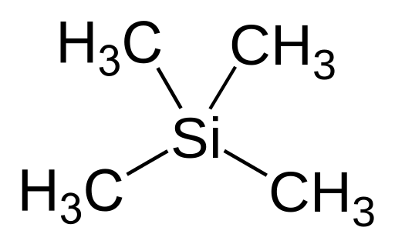
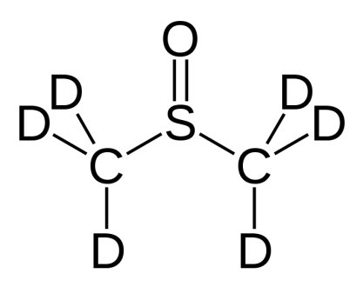
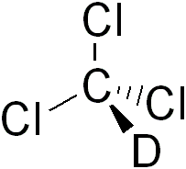
Internal Standards & Solvents
An internal standard, which is calibrated to appear at the highest up-field position (0 ppm) is used for all NMR spectroscopy
TMS = tetramethylsilane
Why use TMS?
DMSO – d6 (DMSO – d5) and CDCl₃ are common solvents used in NMR sample preparations
DMSO = dimethyl sulfoxide
CDCl₃ = deuterated chloroform
Why use deuterium?

Slide 37
¹³C NMR Terminology
Signal peak intensity
How high/intense the peaks are
Resonance peak/signal
peaks/signals that appear in a spectra
Up-field
Towards 0 ppm – resonance peaks up-field tend to be saturated
Down-field
Towards 220 ppm – resonance peaks shifted this direction tend to be unsaturated
Spin splitting
Pattern of peaks that shows the number of hydrogens bonded to a carbon

Slide 38
¹H-NMR Terminology
Signal peak intensity/relative area/intensity
How high/intense the peaks are
Tells us relative number of hydrogens causing resonance
Resonance peak
Peaks that appear in a spectra
Up-field
Towards 0 ppm – resonance peaks up-field tend to be saturated
Down-field
Towards 12 ppm – resonance peaks dn-field tend to be unsaturated
Signal splitting
Pattern of peaks that shows the number of hydrogens bonded to an adjacent atom(s)

Slide 39
Systematic ¹³C-NMR Interpretation
Look at the spectrum! Don’t let the information overwhelm you, but put it together like a puzzle.
How many resonance peaks appear?
What does this tell you?
Label TMS and DMSO (if present)
Look at the chemical shift – use correlation chart!
Upfield or downfield?
What does this tell you?
Are there electronegative atoms present?
What does the carbon-hydrogen splitting tell you about the # of hydrogens attached to a given carbon?

Slide 40
Systematic ¹H-NMR Interpretation
Look at the spectrum! Don’t let the information overwhelm you… Put it together like a puzzle.
How many resonance peaks appear?
What does this information tell you?
Label TMS and DMSO or CDCl₃ (if present)
Look at the chemical shift – use your correlation chart!
Are peaks up-field or down-field?
What does that tell you?
Are there electronegative atoms present?
What does the peak intensity/relative area/integration tell you?
What does the splitting tell you?

Slide 41
Typical Chemical Shifts in Carbon NMR Spectra

