Slide 1
Synthesis of dibenzalacetone
Chemistry 318
Fall 2018

Slide 2
Schedule of day:
PPE check – at the door
Pre-lab check – at the door
Quiz
Recitation
Synthesis of Dibenzalacetone
Safety
Put bags away
Goggles
Gloves
Lab Coat
LAB!

Slide 3
Due Dates
Today
Synthesis of Banana Oil Report due
End of lab – notebook copy pages (Synthesis of dibenzalacetone)
Next Week
At the beginning of lab – Synthesis of Dibenzalacetone Report
See “Notebook & Report Formats” on Bb for instructions for a synthesis report.
Two Weeks
Final Exam

Slide 4
Synthesis of Dibenzalacetone
This reaction is an example of an aldol condensation.
The reaction is also a mixed aldol, between and aldehyde and a ketone.
The product is quite stable because of conjugation (resonance stabilization), and so product formation is highly favored.

Slide 5
Synthesis of Dibenzalacetone
Only the ketone has an alpha-H that can be removed by OH⁻ base to form the enolate:
The carbonyl group in the aldehyde is more reactive than the carbonyl of the ketone:

Slide 6
Synthesis of Dibenzalacetone
The tetrahedral intermediate from addition is protonated:
Then dehydration occurs to give a stable conjugated product (α,β-unsaturated ketone):
The tetrahedral intermediate from addition is protonated:

Slide 7
Synthesis of Dibenzalacetone
The reaction is repeated by a) removing the α-H from the newly-formed ketone; b) the enolate reaction with the aldehyde; c) followed by dehydration:
The product has two trans double bonds (more stable).

Slide 8
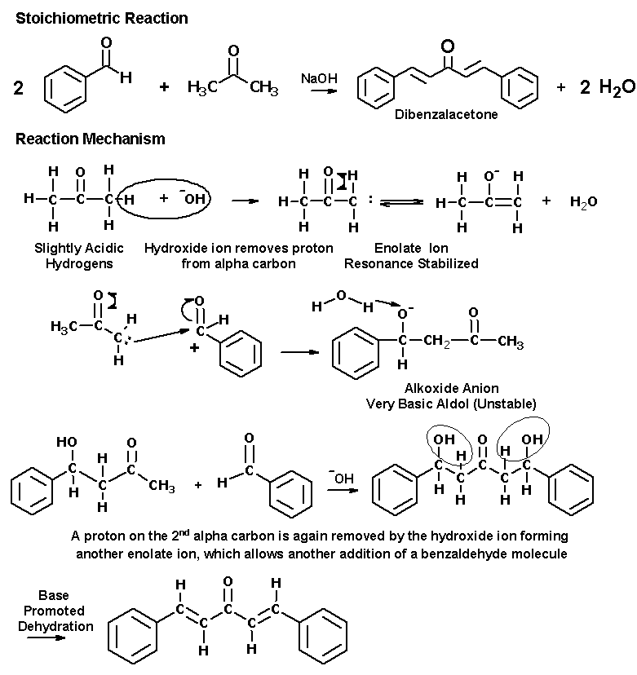
Synthesis of Dibenzalacetone Overall

Slide 9
Experiment Notes
You will need to do several calculations to convert mass, volume, and moles of reagents. Make sure your pre-lab contains the necessary densities, M.W.’s, etc.
The experiment is very simple – follow the instructions in the Manual.
Also see the additional instructions for TLC that are linked to the CHEM 313 syllabus.
You will need to calculate the quantity of acetone to use based on the amount of benzaldehyde that is in your vial.
Weigh the vial + contents; pour contents into a small beaker and cover with a watch glass; weigh empty vial.
Calculate the moles of benzaldehyde in the beaker.
Calculate the moles and volume of acetone required for the 2:1 stoichiometry. Add the calculated volume of acetone to the beaker.

Slide 10
Experiment Notes
Be sure the water you wash the filtered crystals with is ice cold.
Pressed the air-dried solid between two pieces of filter paper to further dry it.
Place the crystals a pre-weighed weigh boat and determine the mass of your (semi)-dried product.
Perform a TLC as instructed in the Manual and document linked to the course syllabus.

Slide 11
Experiment Notes
Store the product crystals in the class storage drawer.
Submit your TLC to the instructor.

