Slide 1
Types of scheduling problems
Project scheduling - Chapter 4
Job shop - Chapter 5 (shifting bottleneck)
Flexible Assembly systems- Chapter 6 (profile fitting, Grouping and Spacing)
Unpaced and paced without bypass
Flexible Flow systems - Chapter 6 (flexible flow line loading FFLL)
With bypass
Lot sizing and scheduling - Chapter 7 (frequency fixing and sequencing FFS)

Slide 2
MPS
Minimum part set
MPS is the smallest size set, which repeats.
Multiple units of each job and they are sequenced if there are sequence dependent set up costs.
Jobs in a MPS do not repeat (J1, J2, J3, ….)
Identical units of a job are processed all together

Slide 3
Lot Sizing and Scheduling
A set of identical jobs may be very large in size
Set up times and set up costs are very high
Definition: run – uninterrupted processing of a series of identical items
If a run is long then inevitably there will be inventory holding costs
Long-run is also known as continuous manufacturing
Obj func. is to minimize the total cost, which includes the inventory holding costs and the setup costs
Optimal schedule is often a tradeoff between the above two costs.
It is required to determine the run length – lot sizes by a trade-off between inventory holding costs and the setup costs and the order of the runs – minimize setup times and set-up costs
The above problem is called ELSP – economic lot scheduling problem
Solved using FFH heuristic- frequency fixing and sequencing heuristic

Slide 4
Lot Sizing and Scheduling
n different jobs, each job has several (usually large # of units)
p_{j} – processing time of job j
q_{j} is the rate of production per unit time = 1/p_{j}
d_{j} is the constant demand per unit time
h_{j} is the holding cost per unit time for job j
If job j is followed by job k then set up cost is c_{jk} and set up time is s_{jk}
x is the cycle length (time) (production time + idle time if setup time < idle time or production time + setup time if setup time > idle time)
Also the sequence of the cycle has to be determined

Slide 5
Lot Sizing and Scheduling
Applications
Chemical, paper, pharmaceutical, aluminum and steel industries where set up and inventory costs are high
Walmart type stores where ordering and inventory costs are high.

Slide 6
Lot Sizing and Scheduling
1 job and 1 machine
Determine EOQ – economic order quantity (lot size) - dx
Also expressed in terms of the length of the production run (cycle time) - x
Tradeoff between inventory holding and set-up time costs
Assume q>d production rate/unit time > demand/unit time
dx/q = quantity produced in a cycle/production rate per unit time
The inventory level in a cycle (run) increases at q-d per unit time, so max inventory builds till (q-d)dx/q in a run (cycle)
Then production stops and inventory depletes at d/unit time until it reaches zero and the next cycle starts.
Average inventory level in a cycle is ½ (q-d)dx/q

Slide 7
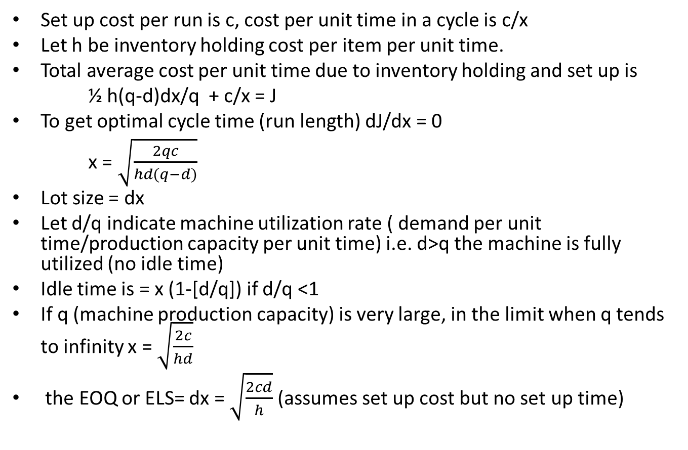
Lot Sizing and Scheduling
Set up cost per run is c, cost per unit time in a cycle is c/x
Let h be inventory holding cost per item per unit time.
Total average cost per unit time due to inventory holding and set up is
½ h(q-d)dx/q + c/x = J
To get optimal cycle time (run length) dJ/dx = 0
x = $\sqrt{\frac{2qc}{hd(q−d)}}$
Lot size = dx
Let d/q indicate machine utilization rate ( demand per unit time/production capacity per unit time) i.e. d>q the machine is fully utilized (no idle time)
Idle time is = x (1-[d/q]) if d/q <1
If q (machine production capacity) is very large, in the limit when q tends to infinity x = $\sqrt{\frac{2c}{hd}}$
the EOQ or ELS= dx = $\sqrt{\frac{2cd}{h}}$ (assumes set up cost but no set up time)

Slide 8
Lot Sizing and Scheduling
If set up time s <= idle time x (1-[d/q]) then x = $\sqrt{\frac{2c}{hd}}$
Ignore set up time. Set up happens when machine is idle.
If set up time s > idle time x (1-[d/q]) then x = $s/(1−\frac{d}{q})$
The machine is never idle.

Slide 9
Rotation schedules
1 machine but n jobs (a job usually has multiple identical units)
With and without set-up time but with set up costs
Sequence dependent and sequence independent set up time
Sequence dependent s_{jk}
Sequence independent s_{jk} = s_{k}
The cycle times of the n jobs must be identical. Hence, it is called rotation schedule
A cycle cannot have a job repeating itself within the cycle
Determine the cycle time x and lot sizes d_{j}x (Remember x incorporates set up cost)
Case 1 : no set up time
Case 2 : Sequence independent set up time but setuptime <=idle time
- no sequencing
- case 2 reduces to case 1
Case 3 : Sequence independent set up time but setuptime >idle time
- no sequencing
Case 4 : Sequence dependent set up time which is the same as a TSP problem (setuptime <=idle time)
Minimize the sum of set up times to obtain a sequence
Also has lot sizing as a separate problem (x is same as case 2, which incorporates the set up cost)
Case 5: Sequence dependent set up time which is the same as a TSP problem (setuptime >idle time)
Minimize the sum of set up times to obtain a sequence
Also has lot sizing as a separate problem (x is same as case 3, which incorporates the set up time)

Slide 10
Rotation schedules
Length of production run of job j is d_{j}x/q_{j}
Average inventory level ½ (q_{j}-d_{j})d_{j}x/q_{j} = ½ (d_{j}x – d_{j}²x/q_{j})
Total average cost per unit time due to inventory holding and set up is $\sum_{j=1}^{n}{\text{½ }\text{h}\text{j}\text{(}\text{qj}\text{−}\text{d}\text{j}\text{)}\text{d}\text{j}\text{x}\text{/}\text{qj}}$+ c_{j}/x = J
After taking the derivative
x= $\sqrt{(\sum_{j=1}^{n}{\frac{hjdj\left(qj−dj\right)}{2qj})−1 \sum_{j=1}^{n}{cj}}}$
Idle time = x (1-[$\sum_{j=1}^{n}{\text{d}\text{j}\text{/}\text{q}}j$]) if $\sum_{j=1}^{n}{\text{d}\text{j}\text{/}\text{q}}j$ <1
If q (machine capacity) is very large then
x= $\sqrt{(\sum_{j=1}^{n}{\frac{hjdj}{2})−1 \sum_{j=1}^{n}{cj}}}$(for cases 1, 2, and 4)
x = ($\sum_{j=1}^{n}{\text{s}\text{j}}$) / (1-[$\sum_{j=1}^{n}{\text{d}\text{j}\text{/}\text{q}}j$]) (for cases 3, and 5)

Slide 11
So far no heuristics, although you might use a heuristic for cases 4 and 5, which is same as TSP for sequencing to minimize set up times.

Slide 12
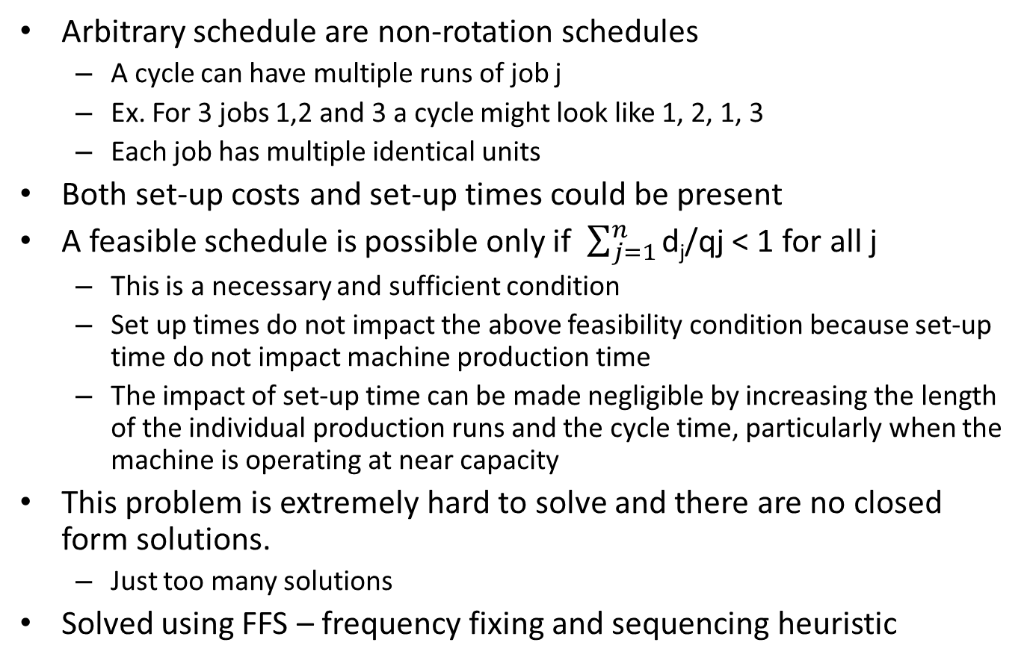
n jobs with arbitrary schedules
Arbitrary schedule are non-rotation schedules
A cycle can have multiple runs of job j
Ex. For 3 jobs 1,2 and 3 a cycle might look like 1, 2, 1, 3
Each job has multiple identical units
Both set-up costs and set-up times could be present
A feasible schedule is possible only if $\sum_{j=1}^{n}{\text{d}\text{j}\text{/}\text{qj}}$ < 1 for all j
This is a necessary and sufficient condition
Set up times do not impact the above feasibility condition because set-up time do not impact machine production time
The impact of set-up time can be made negligible by increasing the length of the individual production runs and the cycle time, particularly when the machine is operating at near capacity
This problem is extremely hard to solve and there are no closed form solutions.
Just too many solutions
Solved using FFS – frequency fixing and sequencing heuristic

Slide 13
FFS – frequency fixing and sequencing heuristic
Three phases
The computation of relative frequency
Frequency at which the various jobs have to be produced
The adjustment of relative frequency
Space them out evenly over the cycle
The sequencing phase
Determine the actual sequence
No set up times
Minimize $\sum_{k=1}^{n}{\frac{akx}{yk}}$ + $\sum_{k=1}^{n}{\frac{ckyk}{x}}$
y_{k}, x
y_{k} is the number of times job k is produced during a cycle
a_{k} = ½ (h_{k} (q_{k} – d_{k} ) d_{k}/q_{k}
Runtime of job k is t_{k} = d_{k} x/ q_{k} y_{k}

Slide 14
FFS – frequency fixing and sequencing heuristic
Phase 1
Step 1: Check ρ = $\sum_{j=1}^{n}{\text{d}\text{j}\text{/}\text{qj}}$ < 1 for all j
Step 2: solve the unconstrained optimization problem
Minimize $\sum_{k=1}^{n}{\frac{akx}{yk}}$ + $\sum_{k=1}^{n}{\frac{ckyk}{x}}$
y_{k}, x
Find a relation between y_{k}, x
Step 3: Find a_{k}
a_{k} = ½ (h_{k} (q_{k} – d_{k} ) d_{k}/q_{k}
Phase 2
Step 4: Find an appropriate x that yields integer y_{k}‘ which are also powers of two. It has been proved that rounding y_{k} to the nearest integer y_{k}‘ which is also a power of two will alter the cost to within 6% of the original solution

Slide 15
FFS – frequency fixing and sequencing heuristic
Step 5: find t_{k}’
t_{k}’ = d_{k} x/ q_{k} y_{k}
Phase 3
Apply a longest processing time first heuristic to sequence the jobs
y‘_{max} = max ( y’₁……….y’_{n})
-For each job k there are y‘_{k} jobs with t_{k}’ processing times
-Total number of jobs is $\sum_{k=1}^{n}{\text{y}\text{‘}\text{k}}$
-There are y‘_{max} parallel machines
-The job j with $\text{y}\text{‘}\text{k}$ frequency must be evenly spaced
-Start with highest $\text{y}\text{‘}\text{k}$ to sequence (space them evenly). Break any tie by choosing the highest $\text{t}\text{‘}\text{k}$
-Continue until all jobs are sequenced. Concatenate to get a single sequence

Slide 16
FFS – frequency fixing and sequencing heuristic
With set up times
Minimize $\sum_{k=1}^{n}{\frac{akx}{yk}}$ + $\sum_{k=1}^{n}{\frac{ckyk}{x}}$ + λ $\left(\sum_{k=1}^{n}{\frac{skyk}{x}} −(1−\frac{dk}{qk})\right)$
y_{k}, x
y_{k} is the number of times job k is produced during a cycle
a_{k} = ½ (h_{k} (q_{k} – d_{k} ) d_{k}/q_{k}
y_{k} = x $\sqrt{\frac{ak}{ck+λsk}}$
If there are idle times and setup time<= idle time then λ is set to zero
If there are no idle times then λ has to satisfy
$\left(\sum_{k=1}^{n}{\text{s}\text{k} \sqrt{\frac{ak}{ck+λsk}}}=(1−\frac{dk}{qk})\right)$

