Slide 1
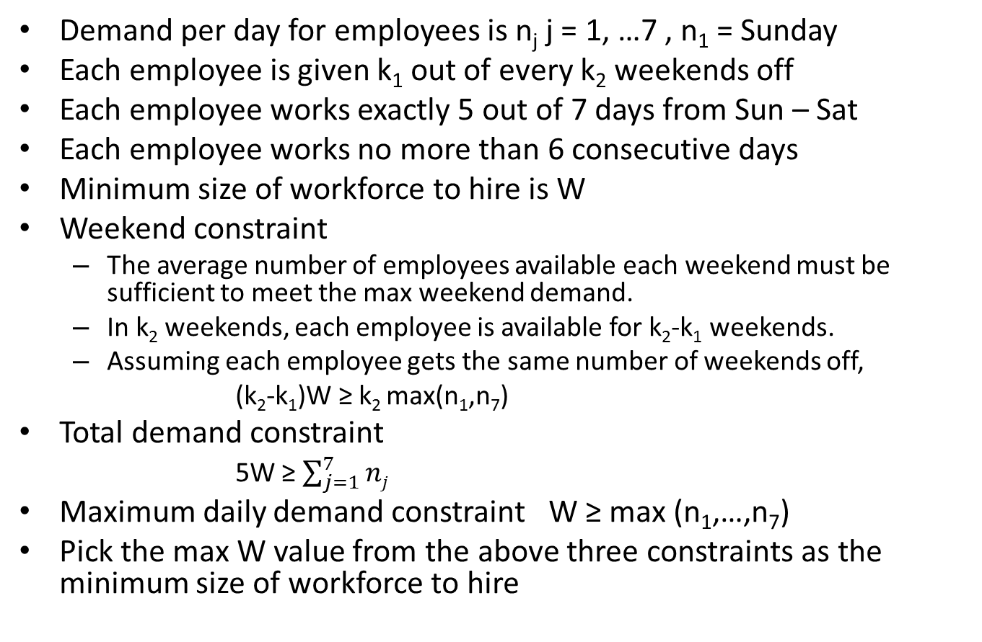
Workforce scheduling – Days off scheduling
Demand per day for employees is n_{j} j = 1, …7 , n₁ = Sunday
Each employee is given k₁ out of every k₂ weekends off
Each employee works exactly 5 out of 7 days from Sun – Sat
Each employee works no more than 6 consecutive days
Minimum size of workforce to hire is W
Weekend constraint
The average number of employees available each weekend must be sufficient to meet the max weekend demand.
In k₂ weekends, each employee is available for k₂-k₁ weekends.
Assuming each employee gets the same number of weekends off,
(k₂-k₁)W ≥ k₂ max(n₁,n₇)
Total demand constraint
5W ≥ $\sum_{j=1}^{7}{nj}$
Maximum daily demand constraint W ≥ max (n₁,…,n₇)
Pick the max W value from the above three constraints as the minimum size of workforce to hire

Slide 2
Workforce scheduling – Days off scheduling
n is the max weekend demand n = max(n₁,n₇)
Surplus number of employees in day j is u_{j} = W – n_{j} for j = 2,…,6 and u_{j} = n-n_{j} for j = 1, 7
Since max weekend demand is n the remaining W-n can take the weekend off
See text for the heuristic and an example

Slide 3
Shift scheduling
m time intervals that are not equal
During each time interval i, i = 1,…,m, b_{i} personnel are required
n different shift patterns and each employee is assigned to only one pattern j, j = 1,…,n
Shift pattern j is denoted as vector (a_{1j}, a_{2j}, …, a_{mj}) where a_{ij} = 1 if period i is a working period in shift j
c_{j} is the cost of assigning a person to shift j
x_{j} is the number of people assigned to shift j
Solve using integer programming
Min cx a₁₁……….a_{in}
st Ax≥b A= a₂₁..........a_{2n}
x≥0, x = integer a_{m1}……….a_{mn}
Strongly NP Hard- hence use LP relaxation and solve in polynomial time.
Easy to solve if each column has a contiguous set of 1’s
Or use heuristics

Slide 4
Cyclic Staffing Problem
Minimize the cost of assigning people to a m-period cyclic schedule
Sufficient workers are available at time i to meet the demand of b_{i}
Each person works a shift of k consecutive periods and is off for the m-k periods
Period m is followed by period 1
x_{j} is the number of people assigned to shift j
A = 1001111
1100111 for a 7 day cycle with 2 consecutive days off
1110011
and so on

Slide 5
Cyclic Staffing Problem
Solve the LP relaxation an obtain x_{j}’ = x₁’ ,……, x_{n}’
If x_{j}’ are integers then it is the optimal solution. STOP
Else from two LPs LP’ LP” and add constraint
x₁ + x₂ +,…,+ x_{n} = x₁’ +,……,+ x_{n}’ (rounded to the lower side) to the original problem and solve LP’
x₁ + x₂ +,…,+ x_{n} = x₁’ +,……,+ x_{n}’ (rounded to the upper side) to the original problem and solve LP”
LP” has an optimal solution that is integer
If LP’ does not have a feasible solution then LP” is optimal
If LP’ has a feasible solution, then it has an optimal solution that is integer and the solution to the original problem is the better one among the solutions to LP’ and LP”

Slide 6
Crew Scheduling
m jobs – flight legs i = I,…,m
n - feasible and all possible combinations of flight legs that a crew can handle – these are n feasible and all possible round trips j, j = 1,…,n that can be generated from the flight legs.
c_{j} cost of round trip j
Each flight leg must be covered by exactly one round trip b_{i} = 1
Minimize cost
a_{ij} is 1 if flight leg i is covered by round trip j
x_{j} is 0-1 variable and denotes whether a round trip is selected.
Min cx a₁₁……….a_{in}
st Ax=1 A= a₂₁..........a_{2n}
x=0-1, x = integer a_{m1}……….a_{mn}
NP hard. So use heuristics

