Slide 1
Reservation Systems
Parallel machine environment with n jobs and m machines
The processing time of the job has to fit within a time window and there may or may not be slack
In an assignment problem there is no time window concept and typically there are equal jobs and machines and the objective is to assign in such as way that the makespan is minimized.
The time window is specified by the release date r_{j} and due date d_{j}
It may be the case that all n jobs cannot be processed and the scheduler has to decide which jobs to process.
Obj fnc – maximize number of jobs processed or minimize the total amount of processing time
Examples: Factories must decide which orders to accept and which one to reject, likewise hotel room and car rental reservations

Slide 2
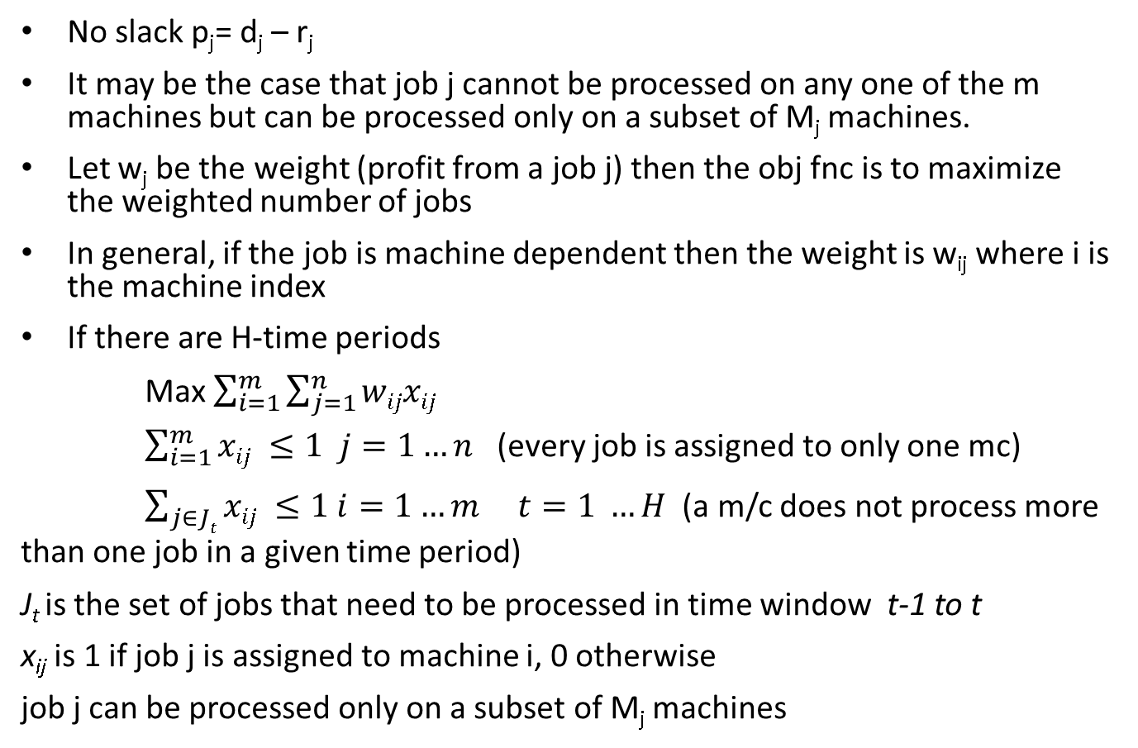
Reservation Systems without slack (feasibility problem)
No slack p_{j}= d_{j} – r_{j}
It may be the case that job j cannot be processed on any one of the m machines but can be processed only on a subset of M_{j} machines.
Let w_{j} be the weight (profit from a job j) then the obj fnc is to maximize the weighted number of jobs
In general, if the job is machine dependent then the weight is w_{ij} where i is the machine index
If there are H-time periods
Max $\sum_{i=1}^{m}{\sum_{j=1}^{n}{wijxij}}$
$\sum_{i=1}^{m}{xij ≤1 j=1…n}$ (every job is assigned to only one mc)
$\sum_{j∈Jt}{xij ≤1 i=1…m t=1 …H }$ (a m/c does not process more than one job in a given time period)
J_{t} is the set of jobs that need to be processed in time window t-1 to t
x_{ij} is 1 if job j is assigned to machine i, 0 otherwise
job j can be processed only on a subset of M_{j} machines

Slide 3
Reservation Systems without slack
The problem is solvable in polynomial time only if p_{j} =1 and is equal for all j. Each time period is an independent assignment subproblem
Otherwise it is NP hard because processing times can overlap and each time period is no longer independent
If w_{ij} =1 for all i, j and if each set M_{j} contains all m machines then a simple heuristic can solve the above problem
Arrange jobs in the increasing order of their release times r_{j}
Let J denote the set of jobs already selected for processing
Obj fnc: Maximize the number of jobs processed
If a machine is available at r_{j} then assign job j, and add j to set J
If a machine is not available then calculate completion time
C_{j*} = max (C_{k}) for k in J
If C_{j} > C_{j*} do not include j in J and go to the next unassigned j. Otherwise delete job j* from J and assign j to the freed machine

Slide 4
Reservation Systems without slack
Job 1 2 3 4 5 6
p_{j} 6 1 4 2 3 3
r_{j} 2 7 5 2 1 0
3 machines in parallel
Calculate d_{j}
d_{j} 8 8 9 4 4 3
In increasing order of r_{j} Job sequence is 654132. However, Job 1 cannot be scheduled. Final schedule is 65432.
If p₄ = 8 then d₄ = 10
J = {6,5,4}
C_{j*} = max (C_{k}) for k in J = 10 and j* = 4
C₁ = 8 < C_{j*}
So, delete 4 from J and add 1, J= {6,5,1} . Job 4 cannot be scheduled
Then add job 3 when job 6 is completed J = {6,5,1,3}
Then add job 2 when job 5 is completed J = {6,5,1,3,2}
In summary, with J1 machine 3 was freed on day 8, which allows the next reservation to start (with J4 it was day 10). This increases the # of jobs processed over time. You also make a decision whether to accept a job or not.

Slide 5
Reservation Systems without slack
Job 1 2 3 4 5 6
p_{j} 6 1 4 2 3 3
r_{j} 2 7 5 2 1 0
How many machines to do all the jobs?
Calculate d_{j}
d_{j} 8 8 9 4 4 3
In increasing order of r_{j} Job sequence is 654132
Dual problem: How many machines (minimum number) to process all the jobs?
Arrange j jobs in the increasing order of their release times r_{j}
Assign job 1 to machine 1
Suppose j-1 jobs are assigned to machines 1,2….,i then it is likely that jobs have been assigned to the same machine. So $i ≤j−1$
Next assign job j to the available machines from 1,2,…,i. If no machine is available at r_{j} then assign j to i+1 th machine.

Slide 6
Reservation Systems with slack
Slack p_{j} ≤ d_{j} – r_{j}
Trivial case
p_{j} = 1 for all j, w_{j} is also equal, and set M_{j} has all m machines
A schedule can be worked out progressively in time to maximize the number of jobs assigned
A more difficult case if p_{j} and w_{j} are unequal

Slide 7
Reservation Systems with slack – unequal p_{j}
Unequal processing times and weights
M_{j} has different machines m
Maximizing the weighted number of jobs processed is a NP-hard problem
Use a heuristic but there is no guarantee for obtaining an optimal solution

Slide 8
Timetabling with resource or workforce constraints
Each job uses only one type of tool (resource, workforce)
No precedence constraints
W₁ identical units of the tool are available (say 10 operators)
Job j needs W_{1 j} of these tools (say 5 operators)
Job k needs W_{1 k} of these tools (say 6 operators)
If W_{1 j} + W_{1 k} > W₁ then the jobs j and k cannot be scheduled at the same time
Bin-packing problem in combinatorial optimization with bin capacity of W₁ and job j has W_{1 j} units. Objective is to minimize number of bins
If each bin corresponds to one time period then the objective is to minimize makespan. The items packed in one bin correspond to jobs processed in that time interval
If number of bin = 1 then it is a knapsack problem.

Slide 9
Timetabling with resource or workforce constraints
Even if p_{j} is equal for all j the problem is NP hard
First fit FF heuristic
First fit decreasing FFD heuristic
Neither are optimal but FFD is better than FF

Slide 10
Timetabling with operator or tooling constraints
Unlimited number of identical parallel machines
All n jobs must be completed
Each job requires one or more tools (resources)
Tools are not identical - so are not interchangeable.
There are N_{p} types of tools with each type having one tool W_{l} =1 for l= 1,2,…., N_{p}.
If two jobs need the same tools then they cannot be processed at the same time
Two problems
Feasibility: Find a timetable that completes all jobs in a given time horizon H
Optimization: Process all jobs in the shortest available amount of time
Special case of Project-scheduling but with no precedence relationship and all W_{l} = 1 (number of resources of a type)
No efficient algorithm exists even with p_{j} = 1

Slide 11
Timetabling with operator or tooling constraints
Let p_{j} =1
Find a conflict free schedule (feasibility problem)
This is equivalent to the node coloring problem
Each job is a node and is connected by an undirected arc if they need the same tools
Feasibility problem: Can the nodes be colored using H different colors so that no two connected nodes have the same color?
The associated optimization problem is to determine the minimum number of colors necessary such that no two connected nodes have the same color. Conflict-free timetable.

Slide 12
Timetabling with tooling constraints
Graph coloring heuristic
Degree of a node: number of arcs to uncolored nodes that are connected to that node
In a partially colored graph, the saturation level of a node is the number of differently colored nodes already connected to it
The first color used is labeled 1 and then the next one is 2 and so on
Step 1: Arrange the nodes in decreasing order of degree
Step 2: Color a node with max degree with color 1
Step 3: Choose an uncolored node with max saturation level. Break any tie by choosing any node with max degree among the uncolored ones
Step 4: Color the selected node using the color with the lowest possible number
Step 5: if all are colored stop otherwise go to step 3

Slide 13
Timetabling with costs
p_{j} = 1 for all j
An aversion cost c_{jk}’ for assigning job j to period k
A proximity cost c”(l) for scheduling two conflicting jobs (jobs that seek the same tool) l periods apart. c”(l) is decreasing in l
Obj fnc: minimize cost
Step 1: take job j from those unscheduled
Step 2: find all periods where job j can be assigned (no tool conflict)
Step 3: Calculate aversion + proximity cost for each time period and assign job j to the lowest cost time period
Step 4: Otherwise, find periods where job j can be scheduled by rescheduling other jobs that conflict job j
Step 5: calculate rescheduling cost for jobs that conflict job j in each time period and assign job j to the period with lowest rescheduling cost
Step 6: If rescheduling is not possible (without further conflict) then count the number of jobs that cannot be rescheduled in each time period. Assign j to the period with the smallest count. Reschedule the conflicts from that period (to which j is assigned) and send all those that conflict job j back to the list of unscheduled
If the number of times job k is bumped by the same job j reaches N then k is dropped as unschedulable.

Slide 14
Timetabling Summary
Timetabling with resource constraints
Each job uses only one type of resource (there many identical units (quantity) of the resource ) Ex of resource – people, seats in a classroom…
No precedence constraints
R identical units of the resource are available
R_{j} units needed by each job j
FF, FFD heuristic
p_{j} = 1 for all j
Timetabling with tooling constraints
Different types of tools but only 1 unit (quantity) of each type of tool
p_{j} = 1 for all j
Problem equivalent to graph coloring heuristic
No cost involved
No precedence relationship
With minimizing timetabling costs
p_{j} = 1 for all j
No precedence relationship
Everything same as above but p_{j} is different – more in workforce scheduling
Timetabling with both tooling and resource constraints
Different types of tools, multiple quantities, p_{j} is different, and there is a precedence constraint
Project scheduling

Slide 15
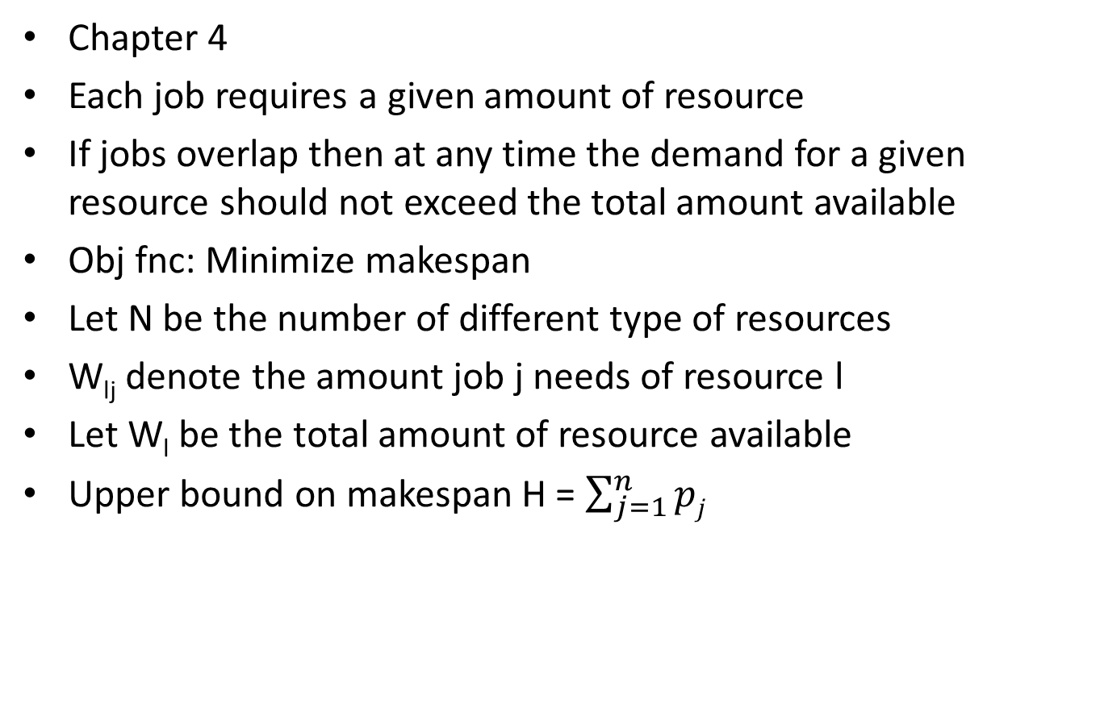
Project-Scheduling with Resource Constraints
Chapter 4
Each job requires a given amount of resource
If jobs overlap then at any time the demand for a given resource should not exceed the total amount available
Obj fnc: Minimize makespan
Let N be the number of different type of resources
W_{lj} denote the amount job j needs of resource l
Let W_{l} be the total amount of resource available
Upper bound on makespan H = $\sum_{j=1}^{n}{pj}$

Slide 16
Project-Scheduling with Resource Constraints
The integer program is NP Hard when the number of jobs, and resources grow in size
Hence, a combination of heuristics are needed for different processing times
Both FF and FFD can be adapted to solve this problem if p_{j} = 1 for all j
Also considering preemptions can improve the solution
Job interruptions

Slide 17
Project-Scheduling with Resource Constraints
Precedence constraints
Machine sequences for each job
Tooling constraints
Resource constraints – workforce
Obj fnc: minimize makespan
One possible solution
Start with shifting bottleneck and use only those sequences for lateness calculation in which the precedence constraint is satisfied on each machine.
For each interval [t-1, t] check feasibility using the tooling constraint and resource constraint.
Resequence and check feasibility again.
If p_{j} = 1 for all j then use FFD to create an initial set of bins [t-1,t] and identify the jobs in those bins
Check for tooling conflicts
Shift jobs between bins to avoid tool conflicts.
Assign the jobs to the machines in each bin while checking for precedence constraints

