Slide 1
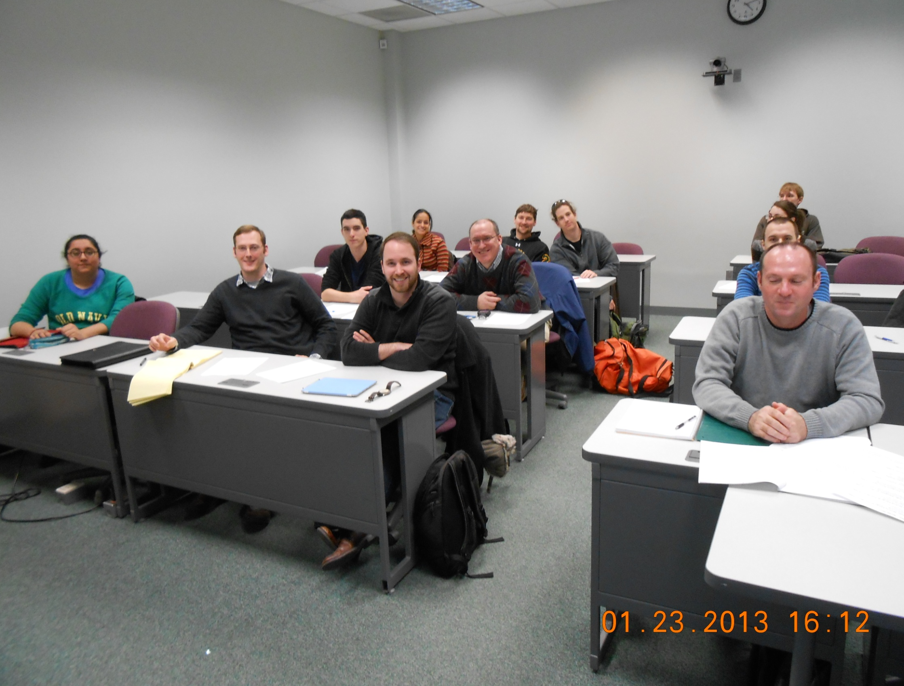
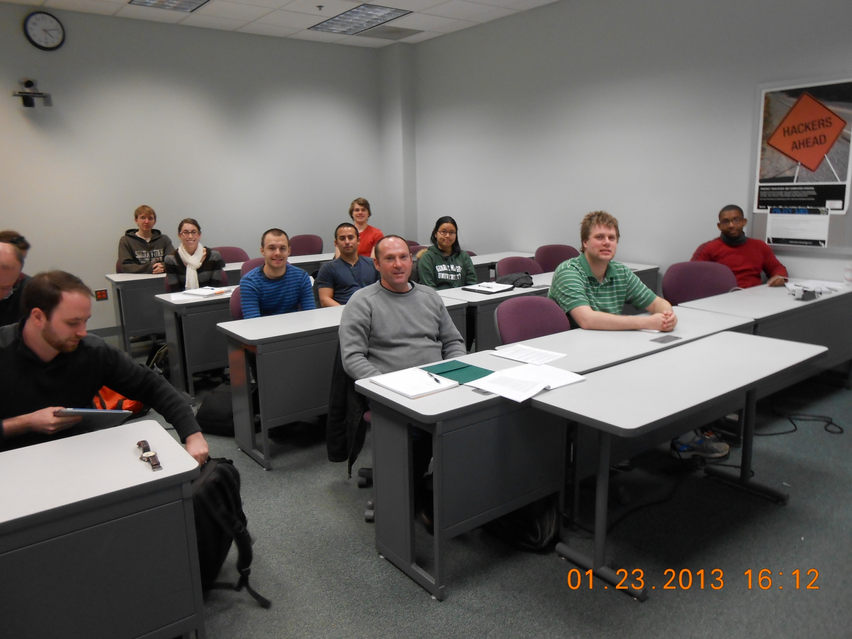
Veronica
Sharma
Abhijot Kaur
Kevin
Adams
Curtis Mason
Drew Merkle
Sam
Steiner
Dylan
Kilpatrick
Preston Thomas
Jonathan
Dooley
Grace Shin
Ben Johnson
Patrick
Kenny
Tom
Roltsch
Steven
Brown
Katelyn Fariss
Sean
Oliver
Grace
Shin
Michael
Dadok

