Slide 1
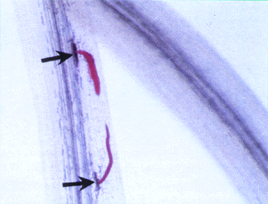
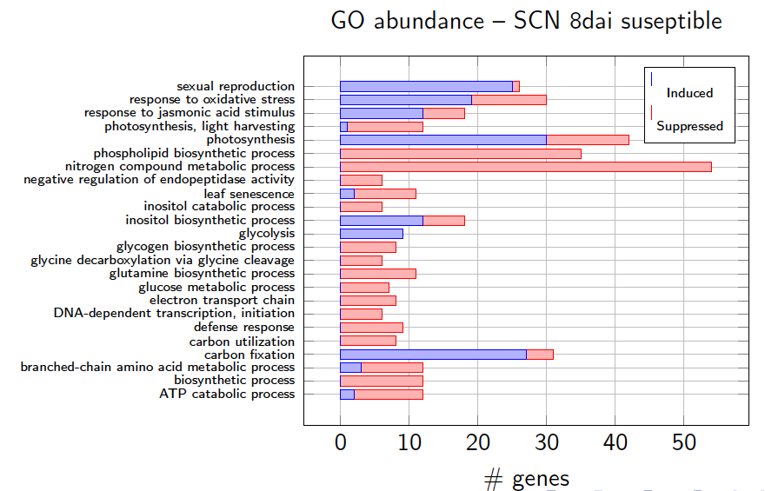
Over-represented transcription factor binding sites of promoters from soybean genes changed in expression during soybean cyst nematode infection
Parsa Hosseini^{1,2,3}, Ivan Ovcharenko², Benjamin F. Matthews¹ 1. USDA-ARS, Soybean Genomics and Improvement Laboratory, PSI
2. National Center for Biotechnology Information (NCBI) – NIH, Bethesda, MD 3. School of Systems Biology, George Mason University, Manassas, VA
Introduction
The soybean cyst nematode (SCN) causes at least $600 million in annual yield-loss in the US. It was introduced in the United States in the mid-1950s and is found in soybean fields spanning from eastern Nebraska to Mississippi.
We are developing soybean plants resistant to SCN by redesigning the soybean transcriptome. To achieve this, we are exploring soybean regulatory mechanisms upon infection with SCN and utilize high-throughput transcriptomic assays to quantify pathogen-dynamics.
Gene expression is modulated through the interactions of transcription factors (TF) with the gene promoter. If the promoter contains a DNA sequence to which the TF can bind a transcription factor binding site (TFBS), then the expression of that gene can be regulated by the TF.
Using RNA-seq, we compared soybean gene expression in soybean roots in both a resistant and susceptible interaction at 6 and 8 days after inoculation (dai) and uninoculated control roots.
In total, approximately 30 million reads were produced. Per time-point, the top 500 differentially-expressed genes were identified and their promoter sequences 2.5kb upstream from the transcription start site was extracted. We used multivariate statistical methods to measure magnitude of TFBS over-representation and show most over-represented TFBSs to be perceived during defense-response.
Differential expression & annotation
Reads generated per time point were mapped to the soybean transcriptome using BWA. Resultant, transcript differential expression was performed against the baseline using DESeq (Anders, 2010). Python scripts were then developed to derive RPKM and identify the top 500 induced and top 500 suppressed transcripts at 8dai in the Race 14 susceptible reaction. For each differential transcript, abundance of various Gene Ontology (GO) Biological Processes were identified (Figure 3).
Binding site over-representation
For each of the top 500 induced and top 500 suppressed transcripts in the 8dai Race 14 reaction, promoter sequences 2.5kb upstream from the transcription start site (TSS) were identified. To contrast transcription factor binding site (TFBS) over-representation, the software tool Marina (Hosseini et. al, in-press) was used to identify over-represented TFBSs between induced and suppressed sequences. Marina ranks TFBS over-representation from 1 to N whereby TFBSs with a rank of 1 are highly over-represented while those with a rank of N are quite the opposite. To identify over-represented TFBSs over a time course, we extended both Marina and the Compound Annual Growth Rate (CAGR) algorithm to better identify peaks in TFBS over-representation (Table 2).
Figure 1 A. Soybean cyst nematode feeding in soybean roots approximately 3 days after inoculation (dai); B. Female nematodes approximately 21 dai.
TFBS | 6dai | 8dai | CAGR
HY5 | 80 | 13 | 958%
TGA1A | 26 | 25 | 510%
GT-3b | 38 | 28 | 351%
EmBP-1* | 43 | 32 | 307%
TGA1 | 24 | 15 | 277%
ATHB5 | 20 | 3 | 223%
AGP1* | 35 | 40 | 213%
WRKY18 | 31 | 14 | 208%
AtMYB2 | 77 | 55 | 187%
ARF1 | 22 | 19 | 178%
bZIP911 | 25 | 12 | 157%
OsbHLH66 | 37 | 47 | 141%
ATHB6 | 23 | 18 | 139%
DYT1 | 11 | 76 | -1066%
ID1 | 73 | 66 | -673%
MYB98 | 66 | 54 | -509%
AtMYB77 | 78 | 59 | -340%
BLR/RPL/PNY | 68 | 61 | -296%
MYB.PH3(1) | 19 | 58 | -288%
AtMYB84 | 6 | 27 | -227%
AtMYC2 | 70 | 39 | -194%
CArG-BOX | 56 | 31 | -191%
O2 | 42 | 56 | -186%
Peking 6D
Peking 8D
Figure 2 (A). SCN in roots 6 dai; and (B) 8 dai in a resistant interaction;
(C) 6 dai and (D). 8 dai in a susceptible interaction.
Kent 6D
Kent 8D
Figure 3 – GO Biological Process abundance given the top 1,000 differentially
expressed transcripts.
Conclusions:
We identified a conserved set of 23 binding sites over-represented at 8 dai. Of this set, the top-12 most over-represented binding sites from this set were all either directly or indirectly associated in defense response. We find that our CAGR implementation identifies many over-represented TFBSs such as ATHB5, ARF1, bZIP911 and TGA1.
 |  | Race 3 (Resistant) |  | Race 14 (Susceptible)
 | Baseline | 6dai | 8dai | 6dai | 8dai
Total | 2,141,303 | 8,069,844 | 7,319,342 | 9,160,690 | 4,078,344
Filtered | 401,913 | 1,130,372 | 745,019 | 1,624,774 | 637,475
G. Max Mapped | 1,201,664 | 4,640,251 | 4,135,793 | 4,486,182 | 2,193,208
Table 2 – Almost all over-represented TFBSs have both a positive CAGR and
are associated with defense response (orange fill). Many development-specific
TFBSs decrease in over-representation from 6 to 8dai.
* TFBS indirectly associated with defense response.
Table 1 – Read counts in a susceptible and resistant soybean-SCN reaction.

