Slide 1
-This is a rough draft of our presentation

Slide 2
Video Clip…
http://www.youtube.com/watch?v=V9It24cN3_E

Slide 3
Title IX
Scholastica Torregrossa
Karyn Sykes
Allison Aycock
Javiere Gaines
Michael Olson

Slide 4
History of Title IX

Slide 5
History of Title IX Continued
1972: President Nixon signs Title IX of the Education Amendments of 1972 on June 23.
1974: Congress in July directs the Department of Health, Education and Welfare to issue Title IX regulations, including for athletics.
1975: the department issues regulations prohibiting sex discrimination in athletics and gives colleges three years to comply.
1977-78: The department puts Title IX athletic complaints on hold until further policy interpretation.
1979: final policy interpretation that includes a three-part test. Schools need to pass one part to be in compliance. First part: the number of athletes from each sex should be roughly equivalent to enrollment percentages. Second Part: a school should show a history and continuing practice of adding women's sports. Third Part: a school should show the athletic interests and abilities of women have been accommodated.

Slide 6
History of Title IX Continued
1984: The Supreme Court rules in Grove City v. Bell that Title IX does not apply to programs that do not directly receive federal aid, essentially ending its application to athletics.
1988: Overriding a veto by President Reagan, Congress passes the Civil Rights Restoration Act, which mandates that civil rights law applies to all operations of any school that gets federal funds. This effectively supersedes Grove City.
1994: The Equity in Athletics Disclosure Act is passed. The act requires schools that provide federally funded student aid and offer athletics to report annually on participation, staffing, revenue and expenses by both the men's and women's teams.

Slide 7
History of Title IX Continued
1996: The Department of Education in January issues a clarification of the 1979 policy interpretation. Much of it involves the three-part test.
2002: in January, coaches with the National Wrestling Coaches Association sues challenging the regulations of Title IX. They say that the three-part test is a quota system. The Justice Department asks in May that the suit be dismissed on technical grounds. In September, the plaintiffs ask for summary judgment. The plaintiffs want the 1979 test and 1996 clarification vacated.

Slide 8
Impact on Education
There is a lack of women in science, technology, engineering and math in college courses partly due to women’s lack of interest
People are talking about setting up a quota system to equal the numbers of men and women in these fields
In the science field educators are trying to even the numbers of men and women, however, there are three problems that need to be addressed first; confidence gap, the stress gap and the economic gap

Slide 9
Impact on Education Continued

Slide 10
Impact on Men’s Sports
Cut men’s sports; Swimming gymnastics and wrestling
130 colleges cut wrestling
UCLA dropped both swimming and gymnastics

Slide 11
UCLA 2006-2007 VARSITY ATHLETES
NCAA Division I-A | Men | Women
All Track Combined | 111 | 114
Baseball | 37 | -
Basketball | 17 | 16
Football | 111 | -
Golf | 11 | 6
Gymnastics | - | 16
Rowing | - | 109
Soccer | 31 | 36
Softball | - | 24
Swimming and Diving | - | 40
Tennis | 16 | 13
Volleyball | 30 | 22
Water Polo | 34 | 19

Slide 12
Impact on Men’s Sports Continued
Title IX does not require men’s sports to be cut
Brown University’s plan to comply with Title IX was not accepted by the court

Slide 13
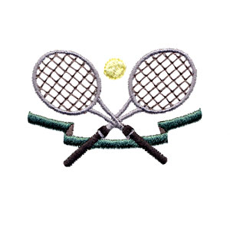
Impact on Women’s Sports
There are more opportunities for women in sports
Billie Jean King defeated a male tennis player in all three matches
Over 3,800 athletic programs have been added for women since 1972

Slide 14
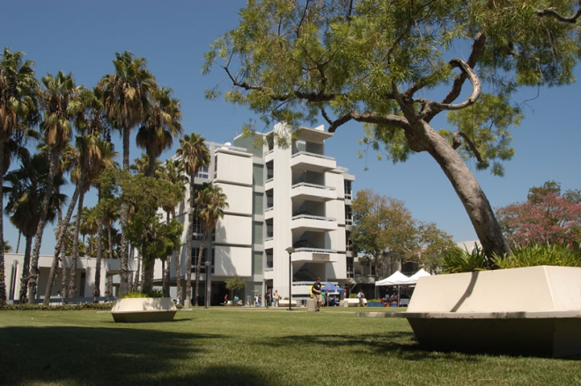
Impact on Women’s Sports Continued
Many colleges still do not comply with Title IX
80 percent have compliance issues
Rio Hondo, a college in California, has more men than women in sports even though the attendance ratio between men and women on campus are almost the same

Slide 15
George Mason University
GMU is committed to providing athletic scholarships equally among men and women.
GMU’s undergraduate enrollment is 45 percent male and 55 percent female.
The University has a 5-year Scholarship Plan
The available funding was increased from 50 percent male and 50 percent female in 1996-97 to 46 percent male and 54 percent female in 2000

Slide 16
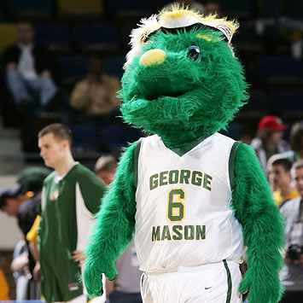
George Mason University Continued
GMU tries to maintain proportionality among men’s and women’s sports
Men’s supplies and funding is greater than that of women’s but they are attempting to level it out.
GMU also tries to make sure that both men’s and women’s teams have equal practice time and game time

Slide 17
George Mason University Continued
The budget for the men’s team is greater than the women’s but they are trying to make it equal by adding ten thousand dollars a year to the women’s budget
Tutor programs are provided for all athletes
Men’s and Women’s teams have equal accessibility to services and facilities such as locker rooms, medical and training facilities and housing

Slide 18
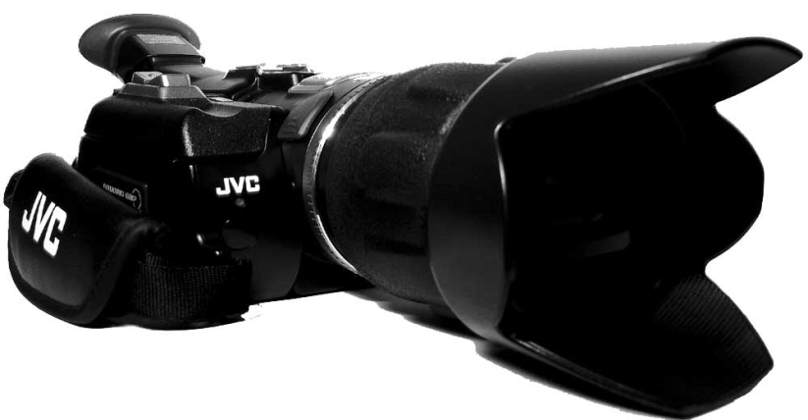
George Mason University Continued
GMU makes sure that both men and women’s sports have equal publicity
They have spent more money on recruiting men than on women

Slide 19
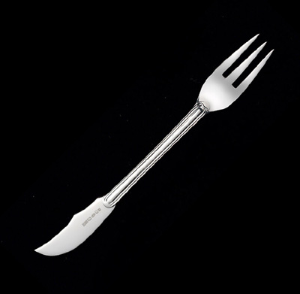
How Title IX is enforced
Three part test
E-mail survey

Slide 20
Conclusion
Education bullet
Men’s sports cut
Gave women opportunities
Title IX still shows room for improvement
Colleges bullet
Enforcement

Slide 21
Works Cited
Evelyn, Jamilah. "Calif. 2-Year Colleges Criticized on Title IX." Chronicle of Higher
Education 48.22 (08 Feb. 2002): A40. Academic Search Complete. EBSCO. [Library name], [City], [State abbreviation]. 23 Sep. 2008 <http://search.ebscohost.com/login.aspx?direct=true&db=a9h&AN=6124308&site=ehost-live>.
"Former WNBA Star to Chair Title IX Review Panel." Black Issues in Higher Education
19.12 (Aug. 2002): 9. Academic Search Complete. EBSCO. [Library name], [City], [State abbreviation]. 22 Sep. 2008 <http://search.ebscohost.com/login.aspx?direct=true&db=a9h&AN=7091025&site=eh ost-live>.
Heather Tucker. "Beating men opened doors for athletes." USA Today (n.d.). Academic
Search Complete. EBSCO. [Library name], [City], [State abbreviation]. 23 Sep. 2008
<http://search.ebscohost.com/login.aspx?direct=true&db=a9h&AN=J0E2680545
41608&site=ehost-live>.
Jill Lieber Steeg. "Disputes reflect continuing tension over Title IX." USA Today (n.d.).
Academic Search Complete. EBSCO. [Library name], [City], [State abbreviation]. 23 Sep. 2008
<http://search.ebscohost.com/login.aspx?direct=true&db=a9h&AN=J0E07010
0619308&site=ehost-live>.

Slide 22
Works Cited Continued
"Judge Criticizes Plan at Brown." New York Times (18 Aug. 1995): 14. Academic Search Complete. EBSCO. [Library name], [City], [State abbreviation]. 22 Sep. 2008 <http://search.ebscohost.com/login.aspx?direct=true&db=a9h&AN=29497739&s ite=ehost-live>.
Lichtman, Brenda. "Sexual discrimination and school sports: The Title IX compliance
challenge." USA Today Magazine 126.2634 (Mar. 1998): 62. Academic Search Complete. EBSCO. [Library name], [City], [State abbreviation]. 23 Sep. 2008 <http://search.ebscohost.com/login.aspx?direct=true&db=a9h&AN=359681&site=ehost-live>.
M., A. (2008, April). Study: Co-ed HBCUs Not Meeting Title IX. University Business, 11(4), 22-22. Retrieved September 28, 2008, from Academic Search Complete database.
"Measure's key moments." USA Today (n.d.). Academic Search Complete. EBSCO. [Library name], [City], [State abbreviation]. 29 Sep. 2008 <http://search.ebscohost.com/login.aspx?direct=true&db=a9h&AN=J0E398089361708&site=ehost-live>.
Sax, Linda. "College Women Still Face Many Obstacles in Reaching Their Full Potential." The Chronicle of Higher Education 28 September 2007.
Sax, Linda. "Her College Experience is Not His." The Chronicle of Higher Education 26 September 2008.

Slide 23
Works Cited Continued
Sax, Linda. "College Women Still Face Many Obstacles in Reaching Their Full Potential." The Chronicle of Higher Education 28 September 2007.
Sax, Linda. "Her College Experience is Not His." The Chronicle of Higher Education 26 September 2008.
Schachter, R. (2007, March). Title IX Turns 35. (Cover story). University Business, 10(3), 44-50. Retrieved September 28, 2008, from Academic Search Complete database.
Tierney, John. "A New Frontier for Title IX: Science." The New York Times 15 July 2008.
Wertheim, L. Jon, Mark Bechtel, and Stephen Cannella. "Ladies' Day." Sports Illustrated
101.19 (15 Nov. 2004): 18-19. Academic Search Complete. EBSCO. [Library name], [City], [State abbreviation]. 22 Sep. 2008. <http://search.ebscohost.com/login.aspx?direct=true&db=a9h&AN=15037258&site=ehost-ive>.
White, Kerry A. “25 years after title IX, sexual bias in K-12 sports still sidelines girls.”
Education Week 16.38 (18 June 1997): 1. Academic Search Complete. EBSCO.
[Library name], [City], [ State abreviation]. 24 Sep. 2008
<http://search.ebscohost.com/login.aspx?direct=true&db=a9h&AN=9707251660&site=ehost-live>.
Wilson, Robin and Karen Birchard. "Looking for Gender Equity in the Lab." The Chronicle of Higher Education 20 January 2006.

Slide 24
Work Cited Continued
Wilson, Robin. "The New Gender Divide." The Chronicle of Higher Education 26 January 2007.
Wolverton, B. (2006, October 6). Missouri State U. Settles Gender Claim. Chronicle of Higher Education, 53(7), A35-A35. Retrieved September 28, 2008, from Academic Search Complete database
Wertheim, L. Jon, Mark Bechtel, and Stephen Cannella. "Ladies' Day." Sports Illustrated
101.19 (15 Nov. 2004): 18-19. Academic Search Complete. EBSCO. [Library name], [City], [State abbreviation]. 22 Sep. 2008. <http://search.ebscohost.com/login.aspx?direct=true&db=a9h&AN=15037258&site=ehost-live>.

Slide 25
This concludes our presentation…
Are there any questions?

Slide 26
The End

