Slide 1
Career Corner Project!!!!!:P
Grace Votroubek

Slide 2
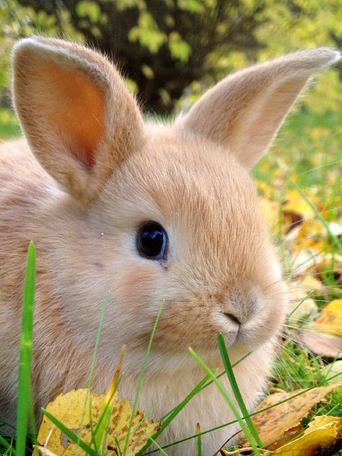
My Skills
Work’s Hard
Love’s Animals
Well Organized
People Person

Slide 3
Skills You Will Need
Organized
People Person
Focused
Hard Worker
Good Imagination
Good Listener
Respectful

Slide 4
Possible carriers
Vet
Zookeeper
Positives
Always with animals
Taking care of them every second of the day and being paid for it!
To do something I love
Annual salary: $29.900- $44.500
Negatives
Sometimes having to put a loved animal down☹
Having a case were you can’t do anything about it (or no cure)
Not a ton of vet schools

