Slide 1



Career Corner
Project

Slide 2



My Skills
Listens
Works hard
Well organized
Focused

Slide 3
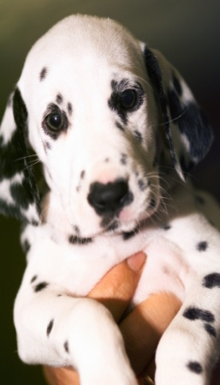


Successful Traits
Good at working with people and animals
Good at working under pressure
Honest and trustworthy
Problem solver
Multitasking
Hard worker
Responsible
Pressure

Slide 4
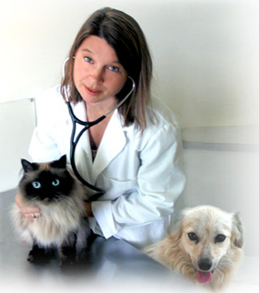

Career Choices
Veterinarians
Lawyer
Positive
Helping animals
The most annual salary is more than $142,910 a year
Learning about new things
The satisfactory of helping or saving an animal
Negatives
The least amount of the annual salary is less than $47,670 a year.
Not being able to save every animal
Hard to make it into a vet school
Have to stay another 4 years in school
Positive
Fighting for what you think is right
Learning new things
The most annual salary is about $171,552 a year
Putting bad people in jail
Negatives
Hard to make it into law school
Sometimes not being able to fight who you think is right
Have to stay in school longer
The least amount of the annual salary is about $44,311 a year.

Slide 5


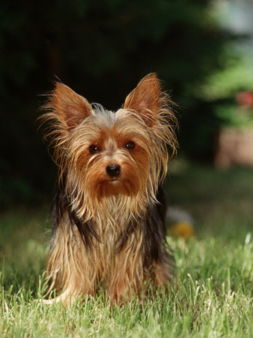
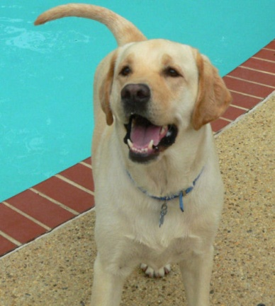
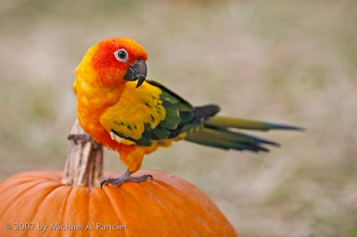
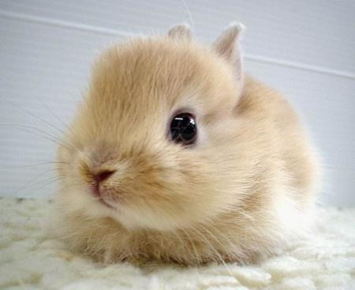

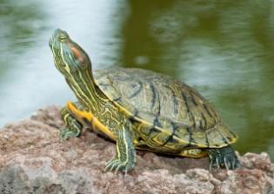
Veterinarian
I get to take care of animals
I get to see and study different types of animals.
I get a lot of money.
I learned that I’m not that much afraid of blood than I thought.

