Slide 1
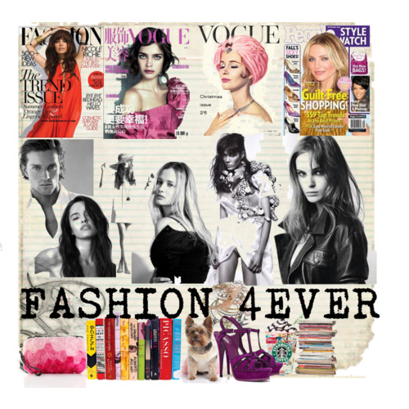
If you buy 10 or more items you get a free twenty dollar gift certificate
wwwFind us at:
.Fashion4Ever.com
703-444-555
2177 Cameron Swiggle Place
FASHION4EVER
Selling shoes and other wonderful products

