Slide 1
Lecture 1:
The Engineering Profession
C. Schaefer
Department of Electrical and Computer Engineering
George Mason University

Slide 2
Course Overview
Introduce students to:
  the engineering profession;
  engineering fundamentals and problem solving;
  engineering design principles.
Generate excitement by providing students;
  Hands-on group design projects;
  Insights into contemporary engineering topics.

Slide 3
Class Information
ENGR 107: Engineering Fundamentals (Section 3)
Meeting Time and Place
  Tuesday, 4:30 pm – 7:10 pm
  Room 122, East Building
Instructor: Carl Schaefer
    Office Hours: By Appointment only.
    E-Mail: cgschaefer@gmail.com or cschaef3@gmu.edu
    Phone: 703-331-5723
Course web site: http:/mason.gmu.edu/~cschaef3/
Course text:
  Engineering Fundamentals: An Introduction to Engineering, 4th Edition, Saeed Moaveni, Cengage Learning, ©2011

Slide 4
Grading
Group Project: 20%
Individual Design Projects/Homework: 15%
Mid-Term Exam: 30%
Final Exam: 35%
  December 14, 2010, 4:30 – 7:10 pm
Review of syllabus and class policies

Slide 5
Course Overview
Introduce students to:
  the engineering profession;
  engineering fundamentals and problem solving;
  engineering design principles.
Generate excitement by providing students;
  Hands-on group design projects;
  Hands-on individual petit projects
  Insights into contemporary engineering topics.

Slide 6
Stuff
Please read Chapter 1 and 2 of the textbook.
Semester project assigned next week.
Group assignments today

Slide 7
Do you really want to be an engineer?
Introduce the engineering profession and its various branches
Provide some answers to
  Do I really want to study engineering?
  What is engineering and what do engineers do?
  What are some of the areas of specialization in engineering?
  Which disciplinary area of engineering do I want to pursue?
  How will I know that I have picked the best field for me?
  Will the demand for my area of specialization be high when I graduate, and beyond that?
Notes:
7

Slide 8
Other References
“Engineering in History”, Richard Shelton Kirby, et al, Dover, 1990.
“Beyond Engineering: How Society Shapes Technology”, Robert Pool, Oxford University Press, 1997.

Slide 9
So, What is an Engineer?
National Council of Engineering Examiners: “Engineer shall mean a person who, by reason of his special knowledge and use of mathematical, physical, and engineering sciences and the principles of engineering analysis and design, acquired by education and experience, is qualified to practice engineering”
OK, but really, what is an engineer.

Slide 10
No Really, What is an Engineer?
Individuals who combine knowledge of science, mathematics, and economics (yes, economics, too) to solve technical problems that confront society.
Practically;
  Engineers convert scientific theory into useful application.
  Engineers help to provide for mankind’s material needs and well being.

Slide 11
What is Engineering?
Engineering is the practice and method of applying scientific and empirical knowledge to the service of humanity.
It is distinct from the physical sciences, which are studies of the natural universe.
http://vimeo.com/6623309
Source: Wikipedia (“Outline of Engineering”)

Slide 12
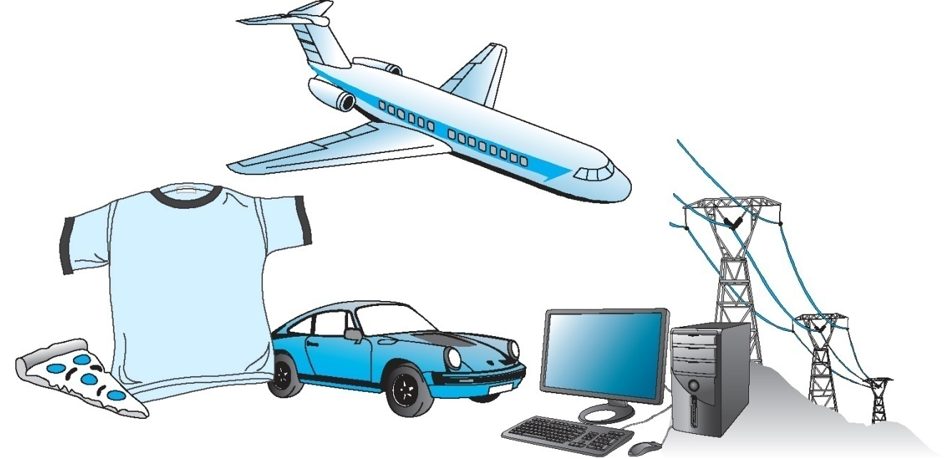
What Do Engineers Do?
Engineers apply physical and chemical laws and principles and mathematics to design millions of products and services that we use in our everyday lives

Slide 13
What Do Engineers Do?
Engineers consider factors such as cost, efficiency, sustainability, reliability, and safety in their designs
Engineers perform tests to ensure their designs can withstand the loads and conditions prescribed
Engineers continue to seek ways to improve existing products and services
Engineers continue to develop new, advanced materials to make products lighter and stronger for different applications

Slide 14
Traits of Successful Engineers
Engineers:
are problem solvers
have firm grasp of fundamental principles of engineering
are analytical, detailed oriented, and creative
have desire to be lifelong learners
have ability to work outside their area of specialization in other related fields

Slide 15
Traits of Successful Engineers
Good Engineers
have good communication and time management skills
have good “people skills”
are good team player
have ability to use modern tools to solve various engineering problems or to solve problems in various ways
are active in the profession and community

Slide 16
Some Engineering Fields
Aerospace
Architectural
Biomedical
Chemical
Civil
Computer
Electrical
Industrial
Mechanical
Mining
Marine and Ocean
Metallurgical
Nuclear
Petroleum
Systems

Slide 17
What is a Scientist?
Prime objective is increased knowledge of nature and its “laws”.
Scientists use knowledge to acquire new knowledge.
Systematic search using “scientific method”
Science
Engineering

Slide 18
The Scientific Method
Formulate a hypothesis to explain a natural phenomenon.
Conceive and execute experiments to test the hypothesis.
Analyze test results and state conclusions.
Generalize the hypothesis into the form of a law or theory if experimental results are in harmony with the hypothesis.
Publish the new knowledge.

Slide 19
The Engineer
The engineer uses knowledge of mathematics and natural sciences and applies this knowledge along with his/her judgment to develop devices, processes, structures, and systems that benefit society.
Where a scientist uses knowledge to acquire new knowledge, the engineer applies this knowledge to develop things for society.
Scientist seeks to know: engineers aim to do.

Slide 20
How Society Perceives Engineers
“By and large, engineers are paid by society to work on systems dealing with problems whose solutions are of interest to society. These systems seem to group conveniently into:
  (a) systems for material handling, including transformation of and conservation of raw and processed materials,
  (b) systems for energy handling, including its transformation, transmission, and control, and,
  (c) systems for data on information handling, involving its collection, transmission, and processing.”

Slide 21
How Engineers Picture Themselves!
“Normal people believe that if it ain’t broke, don’t fix it. Engineers believe that if it ain’t broke, it doesn’t have enough features yet!”
Author unknown; quote adapted from Va. Tech lecture on engineering.

Slide 22
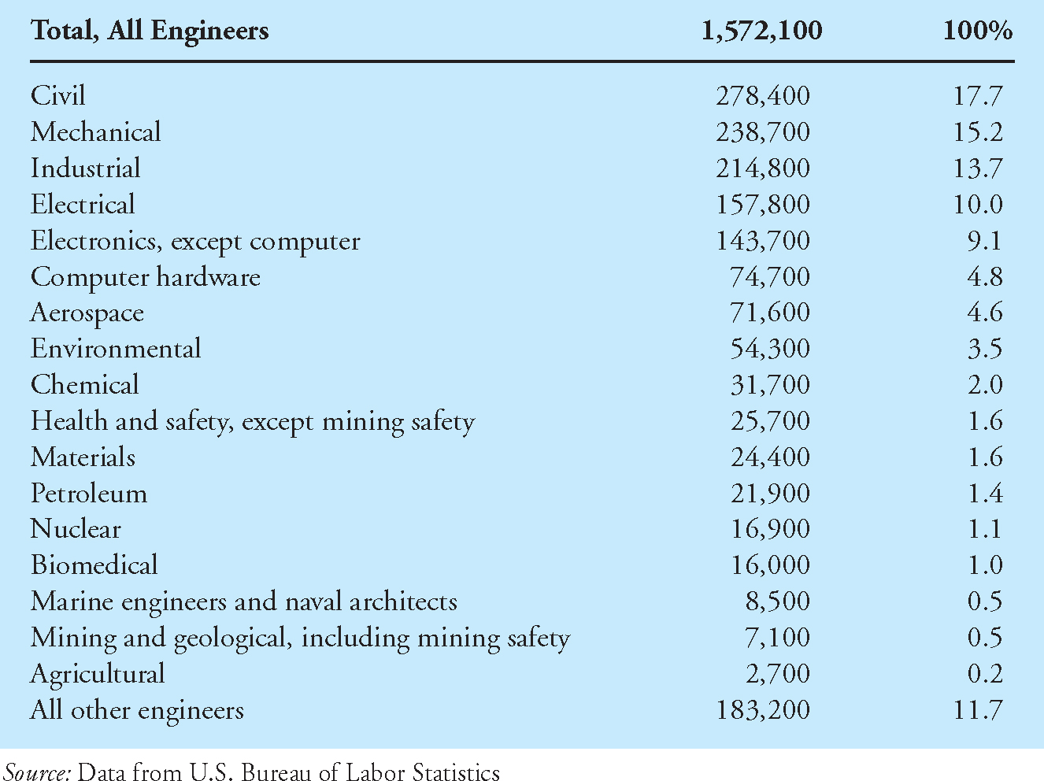
Distribution of Employment by Disciplines

Slide 23
Engineering Starting Salaries
Top 10 2010 College Degrees by Highest Starting Salary
(Average salary for all graduates = $48,351)
Petroleum Engineering: $86,220
Chemical Engineering: $65,142
Mining & Mineral Engineering: $64,552
Computer Science: $61,205
Computer Engineering: $60,879
Electrical/Electronics Engineering: $59,074
Mechanical Engineering: $58,392
Industrial/Manufacturing Engineering: $57,734
Aerospace/Aeronautical Engineering: $57,231
Information Sciences & Systems: $54,038

Slide 24
The Technology Team
Scientists
Engineers
Technologists
Technicians
Artisans/Craftsman
Note: The Technology Team should not be confused with
the project or design team. The latter is truly multidisciplinary,
and includes management, sales, purchasing, etc.

Slide 25
The Engineering Team
Engineer
  Conceptual design
  Research
  Project planning
  Product innovation
  System development
  Supervision of technologists, technicians, and craftsmen
Technologist
  Routine product development
  Construction supervision
  Technical sales
  Hardware design and development
  Coordination of work force, materials, and equipment
  Supervision of technicians and craftsman
Technician
  Drafting
  Estimating
  Field inspections
  Data collection
  Surveying
  Technical writing
Craftsman
  Uses hand and power tools to service, maintain, and operate machines or products useful to the engineering team
Ref: Introduction to Engineering, 3rd Edition, Paul H. Wright,
John Wiley and Sons, Inc., 2002.

Slide 26
Engineering Functions
Research
Design
Development
Test
Production
Deployment
Maintenance and operations
Management
Sales
Consulting
Teaching

Slide 27





Areas of Engineering Disciplines and Their Corresponding Organizations
to learn more about what engineers do……….
Chemical Engineering
Mechanical Engineering
Civil Engineering
Manufacturing Engineering
Electrical & Electronic Engineering
Notes:
27
ASCE, ASME, AIChE, IEEE, SME, NSPE

Slide 28
ABET Accreditation
ABET stands for Accreditation Board for Engineering and Technology
ABET is the only organization in U.S. that can accredit engineering and technology programs
ABET examines the credentials of the engineering program’s faculty, curricular content, facilities, and admission and graduation standards before granting accreditation

Slide 29
ABET Accreditation
Many states require engineers to be graduates of an ABET accredited engineering program before they are eligible to take the Professional Engineer (PE) exam
Visit your state’s licensing board to learn about their engineering licensing requirements
Visit http://www.abet.org to see the list of all accredited programs and learn more about ABET

Slide 30

What Do Civil Engineers Do?
Civil Engineers design and supervise, among others, the construction of roads, buildings, airports, tunnels, dams, bridges, water supply, and water and wastewater treatment systems. Civil engineering is concerned with providing public infrastructure and services.
Notes:
30

Slide 31
What Do Electrical Engineers Do?
Electrical Engineers design, develop, test, and supervise the manufacturing of electrical equipment, including lighting and wiring for buildings, cars, buses, trains, ships, and aircraft; power generation and transmission equipment for utility companies; electric motors found in various products; control devices; and radar equipment.
Notes:
31

Slide 32
What Do Electronic Engineers Do?
Electronic Engineers design, develop, test, and supervise the production of electronic equipment, including computer hardware; computer network hardware; communication devices such as cellular phone, television, and audio and video equipment; as well as measuring instruments.
Notes:
32

Slide 33

What Do Mechanical Engineers Do?
Mechanical Engineers are involved in the design, development, testing, and manufacturing of machines, robots, tools, power generating equipment such as steam and gas turbines, heating, cooling, and refrigerating equipment, and internal combustion engines.
Notes:
33

Slide 34

What Do Aerospace Engineers Do?
Aerospace Engineers design, develop, test, and supervise the manufacture of commercial and military aircraft, helicopters, spacecraft, and missiles. They may work with projects dealing with research and development of guidance, navigation, and control systems.
Notes:
34

Slide 35
What Do Biomedical Engineers Do?
Biomedical Engineers apply the laws and the principles of chemistry, biology, medicine, and engineering to design artificial limbs, organs, imaging systems, and devices used in medical procedures. They also perform research alongside of medical doctors, chemists, and biologists to better understand various aspects of biological systems and the human body.
Notes:
35

Slide 36
What Do Chemical Engineers Do?
Chemical Engineers use the principles of chemistry and basic engineering sciences to solve a variety of problems related to the production of chemicals and their use in various industries, including the pharmaceutical, electronic, and photographic industries.
Notes:
36

Slide 37

What Do Environmental Engineers Do?
Environmental Engineers apply the laws and principles of chemistry, biology, and engineering to address issues related to water and air pollution control, hazardous waste, waste disposal, and recycling. They also get involved with the development of local, national, and international environmental policies and regulations.
Notes:
37

Slide 38
What Do Manufacturing Engineers Do?
Manufacturing Engineers develop, coordinate, and supervise the process of manufacturing all types of products. They are concerned with making products efficiently and at minimum cost. They are involved in all aspects of production, including scheduling and materials handling and the design, development, supervision, and control of assembly lines.
Notes:
38

Slide 39

What Do Petroleum Engineers Do?
Petroleum Engineers specialize in the discovery and production of oil and natural gas. In collaboration with geologists, petroleum engineers search the world for underground oil or natural gas reservoirs. Petroleum engineers are also involved in monitoring and supervising drilling and oil extraction operation.
Notes:
39

Slide 40


What Do Nuclear Engineers Do?
Nuclear Engineers design, develop, monitor, and operate nuclear power equipment that drives its power from nuclear energy. They are involved in the design, development, and operation of nuclear power plants to generate electricity or to power Navy ships and submarines. They are also involved in the design and development of industrial and diagnostic medical equipment.
Notes:
40

Slide 41

What Do Mining Engineers Do?
Mining Engineers, in collaboration with geologists and metallurgical engineers, find, extract, and prepare coal for use by utility companies; they also look for metals and minerals to extract from the earth for use by various manufacturing industries. Mining engineers design and supervise the construction of aboveground and underground mines.
Notes:
41

Slide 42


What Do Materials Engineers Do?
Materials Engineers research, develop, and test new materials for various products and engineering applications. They manipulate the atomic and molecular structure of materials in order to create materials that are lighter, stronger, and more durable. They create materials with specific mechanical, electrical, magnetic, chemical, and heat-transfer properties such as graphite racquets and stealth military planes.
Notes:
42

Slide 43
To Become an Engineer
Education – accredited program, BS and/or MS level
Professional registration (for professional engineers)
  Fundamentals of Engineering Exam
  Professional Engineering Exam
Professional organizations
Life-long learning

Slide 44
The Volgenau School of Information Technology and Engineering
Applied Information Technology (B.S., M.S.)
  “ … fundamental knowledge regarding concepts, tools and methods of IT”.
Civil, Environmental, and Infrastructure Engineering (B.S., M.S.)
  “To plan, design, and maintain infrastructure systems, sophisticated civil engineering and information technology-based methods and tools have to be used for the public good.…”
Computer Science (B.S., M.S., Ph.D.)
  “… networking, architecture, parallel and distributed computing, performance evaluation, software engineering, multimedia, graphics and visualization, databases, software engineering, data mining, security, information systems, artificial intelligence, computer vision, and robotics”.
Electrical and Computer Engineering (B.S., M.S., Ph.D.)
  “ … focuses on the technical, managerial, and policy issues associated with building computer-based information systems for modern organizations”.

Slide 45
The Volgenau School of Information Technology and Engineering
Engineer Degree in Information Technology
  “… focus on the science and technology of information processing … and engineering”.
Statistics (undergrad certificate, M.S., Ph.D. through IT&E doctoral program)
  “… the theoretical and empirical study of managerial and operational processes and the use of mathematical and computer models to optimize these systems”.
Systems Engineering and Operations Research (B.S., M.S., Ph.D. through IT&E doctoral program)
  “… the process of defining, developing, and integrating quality systems. System engineers define what the system must do, analyze cost and performance of the system, and manage the development of the system”.
Bioengineering Option

Slide 46
Summary
You should have a good understanding of the significant role that engineers play in our everyday lives in providing water, food, shelter, and other essential needs.
You should have a good idea of common traits and activities of good engineers.
You should be familiar with the differences among various engineering disciplines.

Slide 47
http://www.ehow.com/video_4411644_the-engineer-profession-world-warcraft.html

Slide 48
The Engineering Profession
Questions

