Slide 1
A Review of FAERS Data for Estimation of Risk Prone Populations
Bin Lu
Chris Mynatt
Srija Ummaneni
Victoria Golden

Slide 2
Outline
Abstract
Background
History
Significance
Literary Review
About the Dataset
Limitations
Pre-Processing Methods
Post Processing Methods
Objectives
Results and Discussion
Future Work
Conclusions

Slide 3
Abstract
Notes:
Lead with bottom line up front: If you fall into X population group, you have a higher chance of experiencing an adverse drug reaction
**Victoria’s talking point

Slide 4
Drugs developed in response to new disease challenges
Over abundance of drugs without reporting system
Need for categorization of risk prone patient groups
Notes:
Overview the historical relevance of FAERS (i.e. why adverse drug reactions became a topic of concern)
These things led the to development by many countries of their own respective consolidation sources of adverse reactions
FAERS uses this information to survey the marketplace using Sentinel system
**Victoria’s Talking Point

Slide 5
Background

Slide 6
History
Dual Nature of Drugs
Drug Tolerance
Severity (statistics) & Scale of drugs
2003: Approximately 2 M patients who were exacerbated by adverse drug reactions each year and 110,000 died from adverse drug reactions
Imperfections in Regulatory System
Thalidomide Event
Organizations to Monitor Drug Safety
FDA
WHO
Tools to Track Adverse Events
FAERS database
ICH ICSR

Slide 7
Significance
Nearly 6-12 % of annual inpatients are hospitalized due to adverse drug reactions - WHO
Estimating risk prone populations
rational use of drugs
more targeted prescription
Notes:
Rational use of medicines requires that "patients receive medications appropriate to their clinical needs, in doses that meet their own individual requirements, for an adequate period of time, and at the lowest cost to them and their community". - WHO

Slide 8
Literary Review
Comparable Studies
Length of time from prescription to reaction
Peng et al
Global population prone traits in similarly typed databases
Drug Safety Research Unit - Southampton, UK
Notes:
This really just focuses on the fact that we need to talk to how others are interested in this type of data and how our experiment bolsters the information available surrounding this topic

Slide 9
About the Dataset

Slide 10
Limitations
FDA Outlined Limitations
Duplicate or incomplete reports may be present
Drugs suggested as causal factors for adverse reactions are not definitive and cannot be proven on an individual report basis
Report content has not been verified by the FDA
Incidence rates may not be established by the reports due to incomplete data

Slide 11
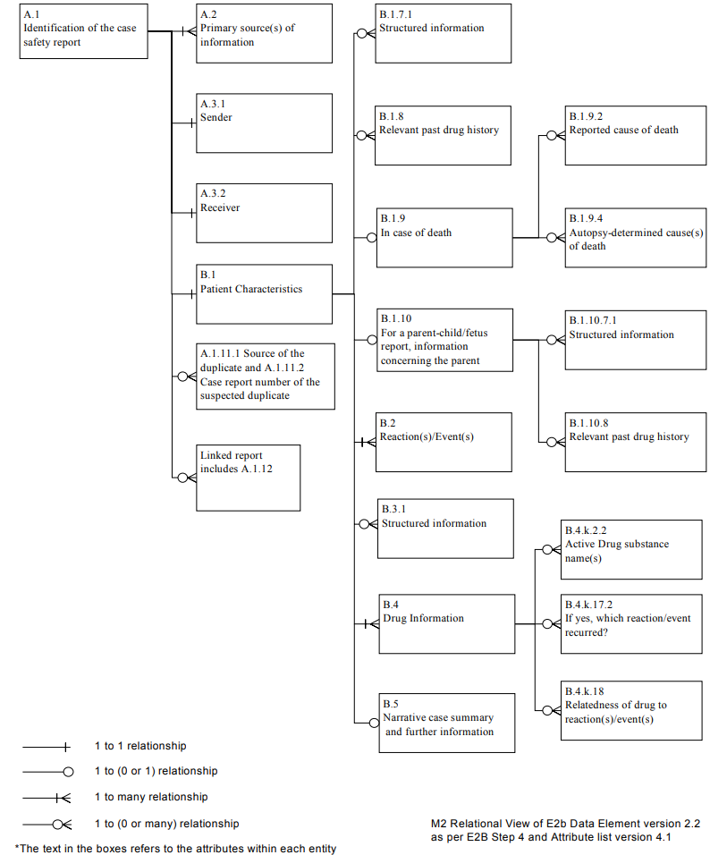
ICH ICSR
Data Specification

Slide 12
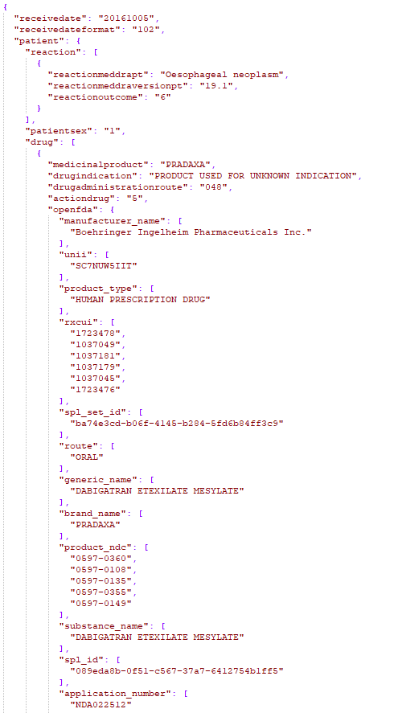
Original JSON Format
Data.gov
325 Files
3,718,300 Records

Slide 13
Novel Methods

Slide 14
Choosing Data Storage
Comma Separated Values
Easy, slow.
MySQL
Fast, difficult.
SQLite
Goldilocks.
Notes:
So now what fields do we use?

Slide 15
Parsed Fields from FAERS Report
Field Name | Field Description
safetyreportid | The 8-digit Safety Report ID number, also known as the case report number or case ID. The first 7 digits (before the hyphen) identify an individual report and the last digit (after the hyphen) is a checksum. This field can be used to identify or find a specific adverse event report.
serious | Boolean for if the adverse event was serious.
companynumb | Identifier for the company providing the report. This is self-assigned.
occurcountry | The name of the country where the event occurred.
receiptdate | Date that the most recent information in the report was received by FDA.
transmissiondate | Date that the record was created. This may be earlier than the date the record was received by the FDA.
receivedate | Date that the report was first received by FDA. If this report has multiple versions, this will be the date the first version was received by FDA.
fulfillexpeditecriteria | Identifies expedited reports (those that were processed within 15 days). (Either 'yes' or 'no').
patientonsetage | Age of the patient when the event first occurred.
patientsex | The sex of the patient. (Either 'Male', 'Female', or 'Unknown').
patientagegroup | Populated with Patient Age Group code. (Either 'neonate', 'infant', 'child', adolescent', 'adult', or 'elderly').
patientweight | The patient's weight, in kg (kilograms).
reactionoutcome | Outcome of the reaction in reactionmeddrapt at the time of the last observation. (Either 'Recovered/resolved', 'Recovering/resolving', 'Not recovered/not resolved', 'Recovered/resolved with sequelae (consequent health issues)', 'Fatal', or 'Unknown').
reactionmeddrapt | Patient reaction, as a MedDRA term. Note that these terms are encoded in British English. For instance, diarrhea is spelled diarrhoea. MedDRA is a standardized medical terminology.
seriousnessdeath | Boolean if the adverse event resulted in death.
seriousnesslifethreatening | Boolean if the adverse event resulted in a life threatening condition.
seriousnesshospitalization | Boolean if the adverse event resulted in a hospitalization.
seriousnessdisabling | Boolean if the adverse event resulted in disability.
seriousnesscongenitalanomali | Boolean if the adverse event resulted in a congenital anomaly.
seriousnessother | Boolean if the adverse event resulted in some other serious condition.

Slide 16
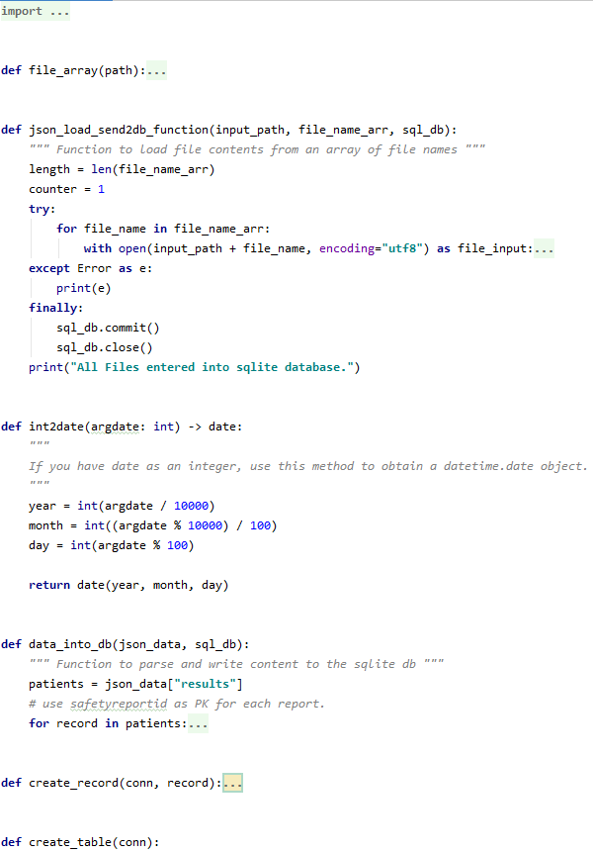
Changing Formats with Python
Data Transformation
Age
Weight
dates
Missing Data

Slide 17
Post-Processing Methods
Tableau
Visualizations
Quantitative Metrics
Machine Learning
Classification Model
Notes:
Victoria and Bin to talk about Tableau experiences/use/etc
Chris to talk about ML model

Slide 18
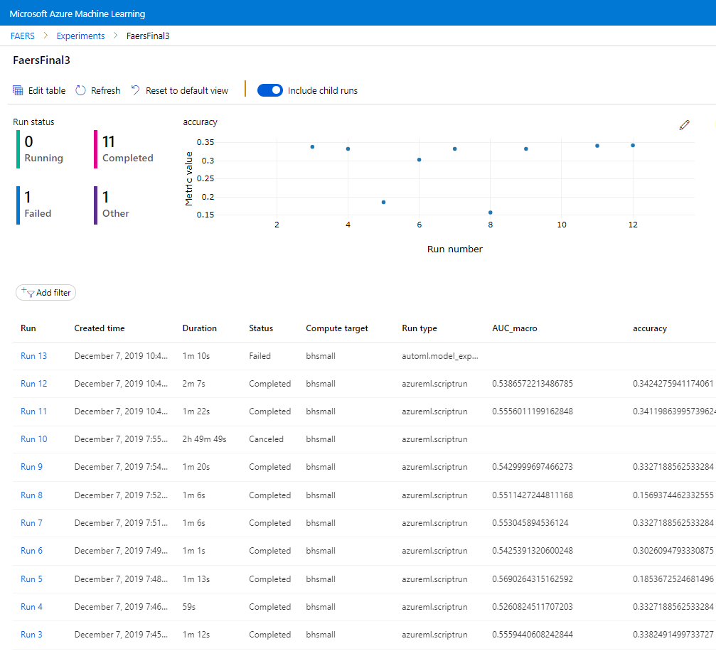
Machine Learning
Studio
Azure Machine Learning Studio
Automated ML
Identify ML Problem
Instance Selection on SQLite DB
Data Guardrails
Train-Validation Split

Slide 19
Objectives

Slide 20
Categorization of a risk prone patient population
Analyze relationships between individual physiological metadata and patient reactions
Identify differentiation in trends between male or female populations when compared to the general populous
Evaluate FAERS reports with geospatial information to review trends in patient demographics between varying nations
Create a distributable model that estimates drug reaction fatality based on patient characteristics through the use of unsupervised machine learning

Slide 21
Results and Discussion

Slide 22
USA Population
Distribution of Sex by Count of Age in Population
Notes:
This considers only the USA based records and instances where a sex was explicitly stated

Slide 23
USA Population
Sex Distributions FAERS
64% Female
36% Male
Statistically significant deviation from overall US populations*
Likelihood to have an adverse drug reaction
Females – 20% more likely
Males – 35% less likely
Notes:
* p=0.007 based on comparison to US Census data

Slide 24
Mortality Rate
USA Population
0.86%
FAERS USA Population
5%
FAERS Global Population (Exclusive of USA)
11%

Slide 25
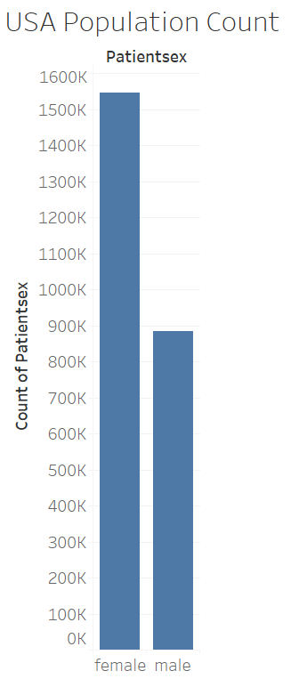
Male vs Female Distribution
United States distribution
51% Female
49% Male
Statistically significant (p=0.007)
Females prone to visiting the doctor more often than males
*Unknown values excluded to prevent any assumptions
Notes:
This can talk about the relevance of USA census data vs FAERS data

Slide 26
Global Population
Heatmap for Ranking by Country by Occurrence of Reported Country
Notes:
USA: 1
India: 15
China: 12
Gambia: 168
**Victoria’s talking point

Slide 27
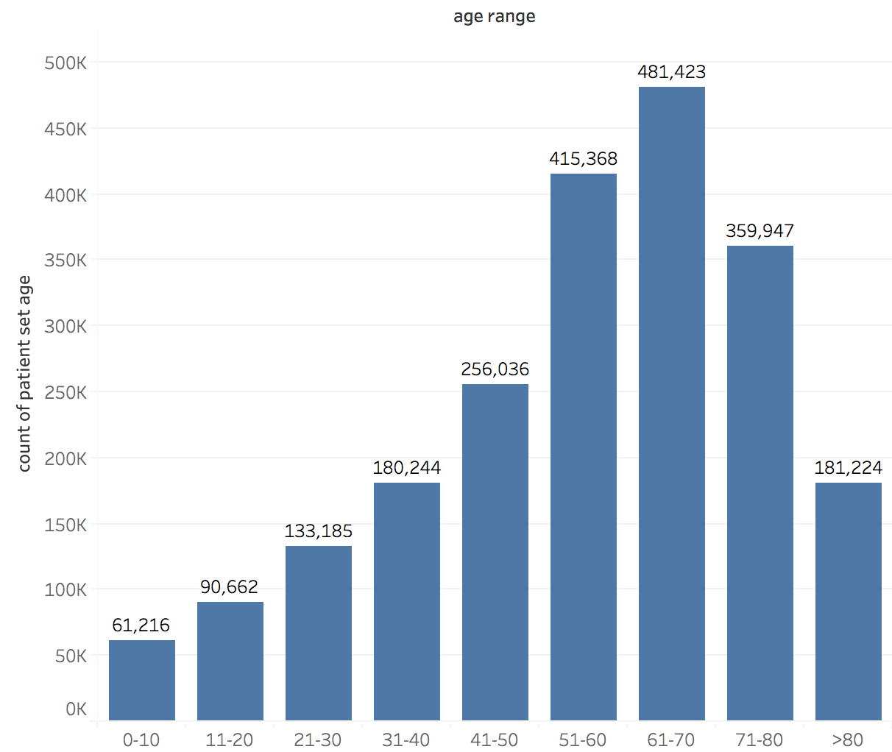
Age Classifications

Slide 28
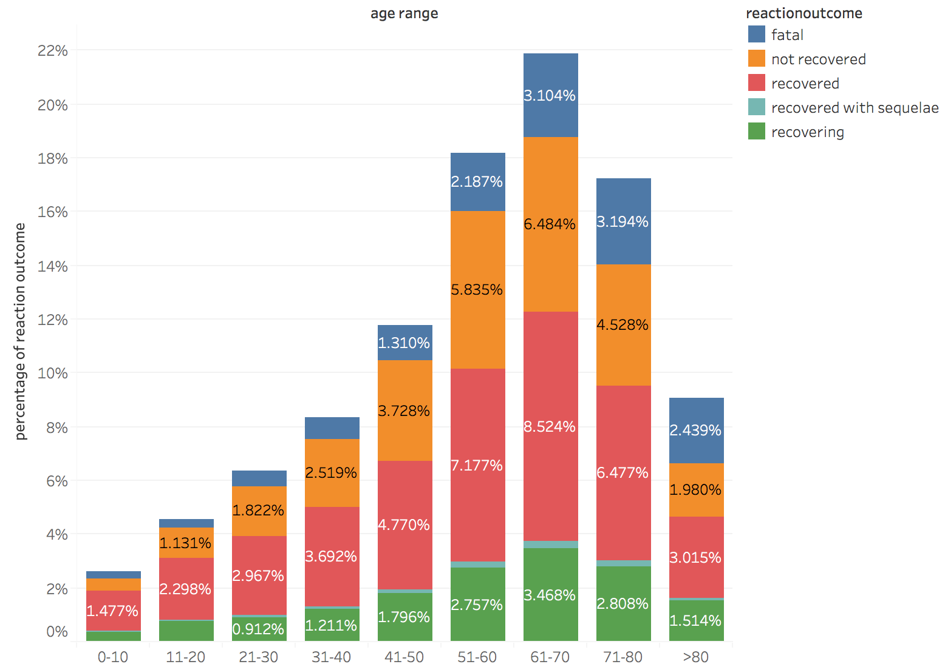
Age Group Relation to Reaction Outcome

Slide 29
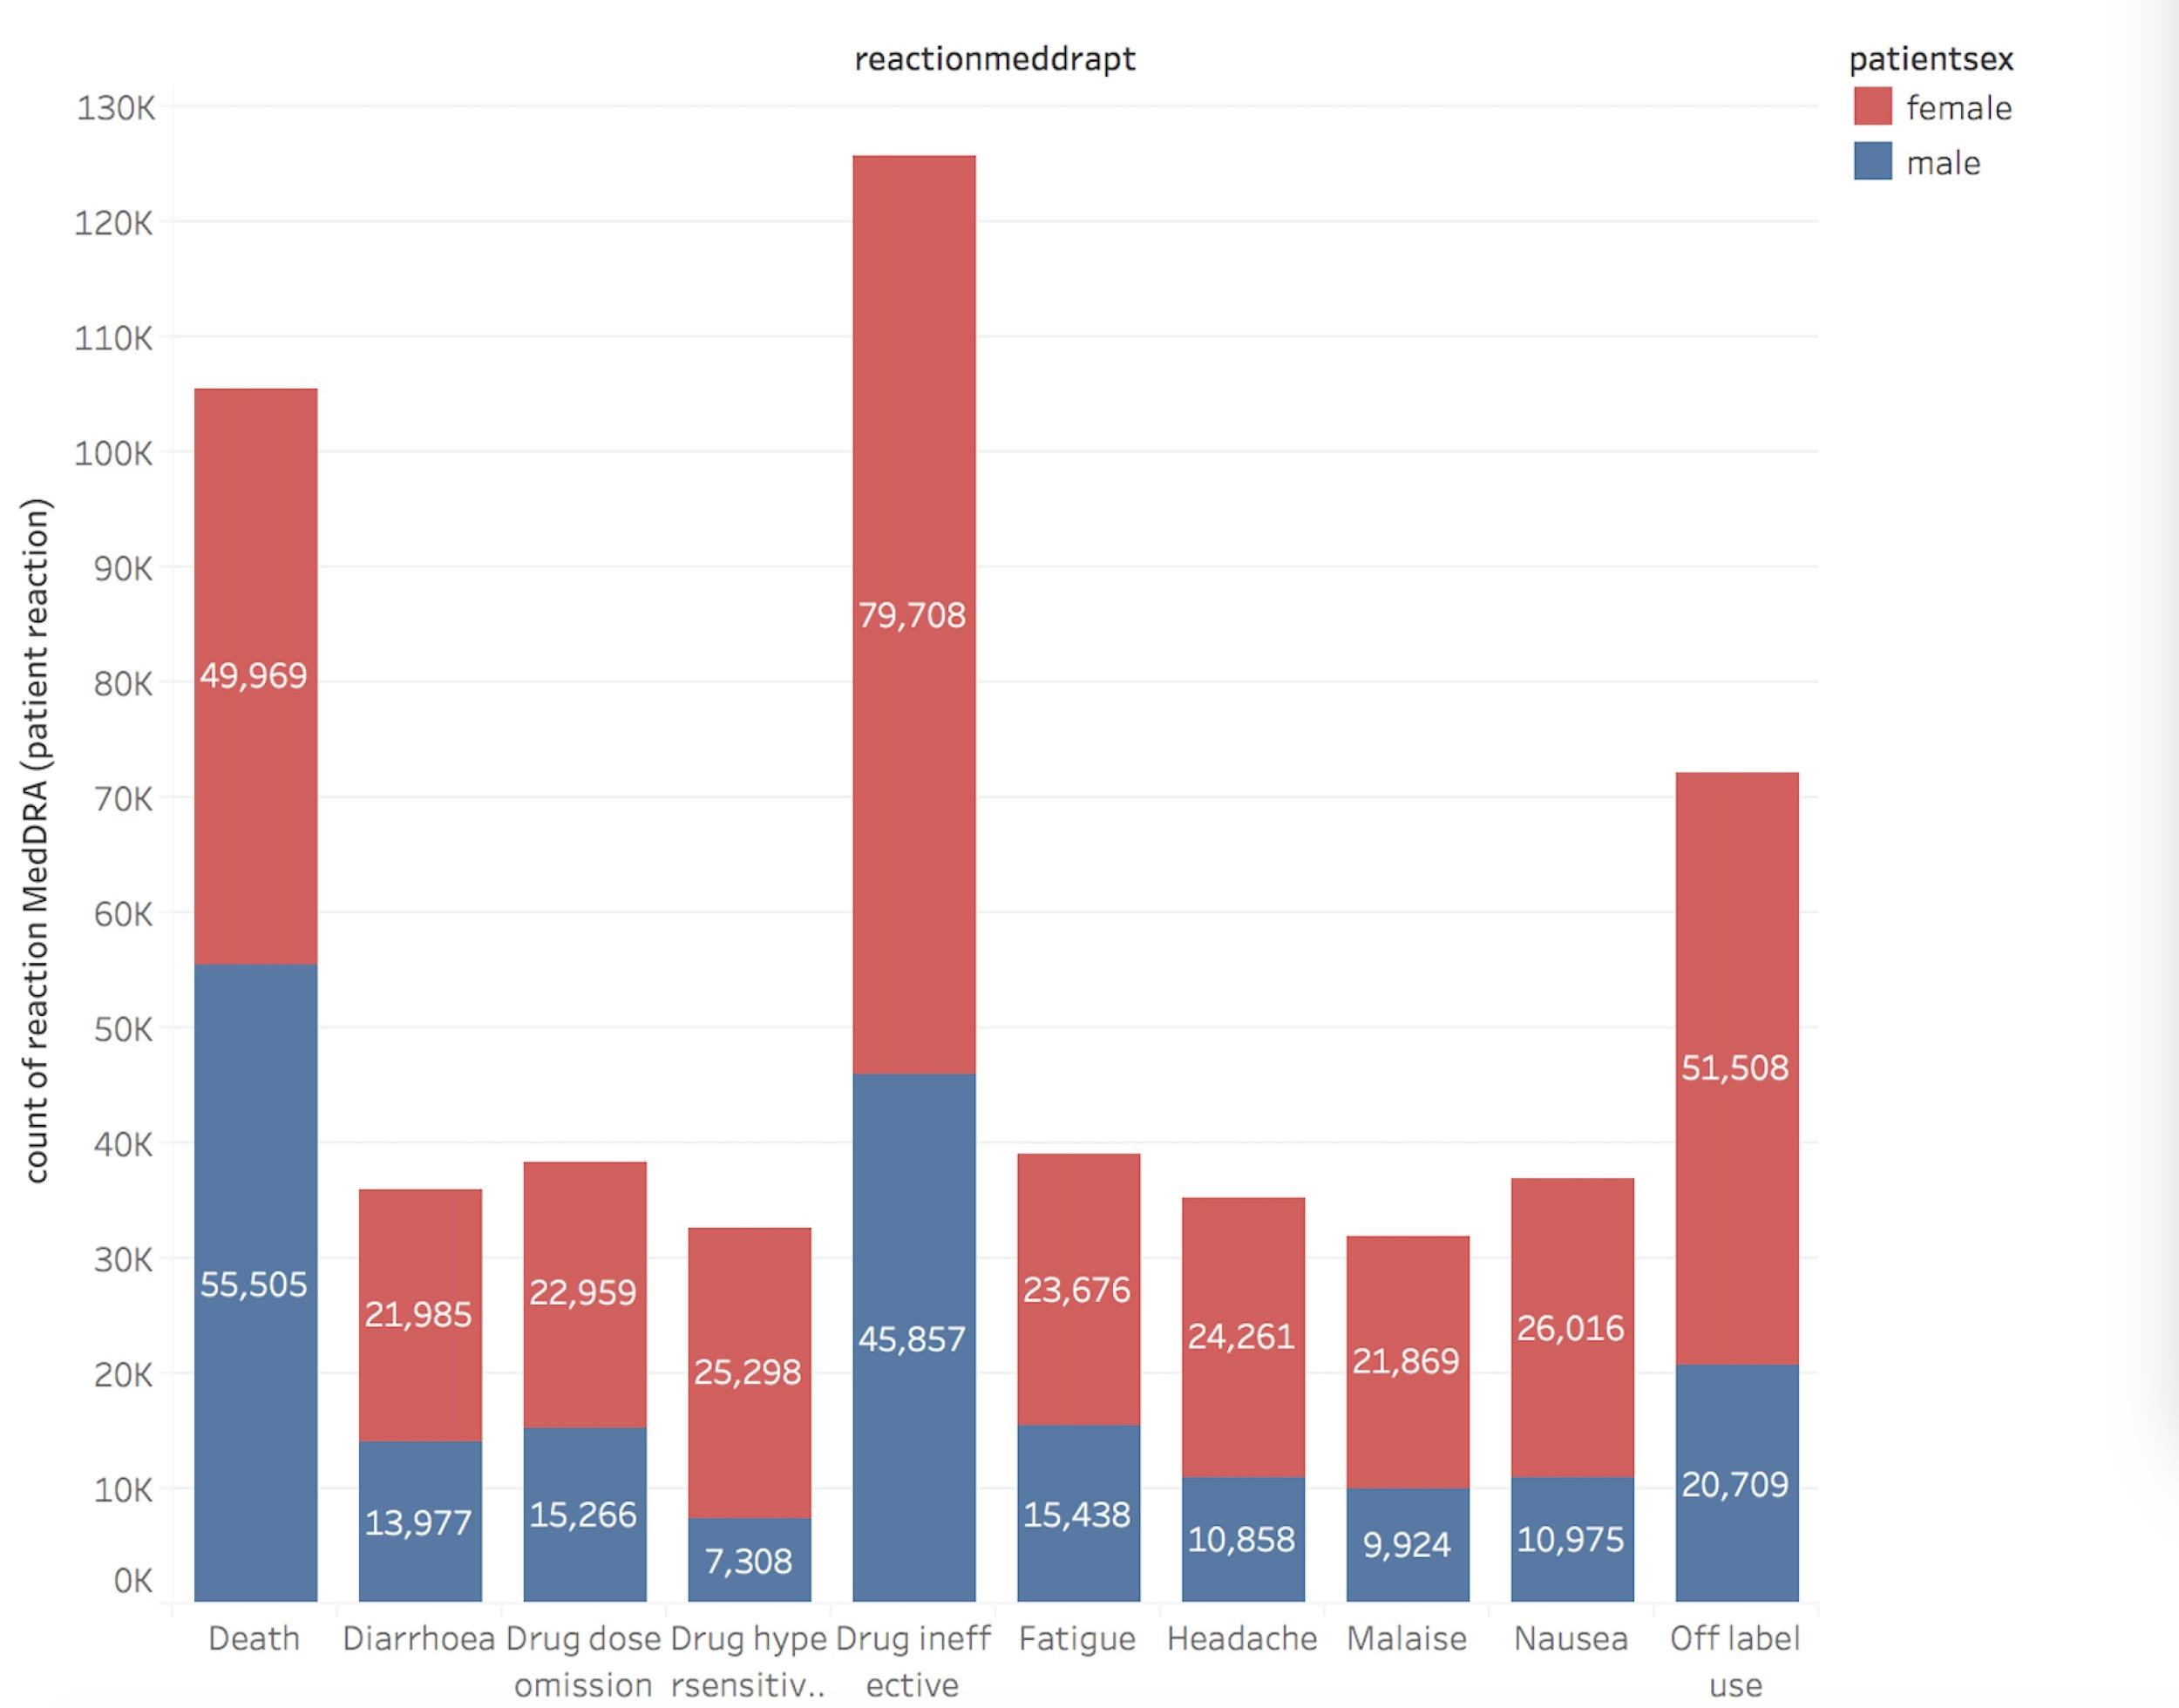
Sex vs Symptoms

Slide 30
ML Best Run: Properties & Metrics
Norm macro recall: 0.022314
Avg precision score macro: 0.21378
Precision score micro: 0.34961
Recall score micro: 0.34961
F1 score micro: 0.34961
Balanced accuracy: 0.18526
AUC weighted: 0.57170
F1 score weighted: 0.26015
Recall score weighted: 0.34961
Precision score macro: 0.42981
Weighted accuracy: 0.46386
Precision score weighted: 0.34415
F1 score macro: 0.14557
AUC macro: 0.59018
Avg precision score weighted: 0.29151
AUC micro: 0.74297
Recall score macro: 0.18526
Accuracy: 0.34961
Average precision score micro: 0.32689
Log loss: 1.5130
Field Name | Field Description
Algorithm name | StandardScalerWrapper, XGBoostClassifier
Primary metric | Accuracy
Score | 0.34961081523965587

Slide 31
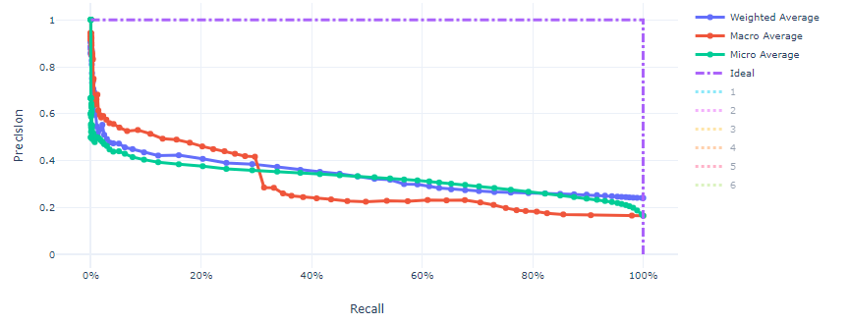
Precision - Recall

Slide 32
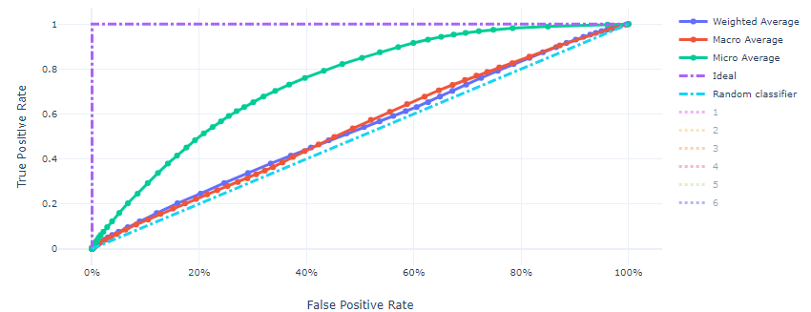
ROC

Slide 33
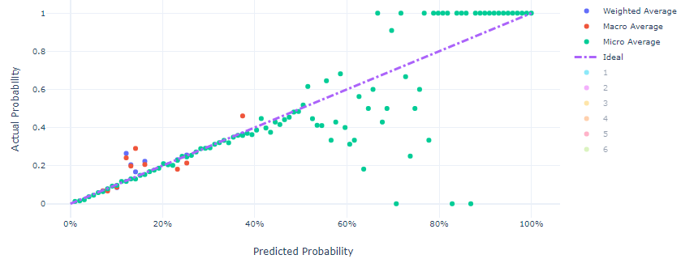
Calibration Curve

Slide 34
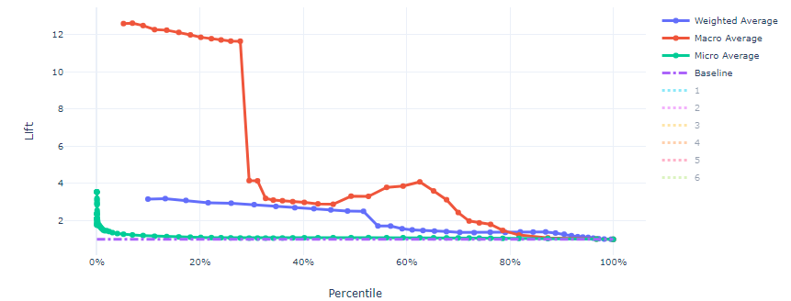
Lift Curve

Slide 35
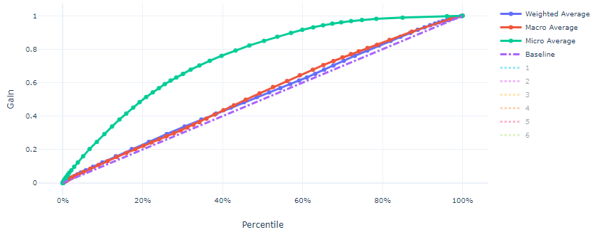
Gain Curve

Slide 36
Future Work

Slide 37
Expansion of the dataset
Assumptions based on sex specific related issues
female (uterus )
male (prostate )
Other factors that may be related to ADR
Route of administration (taken by mouth, by injection into a vein...)
Drug types (Antibacterial drugs，Circulatory Drugs…)

Slide 38
Conclusions

Slide 39
Summary
Most likely risk prone patient population
Females aged 55-65 years
Likelihood for Death with adverse drug reaction
Increased
Disclaimer
How this study helps the industry

Slide 40
Questions?
Thank you

