Slide 1
A Rational Theory of the Size of Government
(Application of the median voter theorem.)
Allan H. Meltzer and Scott F. Richard. 1981. A Rational Theory of the Size of Government. Journal of Political Economy 89 (5 ): 914-927
Alex Tabarrok
Notes:
The MR model is

Slide 2
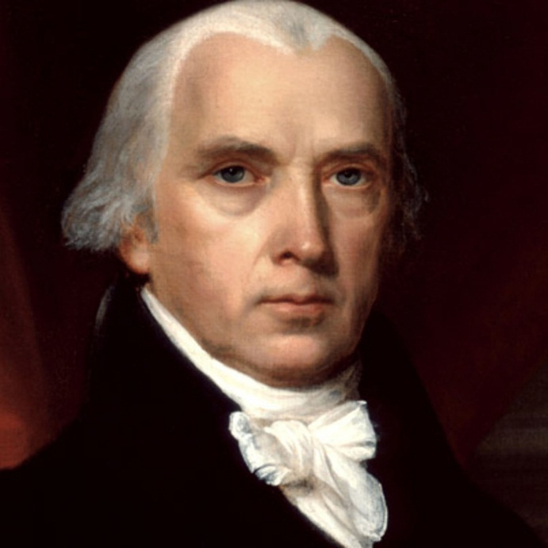
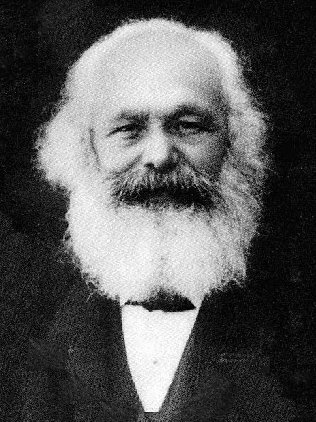
Does Democracy Threaten Property?
As the franchise was extended thinkers as diverse as James Madison and Karl Marx feared and hoped (respectively) that democracy would end property.
The intuition: the rich are always a minority, thus the majority will exploit them.
Meltzer-Richards create a formal model of taxation and income redistribution to test this intuition and its limits.
“[pure ] democracies…have ever been found incompatible with personal security or the rights of property.”
Madison, Federalist 10
Karl Marx thought that democracy was the road to socialism.

Slide 3
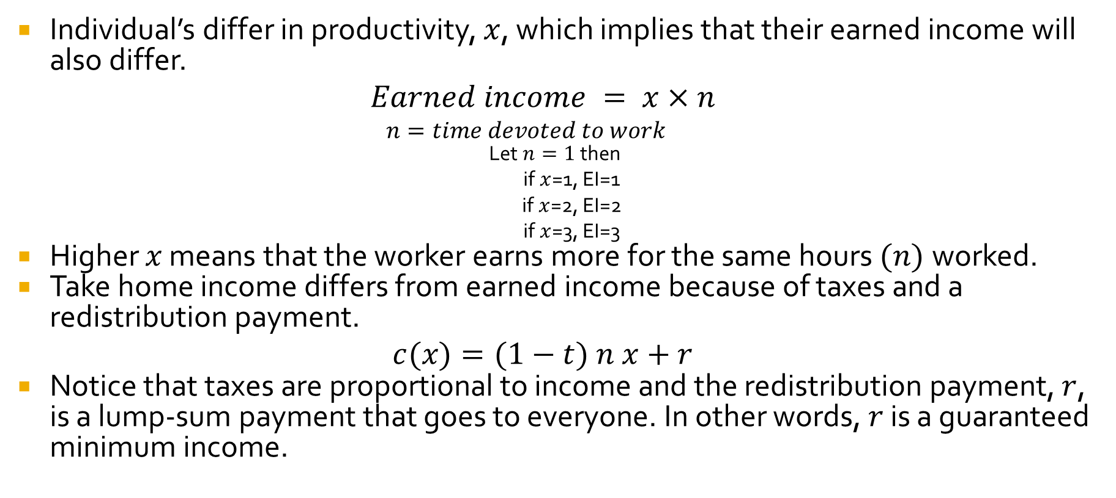
The Meltzer-Richard Model
Individual’s differ in productivity, $x$, which implies that their earned income will also differ.
$$Earned income = x×n$$
  $$n=time devoted to work$$
Let $n=1$then
  if $x$=1, EI=1
  if $x$=2, EI=2
  if $x$=3, EI=3
Higher $x$ means that the worker earns more for the same hours $(n)$worked.
Take home income differs from earned income because of taxes and a redistribution payment.
$$c(x)=(1−t) n x+r$$
Notice that taxes are proportional to income and the redistribution payment, $r$, is a lump-sum payment that goes to everyone. In other words, $r$ is a guaranteed minimum income.

Slide 4
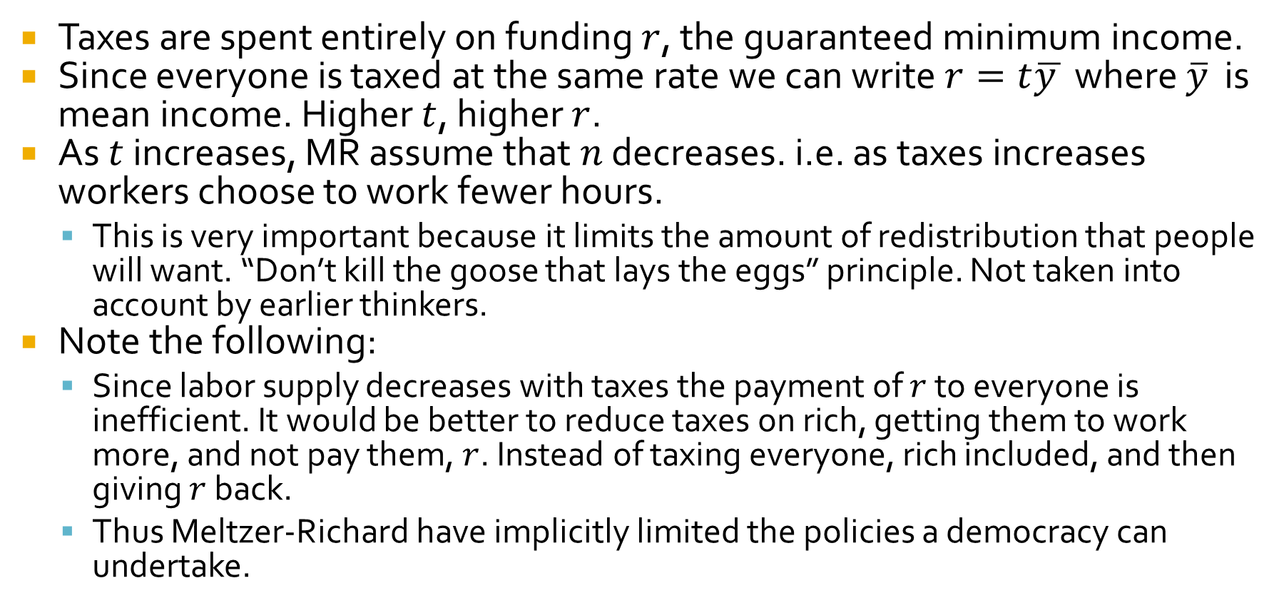
The Meltzer-Richard Model
Taxes are spent entirely on funding $r$, the guaranteed minimum income.
Since everyone is taxed at the same rate we can write$r=t\overline{y }$ where $\overline{y}$ is mean income. Higher $t$, higher $r$.
As $t$ increases, MR assume that $n$ decreases. i.e. as taxes increases workers choose to work fewer hours.
  This is very important because it limits the amount of redistribution that people will want. “Don’t kill the goose that lays the eggs” principle. Not taken into account by earlier thinkers.
Note the following:
  Since labor supply decreases with taxes the payment of $r$ to everyone is inefficient. It would be better to reduce taxes on rich, getting them to work more, and not pay them, $r$. Instead of taxing everyone, rich included, and then giving $r$ back.
  Thus Meltzer-Richard have implicitly limited the policies a democracy can undertake.

Slide 5

The relationship between $r$ and $t$
Everyone (even socialists!) want to be on the left side of the curve.
At 0% tax no revenues are raised and r, the guaranteed minimum income, is zero.
At 100% tax no revenues are raised and r, the guaranteed minimum income, is zero.
tmax

Slide 6
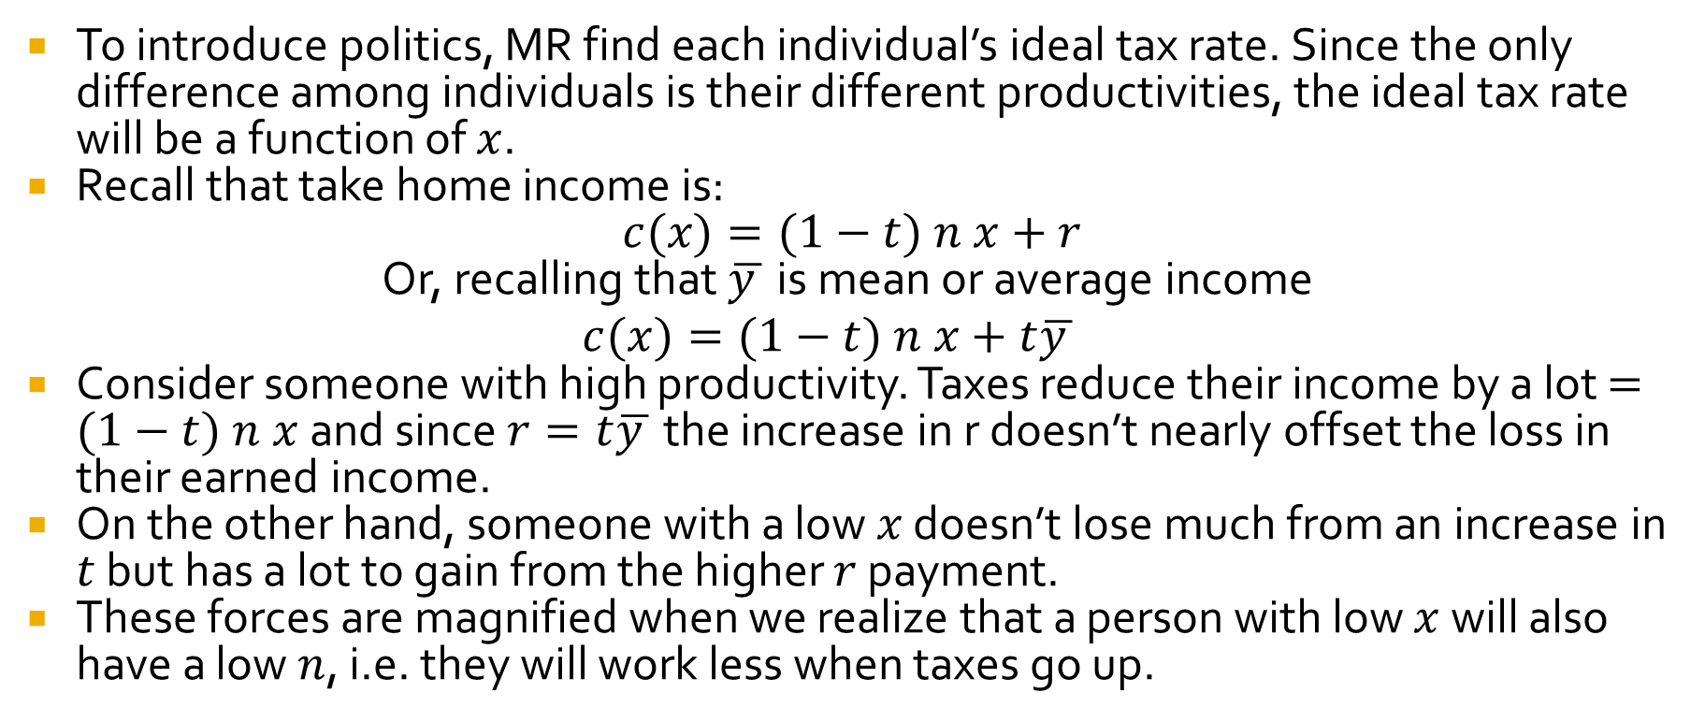
Meltzer-Richard Model
To introduce politics, MR find each individual’s ideal tax rate. Since the only difference among individuals is their different productivities, the ideal tax rate will be a function of $x$.
Recall that take home income is:
$c(x)=(1−t) n x+r$
Or, recalling that $\overline{y }$ is mean or average income
$$c(x)=(1−t) n x+t\overline{y }$$
Consider someone with high productivity. Taxes reduce their income by a lot $=(1−t) n x$and since $r=t\overline{y }$ the increase in r doesn’t nearly offset the loss in their earned income.
On the other hand, someone with a low $x$ doesn’t lose much from an increase in $t$ but has a lot to gain from the higher $r$ payment.
These forces are magnified when we realize that a person with low $x$ will also have a low $n$, i.e. they will work less when taxes go up.

Slide 7


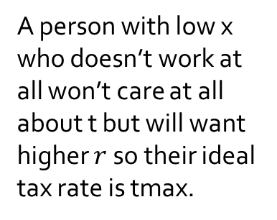
Ideal $r$ and $t$ for each individual
Low x wants high t.
A person with low x who doesn’t work at all won’t care at all about t but will want higher $r$ so their ideal tax rate is tmax.
High x wants low $t$
Higher
Utility
(low t, high r)
tmax

Slide 8

Ideal tax rates as a function of $x$

Slide 9
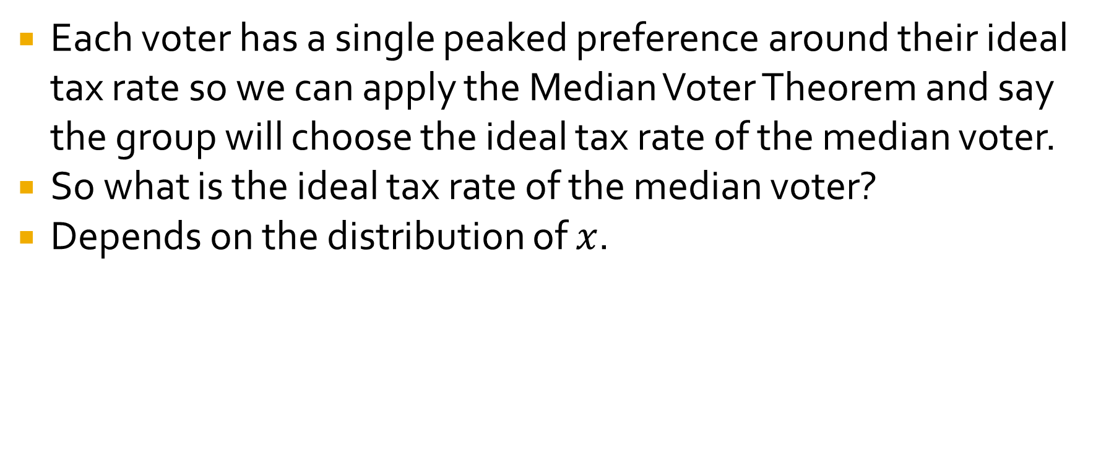
Applying the Median Voter Theorem
Each voter has a single peaked preference around their ideal tax rate so we can apply the Median Voter Theorem and say the group will choose the ideal tax rate of the median voter.
So what is the ideal tax rate of the median voter?
Depends on the distribution of $x$.

Slide 10
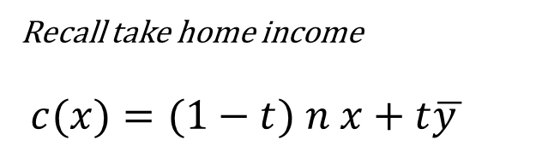
Recall take home income
$$c(x)=(1−t) n x+t\overline{y }$$
If x is distributed symmetrically then mean income (mean x) is equal to median income (median x). In this case the median voter (person with median income) wants what tax rate?
  If x is distributed symmetrically then the median voter loses just as much income from a tax as they gain from the redistribution payment so the median voter will be happy with a zero tax rate.

Slide 11
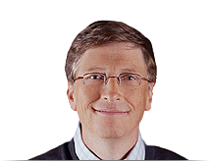
What about if income is “right-skewed.”?
Recall take home income
$$c(x)=(1−t) n x+t\overline{y }$$
If the x (income) distribution has a long right tail then Mean income will be greater than Median income. Now what tax rate does the median voter want?
  The median voter will want a higher tax rate the greater is mean income relative to median income.

Slide 12
Predictions of the Model
Higher taxes and redistribution the greater is Mean/Median income.
What happens with extension of the franchise?
  Prediction is that extending the franchise to lower income voters will increase Mean/Median(voter) income and increase taxes and redistribution.
What happens as population ages and goes on social security?
  Old people don’t work! Therefore higher taxes are all benefit and no cost.
What happens if inequality increases?
  The model predicts higher taxes and more redistribution.

Slide 13
Testing the Predictions
The MR model is a simple, interesting and plausible model but do its predictions hold true?

Slide 14
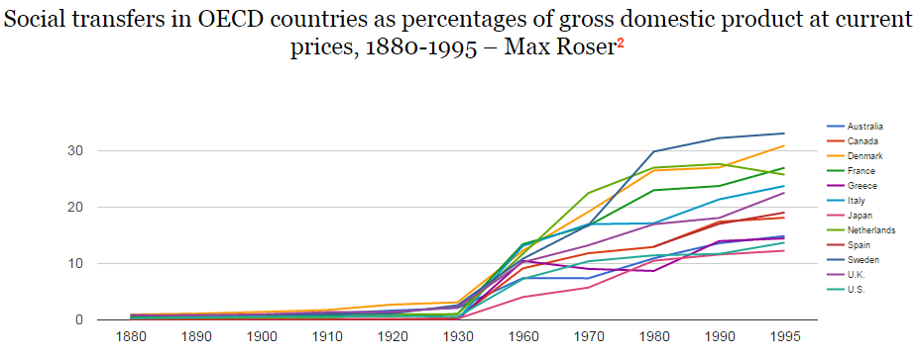
Did Extending the Franchise Increase the Size of the Welfare State?
Maybe: The welfare state has grown tremendously since the 19th century but growth began considerably later than universal franchise.

Slide 15
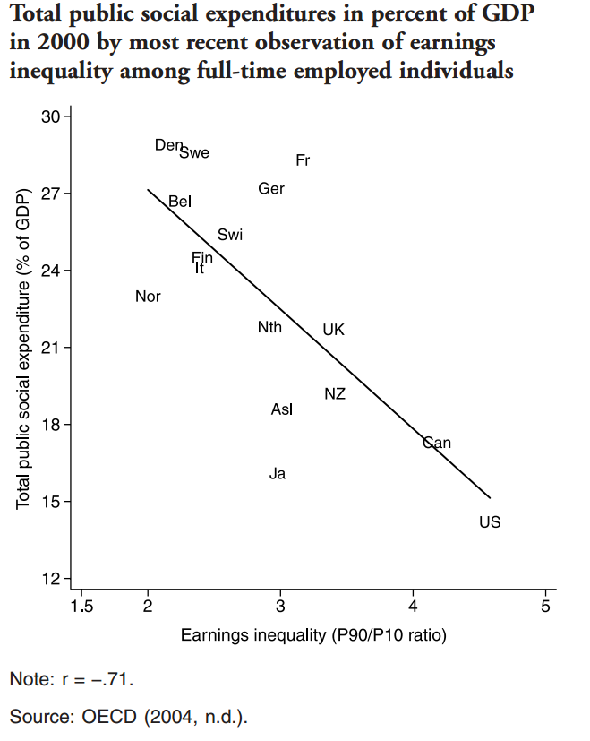
The Robin Hood Paradox
Comparing Europe and the United States, for example, we see a negative correlation between inequality and size of government.
In other words, more equal societies redistribute more and less equal societies redistribute less – this is often called the Robin Hood Paradox.
Kenworthy and Pontusson 2005

Slide 16
The Robin Hood Paradox
Why might MR Theory fail to predict cross-country results?
Three Theories
  Median voter theorem holds with one-dimensional politics. What if there is a second dimension? E.g. Race, Culture, History, Gender.
  Constraints on democracy.
  People don’t vote their self-interest but may vote “ideologically”.
Notes:
Note that the three theories are all related, not mutually exclusive.

Slide 17
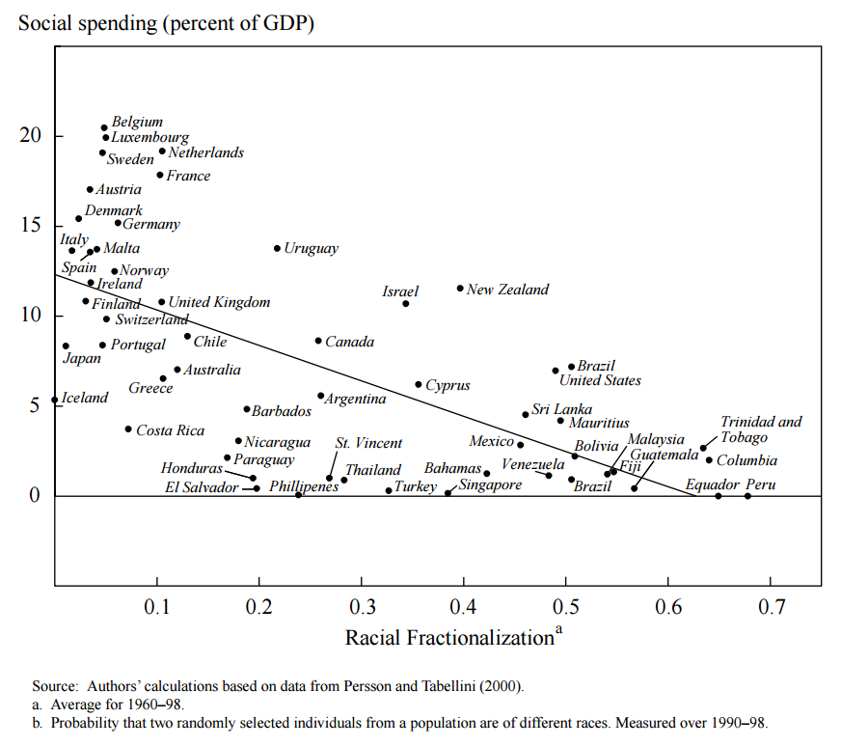
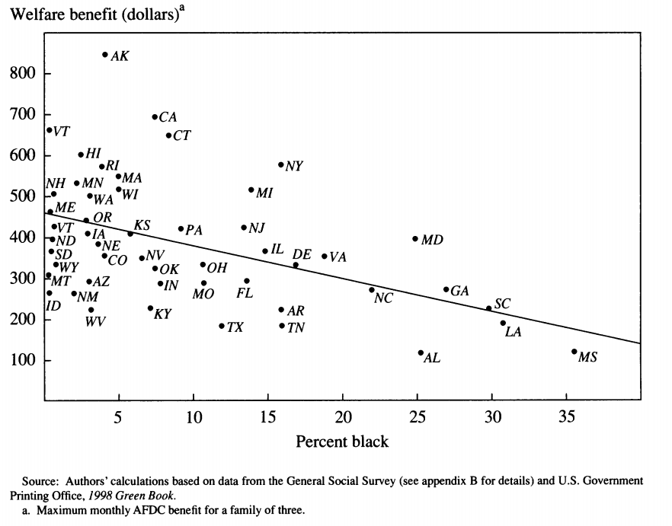
The Robin Hood Paradox: Race
The MR model assumes that only income matters for voting.
Factors other than income may be more salient—religion or, especially in the United States, race.
Source: Alesina, A., Glaeser, E. L., & Sacerdote, B. 2001. Why Doesn’t the United States Have a European-Style Welfare State? Brookings Papers on Economic Activity, 2001(2): 187–277.
Notes:
Other divisions, e.g. religion distrust of Catholics in earlier eras may have impeded formation of workers’ party. Within the United States, with more blacks spend less on welfare (Alesina, Glaeser, Sacerdote 1999). See also Alesina, Baqir and Easterly.

Slide 18
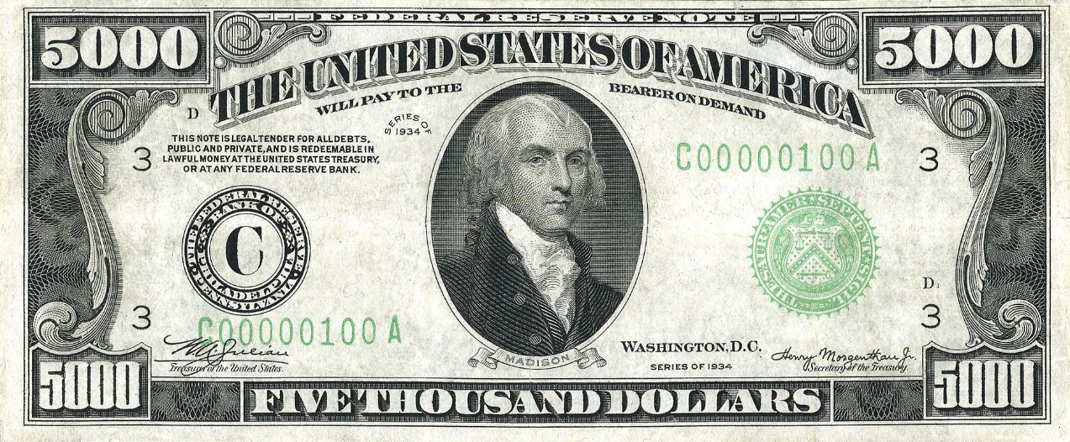
The Robin Hood Paradox: Constraints on Democracy
US system of Checks and Balances, House, Senate, Presidency, Supreme Court, Federalism, Bill of Rights give greater power to minorities, including the wealthy minority, to protect their rights and property.
James Madison would have been proud. The system worked the way he designed it to work.

Slide 19
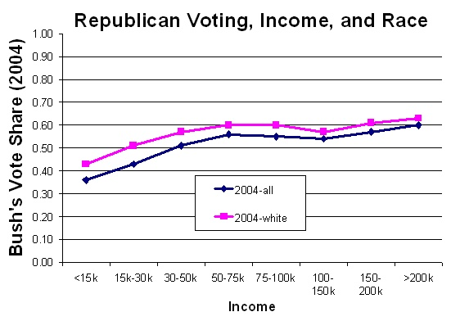
The Robin Hood Paradox: The Failure of Self-Interested Theories of Voting
Conventional wisdom tells us that "the poor" are Democrats and "the rich" are Republicans. In fact, the rich are only slightly more likely to be Republicans than Democrats.
  Race matters far more than income: High-income blacks are much more likely to be Democrats than white minimum wage workers.
  Gender also dwarfs the effect of income: a man earning $25,000 per year is about as likely to be a Democrat as a women earning $100,000 per year.
Big changes in income, hardly any change in voting Republican
From Bryan Caplan based on Gelman, Red State, Blue State, Rich State, Poor State

Slide 20
Self-Interested Voting Fails in Other Contexts
Unemployment policy - The unemployed are not much more in favor of unemployment insurance.
Social Security and Medicare- The elderly are if anything slightly less in favor than the young.
Abortion - Men are slightly more pro-choice than women.
Self-interest fails even for potential death in combat! Relatives and friends of military personnel in Vietnam were more in favor of the war than the rest of the population.
Notes:
Similarly, draft-age males support the draft as strongly as other people. Educated more likely to support welfare, less likely to use it.

Slide 21
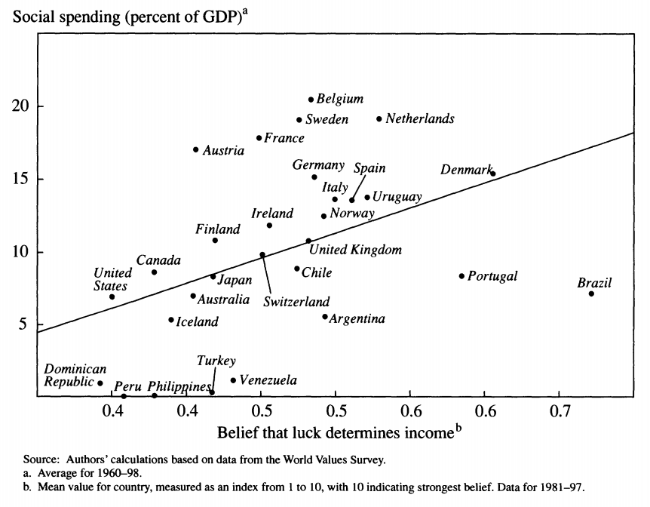
Ideology
If self-interest doesn’t determine voting->lots of room for ideology.
Ideology could explain both growth in government and why government hasn’t grown as much in the United States as one might expect given Mean/Median income.
  American dream and mobility.
  What determines riches/poverty luck or hard work?
Could ideology be used to divert attention of the poor?
Source: Alesina, A., Glaeser, E. L., & Sacerdote, B. 2001. Why Doesn’t the United States Have a European-Style Welfare State? Brookings Papers on Economic Activity, 2001(2): 187–277.
Notes:
MR models predicts if Median voter expects to rise then less interested in redistribution. Not much evidence that this probability is markedly higher in US but perhaps dream of these is higher.
American dream/mobility can also reduce support for welfare by making mobile believe that if they can do it anyone can.
In US people believe that the poor are lazy more than in Europe where people believe the poor are unlucky. Note correlation of income and hours worked is strongly positive in the US less so elsewhere.
In one survey when asked are the poor lazy, 26% of EU residents said yes, 60% of US residents.
Greater support for punishment in US

Slide 22
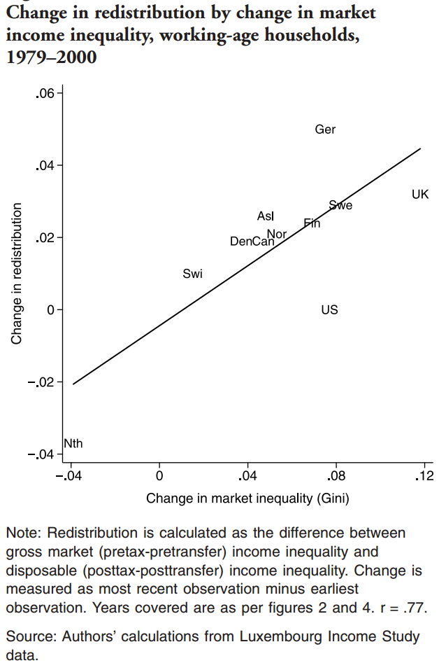
Inequality is increasing in the United States
MR model suggests inequality will be met by increasing redistribution.
MR theory didn’t explain cross-country data but there is some evidence that it does better looking at the same country over time, i.e. increases in inequality lead to increases in redistribution.
So MR theory does better as theory of changes on the margin
  Affordable Care Act?
Robin Hood paradox suggests an alternative possibility: politics will become less democratic.

Slide 23
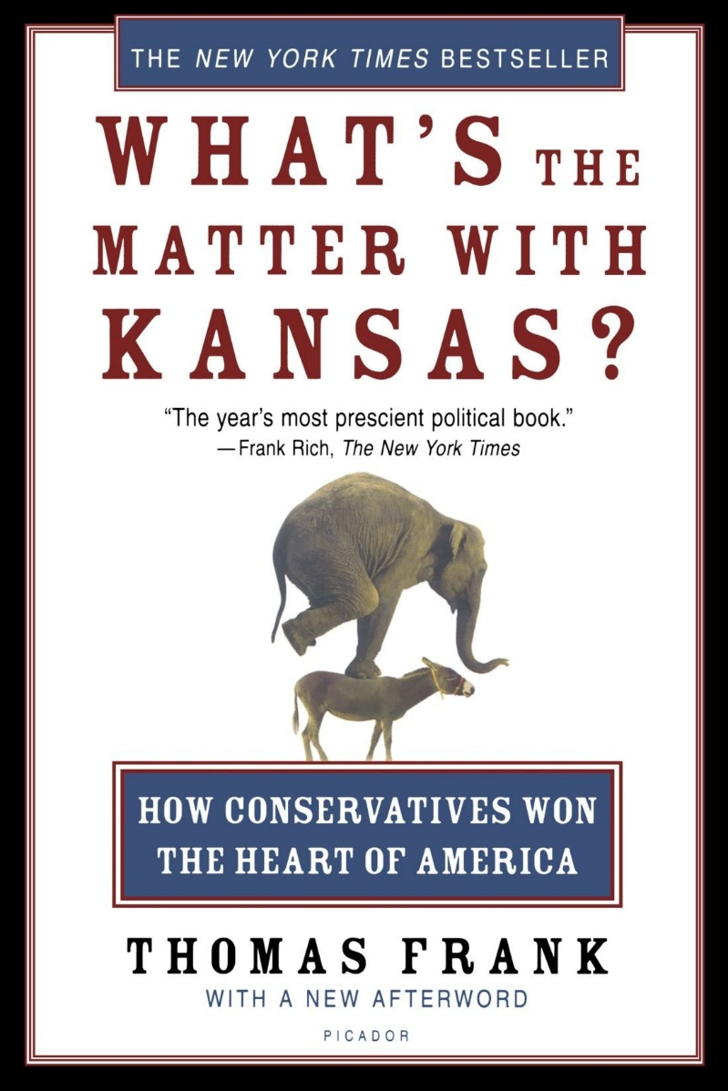
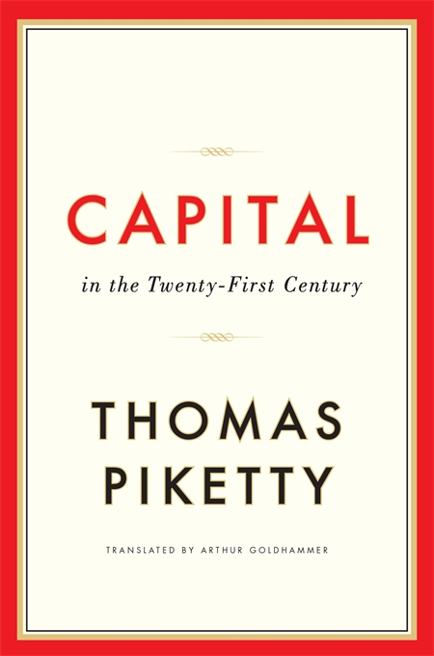
The Robin Hood Paradox
With greater inequality can the rich protect themselves better?
  Change ideology and get people to vote against their interests?
    What’s the Matter with Kansas?
  Crush the unions?
  Reduce democracy? Rise of the plutocrats?

Slide 24
Conclusions
The MR model is a simple, clean model of the growth of the welfare state with interesting predictions based on Mean/Median income.
The MR model is a good place to begin but the simple predictions are hard to verify in the data. It may be that the simple predictions aren’t false but a lot of other things are also going on.
Thus to explain growth of government and different levels of government in different countries will require history, ideology and political variables going beyond the median voter theorem.
Notes:
Proportional representation, frontier, population density and riots.

