Slide 1
Introduction to Public Choice
Alex Tabarrok

Slide 2
What is Public Choice?
Public choice is political science influenced by the economic way of thinking.
As with political science, public choice attempts to understand how public policies come to be adopted and what the influence of different institutions are on the political process.
Public choice approaches typically assume self-interest and rational actors and the goal is to find an equilibrium given these assumptions.
Both the self-interest and rational actor assumption may be moderated in specific settings.

Slide 3
What is Public Choice?
Central to the idea of public choice is that everyone is modeled similarly.
We assume that voters, politicians and bureaucrats, just like consumers, entrepreneurs and managers, act in their self-interest.
Self interest does not necessarily mean greedy or materialistic.
Eg. Politicians as vote-maximizers.
Given these assumptions, public choice scholars logically work out the consequences for electoral equilibrium, the behavior of bureaucracy, the political power of interest groups, the differences between democracies and dictatorships, the logic of collective action, the importance of constitutions etc.

Slide 4
What is Public Choice?
All of this may seem obvious but at the time these ideas came into play with Buchanan and Tullock’s Calculus of Consent (1962), William Riker’s Theory of Political Coalitions, and Mancur Olson’s The Logic of Collective Action (1972) this was quite radical.
Even today it is common for economists and many others to put forward ideas that would work only if government were a benevolent despot.

Slide 5
Why Study Public Choice?
Understand government behavior both in democracies and non-democracies.
Better understand the consequences of government behavior. Why do some countries failure to grow?
Better design constitutions.
Avoid the Nirvana Fallacy.

Slide 6
The Nirvana Fallacy
The Nirvana Fallacy is rejecting a realistic solution because it doesn’t meet the standard of an imaginary, perfect solution.
Seat belts could trap a person in a fire therefore seatbelts shouldn’t be worn. Fallacy->seatbelts save lives on average. No solution is perfect.
Abstinence is 100% effective at preventing pregnancy but condoms can break and are often misused therefore we should promote abstinence not condoms. Fallacy->abstinence is perfect solution only in an imaginary world.
Economists often commit the Nirvana fallacy by comparing an imperfect market solution to a perfectly working government solution (the benevolent dictator assumption).
Public choice is the rebuttal to the Nirvana fallacy. We must compare realistic market with realistic government.
Public choice is a theory of government failure to complement theory of market failure.
Notes:
Don’t let the perfect be the enemy of the good. Voltaire.

Slide 7
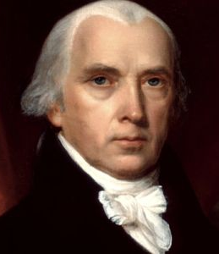
Politics Without Romance
Ambition must be made to counteract ambition…It may be a reflection on human nature, that such devices should be necessary to control the abuses of government. But what is government itself, but the greatest of all reflections on human nature? If men were angels, no government would be necessary. If angels were to govern men, neither external nor internal controls on government would be necessary. In framing a government which is to be administered by men over men, the great difficulty lies in this: you must first enable the government to control the governed; and in the next place oblige it to control itself.
James Madison, Federalist 51
James Madison

Slide 8
Does Your Vote Count?
Probability that your vote changes the outcome of an election is miniscule. So why vote?
Voting Schmoting.
In fact a lot of people do vote which is a bit of a puzzle for standard public choice.
Duty?
Altruism?

Slide 9
Rational Ignorance
Although people vote, do they invest much time and energy in learning about what they are voting on? No. Here public choice prediction is overwhelmingly supported.
Who is Joe Biden?
Item | %
Know President's term is 4 years | 94
Can name governor of home state | 89
Can name vice president | 78
Know which party has U.S. House majority | 69
Know there are two U.S. senators per state | 52
Can name their Congress member | 46
Aware Bill of Rights is first ten amendments to U.S. Constitution | 41
Can name both of their U.S. senators | 39
Can name current U.S. secretary of state | 34
Know term of U.S. House members is 2 years | 30
Can name one of their state senators | 28
From Dye and Zeigler

Slide 10
Rational Ignorance
Let’s check on whether you are rationally ignorant. Which of the following four items is the smallest in terms of government expenditure?
Social Security
Welfare
Foreign aid
Health care

Slide 11
Rational Ignorance
Who is your Senator? Representative? Mayor? Few people know.
How did they vote on road construction, bank regulation, farm subsidies? Even fewer!
The average American “spends” more on taxes and regulation than on food, clothing or transportation yet knows much less about the price, quality and providers of government goods than about other goods. Why?
When you spend time comparing food prices and quality at Safeway and Wegmans You get the benefit. When you spend time comparing Democrats to Republicans you benefit only if your vote decides the election!
It doesn’t pay to be informed about politics – hence, rational ignorance.
Can democracy work well when voters are ignorant?

Slide 12
Should everyone vote?
Do you think the government should offer incentives for citizens to vote?
Yes
No

Slide 13
Rational Ignorance, Does it matter? The Miracle of Aggregation
Social scientists agree that voters know little about politics and economics, but some deny that it matters.
How could it not matter? If voters’ errors are random, basic statistics says they tend to cancel out, leaving the well-informed in charge.
Ex: Suppose 90% know zero, and 10% know everything. Which candidate wins?
Whoever has the support of a majority of the well-informed.
This result is called the Miracle of Aggregation.

Slide 14
If It Seems Too Good to Be True…
The key assumption of the Miracle is that errors are random around the truth, not systematic.
But rational ignorance changes what information gets to voters and who is informed and uninformed with systematic effects on political outcomes.

Slide 15
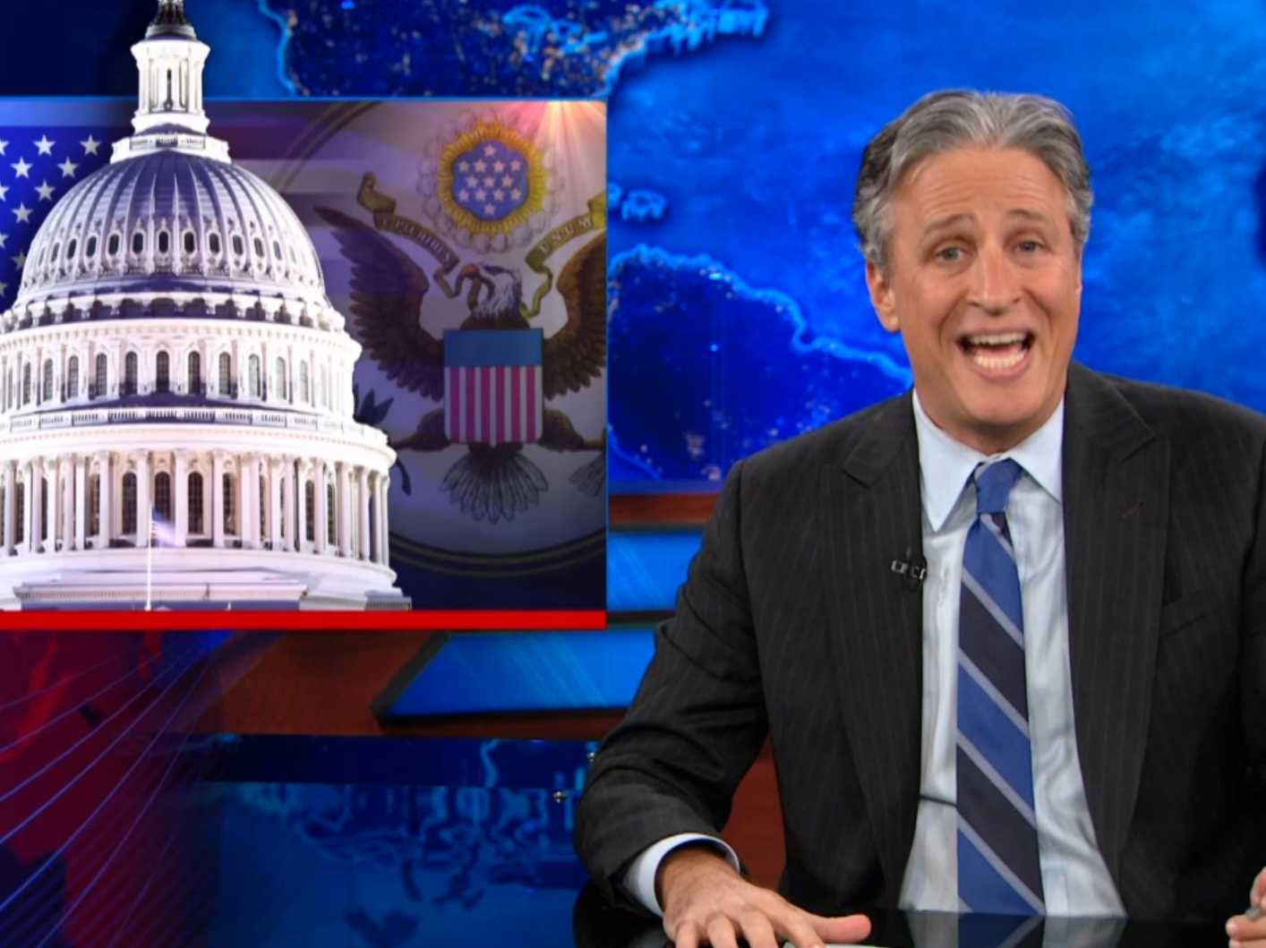
Implications of Rational Ignorance, 1
Political campaigns will be based on hoopla, symbolism, and trivia not on serious, substantive, discussions of the issues.
Parties will work to build brands like “family values”, “tough on defense,” much like Coke and Pepsi and regardless of realities.
The news media will seek to entertain. It’s no surprise that most people get their political information from The Daily Show.
On the whole this may be a good thing, at least some information is communicated, but it does change/bias who succeeds and who fails in the political marketplace.

Slide 16
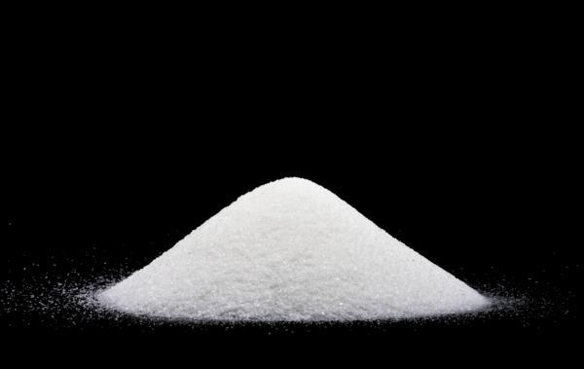
The Sugar Quota
The U.S. government restricts sugar imports.
As a result, the U.S. price of sugar is 3-4 times higher than the world price.
American consumers of candy, soda, and other sweets end up paying a few billion more for these goods than they would without the quota.
Why would the government purposely harm sugar consumers, many of whom are voters?

Slide 17
The Sugar Quota
The cost of the sugar quota are spread over millions of consumers.
BUT
The benefits of the sugar quota are concentrated on a few producers who have a strong incentive to support the quota.
The sugar quota is therefore a winning policy for politicians.

Slide 18
The Sugar Quota
In this case, the self interest of politicians does not necessarily align with the social interest.
Those who are harmed are rationally ignorant and have little incentive to oppose the policy.
Those who benefit are rationally informed and have strong incentives to support the policy.
A self-interested politician may support a policy that damages many (Primarily Warner’s Flush link).

Slide 19
Implications of Rational Ignorance, 2
The secret to political success:
Concentrate Benefits, Diffuse Costs.
Concentrating benefits insures that special interests will vote for you, give campaign donations and be informed.
But when costs are diffuse the public won’t bother objecting and due to rational ignorance may not even know about special interest favors.
e.g. the U.S. Sugar Quota, tariffs, the import-export bank.
Why are tax brackets progressive but tax loopholes regressive?
Regulatory Capture

Slide 20
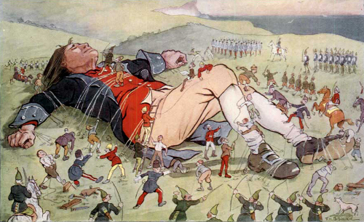
Many small costs can add up

Slide 21
Rational Ignorance
Rational Ignorance exists when the benefits of being informed are less than the costs of being informed.
Voters are rationally ignorant about politics; the incentives to be informed are low.
Ignorance about political matters is important for three reasons.
Ignorance makes it difficult to make informed choices.
Ignorance can lead to bad policy.
Not everyone is rationally ignorant.

Slide 22
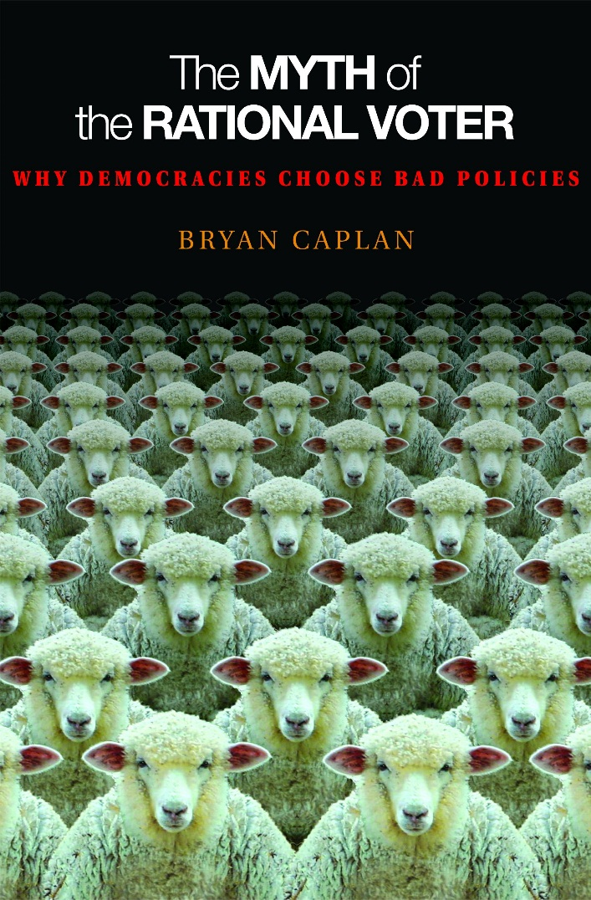
From Rational Ignorance to Rational Irrationality
We all have ideas about ourselves that we like to tell. But in ordinary markets these ideas press up against reality.
E.g. charity.
Politics removes the cost of expressing our ideas about our self.
E.g. Voting on charity/welfare.
The quantity demanded of a good increases the lower the price. Thus we are likely to be more charitable when voting than when giving personal donations.
This may seem like a good thing but the quantity of all goods increases the lower the price – this is true even of stupidity.
Suppose Joe is biased against Asians. Is Joe likely to express his bias by not buying goods from Wal-Mart? What if Joe is asked to vote on restrictions on immigration?

Slide 23
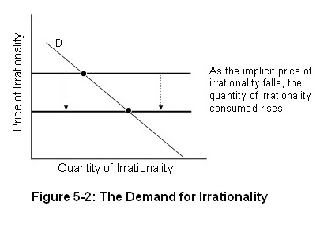
The Price of Irrationality
Think of irrationality as a “good” that we use to protect our comforting beliefs from reality. Put Q on the horizontal axis and P on the vertical axis.
Some errors are costly; others aren’t. In areas like religion, philosophy, and politics, errors are basically free.

Slide 24
Errors are Often Systematic
Ex: Compare public opinion about the budget to the true numbers.
Results: There are large systematic errors on important questions.
Ex: Americans sharply overestimate the level of foreign aid and welfare spending, and sharply underestimate pension and health spending.

Slide 25
Rational Irrationality and Failure to Learn
Return to Joe who is biased against Asians. Recall that Joe’s bias doesn’t cause him to stay away from WalMart because that would be personally costly but it does lead him to vote for tariffs against foreign goods—even if tariffs would be personally very costly.
Now suppose that Joe’s bias is mixed with a belief that immigration lowers wagers, a potentially true fact. Suppose studies show that immigration does not reduce wages. Will Joe be convinced?
No, Joe has no reason to be convinced since being convinced wouldn’t improve Joe’s decisions but would take away his comfortable belief.

Slide 26
Rational Irrationality and Failure to Learn
Joe may have all kinds of ideas about how the minimum wage helps the poor, free trade is bad for economic growth, the Chinese can’t be trusted. Why would he ever question, confront or think carefully about these biases?
So long as the biases do not affect personal decisions then Joe is free to hold these biases at low cost even though these biases may generate very bad political outcomes.
We all have biases. A bias against foreigners/strangers, for example, is probably a natural inclination from evolutionary times. In many ways civilization is about overcoming these biases. But we are not likely to overcome our biases if the price of holding those biases is low.

Slide 27
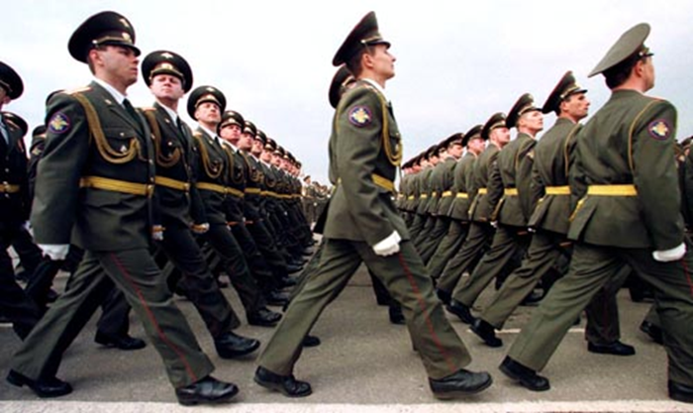
Rational Ignorance and Rational Irrationality as Political Pollution
Suppose there are 1 million voters and the nation is debating whether to go to war.
Each individual wants to believe that their cause is just and “One patriot can lick twenty foreigners, so victory is assured!”
Note that the contrary belief will put you out of step with your fellow citizens and exposes you to a charge of being unpatriotic.
Thus, suppose the value of this belief is $100. If the individual believes s/he will vote for war.
If a war if declared, however, it will be bloody and will cost each individual on average $100,000.
Will the nation smarten up or will the nation vote for war?

Slide 28
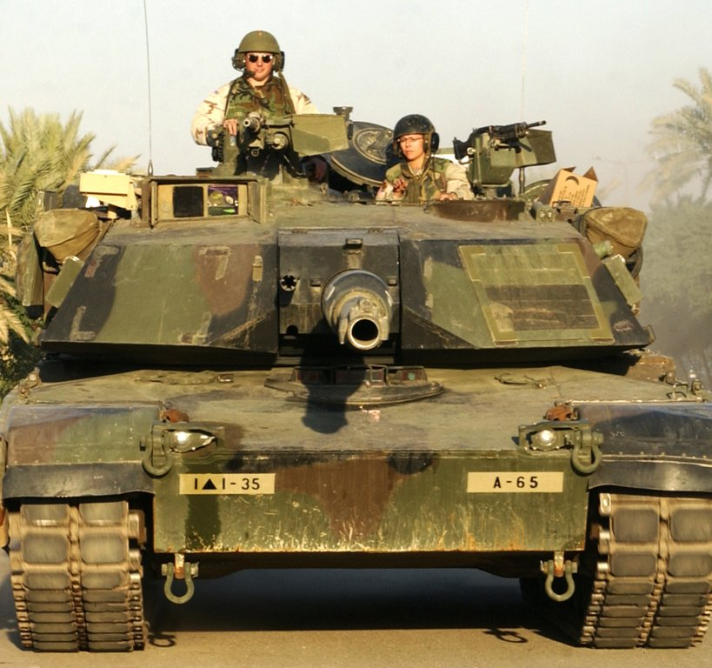
It’s War!
The belief has positive value so long as:
100 - p*100,000>0
where p is the probability that the voter’s vote changes the outcome.
But with 1 million voters p is very small so the belief has positive value and the voter votes for war.
Since the probability that changing your belief changes the outcome is near zero, the nation is going to war (or not) whatever you believe so is it better to have the nice belief that the cause is just and we will win or the not-so-comfortable belief that we are unjust and may lose? Sometimes delusion is rational!
But note that the net per-capita benefit of going to war is -$99,900! How is this possible?
Rational Irrationality is like a pollution externality. The costs to each voter (polluter) of a foolish belief (a little exhaust) are near-zero but netted over the entire population the costs are very large.

Slide 29
Rational Ignorance plus Rational Irrationality
Rational ignorance explains why people don’t know about the sugar quota.
Rational irrationality explains why if you explain the idea to them they stop listening and respond that we need to do it to “Protect Florida’s Family Farmers!”

Slide 30
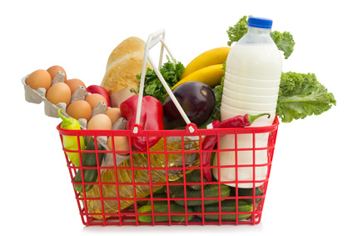
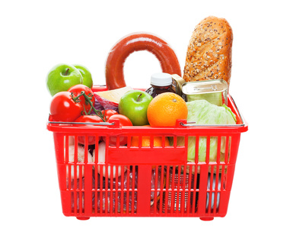
An Inconvenience Store
balogna
eggs
Bundle D
Bundle R
In the market we typically get to pick and choose one good at a time. What would happen to consumer satisfaction, costs, efficiency etc. if our only choice at a grocery store was Bundle D or Bundle R?
Suppose Bundle D wins. Does this mean that consumers prefer eggs to bologna? What problems does this uncertainy create?
Notes:
If bundle D wins

Slide 31
Shortsightedness in Government
Evaluate this argument:
You can’t take it with you. A private owner of a natural resource, like a forest, therefore, will want to clear-cut the forest before he dies in order to maximize his consumption stream (assume the owner has no children or other bequest motive). True or False. Explain.
False: The owner can sell the forest. As a result, the owner of a forest has an incentive to continue to seed it even if seeds planted today won't produce trees until after the owner is dead. The same idea applies to any long-lived productive asset.
Beautiful insight. It's precisely the fact that the forest is owned that gives the owner an incentive to take into account how other people value the forest.

Slide 32
Shortsightedness in Government
Private investors take into account future costs and benefits when making investment decisions today. What about politicians?
A politician is likely to have myopia, an excessive focus on present benefits at the expense of ignored future costs.
Why? Can a politician sell his office? Typically no. Exceptions?
A politician needs to be reelected and is likely to focus on benefits that the voters will see now. This will be especially true if the voters find it difficult to evaluate future costs and benefits.
Applications:
Kicking can down the road until crisis hits
Deficit financing either with tax cuts or spending increases.
Political business cycles/Inflation to juice the economy.
Rent controls.

Slide 33
Bureaucracy
The larger a bureaucracy the more opportunities for promotion. As the bureau expands so does the power, prestige and salary of the typical bureaucrats. Thus, as a first approximation, we can think of bureaucracies as budget maximizers.
Note that this is perfectly consistent with honest bureaucrats who believe in their mission.
Politicians have some incentives to rein in bureaucracies but this is very difficult to do because there are no profit and loss calculations.
Bureaucracies are the major sources of information on which politicians must base their calculations.
The reverse evolution of bureaucracies.

Slide 34
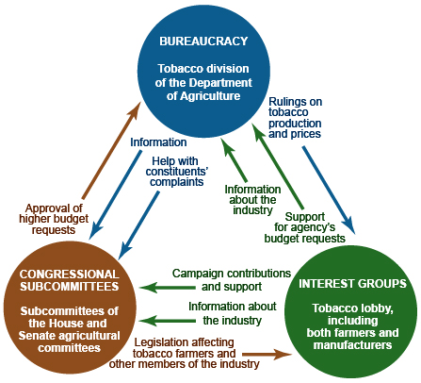
The Iron Triangle : Bureaucracies, interest groups and the committee system.
http://aventalearning.com/courses/GOVTUSs-AP-A09/a/unit4/gov_4.C.16.html
Notes:
Different triangles different policies, hence tobacco both taxed and subsidized.

