Slide 1
Political Business Cycles
Alex Tabarrok

Slide 2
Opportunistic P0litical Business Cycles
PBC models follow naturally from two assumptions;
1) economic conditions before an election significantly affect voter's choices and
2) politicians know this and try to take advantage.

Slide 3
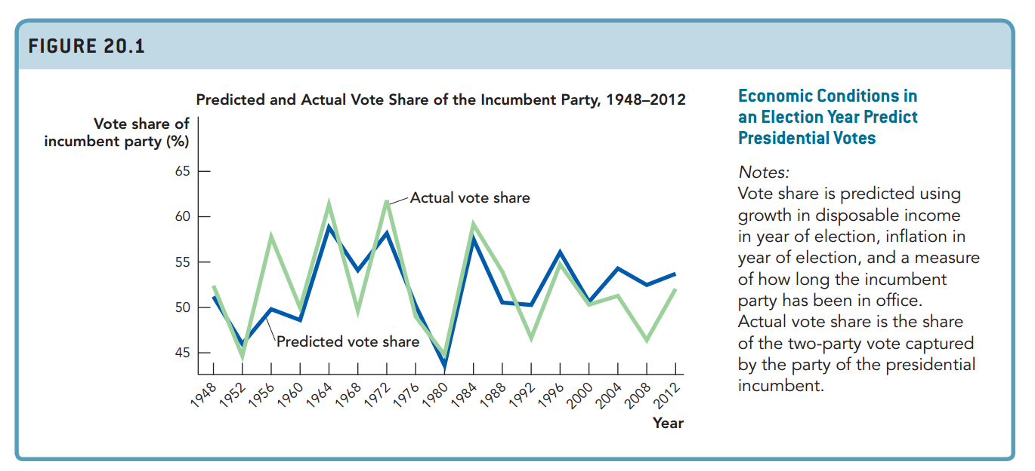
Voter Myopia
Economic conditions in the year of election--
growth of personal disposable income
low inflation
plus incumbency
--do a good job of predicting outcomes.
Notes:
More specifically, the incumbent party wins elections when personal disposable
income is growing, when the inflation rate in the election year is low, and
when the incumbent party has not been in power for too many terms in a row.
Personal disposable income is the amount of income a person has after taxes.
It includes income from wages, dividends, and interest but also income from
welfare payments, unemployment insurance, and Social Security payments. The
inflation rate is the general increase in prices. The last variable, a measure of
how long the incumbent party has been in power, reduces a party’s vote share.
Voters seem to get tired or disillusioned with a party the longer it has been in
power, so there is a natural tendency for the presidency to switch parties even
if all else remains the same.
Figure 20.1 tells us that voters are responsive to economic conditions,
but more deeply it tells us that voters are surprisingly responsive to economic
conditions in the year of an election. Voters are myopic—they don’t look
at economic conditions over a president’s entire term. Instead, they focus on
what is close at hand, namely economic conditions the year of an election.

Slide 4
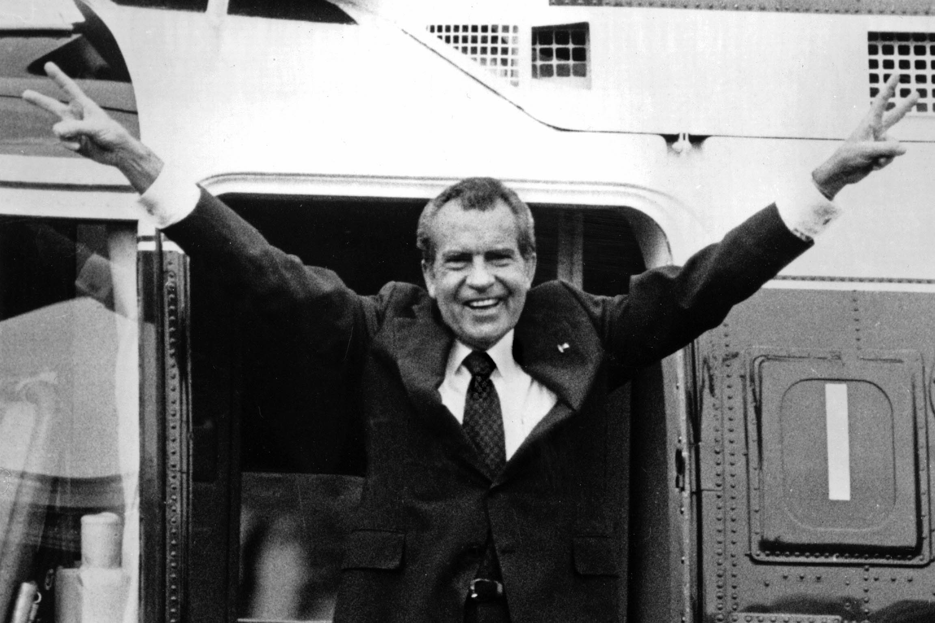
Higher Social Security Payments
Your social security payment has been increased by 20 percent, starting with this month’s check, by a new statute enacted by Congress and signed into law by President Richard Nixon on July 1, 1972.
The President also signed into law a provision that will allow your social security benefits to increase automatically if the cost of living goes up. Automatic benefit increases will be added to your check in future years according to the conditions set out in the law.

Slide 5
Opportunistic Political Business Cycles
Other presidents have acted similarly as one can find evidence for a political cycle in transfer payments (Alesina, Cohen, Roubini 1992). Spending on things like roads and welfare tends to increase, for example, and taxes tend to decline as election approaches.
One can also see PBCs at the local level - the number of police officers, for example, tends to increase when the local mayor is up for election.

Slide 6
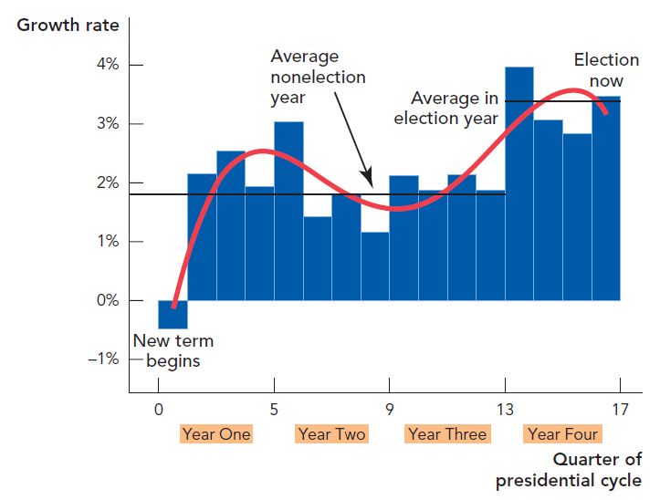
Growth in Disposable Personal Income Peaks in an Election Year (1947–2007)

Slide 7
Does it Work?
Even if manipulation occurs it's not obvious that it will work. President George Bush (senior) had withholding rate reduced prior to his reelection bid - note that by reducing with withholding rate it would appear that tax had gone down but come April workers would still have to pay the same amount!
Of course for Bush it didn't work - at least not well enough to get him reelected.
Voters must be myopic for the story to work - if the voters realized that the lower taxes today were really only masking higher taxes tomorrow they would not reward the incumbent.

Slide 8
Opportunistic Political Business Cycles in GDP and UE?
It's clear that presidents can affect taxes and welfare checks but do they also try to affect the economy as a whole, GDP growth and inflation, as the Fair model suggests is important?
The model predicts a cycle in GDP and inflation with high GDP growth rates and low unemployment rates before an election and inflation peaking after an election. Two problems
Rational expectations - repeatedly fooling voters seems unrealistic.
Empirical results are poor. Consider GDP - growth rate in presidential election years 1949-1994 is 3.66% versus 3.17% in other years; unemployment is only slightly lower 5.66% versus 5.81% over all years, inflation 4.07% in presidential election years versus 4.03% in other years (Alesina, Roubini and Cohen 1997).
Also McCallum showed that a simple model of unemployment, called an auto-regressive model predicted unemployment as well as a model with electoral cycle dummies. That is unemployment was well predicted by past unemployment rates and wasn’t improved by adding information about when elections would occur.

Slide 9
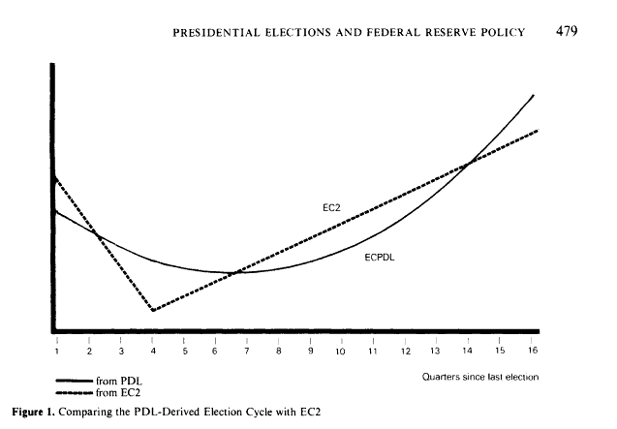
PBC in Money Supply
There is better evidence in inputs rather than outputs. Grier (1987) looks at the money supply and finds that there is a cycle - MS grows faster prior to an election than just after an election.
Adding in other variables that might affect money growth he continues to find evidence for a political cycle.
Adding the money supply growth equations to a model of the economy suggests that the money cycle could influence the economy - but recall that no such influence was found - note also that Grier's model is not a rational expectations model - it implies, in other words, that voters can be repeatedly fooled.

Slide 10
From Opportunistic PBC to Partisan Business Cycles
Whether there is political manipulation of the general economy and whether it works has not been fully resolved - there is evidence for opportunism in fiscal policy, transfers etc. and some evidence in monetary instruments but very little evidence for a political business cycle in outputs. Politicians are trying but perhaps not succeeding in creating a cycle - but note that transfers don't have to change aggregate economy activity to be vote-getting.
Led to new version called the partisan business cycles.

Slide 11
Partisan Business Cycles
Two key assumptions: 1) Wages are set in advance of the election by contract.
Assume that we are in t-1 and that the optimal wage, the wage that both workers and firms agree on is W_{t-1}*. Now we have to write a contract for the nominal wage for the next period. If inflation goes up value of $ goes down. If inflation goes down value of $ goes up. Ideal contract
i.e. real wage stays the same.

Slide 12
Partisan Business Cycles
But π_{t} is unknown at time t-1 thus we must use Eπ_{t} so wage growth equals Eπ_{t} – π_{t}.
Now imagine that Eπ_{t} <π_{t} i.e. expected inflation is less than actual inflation then wage growth is less than price growth and the real wage falls so firms hire -> boom.
But if Eπ_{t}>π_{t} i.e. expected inflation is greater than actual inflation then wages grow faster than prices, the real wage increases, firm hiring goes down -> bust.

Slide 13
Partisan Business Cycles
Second key idea is that parties have different preferences about inflation/output. Republicans are anti-inflation (bond holders, financiers, pensioners). Democrats are pro-inflation (they want to lower unemployment and stimulate the economy).
So assume that there is going to be an election in period t and we are in period t-1. If the R wins then inflation=2%. if the D win then inflation =10% . Suppose election is close then you want to set wage growth at:

Slide 14
Partisan Business Cycles
Expected inflation is 6% so wages are growing at 6% rate.
Now assume that Ds win, wages are rising at 6% and prices are rising at 10%, real wage is down, therefore firms hire and we have a boom.
Now assume that Rs win, wages are rising at 6% and prices are rising at 2% that means real wage is up and firms layoff workers and don't hire - we have a bust.
Prediction - a boom after D wins a bust after R. wins
Note that politicians in this model do not "manipulate" the economy. The Dems alone, for example, can't create a boom. Suppose that the Dems win for certain then wages are rising at 10% and so are prices - no boom. And vice-versa for Republicans.

Slide 15
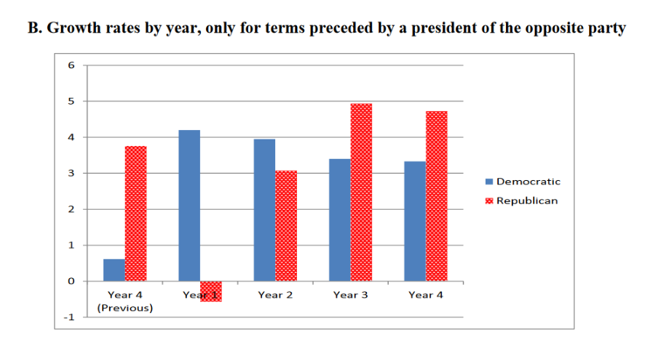
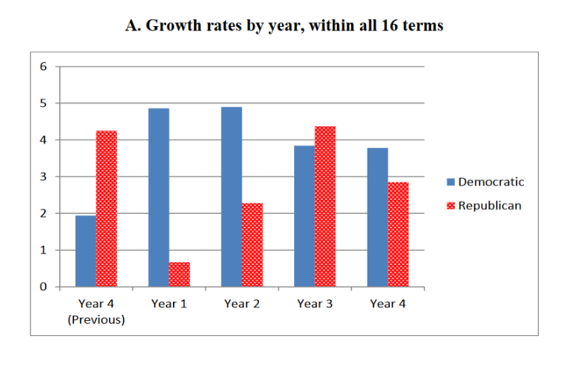
Partisan Business Cycles Data
Notes:
From Blinder and Watson (2013)
Figure 2
A. Growth rates by year, within all 16 terms
B. Growth rates by year, only for terms prec
eded by a president of the opposite party
Notes: Panel A shows average growth rates in ea
ch year of Democratic and Republican terms for
each of the 16 terms in our sample. Panel B shows
average growth rates in each year of the eight
terms preceded by a president of the opposite
party (Eisenhower-1, Kennedy-Johnson, Nixon,
Carter, Reagan-1, Clinton-1,
Bush II-1, and Obama-1).

Slide 16
Partisan Business Cycles
Problems: Everyone knows when the election is coming why not time wages so that they are set immediately after the election? Why not have state-contingent wages? How different are the parties inflation/output preferences? What about reverse causality?
Short term series.

