Slide 1
Regression Discontinuity Design What is the value of an Olympic Gold?
A Good RD Design
Notes:
Regression discontinuity design is based on the simple idea that if process A jumps when process B jumps then we have good grounds for thinking that the change in B caused the change in A so long as other causes of A vary smoothly.

Slide 2
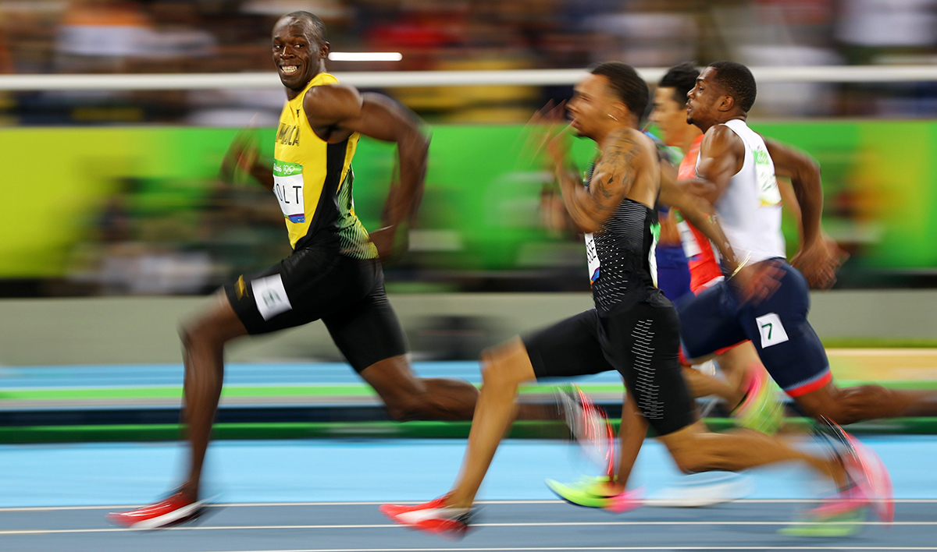
Regression Discontinuity Design
Not a Good RD Design
Notes:
Regression discontinuity design is based on the simple idea that if process A jumps when process B jumps then we have good grounds for thinking that the change in B caused the change in A so long as other causes of A vary smoothly.

Slide 3
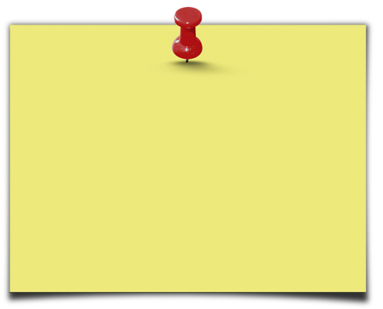
Regression Discontinuity Design
We have a running variable, X, an index with a defined cut-off
Units with a score X≤C, where C=the cutoff are eligible
Units with a score X>C are not eligible
Or vice-versa
For a discontinuity design, you need:
Running variable
Sharp cut-off.
Intuitive explanation of the method:
Units just above the cut-off point are very similar to units just below it – good comparison.
Compare outcomes Y for units just above and below the cut-off point.
Notes:
For presentation (with animation effects)

Slide 4
Estimating 1
The simplest RD design occurs if we have lots of observations with X=C+ε (and thus T=0) and lots of observations with X=C-ε (T=1) where ε is small.
In this case we can just compare means between the two groups who are on either side of C+/-ε. Since the two groups are similar to within an ε this estimates the causal effect of treatment.
More typically, however, we will only have a few observations clustered within ε of the cutoff value so we need to use all of the observations to estimate the regression line(s) around the cutoff value.

Slide 5
Example: Effect of fertilizer program on agriculture production
Goal
Improve agriculture production (rice yields) for small farmers
Method
Farms with a score (Ha) of land ≤50 are small
Farms with a score (Ha) of land >50 are not small
Intervention
Small farmers receive subsidies to purchase fertilizer

Slide 6
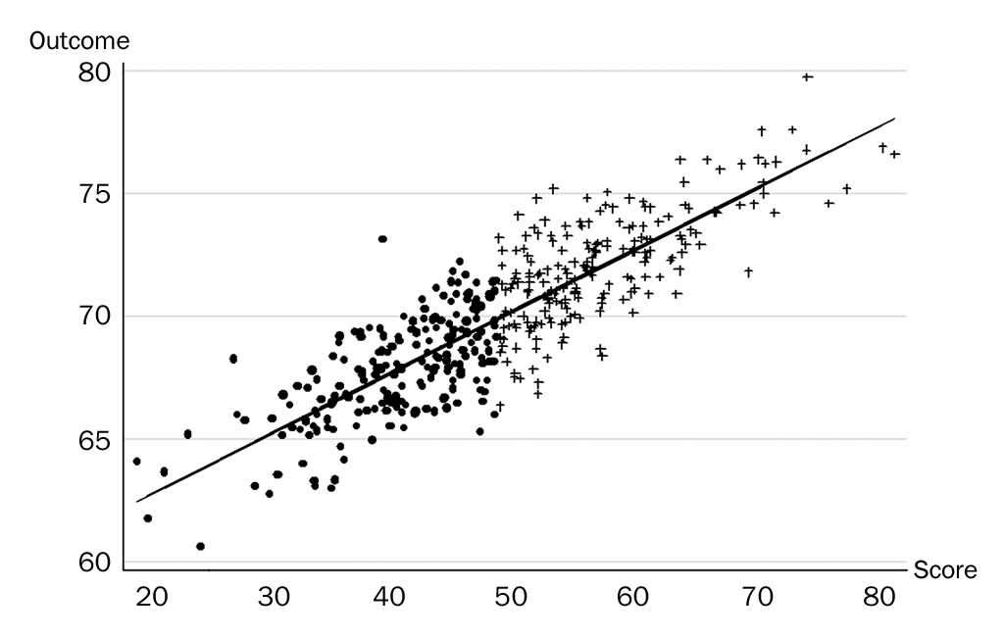
Regression Discontinuity Design-Baseline
Not eligible
Eligible

Slide 7
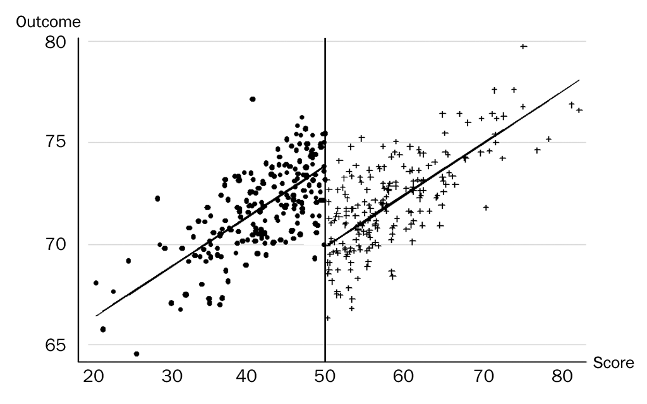
Regression Discontinuity Design-Post Intervention
IMPACT

Slide 8
Estimating 2
A linear model can be estimated very simply where X is the running variable and T the treatment which occurs when X>C.
But this model imposes a number of restrictions on the data including linearity in X and an identical regression slope for X<C and X≥C.

Slide 9
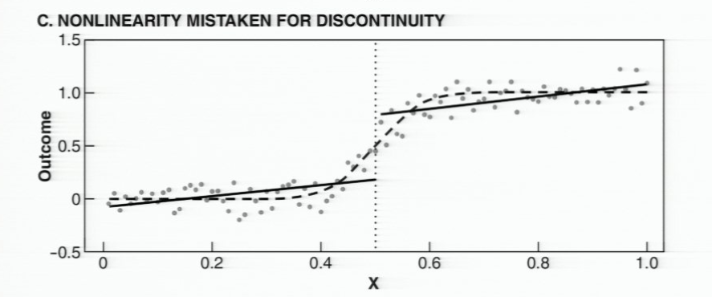
Non-linearity
Non-linearity may be mistaken for discontinuity.
To handle this we can estimate using, for example:

Slide 10
Estimation 3
One can allow different functions pre and post C.
Interpreting coefficients in a regression with interaction terms can be tricky.
To aid in interpretation it's often useful to normalize the running variable so it's zero at the cutoff. In this case, we create a new variable $\tilde{X}$=X-C so $\tilde{X}$=0 at the cutoff then run:
In this case B₇ measures at $\tilde{X}$=X-C=0 which is the jump at C, the estimate of the causal effect.
It's also possible to estimate the function in X using a non-parametric approach which is even more flexible.

Slide 11
Example: The Power of Incumbency
Politicians are routinely reelected at 90%+ rates.
Is this because of advantages of incumbency or is it because of a selection effect?
The best politicians will be the ones in the sample!

Slide 12
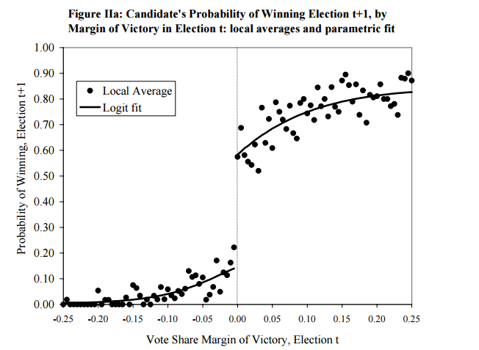

Slide 13
What do we want to see next?

Slide 14
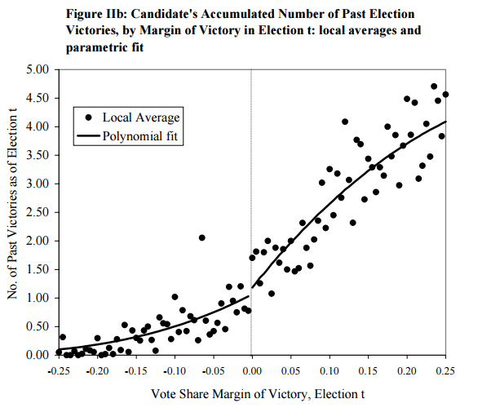

Slide 15
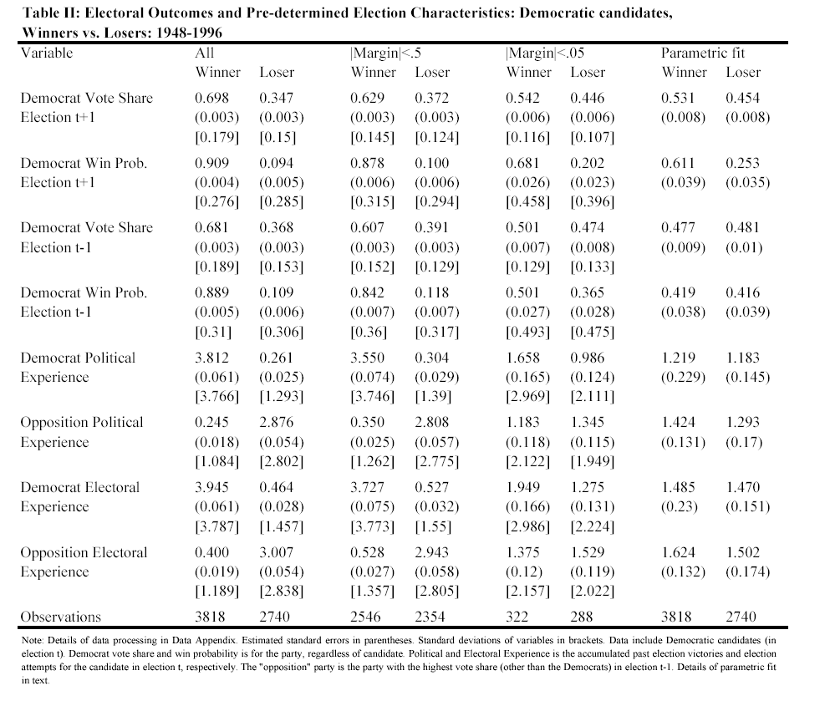

Slide 16
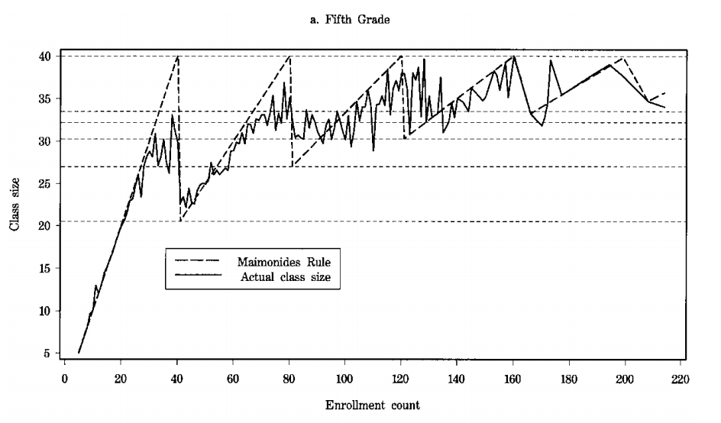
Fuzzy Regression Discontinuity

Slide 17
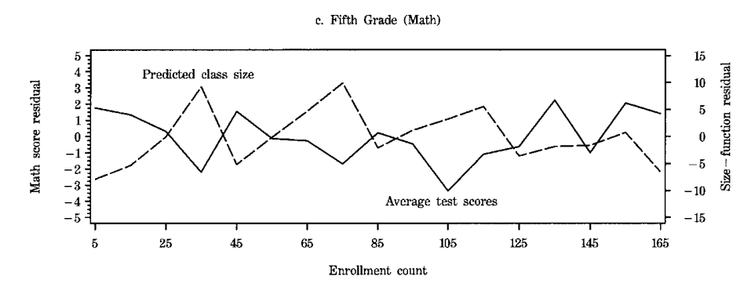
Fuzzy RD
Use predicted class size as an instrument to predict effect of class size on average test scores.
Estimate suggests that increase of 8 students would increase reading scores by 2.2 points (.29 of sd).

Slide 18
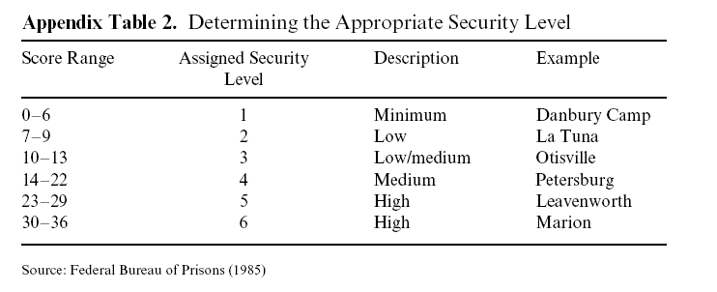
Chen, M. Keith, and Jesse M. Shapiro. 2007. “Do Harsher Prison Conditions Reduce Recidivism? A Discontinuity-Based Approach.” American Law and Economics Review 9 (1): 1–29. https://doi.org/10.1093/aler/ahm006.

Slide 19
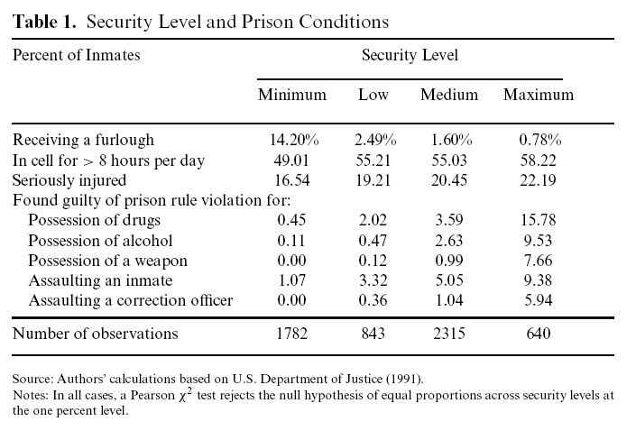

Slide 20
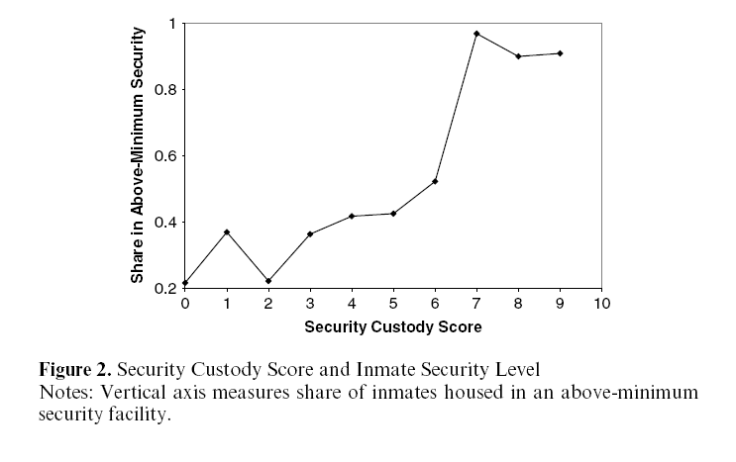

Slide 21
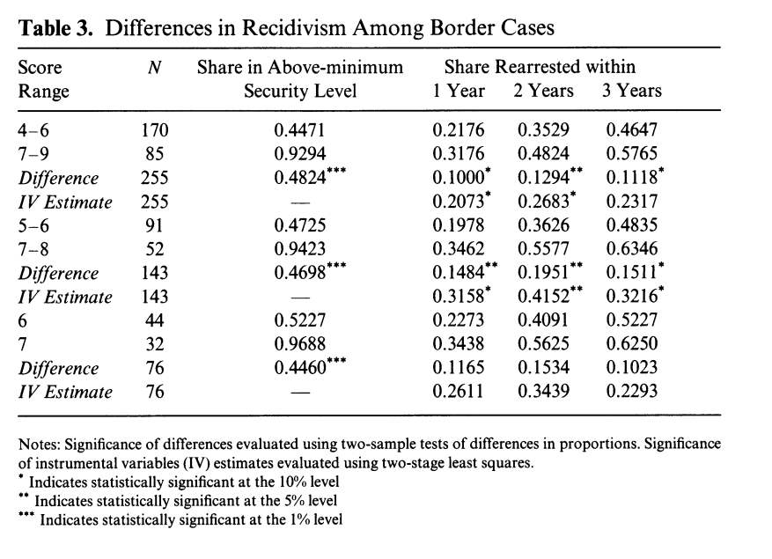

Slide 22
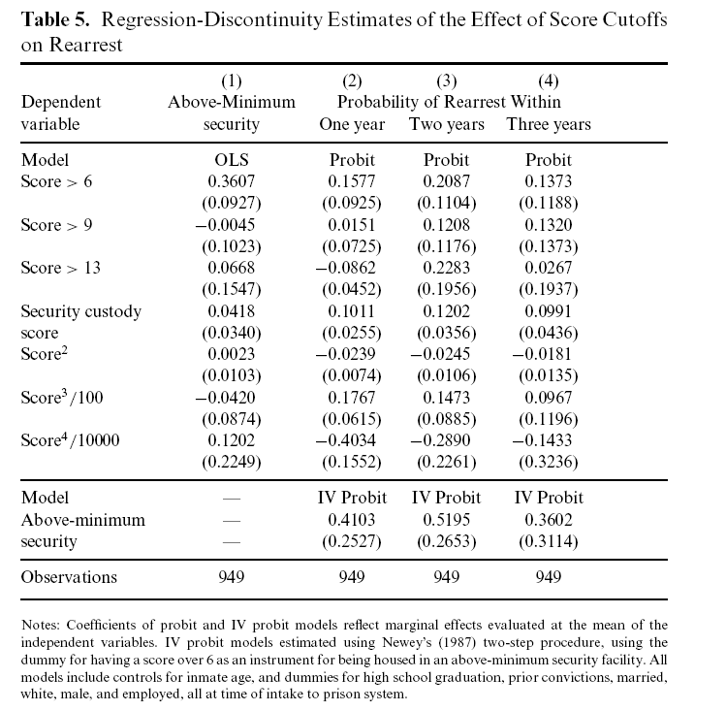

Slide 23
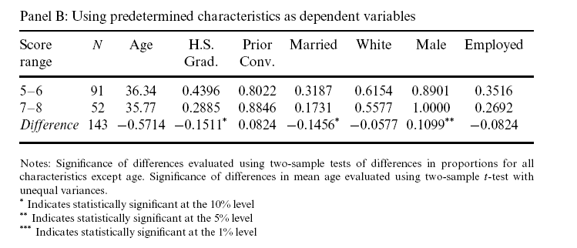

Slide 24
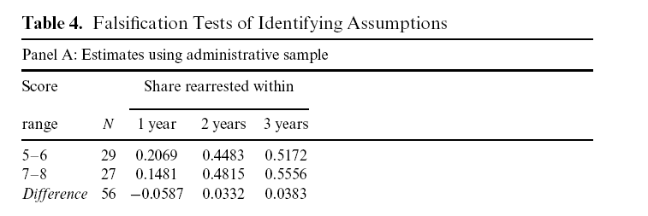

Slide 25
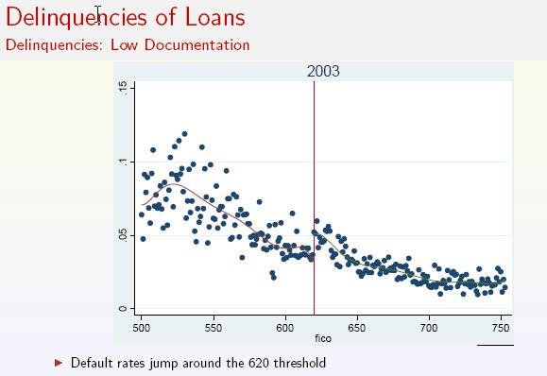
Did Securitization Lead to Lax Screening? Evidence From Subprime Loans (Benjamin J. Keys, Tanmoy Mukherjee, Amit Seru, Vikrant Vig)
Notes:
A FICO score of 620 was the cutoff for most loans – if your loan was 619, you couldn’t be resold to an investment bank in a CDO. At 621 you could. This number was picked arbitrarily by the GSEs in the 1990s, and kept by the hedge funds and investment bankers in the 2000s who were trading the stuff. Since it is arbitrary, a FICO score at 621 is just marginally better than 619. There is no magical jump there in terms of how FICO is measured at that point.
Loans at 621 could be securitized sold off to others – thus less monitoring.
Note that 621 is a slightly better FICO score than 619 but that these loans defaulted more. Note that if the authors control strategy doesn’t work it goes against their theory – so the fact that they find an effect is even more impressive.

Slide 26
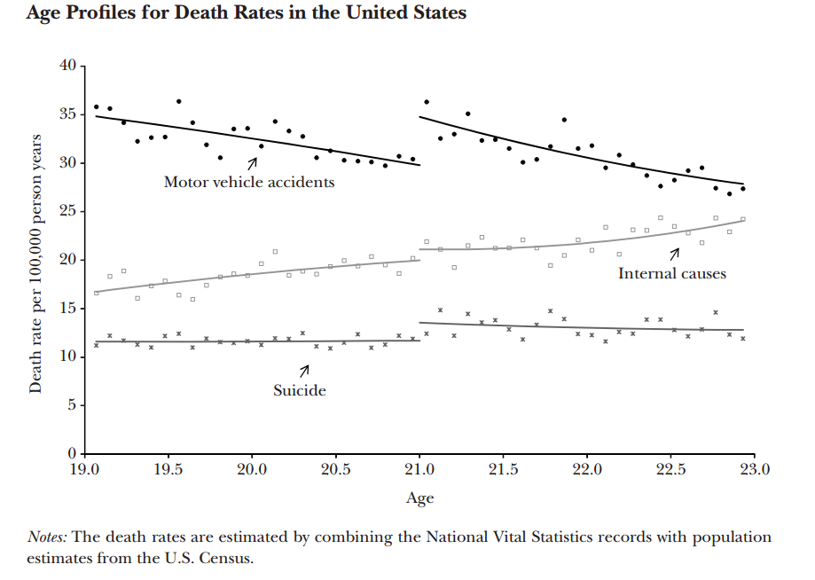
Minimum Legal Drinking Age Carpenter, C., & Dobkin, C. 2011. The Minimum Legal Drinking Age and Public Health. The journal of economic perspectives : a journal of the American Economic Association, 25(2): 133–156. Retrieved from http://www.ncbi.nlm.nih.gov/pmc/articles/PMC3182479/

Slide 27
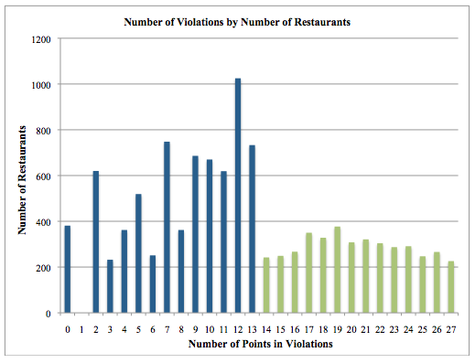
Regression Discontinuity a Warning - Heaping
Consider the following data from NYC hygiene inspections (From NYTimes http://fivethirtyeight.blogs.nytimes.com/2011/01/19/grading-new-york-restaurants-whats-in-an-a/)
A restaurant receiving any score from 0 to 13 points gets an A, but the difference from one end of that range to the other is substantial. A zero score means that inspectors found no violations at all, while 13 points means they found a host of concerns. ..
The graph below shows the distribution of A and B-rated restaurants…The horizontal axis tracks the number of violation points, and the vertical axis tracks the number of restaurants scoring in that category. The blue bars are A-rated restaurants, and the green bars are B-rated.
Notes:
From NYTimes
There are at least two possible explanations for this unusual distribution. One has to do with a provision of the system that allows non-“A” restaurants to request a re-inspection in hopes of earning a better score, and to hang a “Grade Pending” sign in their windows in the meanwhile. The spike in restaurants with 11, 12, or 13 points could be the result of restaurants with initial scores in the B range cleaning up their acts just enough to qualify for an A.
An alternative explanation could be related to the inspectors themselves. Knowing that restaurants that get B grades are likely to appeal them, inspectors may be more likely to rate a restaurants on the cusp with an A-range score; after all, the difference between 13 points and 14 is marginal, but the difference between an A and a B is meaningful. Given the subjective nature of the inspection process and the discretion that inspectors have to assign scores, the data suggest that inspectors may be disproportionately likely to assign restaurants a just-made-it A score than a just-missed B.

Slide 28
Low Birth Weight Babies
Almond, Douglas, Joseph J. Doyle, Amanda E. Kowalski, and Heidi Williams. 2010. “Estimating Marginal Returns to Medical Care: Evidence from At-Risk Newborns.” The Quarterly Journal of Economics 125 (2): 591–634.
VLBW babies (below 1500 grams) get extra treatment.
1500 g is conventional but arbitrary.
Authors find that mortality deceases at just below 1500 suggesting value of additional medical care.
Barreca, Alan I., Melanie Guldi, Jason M. Lindo, and Glen R. Waddell. 2011. “Saving Babies? Revisiting the Effect of Very Low Birth Weight Classification.” The Quarterly Journal of Economics 126 (4): 2117–23.
Finds that outcomes around 1500 grams and in general around many round numbers are peculiar both above and below.
Nurses and doctors may be manipulating.
Reminder that not all discontinuities are equally useful—exogenous discontinuities like election outcome more useful.

