Slide 1
Synthetic Control
Alex Tabarrok

Slide 2
Synthetic Control Abadie, Diamond and Hainmuller . 2010. Synthetic Control Methods for Comparative Case Studies: Estimating the Effect of California’s Tobacco Control Program
As with all method of causal inference, we want to estimate the counter-factual outcomes for the treated group.
Synthetic control does this by weighting “donor units” to replicate the outcome path and key exogenous variables in the treated group in the pre-treatment period.
It is then assumed that the synthetic control evolves like the treated group would have evolved in the post-treatment period had the treated group not been treated.
The idea is similar to differences in differences in panel data but instead of assuming that the treatment group has a parallel trend to the control group in the post-treatment period, we assume that the synthetic control exactly represents the counter-factual.
The advantage of synthetic control is that the post-treatment counter-factual isn’t limited to a trend but can vary widely depending on the evolution of the exogenous variables.

Slide 3
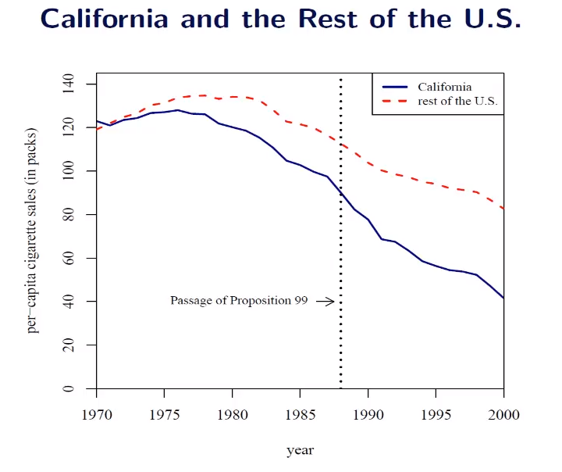
Synthetic Control
Test effect of CA’s Proposition 99 (sales tax with revenues going to anti-tobacco efforts.)
Use other states as control but note that a simple average of the controls appears imperfect.

Slide 4
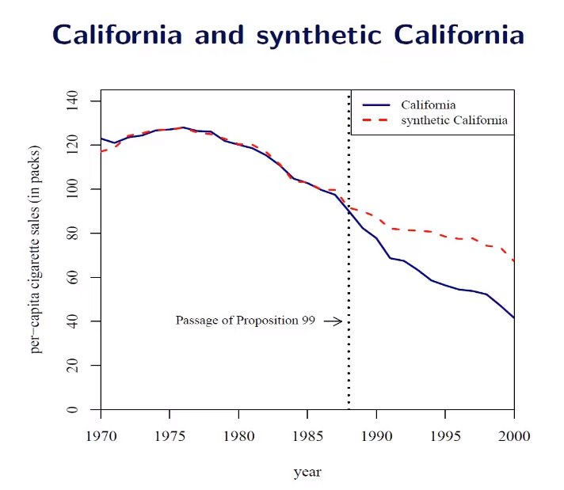
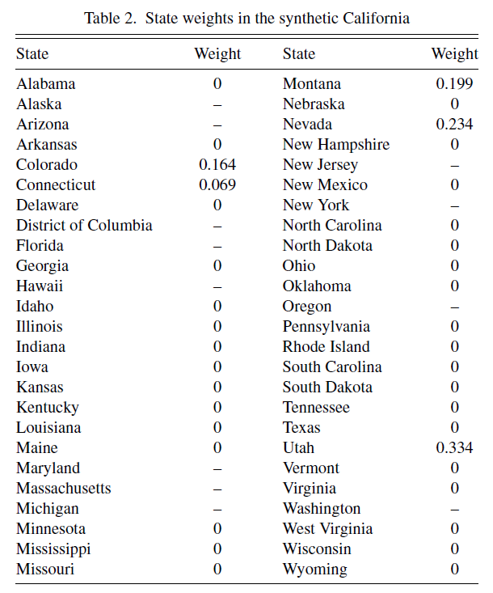
Synthetic Control
CA is 1/3 Utah?
But what weights does regression use???
Notes:
Note that it is easy

Slide 5
Synthetic Control v. Regression
Regression can also be understood as creating weights on control groups.
As with synthetic control the weights sum to 1 but regression allows the weights to be negative!
Synthetic control thus prevents “too much” extrapolation.
Since the weights are all positive, the counter-factual outcome is in the convex-hull of donor group outcomes—i.e. loosely speaking, it’s in the “common support”—similar to how matching keeps you on common support

Slide 6
Synthetic Control-What to Replicate?
We could look for a synthetic control that best replicates the outcome, cigarette consumption, in the pre-treatment period but that risks overfitting.
We want to find a synthetic control that also looks similar to the treated group on exogenous variables that we think are important causes of the outcome, e.g. percent aged 15-24, beer consumption, log gdp.
If we get these right it allows the synthetic control to evolve in the post-treatment period taking into account changes in the exogenous input variables.

Slide 7
Synthetic Control-What to Replicate?
Abadie et al. include some outcome variables, cigarette sales per capita in 1975, 1980, 1988 and some exogenous variables that they will average and seek to match over the per-treatment period.
Note that synthetic matches better than average of 38 control states.

Slide 8
Synthetic Control
Since there is only one treatment and only one control it’s not obvious how to do tests of statistical significance.
Abadie et al. therefore recommend placebo tests.

Slide 9
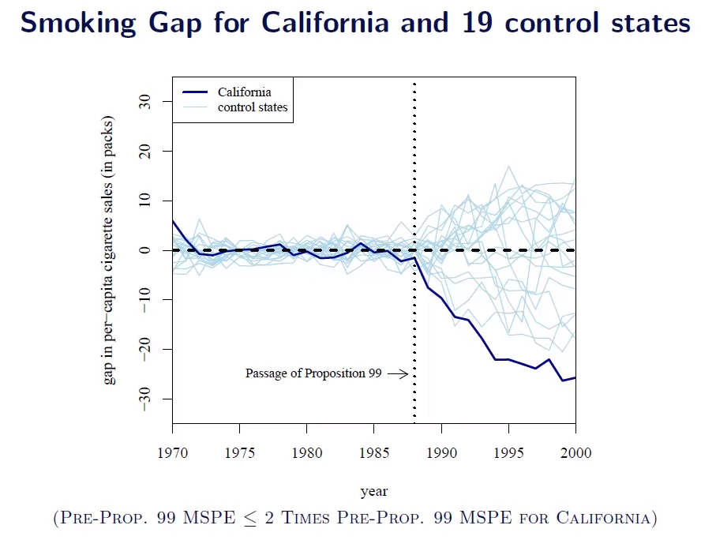
Placebo tests
Iteratively “pretend” that each state is the treatment state.
Compare actual treated to the computed “null” distribution.
(Details next page).

Slide 10
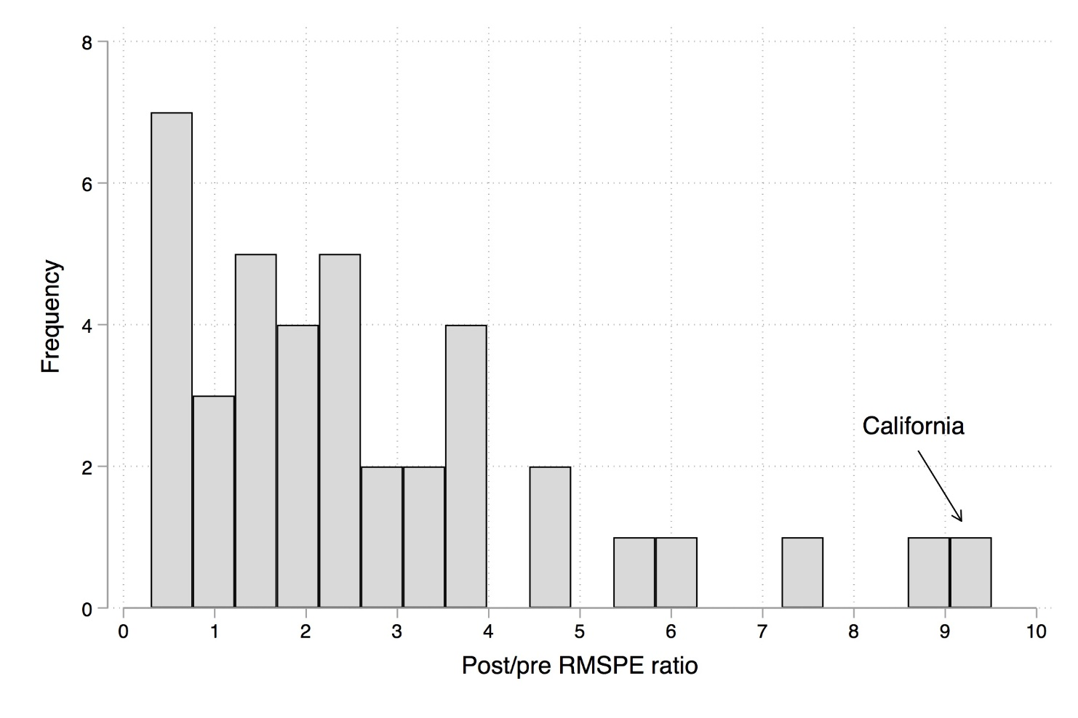
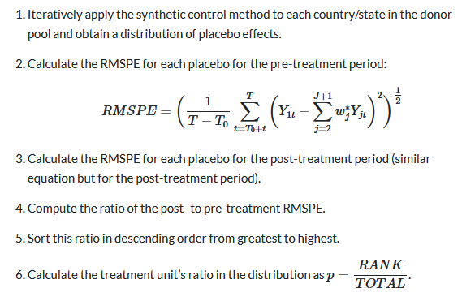
Placebo Inference for Synth Control
Notes:
Drop states for which pre-RMSPE is very high.
California 1/38=p=2.6%

Slide 11
Synthetic Control: Implementation
The mathematics of finding a synthetic control is complicated because two sets of weights must be found: the weights on the control units and the weights on the variables which are used to choose the control units.
E.g. choose state weights to minimize the difference between the synthetic control and CA on per capita cigarette consumption, log GDP, demographics and so forth.
How should we weight log GDP versus percent of population aged 15-24?

Slide 12
Synthetic Control: Implementation
Basic answer: choose the weights on the X’s so that X’s that are better predictors of Y are more heavily weighted.
Note also that these weights will change as the weights on the states change and the weights on the state change as the weights on the X variables change.
Thus, have to use an iterative procedure to search the space to find best set of weights.

Slide 13
Synth for Stata
Install Package, Load Practice Data
ssc install synth, all replace
use smoking
xtset state year
Create synthetic control
synth cigsale beer lnincome retprice age15to24 cigsale(1988) cigsale(1980) cigsale(1975), trunit(3) trperiod(1989) xperiod(1980(1)1988) nested fig
Outcome variable
Match variables
Treated unit
Average the “match” variables over 1980-1988
Treatment begins

Slide 14
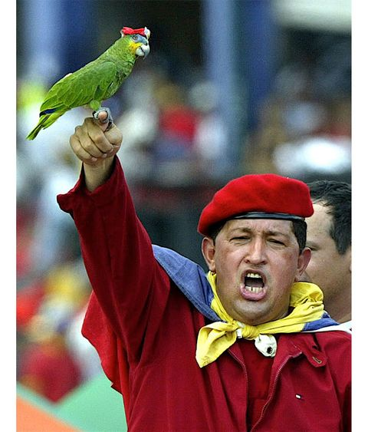
The Economic Consequences of Hugh Chavez Grier, Kevin, and Norman Maynard. 2016. “The Economic Consequences of Hugo Chavez: A Synthetic Control Analysis.” Journal of Economic Behavior & Organization 125 (May): 1–21. https://doi.org/10.1016/j.jebo.2015.12.011.
What were the consequences of Hugh Chavez’s rule of Venezuela (1999-2013)?
Chavez launched his “Bolivarian Revolution” in 1999 with creation of a new constitution.
Converted the legislature from bi-cameral to unicameral and greatly increased the powers of the executive branch.
Increased the presidential term from 5 to 6 years and allowed the president to hold the office for 2 consecutive terms.
In 2000, after another election, Chavez was granted the right to rule by decree.
In 2004, Chavez and the national assembly increased the number of Supreme Court justices from 20 to 32, packing the court with his supporters.
Chavez won re-election in 2006, and in 2007 was granted the right to run again in 2012 in a referendum.

Slide 15
Political Consequences
Constraints on the Executive variable from the Polity project averaged a value of 6.0 in the 14 years before Chavez (1985–1998) but only 4.2 in the 14 years (1999–2012) of Chavez’s rule (a 30% fall).
Polity’s Political Competition variable fell 26% between the two periods and Venezuela’s average Democracy score fell 45% between the two periods (from 8.5 to 4.5).
The International Country Risk Guide (ICRG) data includes an “investment profile” variable that is partly determined by risk of expropriation. That variable fell (indicating a worsening investment climate) from an average of 5.54 in the pre-Chavez period to an average of 3.75 during his time as president, a fall of 32%.

Slide 16
Economic Reforms
Economic “democracy”--100,000 worker-owned cooperatives were created and thousands of "Communal Councils“ to determine how to spend local funds.
Price controls beginning in 2003
Nationalized largest electricity producer, largest farms, leading steel company, cement production, some banks etc.
Increased taxes especially on rich.
Increased spending on poor.

Slide 17
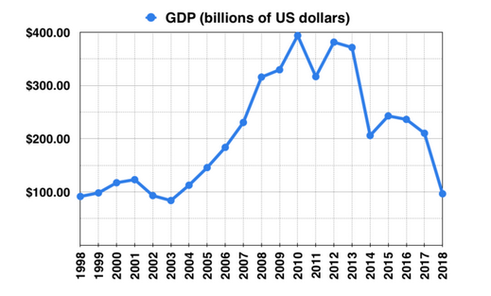
Consequences?
GDP increased considerably beginning in 2003 and only fell later.
But approximately half (depending on year) of state revenues come from oil revenues and oil prices increased by a factor of 6 between 1999 and 2007.
Thus the real question is what would have happened in Venezuela without Chavez’s reforms?
Wikipedia, https://en.wikipedia.org/wiki/Economic_policy_of_the_Hugo_Ch%C3%A1vez_administration

Slide 18
Create a Synthetic Control
19 potential donor countries.
“In order to capture similarities of geography, history, culture and heavy reliance oil exports, we use almost all Latin American countries and OPEC member countries with available data. We also include Canada and Norway, which are major oil exporting countries but are not OPEC members.”
Indicator variables:
Income levels from four pre-Chavez years (1970, 1977, 1983, 1987).
Average population growth rate 1970–1998
Openness to trade in 1970 and 1990
Two educational attainment variables in 1970 and 1990 from the Barro and Lee (2010) database.

Slide 19
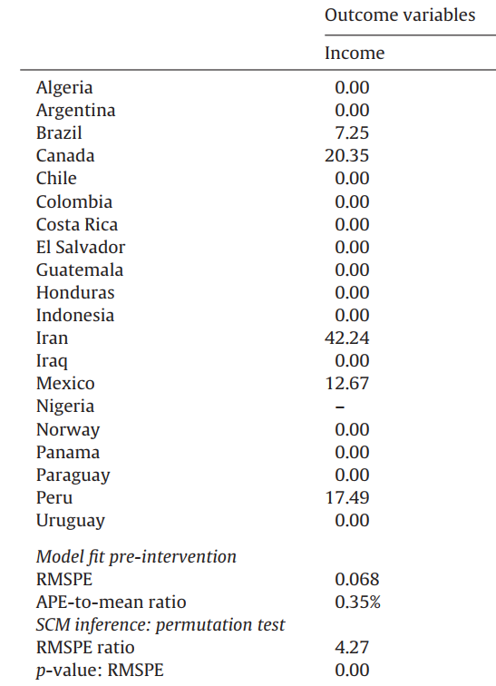
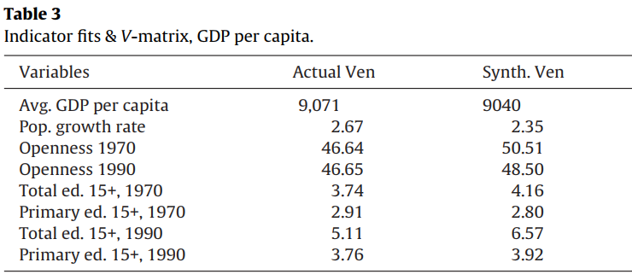
Synthetic Control
On the basis of the indicator variables the synthetic control is a combination of Brazil, Canada, Iran, Mexico, and Peru.
Potential Donor Countries

Slide 20
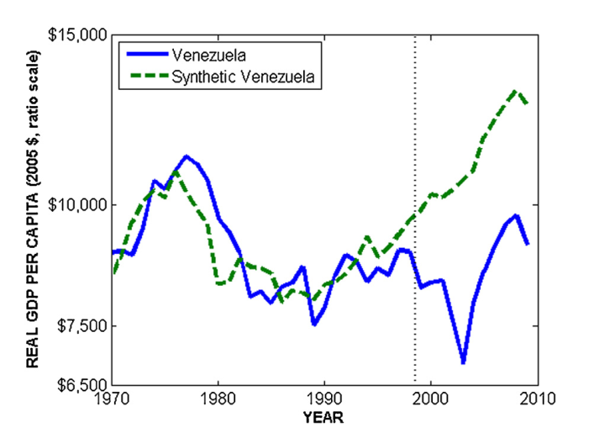
Synthetic Control

Slide 21
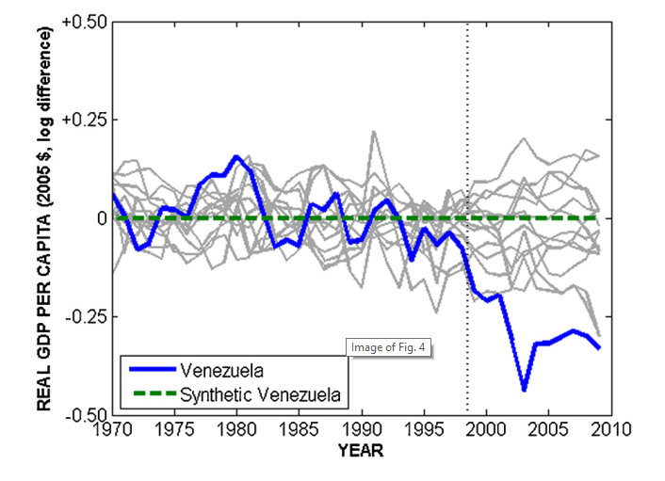
Placebo Test
Note that blue is close to actual outcomes (normalized to zero) in pre-treatment period (as it was required to be).
It departs from outcomes in post-treatment period (suggesting causal effect of treatment was negative) and it does so considerably more than do the placebos suggesting the identification of a causal effect rather than just noise.

Slide 22
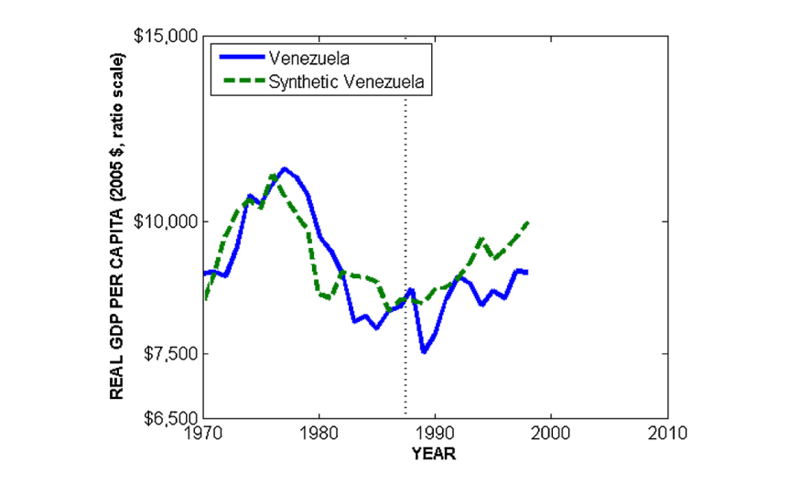
Backdating
Pretend that Chavez came to power in 1988 and ruled to 1998 would the method have found a Chavez effect?
No.
Note-could also have continued the synthetic control to see if difference arises again after 1998.

Slide 23
Other Outcome Variables
Even though real GDP per capita rose during the Chavez period, the synthetic control suggests that Chavez’s policies substantially reduced GDP per capita in Venezuela compared to what it would have been without his policies.
What about other outcomes like life-expectancy and inequality?

Slide 24
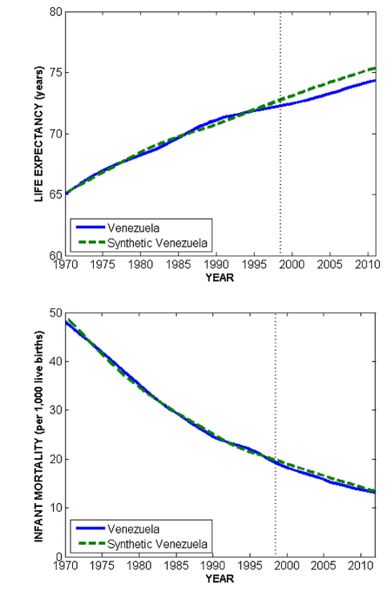
Other outcomes
Life expectancy increased during Chavez’s regime but a little bit less than expected compared to synthetic control.
Infant mortality fell about as much as expected.

Slide 25
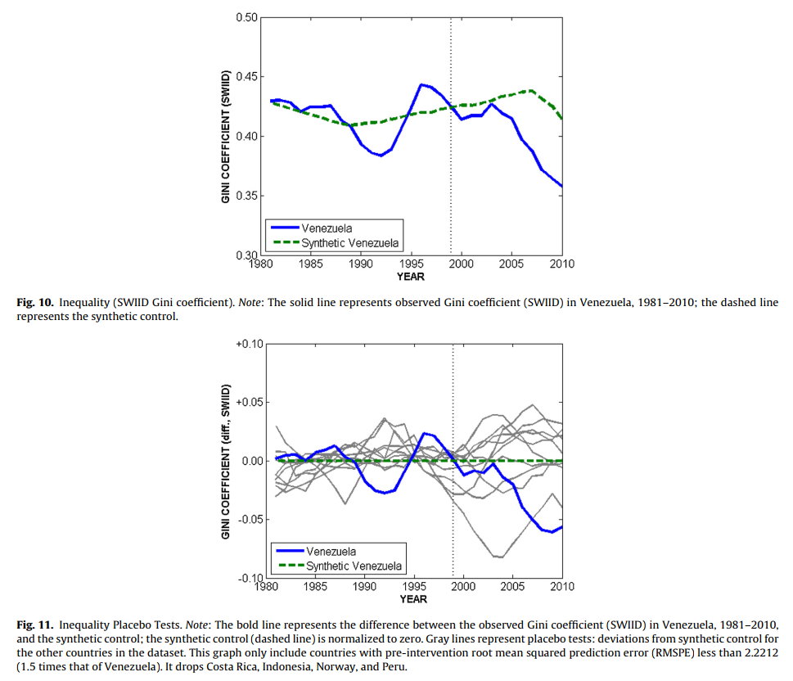
Inequality
Inequality fell during Chavez’s regime and perhaps more so than under the counter-factual although results are quite noisy.
Since 2010 inequality has probably fallen even further although only because everyone has become poor.

Slide 26
Conclusion
The results of Chavez’s policies were a large decline in real GDP per capita and no large changes in other variable such as life expectancy or poverty and at best a decline in inequality.
Estimating the consequences of Chavez’s policy requires estimating a counter-factual and cannot just be estimated from what happened which was due to multiple forces, most notably a large increase in the price of oil.

