Slide 1
Tyler Cowen
Alex Tabarrok
Photo: Ryan Wick
Development Economics
Guns, Germs, Steel

Slide 2
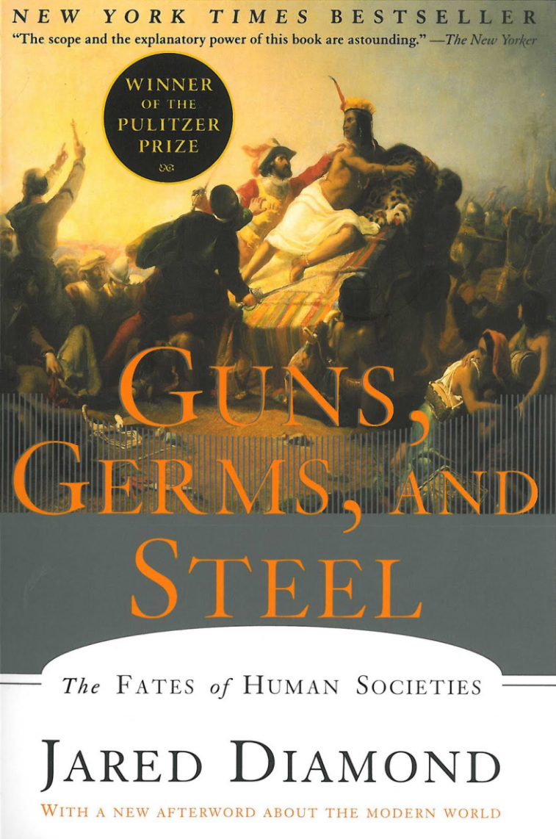
Why are some regions/countries rich while others are poor?
Why Euroasia rather than North or South America, Africa, or Australia?

Slide 3

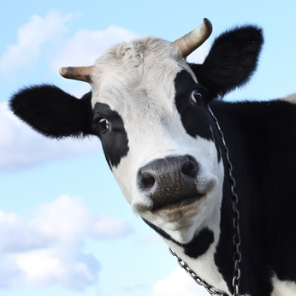
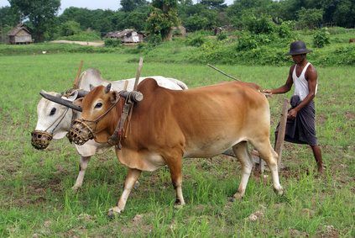
The Importance of Domesticable Animals
Domesticable Animals were not Evenly Distributed on the Globe
There are surprisingly few domesticated animals.
In the world today there are five major cases: sheep, goats, cows, pigs and horses.
  Add in some less important cases: Arabian camel, Bactrian camel, Llama and Alpaca, Donkey, Reindeer, Water Buffalo, Yak, Bali cattle, Mithan we have a total of 14.
The wild ancestors of these animals were not spread evenly across the globe.
Without domesticated animals it’s much harder to develop mass agriculture and from there cities and civilizations.

Slide 4
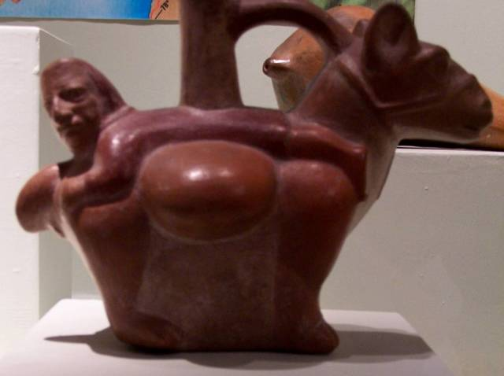
Why Horses are Better than Llamas

Slide 5

Questions
Were the animals that were domesticated the only animals capable of being domesticated?
The arguments for this are varied and none are drop-dead definitive:
  The domesticated animals have been domesticated on several occasions independently – indicating a demand for domestication.
  When introduced to non-indigenous areas the natives quickly appreciated and used domesticated animals.
  Many animals are excluded from domestication by a variety of characteristics:
    Nasty disposition (grizzly bears, African buffaloes, zebras) – why no zebra rodeos?
    Diet is too limited (koalas, pandas) or their diet to growth ratio is not fast enough to make domestication worthwhile.
    Difficult to herd (cats, antelopes in more than a tribe).
    They don’t like to have sex when people are watching (pandas).

Slide 6
Guns, Germs, Steel: Domesticable Crops
The case for crops mirrors that of animals but is harder to make because there are so many more plants that “in principle” could be domesticated (there are maybe 150 large animals which it would be good to domesticate if possible but tens of thousands of such plants.)
Even today two cereals, wheat and rice, account for 41% of all total calories consumed in the world.
The major cereals are wheat, corn, rice, barley, and sorghum.
  4 out 5 of these are from Euroasia
  The indigenous versions of wheat, rice, barley and sorghum are very similar to the domesticated versions. Corn is from MesoAmerica and the wild version is very different. It consequently took much longer to domesticate.
Many plants are surprisingly difficult to domesticate.
Notes:
See Guns, Germs, Steel for more arguments but bottom line is that Diamond argues that the domesticated plants are evidence of the domesticable plants and that these were not evenly distributed across the globe.

Slide 7
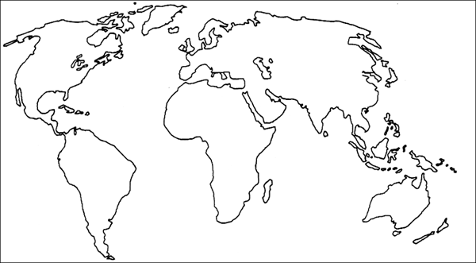
Guns, Germs, Steel: Transmission
Agriculture and other ideas also spread faster in Euroasia because it’s major axis is East-West, along a similar latitude, meaning a similar climate, so crops, animals and ideas could move more easily across Euroasia than through the Americas or Africa where the major axis is North-South.
Hard to test this idea!

Slide 8
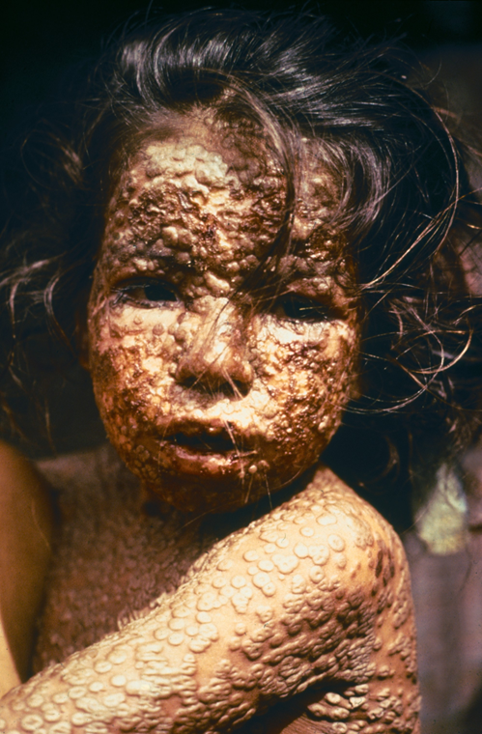
Guns, Germs, Steel: Germs
The major infectious diseases in humans all evolved from diseases of animals:
    Smallpox
    Flu
    Tuberculosis
    Malaria
    Plague
    Measles
    Cholera
Europeans lived next door and often in the same barn as the animals and were repeatedly decimated by these diseases but for that very reason they evolved some immunity.
In 1520 it took just one sick person to bring smallpox to S. America where it may have killed 90%, yes 90%, of the population.
The same story was told a little later in North America
This young girl in Bangladesh was infected with smallpox in 1973. In 1977 smallpox was eradicated from the earth.
CDC # 3265.
Notes:
The devastating effect of smallpox in the early 1500s explains how Cortez was able to defeat the Aztec empire and how in 1533 Pizzaro was able to conquer the entire Incan civilization with less than 200 hundred soldiers and some 60 horses. Pizzaro had the greatest shock troops of all time on his side, germs.

Slide 9
The Pilgrims and the Plague
When the pilgrims arrived in North America they found empty villages, as prepared by providence. John Winthrop, governor of Massachusetts, called the plague miraculous:
But for the natives in these parts, God hath so pursued them, as for 300 miles space the greatest part of them are swept away by the smallpox which still continues among them. So as God hath thereby cleared our title to this place, those who remain in these parts, being in all not 50, have put themselves under our protection.
King James agreed thanking:
    “Almighty God in his great goodness and bounty towards us” for sending “this wonderful plague among the savages.”
Notes:
An interesting piece of evidence on the importance of germs in conquest is that central Africa was not colonized because the settlers quickly died of malaria, a disease native to the tropics that the natives had developed some resistance to but not the settlers. (The crops and animals of the settlers also did not do well in the tropics.)

Slide 10
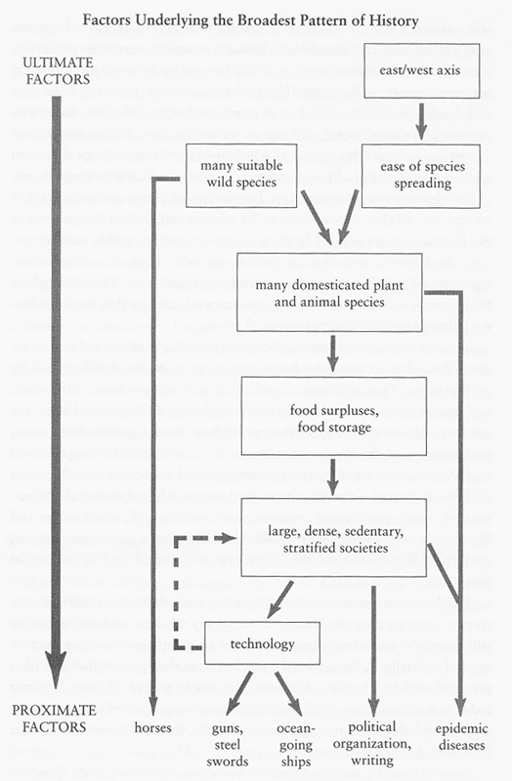
Summarizing the Diamond Argument
Source: Diamond, J. 1999. Guns, Germs, and Steel: The Fates of Human Societies (New York, London: W.W. Norton & Company), p.87

Slide 11
Diamond Takes Us To 1500-1600 But What Then?
France and China are both in Euroasia but the former is rich and the latter poor, despite the fact that they share most of the geographic factors that Diamond focuses on.
Thus geography alone cannot explain why some countries are rich today while others are poor.
There has been a “reversal of fortune,” the rich places in 1500 tend not to be the rich places today, despite the fact that the geographic have not changed.
Rich countries have good institutions; protection of private property, open and competitive markets, the rule of law, limited and honest government.

Slide 12
The Case for Institutions in Brief
I said good institutions are the cause of economic growth.
What do we mean by institutions?
  Enforcement of property rights.
  Legal systems.
  Corruption.
  Entry barriers.
  Democracy vs. dictatorship.
  Constraints on politicians and political elites.
  Electoral rules in democracy.
What is (some of) the evidence that institutions matter?

Slide 13
The Korea Experiment
Korea: economically, culturally and ethnically homogeneous at the end of WWII.
If anything, the North more industrialized.
“Exogenous” separation of North and South, with radically different political and economic institutions.
  Exogenous in the sense that institutional outcomes not related to the economic, cultural or geographic conditions in North and South.
  Approximating an experiment where similar subjects are “treated” differently.
Big differences in economic and political institutions.
  Communism (planned economy) in the North.
  Capitalism (and until 1980 without democracy), in the South.
Huge differences.
Source: Acemoglu (2004)

Slide 15
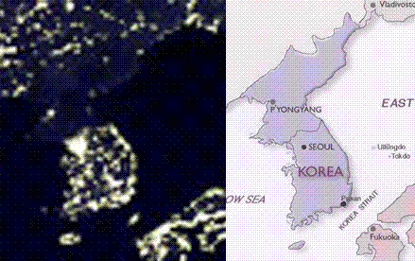
Even Martians can tell that Communism Doesn’t Work

Slide 16
Source: Acemoglu (2004)

Slide 17
The Immigration Experiment and What It Tells us About Institutions
Compare the Haitian taxi-driver who moves to the United States to drive a taxi.
What is the same?
  Human capital
  Physical capital
What differs?
  Wages go up by a lot!
Explanation: Institutions!

Slide 18
But where do Institutions Come From?
There is now a surprising consensus that property rights, rule of law, constraints on government etc. are important and necessary for good government.
Attention is now focusing on asking where do these institutions come from?
We begin by looking at the reversal of fortune in more detail.

Slide 19
Reversal of Fortune
The geography explanation has a problem, the reversal of fortune.
In 1790 the island of St. Domingue was one of the richest places in the world. William Pitt called it “the Eden of the Western World.”
This island:
    produced 30 percent of the world’s sugar and more than 50 percent of the world’s coffee.
    had a level of foreign trade equal to that of the United States.
    had cities larger than Boston with newspapers, museums, public fountains, paved roads, whitewashed stone homes, and markets with imported delicacies from around the world.
    had a capital city with “street magicians and jugglers, a botanical garden, a bathhouse, and several bookstores” and a theatre that held 1500 spectators.
What do we call this island today?
Notes:
Information from Hochschild, Adam. 2005. Bury the Chains. Houghton Mifflin Co. Boston. P. 261-263.

Slide 20
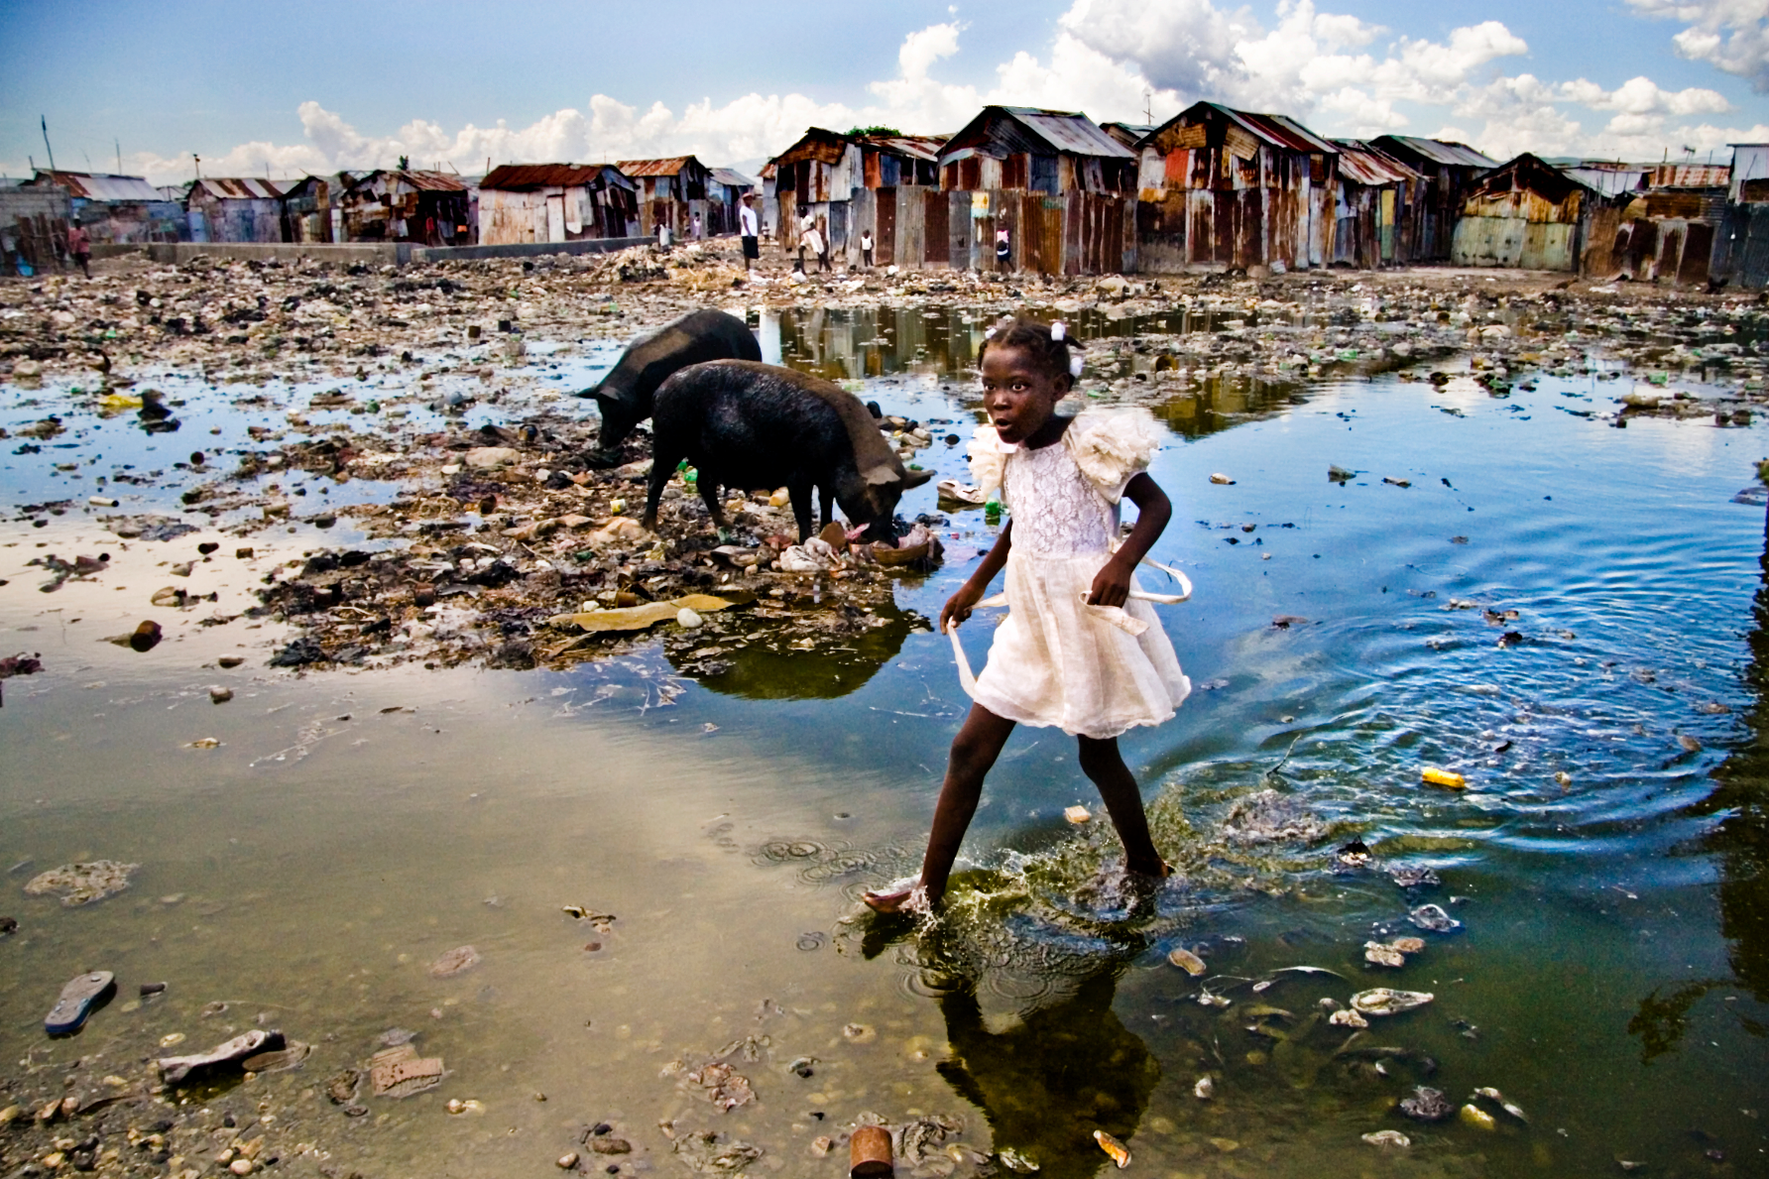
Haiti
Alice Smeets, www.AliceSmeets.com
Notes:
Haiti today is the poorest country in the Western Hemisphere with 80% of the population living in abject poverty.

Slide 21
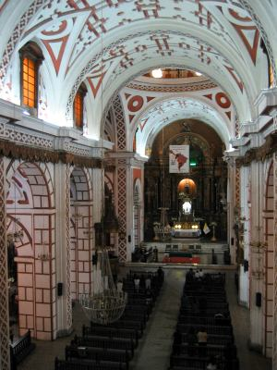
Reversal of Fortune
St. Dominigue was a country of slaves so the riches mentioned earlier were for the French colonists. Even taking this into account, however, the West Indies were rich relative to the United States.
More generally, the West Indies, India, Indonesia, Argentina, Brazil, Mexico, Peru, Barbados, Cuba were all richer than the United States in 1700. This is easy to see if you visit one of these countries.
By 1800, however, a clear trend had emerged in which the formerly poor colonies such as Canada, the United States and Australia began to pull ahead.
What happened? Following Engerman and Sokoloff (2002) we will focus on the North and South American colonies.
Church of San Francisco in Lima, Peru finished 1674.

Slide 22
Factor Endowments, Inequality and Paths of Development
The ES argument is summarized in the title.
  Factor endowments “determined” political and economic inequality which in turn led the colonies along different paths of development.
  Geography (factor endowments) still plays a role, as in Diamond, but now there is an intervening factor, institutions.
Geography Institutions Development

Slide 23
Factor Endowments: Crops & Mineral Resources
The West Indies and much of South and Central America had great climates for sugar, coffee, tobacco, cotton and/or they had great gold or silver mines.
What’s important about these crops and resources is that they are very labor intensive and have large economies of scale. Wherever sugar was produced, for example, it was produced on large plantations using extensive low-skill labor.
In comparison the crops produced in much of North America, grains like wheat, had low economies of scale. (Cotton and to a lesser extent tobacco being the major exceptions).
  In other words, a farmer and his family could make a living working for themselves in North America growing grain but the same family could not produce sugar in Brazil – for that it took a “firm,” a large body of labor and overseers in a “capitalist” production process.
  What implications for politics? – (this is where we are heading.)

Slide 24
Factor Endowments: People
Many of the regions in the W. Indies and C. and S. America also had large native populations – good for forced labor.
In regions with resources but no labor – African slaves were imported in the millions.
  St. Martinique, a tiny island, imported more slaves in its history than all of the United States. (The slaves were worked to death and regularly replaced.)
In fact, few Europeans emigrated to these regions to live – they came to rule.
  We think of Latin America as having a European character but as late as 1825 less than 25 percent of the population of Brazil was white (55% black, 21 percent Indian) and even fewer were white in Spanish America.
Compare with North. America. Who came to live in North. America?

Slide 25

Factor Endowments
Answer: A few religious nuts (nuts as seen by their contemporary society).
The people on the make went to South America where the opportunities were.
The people trying to escape oppression went where no one else wanted to go – places where they could make a life of their own away from the interference of Europe and where there were few other people.
There were relatively few natives in North America and slaves never made up a large share of the population compared to that in S. America and the Indies.
  In 1820, for example, 80% of North America was white and less than 20% black. Almost the reverse of Spanish America.
  This meant that North America began with much more equality while South America began with hierarchy.

Slide 26
From Factor Endowments to Political and Economic Inequality
Economies of scale in sugar and mining and high demand for low-skill labor meant that the S. American colonies (including C. America and the W. Indies) set up highly unequal societies. A few wealthy European immigrants, often with very large land holdings, dominated large slave or Indian populations.
In North America the fact that a family could produce enough grain to support itself meant that many did.
  “Take this job and shove it” was a real possibility when cheap land was easily available by moving West.
  The aristocrats in North America wanted to set up a feudal society but in the face of such pressure they could not.
Aside: Quite often North America’s success is attributed to its “Britishness” and ideas about individual liberty and so forth. While these were surely important, other British colonies such as Jamaica, Barbados, Belize etc. did not develop along N. American lines.
  Even the Puritans, who also had a colony of Nicaragua, quickly decided that hard work was for Indians and not for them.
  Similarly, the French in Quebec were just as French as the French in St. Domingue but they developed along different lines..
Engerman and Sokoloff argue that these initial patterns of inequality persisted and were self-reinforcing through the 19th and 20th centuries to the detriment of economic growth.

Slide 27
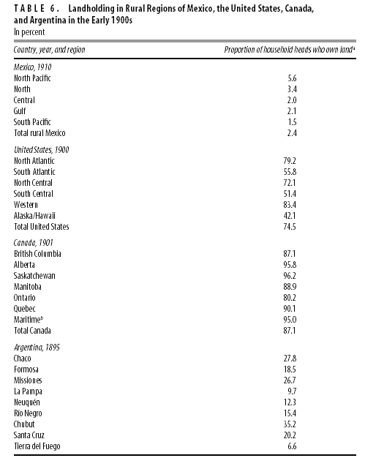
Born in Inequality -> Developed Inequality
Consider the distribution of land circa 1900.
In Mexico in 1910, less than 5% of household heads owned land, in Argentina it’s about 20%, in the United States it’s about 80%, in Canada 90%.
We see similar persistence of inequality in other areas:
  As late as 1900 none of the countries in Latin America had the secret ballot. Wealth and literacy requirements remained common long after they had ended in North America.
  Why did Latin America democratize much later than North America? It’s not just that the elites didn’t want democracy they may have feared democracy. Consider again the inequality in land holding – land is very easy to redistribute because it is hard to hide land and the supply is fixed (unlike income based on human capital). Thus the elites not only didn’t want democracy they probably had more to fear from democracy than elites based on human capital.

Slide 28
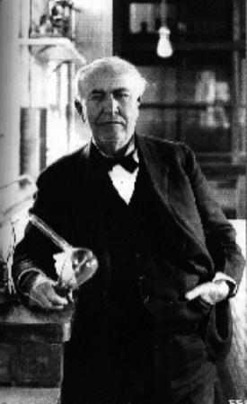
Education and Equality
Why is this important? ES argue that while wealth in earlier centuries was mostly about resource ownership, while in the 19th and 20th centuries, human capital, innovation, productivity, technology etc. became much more important and countries with a lot of inequality had trouble developing along this path.
Consider Thomas Edison, Andrew Carnegie, Sam Walton – none came from the elite. In a society with great inequality these sorts of men and women were not able to exploit their talents to the fullest extent and thus were not able to contribute to economic growth.
Patent records also show that it was not just a few greats that mattered but many, small incremental innovations made by people from all manner of society.
(Note this argument is plausible but very deep with many intervening factors.)
The argument is most direct in the area of schooling.
The Wizard of Menlo Park

Slide 29
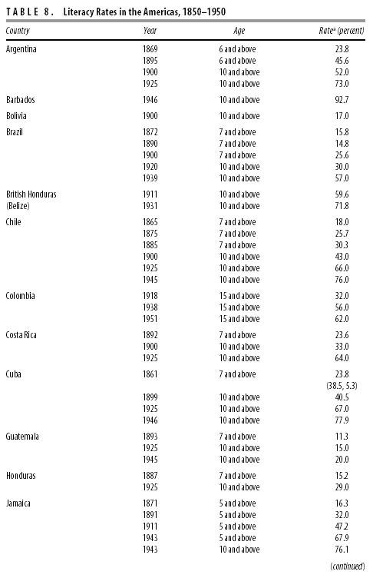
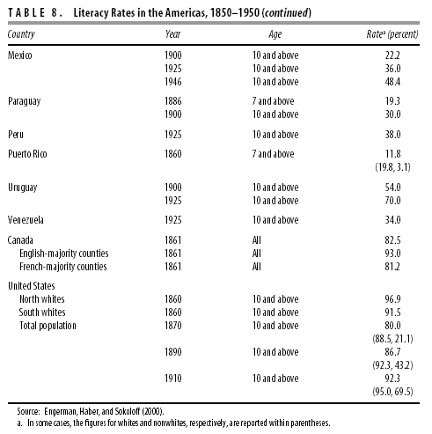
“Where the wealthy enjoyed disproportionate political power, they were able to procure schooling services for their own children and resist being taxed to underwrite or subsidize services to others.”
ES, p.80
Question: Why is this important. If education was important why wasn’t it privately provided?

Slide 30
Summary
Geography Institutions Development
But it’s also the case that
Geography Development
So the structure of causality is not always obvious.
Much needs to be done to fill in the arrows!
Notes:
Questions: Are institutions really as persistent and incapable of being changed as ES seem to maintain? Why do institutions persist?
Is elite control all that bad? Haiti had a revolution and got worse. Argentina did well until the 19th century and has declined since then even as democracy increased.
Why has Poland done so well. Do we really mean institutions or interests/interest groups?
What sort of inequality matters. Economic inequality or political inequality? It seems possible to have either without the other although they may be linked.

