Slide 1
Instrumental Variables
Alex Tabarrok

Slide 2
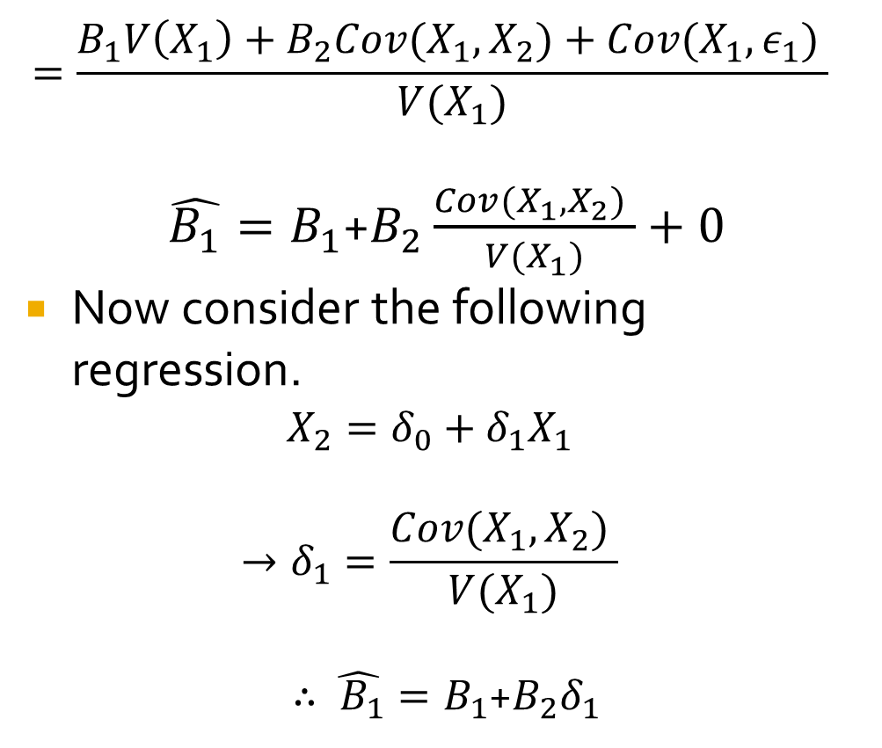
Omitted Variable Bias
Suppose the true model is:
$$Y=B_{0}+B_{1}X_{1}+B_{2}X_{2}+ε_{1}$$
$where E(ε_{1}$| $X_{1}$, $X_{2})=0$
But we estimate:
$$Y=\hat{B_{0}}+\hat{B_{1}}X_{1}+ε_{2 }$$
$$where{{ ε}_{2 }=B}_{2}X_{2}+ε_{1}$$
Then by OLS:
$$\hat{B_{1}}=\frac{Cov(X_{1},Y) }{V(X_{1})}$$
$$\hat{B_{1}}=\frac{Cov(X_{1},B_{0}+B_{1}X_{1}+B_{2}X_{2}+ε_{1}) }{V(X_{1})}$$
$$=\frac{B_{1}V\left(X_{1}\right)+B_{2}Cov(X_{1},X_{2})+Cov(X_{1},ε_{1}) }{V(X_{1})}$$
$\hat{B_{1}}=B_{1}$+$B_{2}\frac{Cov(X_{1},X_{2}) }{V(X_{1})}+0$
Now consider the following regression.
$$X_{2}=δ_{0}+δ_{1}X_{1}$$
$$→δ_{1}=\frac{Cov(X_{1},X_{2}) }{V(X_{1})}$$
$∴\hat{{ B}_{1}}=B_{1}$+$B_{2}δ_{1}$

Slide 3
Omitted Variable Bias
$\hat{{ B}_{1}}=B_{1}$+$B_{2}δ_{1}$
The OVB “formula” indicates that a) omitting a variable will cause bias if two things are true. The omitted variable is an important determinant of Y ($B_{2}$) and the omitted variable is correlated with an included variable ${(δ}_{1})$.
Note that the sign of the bias depends on the sign of $B_{2}δ_{1}$.
E.g. Suppose that $B_{2}>0 \&{ δ}_{1}<0$ then $\hat{{ B}_{1}}$ will be biased downward.
E.g. suppose wlog that $X_{1}↑→Y↑$. Note, however, that when $X_{1}↑, X_{2}↓and Y↓$ and OLS will ascribe the total effect to $X_{1}$ so $X_{1}$ will be underestimated.
Without further assumptions the formula holds only for case of one included and one excluded variable. Rule of thumb.

Slide 4
Introduction
Thus, an omitted variable will cause bias if it is an important determinant of Y and it is correlated with an included variable.
What to do?
Include the omitted variable!
What about if we don’t have the omitted variable and don’t even know what it might be?
Surprisingly, there is a solution.

Slide 5
The Search for Random Variation
Ideally we would control X randomly and run a trial. E.g. ideally we would like to determine education randomly and then find the effect of education variation on earnings.
Experiments are expensive and not always possible.
One approach is to look for “natural experiments.”
A second related approach is to note that there is a lot of variation in X. Surely some of it is due to random factors, i.e. to factors not associated with earnings.
Not every high ability student gets a PhD and not every low ability student stops at high school. Surely some of this is random?
An IV is a strategy to identify some random variation in X and use that variation and that variation alone to estimate the effect of X on Y.
A possible issue with IV is already identified. We are going to have to throw away a lot of variation to focus on the variation that is randomly determined.

Slide 6
Instrumental Variables
Why might education vary for a random reason (i.e. a reason not correlated with ability or other determinant of earnings)?
Some people live near a college, others do not. Someone who lives near a college may find it cheaper to go to college since they can live at home. If living near a college is random (wrt to factors like ability that determine earnings) then we can use living near a college as an IV to estimate the effect of education on earnings.
The idea of the IV is to “isolate” the variation in education that is random.

Slide 7
DAG: Directed Acyclic Graph
Omitted variable bias. Standard notation and DAG.
U
$$Y_{i}=β_{0}+β_{1}X_{i}+U_{i}$$
$E[U_{i}$|$X_{i}≠0$]
X
Y
$$β_{1}$$
IV solution (2SLS). Standard notation and DAG.
Corr$(X_{i},Z_{i})≠0$ Instrument relevance
U
Corr$\left(U_{i},Z_{i}\right)=0 Instrument exogeneity$
Z
X
Y
$$γ_{1}$$
$$β_{1}$$

Slide 8
IV with DAG
IV solution. Standard notation and DAG.
U
Z
X
Y
$$γ_{1}$$
$$β_{1}$$
The DAG is very clear on what to do.
Regress X on Z, learn (first stage)
Regress Z on Y learn (reduced form)
Divide! $\frac{{γ_{1}×β}_{1}}{γ_{1}}=β_{1}$
$$γ_{1}$$
$γ_{1}{×β}_{1}$

Slide 9
IV Language
First stage—show Z influences X.
Reduced form, influence of Z on Y (intention to treat effect).
IV=Reduced Form/First Stage
U
Z
X
Y
$$γ_{1}$$
$$β_{1}$$
First Stage
Reduced Form
$$IVestimate=\frac{{γ_{1}×β}_{1}}{γ_{1}}=β_{1}$$

Slide 10
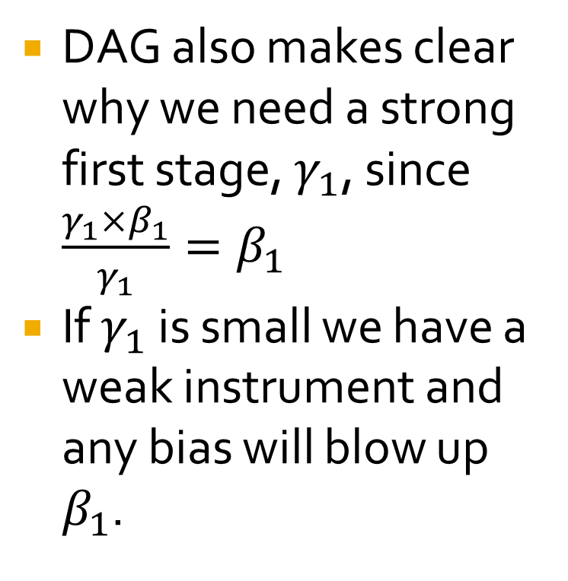
Weak Instruments
DAG also makes clear why we need a strong first stage, $γ_{1}$, since $\frac{{γ_{1}×β}_{1}}{γ_{1}}=β_{1}$
If $γ_{1}$ is small we have a weak instrument and any bias will blow up $β_{1}$.
U
Z
X
Y
$$γ_{1}$$
$$β_{1}$$

Slide 11
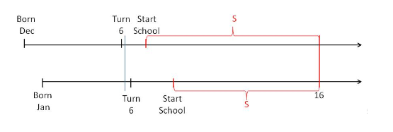
Angrist-Krueger IV
Cunningham, Mixtape.
Children born in December and children born in January are similar but at around age 6 the former goes to school and the latter is still in kindergarten.
Either, however, can quit at age 16 but the December quitter will have had more school at age 16 than the January (1’st QOB) quitter. Thus later QOB->more education.
Use QOB as Z to instrument for X (education)

Slide 12
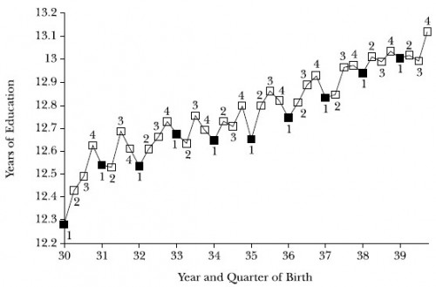
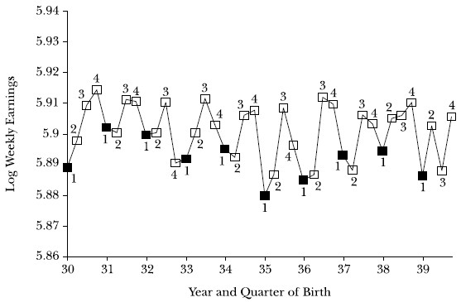
Instruments in Action
(Angrist and Krueger 1991)

Slide 13
Angrist-Krueger IV
Does it pass exclusion?
Weak Instruments?

Slide 14
Exclusion Restriction
U
The exclusion restriction says that Z can influence Y only through X.
A useful way of thinking about this is to imagine that X is fixed but Z is still variable. There should be no effect on Y.
Alternatively imagine that for some Z there should be no effect on X then for these Z we should see no effect on Y.
$$\overline{X }$$
Z
X
Y
$$γ_{1}$$
$$β_{1}$$
E.g. imagine in Angrist-Krueger that there are some states where students are not allowed to quit at 16. In these states QOB should not influence education and thus should not influence earnings.
N.B. this is testable. If QOB influenced earnings even in states where students were not allowed to quit at age 16 this would suggest a violation of exclusion.
Potential solution. Subtract the effect of QOB on earnings found in the can’t quit at age 16 sample from the can quit at age 16 sample to arrive at the true effect.
See Plausible Exogenous (Conley et al. 2012) and especially Beyond Plausibly Exogenous (Kippersluis and Rietveld 2018) for how to do this.

Slide 15
Mathematics of IV (2SLS)
Consider the case of one endogenous regressor and one instrument. Let the population model be:
$$Y_{i}=β_{0}+β_{1}X_{1}+u_{i}, i=1…n$$
Assume that $Corr(X,u)≠0$ so we cannot consistently estimate $β_{1}$ using OLS. Suppose, however, we have an instrument, Z, that satisfies the following three conditions:
$Corr\left(Z,X\right)≠0 Instrument Relevance$
$Corr\left(Z,u\right)=0 Instrument Exogeneity$
Exclusion restriction follows from 1 and 2. Exclusion says Z affects Y only through X.
Monotonicity (no defiers)—instrument works in same direction for all cases.

Slide 16
2SLS
If our 3 conditions are satisfied we can estimate $β_{1}$ using the following two stage procedure. First regress X on Z.
$$X_{i}=π_{0}+π_{1}Z_{1}+v_{i}$$
This regression “decomposes” X into two parts. The part that can be predicted from Z, ${\hat{X}}_{i}$, and the error component${ v}_{i}$.
Since Z is not correlated with u the part of X that is predicted by Z, ${\hat{X}}_{i}$,won’t be correlated with u either.
Thus we can consistently estimate $β_{1}$ by $\hat{β_{1}}$ by regressing Y on the predicted X:
$Y_{i}=\hat{β_{0}}+\hat{β_{1}}{\hat{X}}_{i}+u_{i}$
The First Stage
Equation

Slide 17
2SLS in STATA
ivregress 2sls Y exog varlist (endog var=IV var), vce(robust)
Follow by “estat firststage”
With more than one instrument
ivregress 2sls Y exog varlist (endog var=IV1 IV2), vce(robust)
Follow by “estate overid” to check for consistency.

Slide 18
IV with Two Binary Variables (interesting special case)
We are interested in effect of treatment, T[0,1] on outcome Y.
But suppose T is correlated with other unobserved variables that also affect Y.
 | $$Pr⁡(T=1)$$ | $$Pr⁡(T=0)$$
$$Z=1$$ | $$.75$$ | $$.25$$
$$Z=0$$ | $$.3$$ | $$.7$$
We find a Z that satisfies IV assumptions.
Notice that when Z=1 the probability of T=1 increases by .45.
Now consider $E(Y_{z=1})−$ $E(Y_{z=0})$. Since by exclusion assumption the only reason why Z changes Y is the influence on T this must be the due to the influence of a probabilistic increase in T of .45.
Thus true influence of T going from 0 to 1 is:
$$E\left(Y_{T=1}\right)− E\left(Y_{T=0}\right)=\frac{E(Y_{z=1})− E(Y_{z=0})}{.45}$$

Slide 19
IV with Two Binary Variables
 | $$Pr⁡(T=1)$$ | $$Pr⁡(T=0)$$
$$Z=1$$ | $$.75$$ | $$.25$$
$$Z=0$$ | $$.3$$ | $$.7$$
Assume $E\left(Y_{T=1}\right)=δ+E\left(Y_{T=0}\right)$
Then .75 of the observations with $Z=1$ will have outcomes of $δ+E\left(Y_{T=0}\right)$
.25 of the observations with $Z=1$ will have outcomes of $E\left(Y_{T=0}\right)$
.3 of the obs with $Z=0$ will have outcomes of $δ+E\left(Y_{T=0}\right)$
.7 of the obs with $Z=0$ will have outcomes of $E\left(Y_{T=0}\right)$
Let’s now write out $E\left(Y_{Z=1}\right)−E\left(Y_{Z=0}\right)$

Slide 20
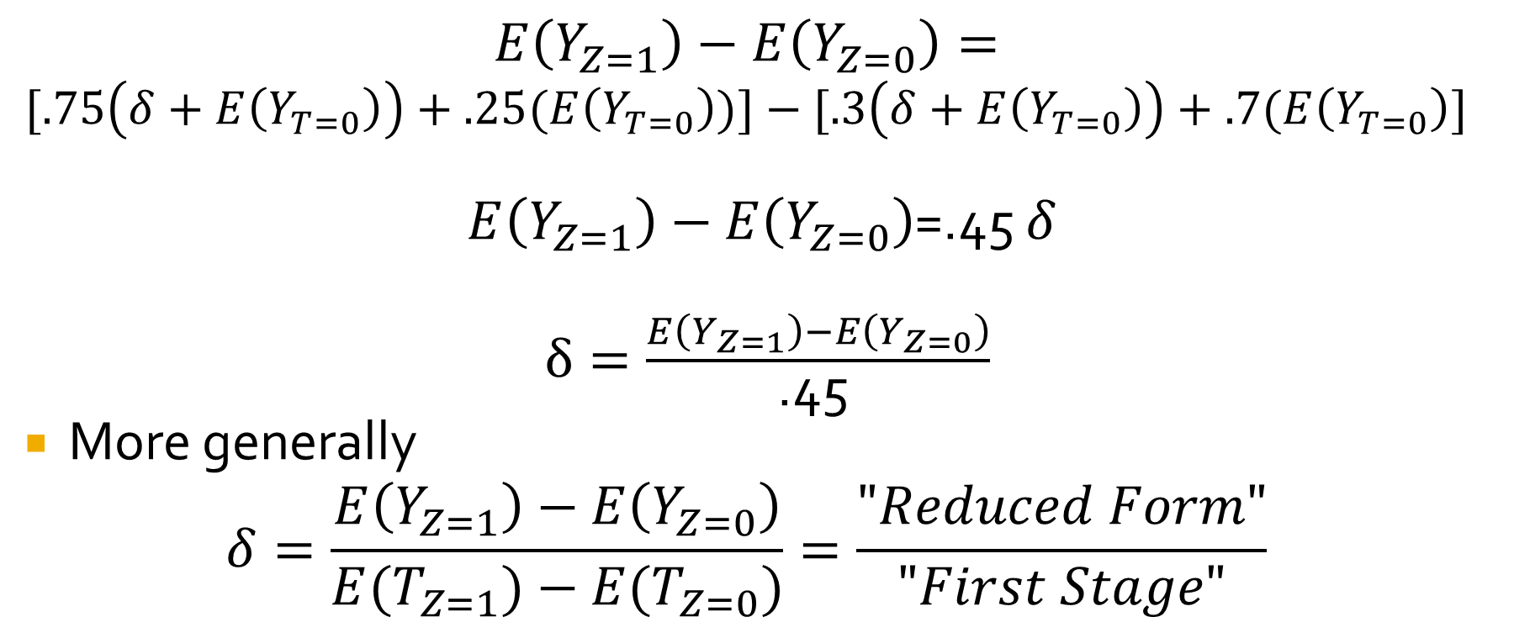
IV with Two Binary Variables (Wald Estimator)
$$E\left(Y_{Z=1}\right)−E\left(Y_{Z=0}\right)=$$
$$[.75\left(δ+E\left(Y_{T=0}\right)\right)+.25(E\left(Y_{T=0}\right))]−[.3\left(δ+E\left(Y_{T=0}\right)\right)+.7(E\left(Y_{T=0}\right)]$$
$E\left(Y_{Z=1}\right)−E\left(Y_{Z=0}\right)$=.45 $δ$
$δ=\frac{E\left(Y_{Z=1}\right)−E\left(Y_{Z=0}\right)}{\text{.45 }}$
More generally
$$δ=\frac{E\left(Y_{Z=1}\right)−E\left(Y_{Z=0}\right)}{E(T_{Z=1})−E(T_{Z=0})}=\frac{"Reduced Form"}{"First Stage"}$$

Slide 21
Finding Good Instruments
Art more than science. Key is to know details, details, details about your area of research.
Creativity: e.g. Levitt and effect of police on crime.
Some common sources:
Probabilities may be assigned randomly even when treatments are not. Encouragement designs.
Distances.
Policy reforms.
Random variation in assignment (judges)
Notes:
Flu, breast feeding.
Note flu shot and importance of LaTE interterpretation.
Distance –McClellan, Cardiac treatment.
Policy—suppose you have a policy where the implementation is exogeneous, e.g. it rolls out over time in a random way. You can use that to study the effect of the policy but you can also use that as instrument to study the underlying variables. E.g. Duflo is interested on effect of schooling on wages in Indonesia. There are two regions High and Low and two cohorts Old and Young. The policy mostly effects Young in High regions so she runs a regression W=a+B1Y +B2 H + delta H*Y which is a dif in dif measuring effect of program but then she runs a first stage of schooling on H*Y and instruments S using H*Y to run W=a+g1Y +g2 H + g3 S with S instrumented by H*Y.

