Slide 1
Difference in Difference Estimators
Alexander Tabarrok

Slide 2
The differences-in-differences estimator
Suppose that we have a before and after treatment.
  A simple estimate of the treatment effect is to look at the after-before difference but this will not be accurate if other factors are changing through time.
Suppose that we have a treatment and control group.
  A simple estimate of the treatment effect is to look at the treatment-control difference but this will not be accurate if the control group differs from the treatment group in important ways.
The difference-in-difference estimator subtracts the after-before difference in the treatment group from the after-before difference in the control group.
  Note that for this to work we do not need all other factors to remain constant through time, the first problem, nor do we need the treatment and control group to be identical, the second problem, what we need is that the time factors affect the two groups in the same way which is often a weaker assumption.

Slide 3
Diff-in-diffs: without regression
One approach is simply to take the mean value of each group’s
outcome before and after treatment
Treatment group Control group
Before T_{B} C_{B}
After T_{A} C_{A}
and then calculate the “difference-in-differences” of the means:
Treatment effect = (T_{A} - T_{B} ) - ( C_{A} - C_{B} )

Slide 4
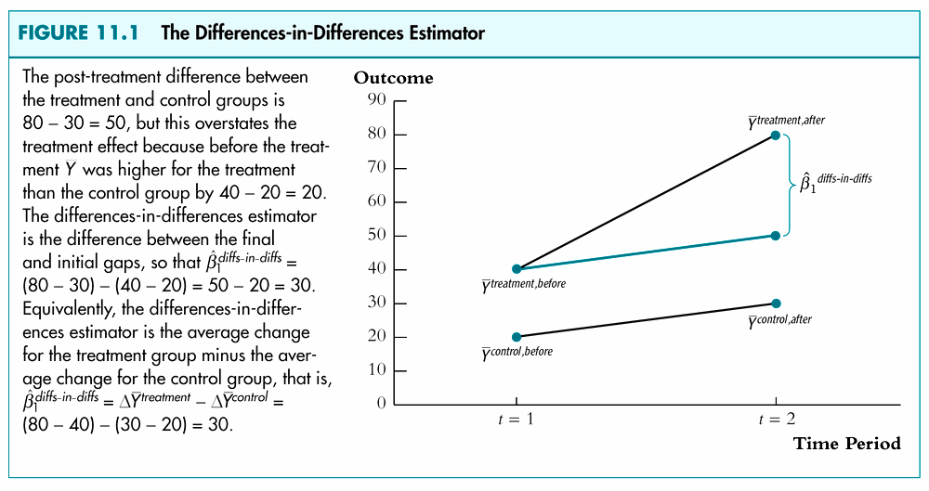
Note that this is counterfactual.
Parallel trends

Slide 5
Diff-in-diffs: with regression
We can get the same result in a regression framework (which allows us to add regression controls, if needed):
y_{i} = β₀ + β₁ treat_{i} + β₂ after_{i} + β₃ treat_{i}*after_{i} + e_{i}
where: treat = 1 if in treatment group
treat = 0 if in control group
after = 1 if after treatment
after = 0 if before treatment
The coefficient on the interaction term (β₃ ) gives us the
difference-in-differences estimate of the treatment effect

Slide 6
Diff-in-diffs: with regression
To see this, plug zeros and ones into the regression equation:
y_{i} = β₀ + β₁ treat_{i} + β₂ after_{i} + β₃ treat_{i}*after_{i} + e_{i}
Treatment Control
Group Group Difference
Before β₀ + β₁ β₀ β₁
After β₀ + β₁ + β₂ + β₃ β₀ + β₂ β₁ + β₃
Difference β₂ + β₃ β₂ β₃

Slide 7

Location of a garbage incinerator’s location on Housing Prices
Based on Kiel and McLain (1995), Wooldridge (2003)
Time Line
  1979 – rumors that incinerator would be built
  1981 – construction begins
  1985 – incinerator begins operation
Data
  1978, 1981 house prices
  Dummy variable for near incinerator, NearInc
Naïve estimator run on 1981 house prices.
  Price = B0+B1*NearInc+u

Slide 8
Naïve Estimator
Results
  Estimated Price=101,307-30,688*NearInc
  The estimate says that housing prices near the incinerator were $30,000 dollars cheaper. Is this a good estimate of the treatment effect?

Slide 9
Location of a garbage incinerator’s location on Housing Prices (con’t)
A test:
  Suppose we run the same regression on the 1978 data, i.e. on the data before the incinerator was even rumored?
Estimated Price=82,517-18,824*NearInc
  Implication? The incinerator was built where houses were already cheaper.

Slide 10
Compare the Two Regressions
Compared to 1978, the price penalty for houses near the incinerator is greater in 1981.
Perhaps, the increase in the price penalty in 1981 is caused by the incinerator
This is the basic idea of the difference-in-difference estimator

Slide 11
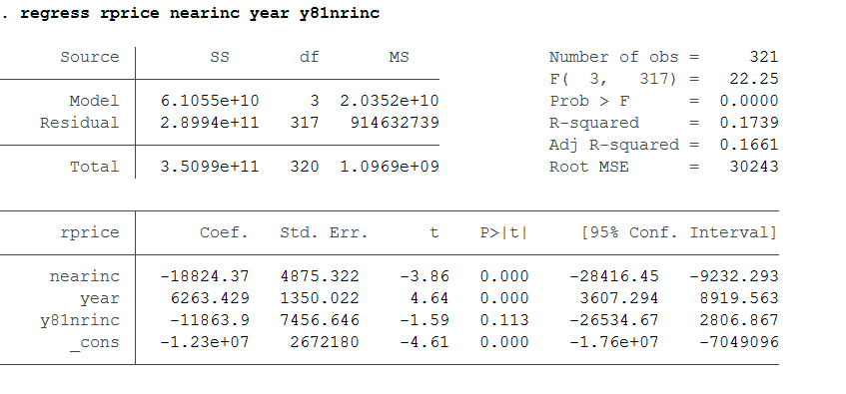
The Estimator
A better estimate is to look at the change in the nearinc coefficient before and after the plans for the incinerator become known, i.e. -30,688-(-18,824)=-11,869
This difference in difference estimate can be obtained by running the regression
price =β₀+β₁(nearinc)
+β₂(year81)+β₃(year81)(nearinc)
Difference in difference estimator

Slide 12
Rating the Millennium Challenge Corporation
The Millennium Challenge Corporation is a new approach to foreign aid that awards aid to countries that perform well on a set of variables such as political rights, civil liberties, the costs of starting a business, trade policy and other variables.
How well has the MCC worked? Doug Johnson and Tristan Zajonc (2006) find that candidates for MCC aid improve their performance to a greater degree on more indicators than similar control countries.

Slide 13
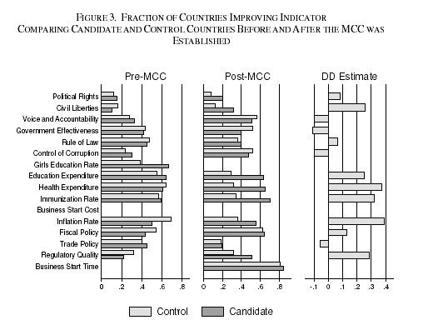
Figuring Out Diff-in-Diff
The first panel is candidate and control countries before the MCC - when we would not expect many differences.
The second panel is the same countries after the MCC was put in place - when we would expect the MCC to have an incentive effect on candidate but not control countries.
The last panel subtracts the differences in the second panel from the differences in the first to arrive at the difference-in-difference estimate - most of the gains are positive and fairly large.
Source: Johnson, Doug and Zajonc, Tristan, "Can Foreign Aid Create an Incentive for Good Governance? Evidence from the Millennium Challenge Corporation" (April 11, 2006). Available at SSRN: http://ssrn.com/abstract=896293

Slide 14
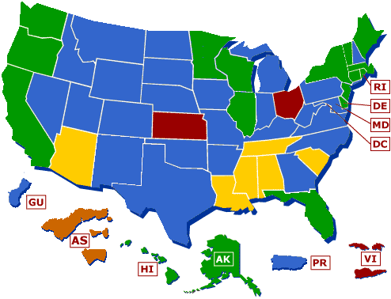
Minimum Wages
Diff-in-diffs: Example 2 from Card and Krueger (1994)
What is the effect of increasing the minimum wage on employment at fast food restaurants?
State minimum wages may exceed the federal minimum wage
    They can also be lower than the federal but then they have no effect.
States with minimum wages above the federal min. wage
States with minimum wages equal to the federal min. wage
States with minimum wages below the federal min. or states with no minimum wage respectively

Slide 15
The NJ Minimum Wage Hike
A increase in the NJ minimum wage above that of the federal minimum was passed in early 1990 to take effect April 1, 1992.
In 1992, the United States slipped into a recession and in March of 1992, the NJ state legislature voted to delay the immediate adoption of the law and instead phase in the new minimum wage over two years.
But the Governor vetoed and the law went into effect as planned.
The history is useful to know because it was not certain the law was going to happen and thus there was little behavioral response before the law went into effect (which could otherwise distort results).
Also the change in the MW, from $4.25 to $5.05/hr was quite large, an 18% increase, so it should be possible to detect an employment impact if it exists.
On the other hand, the fact that law went into effect during a recession suggests that we are going to need a very good research design to get credible estimates.
Notes adapted in part from Bill Evans.

Slide 16
Fast Food
Card and Krueger surveyed fast food restaurants (with the help of a lot of graduate students!) before and after the law went into effect. They asked for:
    # of Employees (full and part time)
    Wages
    Price of a basic meal
The fast food industry is a good one to look at because
  It is the leading employer of low wage workers, 25% of the employees in the restaurant industry are paid minimum wage.
  Fast food employers comply with Min wage.
  No tips are paid to workers – so wage costs are known.

Slide 17
Comparing NJ to PA
Recognizing that the recession may affect the results the basic research design is to compare the change in employment in New Jersey (the treatment group) with the change in employment in Pennsylvania (the control group.)
The idea is that the recession affects NJ and PA equally but the increase in the minimum wage is for NJ only so the difference (NJ-PA) in the difference (after-before) gives the effect of the minimum wage increase.

Slide 18
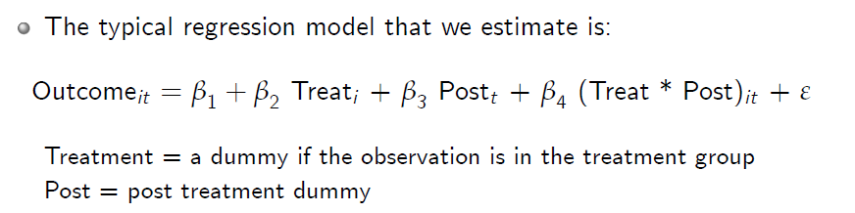
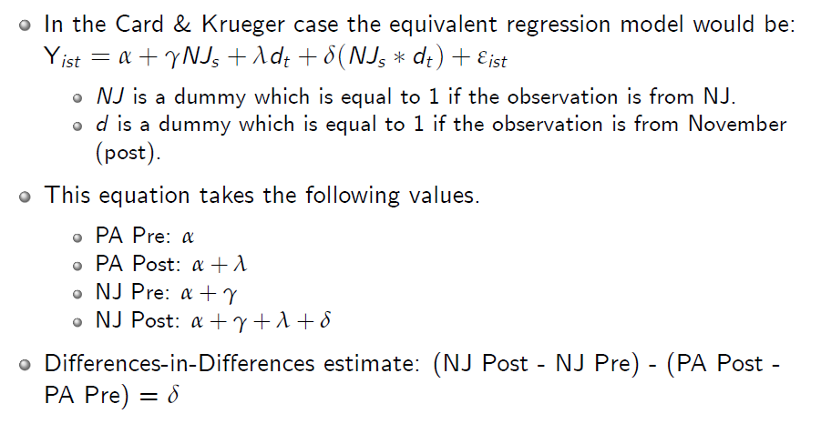
The Basic Estimating Equation

Slide 19

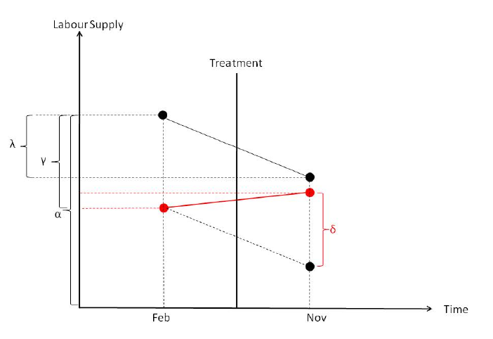
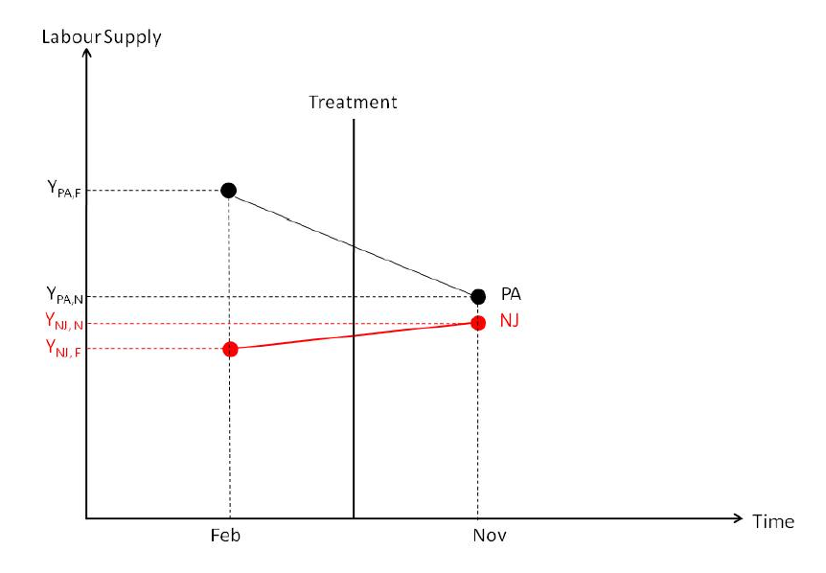
Results
FTE_{i} = 23.33 - 2.89 NJ_{i} - 2.16 Nov92_{i} + 2.76 NJ_{i}*Nov92_{i}
In other words, the estimate is that employment increased in New Jersey following the imposition of the minimum wage!

Slide 20
What is going on!
Card and Kruger is a controversial paper because it runs counter to standard economic theory which predicts an employment decline.
There is a theory, the monopsony theory, which can predict an increase in employment but it is supposed to apply when the buyer of labor has market power – it is hard to see how this applies to the fast food market.
More likely is that PA is a poor control. Notice that the big effect is coming from a decline in employment in PA not the very slightly increase in NJ. Looking at NJ alone we would say the effect was zero.
  E.g. Suppose we randomly allocate steroids and a placebo to two treatment groups. We find that the group on placebo has a big decrease in the weight that they can bench press. Do we conclude that the steroids work?
On paper, however, PA doesn’t look like a bad control.
Are other controls possible?

Slide 21
Other controls
Instead of comparing PA vs NJ let’s compare the low-wage fast food restaurants versus the high-wage fast food restaurants all of them from NJ.
Idea is that the increase in the minimum wage binds the low-wage restaurants but has no effect on the high-wage restaurants since they were already paying more than the min. wage.

Slide 22
Dif and Dif: FTE in Low v. High Wage Restaurants in NJ
Low Before: 19.56
Low After: 20.88
  Dif: 1.32
High Before: 22.25
High After: 20.21
  Dif: -2.04
Dif in Dif: 1.32- (-2.04)=3.36!
Ugh, we find again a relative employment increase!
As before it’s mostly the high wage restaurants that decreased employment rather than the low-wage restaurants which increase. Nevertheless the result is puzzling.

Slide 23
General Comments on Checking a DD Strategy
Show that the treatment and control groups are similar along many margins.
Use more than one control group – as we saw already Card and Krueger used NJ and PA but also High and Low wage within NJ.
The DD assertion is that the control group is like the treatment group but for the treatment. Thus, look at previous years when there was no treatment then the DD should be zero since the control group should look just like the treatment group.
Plot DD by year on graph – should show jump around treatment and not otherwise. Remember key assumption is the parallel trends assumption.

Slide 24
Placebos
Try the DD strategy on a Y that is not supposed to be affected by treatment. If the control group is like the treatment group but for the treatment then if the treatment doesn’t affect Y the DD should be zero.
E.g. Pizzola and Tabarrok (2017) study the effect of delicensing funeral workers in Colorado in 1983 by running a DD comparing the wages of funeral workers in CO to the wages of funeral workers in the rest of the United States.
A placebo study. Run the same DD model with non-funeral workers in Colorado and in the rest of the United States.
  Here we would expect a zero effect of the “treatment” of delicensing funeral workers in 1983.
Variation of this line of thinking can lead to a DDD strategy.

Slide 25
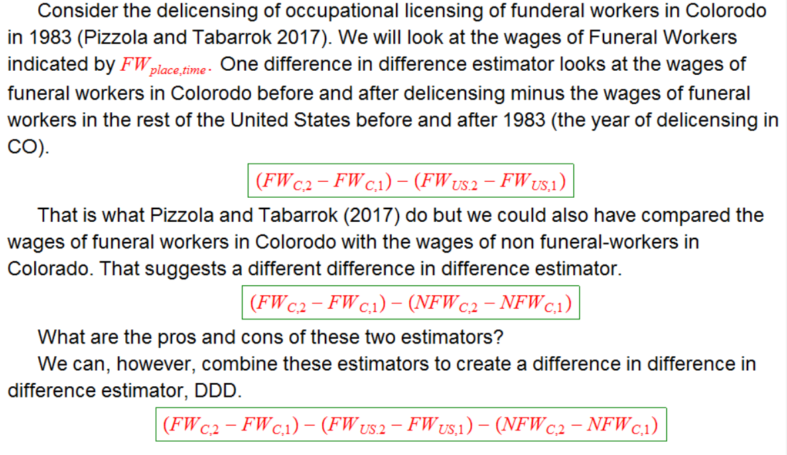
Difference in Difference in Difference (DDD)
Pizzola and Tabarrok (2017)
Notes:
The first compares funeral workers in Colorado with those in the rest of the United States. It's good because the comparison group is close on an important dimensions, namely they are all funeral workers. But the first estimator leaves open the possibility that something else in general was going in Colorado in 1983 that reduced wages. What about the second estimator. It also has some virtues because it compares workers all of whom are in Colorado. Are funeral workers in other states a better control for funeral workers in Colorado or are other workers in Colorado a better control? It's a judgment call.
Consider an ideal case when the only shock is the delicensing of funeral workers in Colorado. In this case the latter two differences will both be zero. Now imagine that we have the delicensing shock and also a shock to funeral worker wages throughout the US. The second difference controls for that. Now suppose there is also a shock to wages in Colorado. The third difference controls for that. Adding a third difference, however, makes it less clear what is driving the estimated effect. My view is that triple difference is great if it shows the same thing as the double difference but if you have to do the triple difference to get your result I am less wowed.

Slide 26
Correlation of Standard Errors Over Time
Diff-in-diffs typically use several years of serially-correlated data but ignore the resulting inconsistency of standard errors (see Bertrand, Duflo, and Mullainathan 2004, Helland and Tabarrok 2004).
Cluster standard errors by unit.
Placebo tests.

Slide 27
Functional Form Dependence
If the treatment and control groups have substantially different levels of Y before the treatment then the magnitude and even the sign of the DD effect can be very sensitive to the functional form!
Simple e.g. (from Duflo)
Suppose that we wish to evaluate a job training program for the young. The u.e. level for the young decreases from 30% to 20% but we are worried about other effects so we use old people and their u.e. levels as controls. Old people u.e. decreases from 10% to 5%.
DD in levels
(30-20)-(10-5)=5>0
DD in percentages.
(30-20)/30-(10-5)/10=33%-50%=-17%<0

Slide 28

Twoway Fixed Effects and DD
In the good old days we used to say that you could “generalize” classic DiD with treatment/control and before/after to multiple treatment groups at different times using TWFE.
As a standard framework think of “Years” and “States” with some states being treated in some years.
Idea was that you could then run a version of
regress y T i.Year i.State
Where year i.Year were year fixed effects, and i.State state fixed effects and T was a dummy variable for treated states in years after treatment
Notes:
Stata
xi: regress y T i.Year i.State
Where T is 0 for non-treated state-years and 1 for treated state-years. T is then the difference in difference estimator.
Or better
xi: areg y T i.Year, absorb(State)
Or best
xtset state year
xtreg y T, fe
What else should we include?
xtreg y T, fe cluster(state)
Other xt commands

Slide 29
Dif and Dif Revolution!
Unfortunately, the extension of the DD estimator to “time and state” fixed effects seems straightforward but hides a lot of complexity that is now better understood due to Goodman-Bacon (2019) and others.
Bottom line: Don’t do TWFE (without adjustments).
Good news: STATA now has implemented many modern estimators.

Slide 30
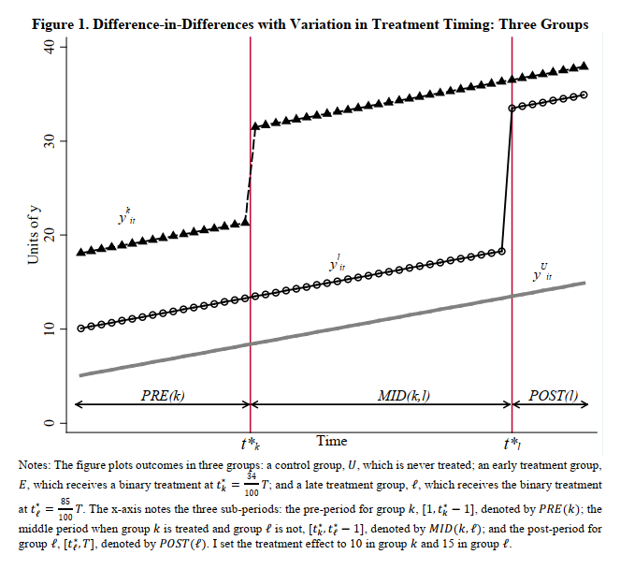
Key Problem with TWFE: Where is Identification coming from?
Suppose that the treatment hits some “states” at time tk and others at tl and others not at all.
Where does ID come from?

Slide 31
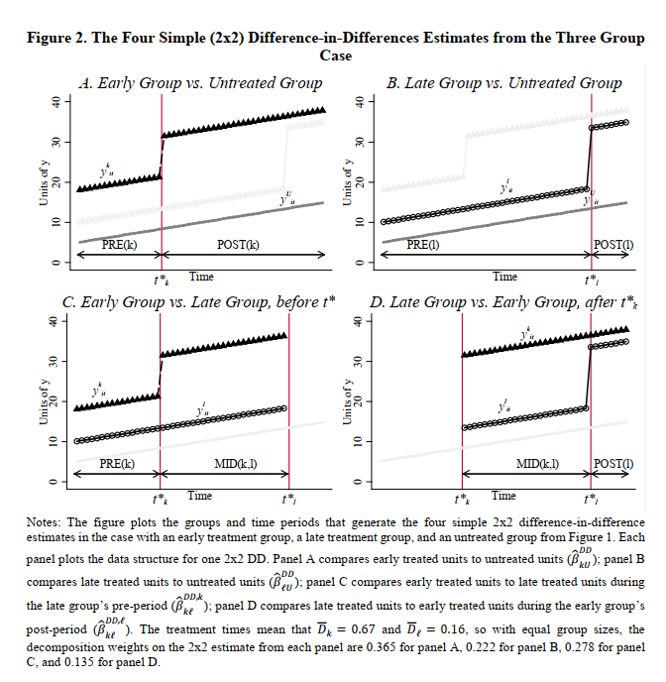
The two-way fixed effects DD estimator is a weighted average of every possible 2x2 DD estimator, with weights based on subsample
shares and variances.

Slide 32
TWFE—Problems and Solutions
It’s not obvious that the weights use in TWFE are ideal for estimating an ATE. In fact, they aren’t!
TWFE doesn’t work when treatments are heterogeneous through time or cohort.
Many new TWFE estimators and models that you need to be aware of. I especially recommend:
  Roth, Jonathan, Pedro H. C. Sant’Anna, Alyssa Bilinski, and John Poe. 2023. “What’s Trending in Difference-in-Differences? A Synthesis of the Recent Econometrics Literature.” Journal of Econometrics 235 (2): 2218–44. https://doi.org/10.1016/j.jeconom.2023.03.008.

Slide 33
Key Idea
DiD still works in the classic 2x2 case so to generalize do a bunch of simpler cases and then add them up.
E.g. Consider shall issue gun laws being passed in different states at different times.
To allow for cohort and time heterogeneity we think of many ATEs.
E.g. states that pass shall issue laws in 2002 we have ATEs in 2003, 2004, 2005….so notation that is used is some variant of ATE(2002, 2003), ATE(2002, 2004) etc.
For states that pass shall issue laws in 2005 we then have ATE(2005, 2006), ATE(2005, 2007)…
We then have lots of options to aggregate these ATEs, e.g. average or weight them by state size, observations etc.
Or we could do a bunch of graphs perhaps aggregating by cohort etc.

Slide 34
How to get the ATEs?
To get the ATEs the key is to choose good comparables (rather than let TWFEs do it for you in arbitrary ways.)
E.g. you could find for every state that passes a shall issue law in 2002 a comparable state that didn’t pass the law and do simple DiD
Or you could use a matching procedure and do simple DiD.
In some ways this is simpler and more straightforward than TWFE!

Slide 35
How to get the ATEs?
In practice, most people choose to get the ATEs by making the comparables either the set of not yet treated states or the set of never treated states.
And rather than a simple difference in means they use a regression adjustment (RA) or inverse-probability weighting (IPW), or augmented inverse-probability weighting (AIPW).

Slide 36
Regression Adjustment
RA runs a regression of control state outcomes on a set of explanatory variables and then creates the means of the treatment variables given the Betas.
i.e. what would the treatment outcomes have looked like given they have different Xs but assuming the Betas are the same.
E.g. shall issue law. Regress murders on %black in control states.
Take the B on %Black and estimate what outcome (murders) in treatment states would have been given same relationship in control states
Then use difference in RAdjusted treatment means from control means to estimate ATEs

Slide 37
Inverse Probability Weights (IPW)
IPW is just using a propensity score to weight observations so that treatment and control groups look like they are from a random sample.
e.g. suppose we find that shall-issue states are more likely to be Republican, i.e. non-shall issue (control) states are less likely to be Republican. To correct for this we weight. Thus:
  Treatment states which were unlikely to be treatment states are given greater weight. Weight by 1/ps
  Control states which were unlikely to be control states are given greater weight. Weight by 1/(1-ps)
In other words the weighting makes the treatment group more similar to the control group and the control group more similar to the treatment group.
Thus it is the similar groups that we compare.

Slide 38
The AIPW
The augmented inverse probability weight model is sometimes called a double robust model.
Consider RA “corrects” the outcomes for other factors so we can compare treatment and control groups.
IPW “corrects” the probability of treatment for other factors so we can compare treatment and control groups.
AIPW combines both in a way that works if either model is correctly specified!

Slide 39
STATA
First use, xtset panel time
e.g. xtstet state year
Then explore your XT data using the XT commands.

Slide 40
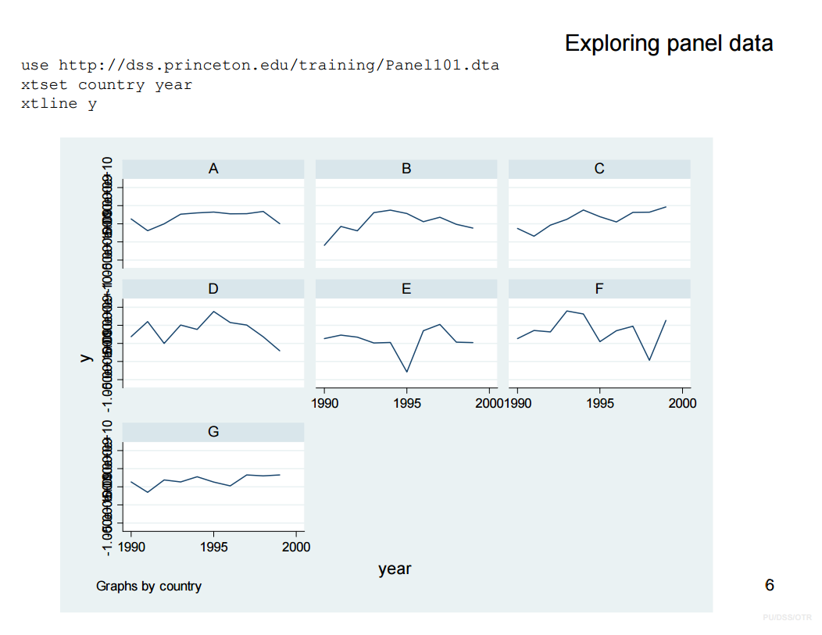
Xtline y

Slide 41
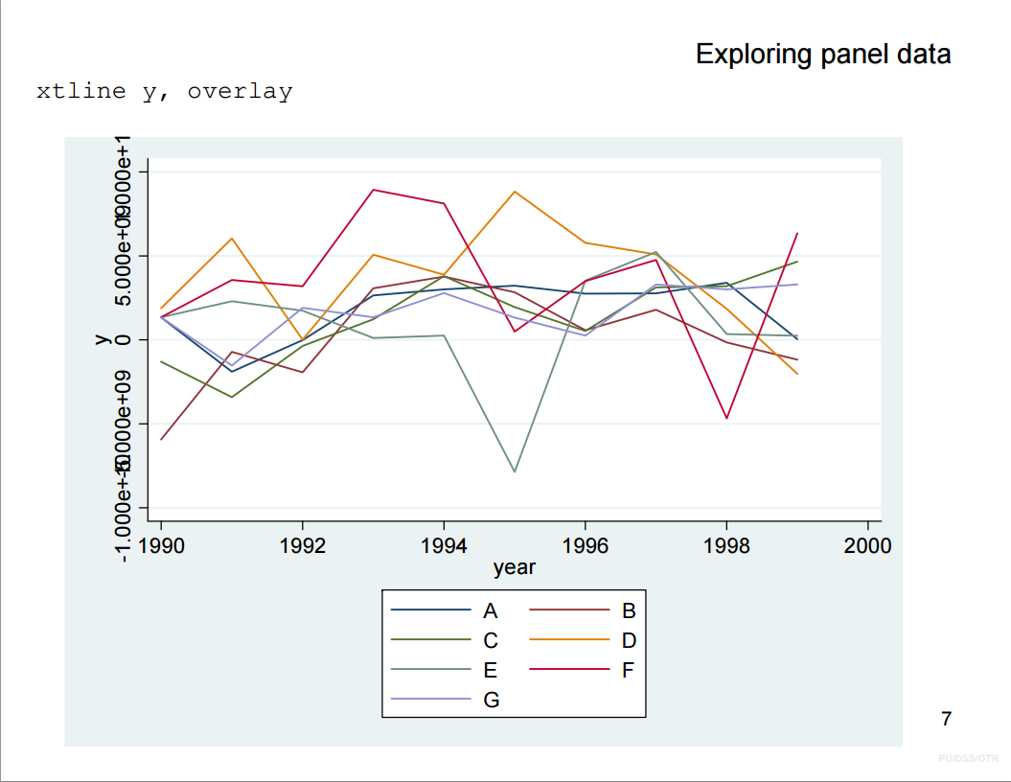

Slide 42
Other xt commands
It is also useful to look at the variance in your variables after the fixed effects
Xtsum variables, i(State)
Make sure you have variation within years after taking into account state fixed effects.

Slide 43
STATA, xthdidregress
xt (cross time) h(etrogeneous) did regress
xtset panel time, e.g. xtstet state year
xthdidregress model (y x) (treat), group(grpvar)
xthdidregress ra (murders %Black) (ShallIssue), group(YearPassed)
xthdidregress ipw (murders) (ShallIssue %Republican), group(YearPassed)
xthdidregress aipw (murders %Black) (ShallIssue %Republican), group(YearPassed)

Slide 44
STATA, xthdidregress: Options
Control group—assumption is never treated
xthdidregress ra (murders %Black) (ShallIssue), group(YearPassed) controlgroup(notyet)
Many others, e.g. clustering
See Stata manual.

Slide 45
Stata, Output
Stata will output for each cohort and set of ATETs. E.g. shall issue passed in
ATE(2002, 2003)
ATE(2002, 2004)
ATE(2002, 2005)
ATE(2003, 2004)
ATE(2003, 2005)
Post estimation commands then let you graph these or aggregate them in a variety of ways.

Slide 46
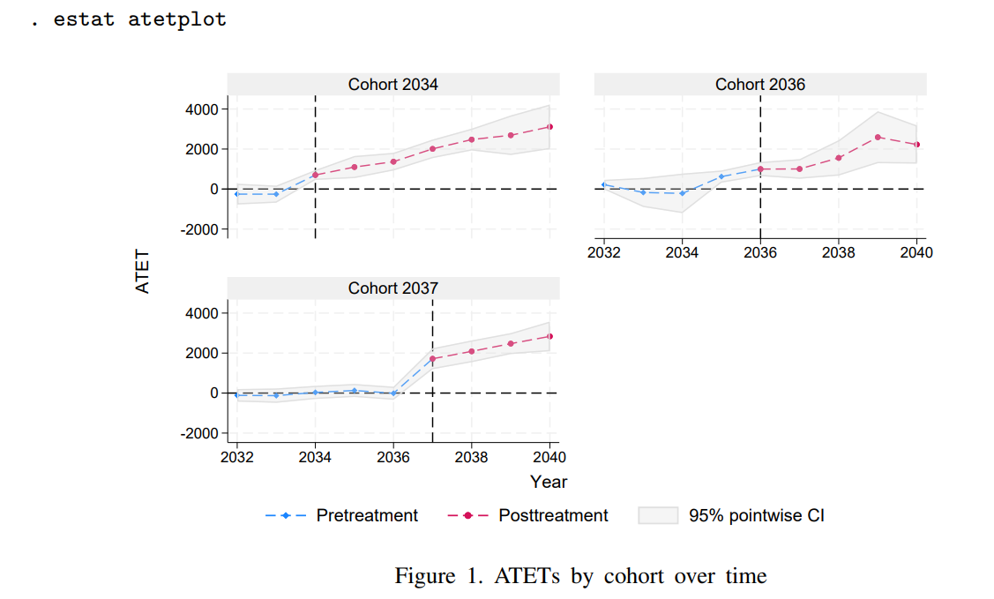
STATA, Output

Slide 47
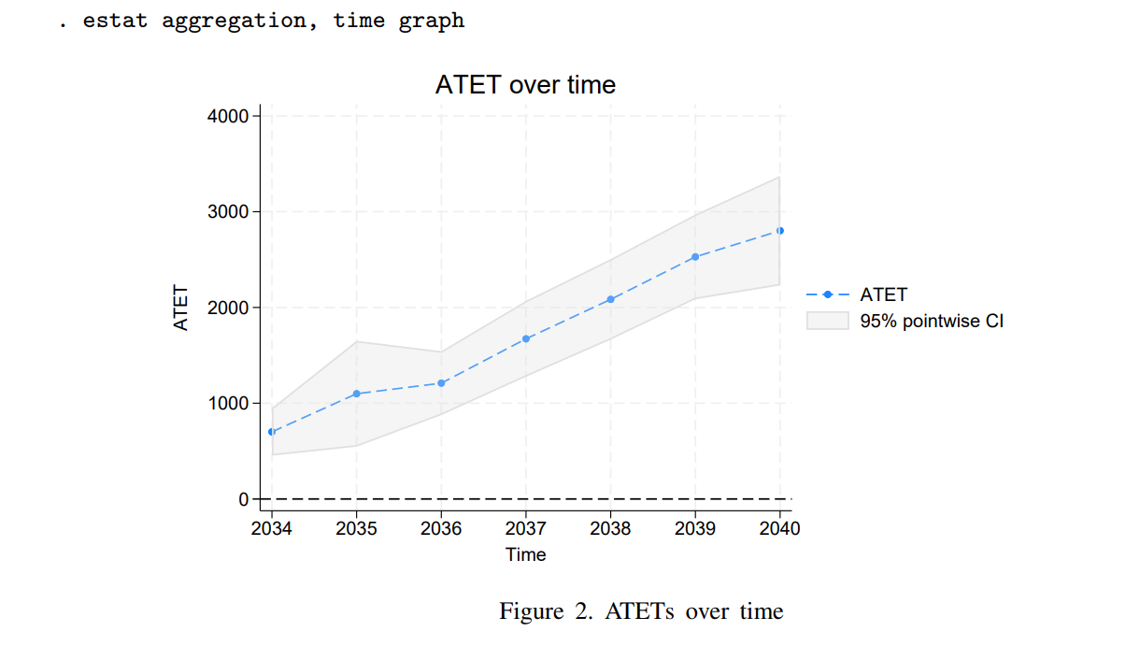
One set of ATETs Aggregating over cohots.

Slide 48
Difference in Difference Estimators
Alexander Tabarrok

Slide 49
Stacked DiD
Uses an event-study metric and careful choice about the possible comparison groups.
From two applied papers
  Cengiz, Doruk, Arindrajit Dube, Attila Lindner, and Ben Zipperer. 2019. “The Effect of Minimum Wages on Low-Wage Jobs*.” The Quarterly Journal of Economics 134 (3): 1405–54. https://doi.org/10.1093/qje/qjz014.
  Deshpande, Manasi, and Yue Li. 2019. “Who Is Screened Out? Application Costs and the Targeting of Disability Programs.” American Economic Journal: Economic Policy 11 (4): 213–48. https://doi.org/10.1257/pol.20180076.

Slide 50
Stacked DiD: Method
Define an Event Window
  E.g.. 5 years before and after the event
Enumerate Sub-Experiments.
  Define explicitly the treated and control groups.
  E.g. treated and not yet treated.
  Treated and never treated.
  (Never use treated and earlier treated!)
  Label each sub-experiment, d=1…D.
Stack The Data
Specify an Estimating Equation

Slide 51
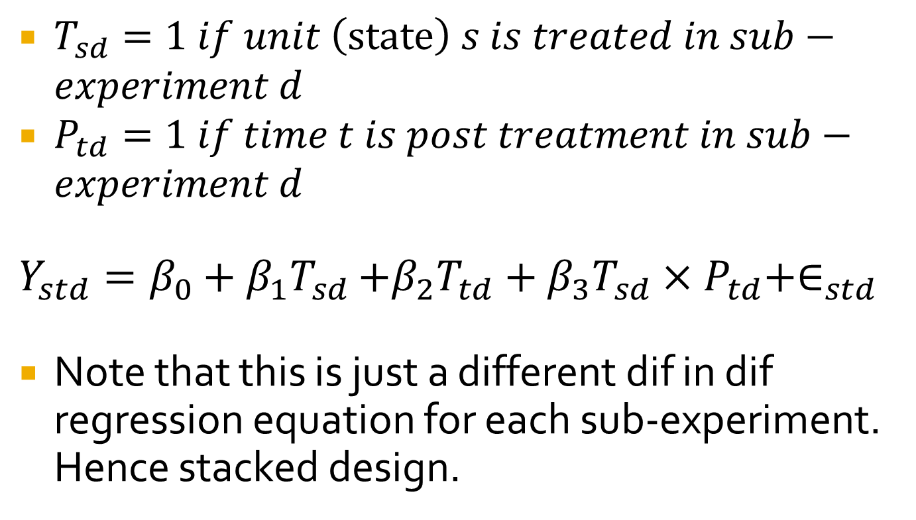
Simplest estimating equation
$T_{sd}=1 if unit \left(\text{state}\right) s is treated in sub−experiment d$
$P_{td}=1 if time t is post treatment in sub−experiment d$
$Y_{std}=β_{0}+β_{1}T_{sd}$ $+β_{2}T_{td}+β_{3}T_{sd}×P_{td}+∈_{std}$
Note that this is just a different dif in dif regression equation for each sub-experiment. Hence stacked design.

Slide 52
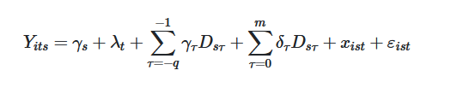
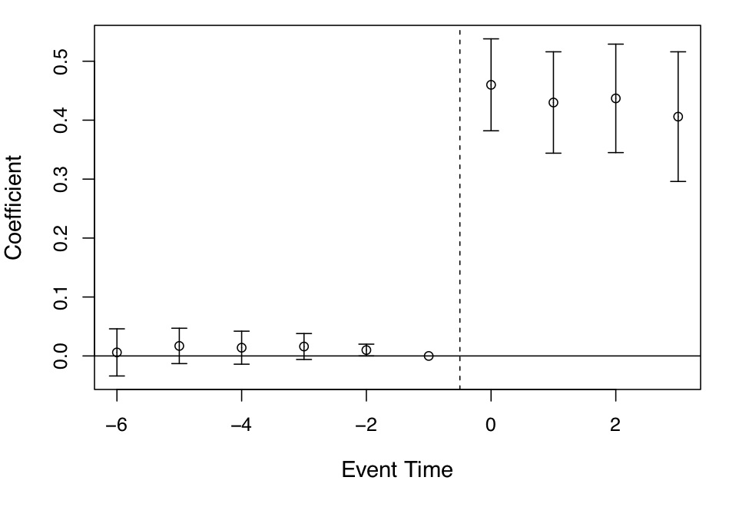
Parallel Trends
Define “event time”.
Run regression with leads and lags
Estimates of Medicaid expansion’s effects on coverage using leads and lags in an event study model.
From Miller, Sarah, Sean Altekruse, Norman Johnson, and Laura R. Wherry. 2019. “Medicaid and Mortality: New Evidence from Linked Survey and Administrative Data.” via Cunningham (2021)

