Slide 1
The Fundamental Problem of Causal Inference
Alexander Tabarrok

Slide 2
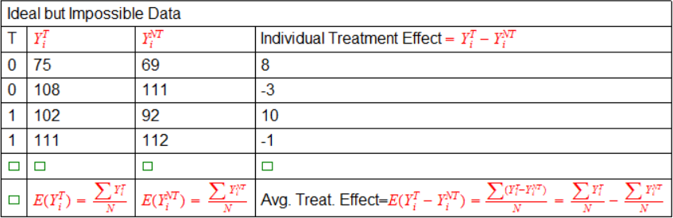
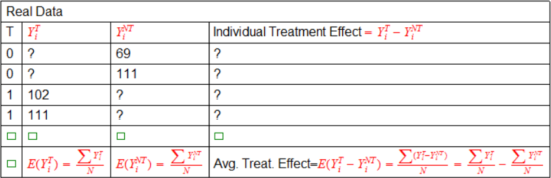
Ideal and Real Data
T=Treatment (0,1)
Y_{i}^{T}=Outcome for i when T=1
Y_{i}^{NT}=Outcome for i when T=0

Slide 3
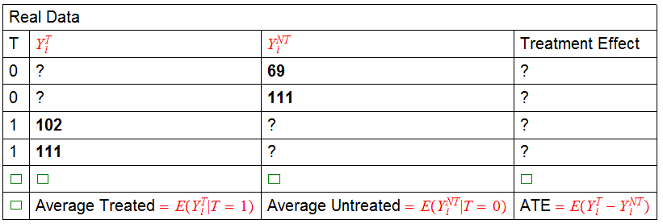

What can we Learn from Real Data?

Slide 4
Danger!
The average outcome among the treated minus the average outcome among the untreated is not, except under special circumstances, equal to the average treatment effect.

Slide 5
What can we Learn from Real Data?
But is anything interesting?

Slide 6
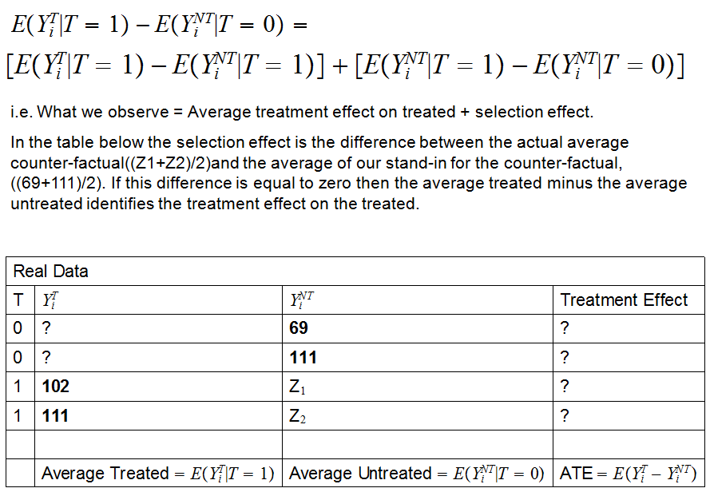

Slide 7
ATE, ATT, ATU
Call what we observe the Naïve Average Treatment Effect, NATE.
We just showed that NATE=ATT+Selection Effect
But what about the ATE? How does this differ from ATT?
Notes:
The ATT is not the same as the ATE. Where is the difference in this chart? E.g. a disease will kill if not treated. There is a drug that if taken will save the patient’s life but it only works for patients with a certain genetic makeup. A doctor tests patients with the disease for the gene and administers the drug to those with the gene. Note that for the ATT the people who were not treated are a good stand-in for what would have happened to the treated had they not been treated-namely they would have died. So the ATT is that the treatment effect is 100%, everyone who got the drug would have died without it. But this is not the same as the ATE since if everyone had been given the drug it would not have saved everyone. Thus, the treated are not a good stand-in for the what would have happened to the untreated had they been treated. Homework, let Pi equal the proportion of the treated. Write NATE in terms of ATE. Use ATT, ATE, ATU.

Slide 8
Homework
I showed NATE=ATT+Selection Effect
Write NATE in terms of the ATE.
Use ATE, ATT, ATU let p=probability of treatment

Slide 9
The Gold Standard
The gold standard is randomization. If units are randomly assigned to treatment then the selection effect disappears.
  i.e. with random assignment the groups selected for treatment and the groups actually treated would have had the same outcomes on average if not treated.
With random assignment the average treated minus the average untreated measures the average treatment effect on the treated (and in fact with random assignment this is also equal to the average treatment effect).
In a randomized experiment we select N individuals from the population and randomly split them into two groups the treated with N^{t} members and the untreated with N-N^{t}.

Slide 10

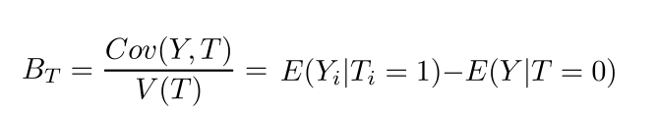
Regression (Aside)
In a regression context we can run the following regression:
and B_{T} will measure the treatment effect. It's useful to run through this once in the simple case to prove that this is true. See handout.
Bottom line one can prove in this example

Slide 11
Matching
Regression is typically one of the first techniques discussed in a class on causal inference but a much more intuitive and straightforward approach is matching.
Basic idea: Match on observables then compute statistics such as the ATE.

Slide 12
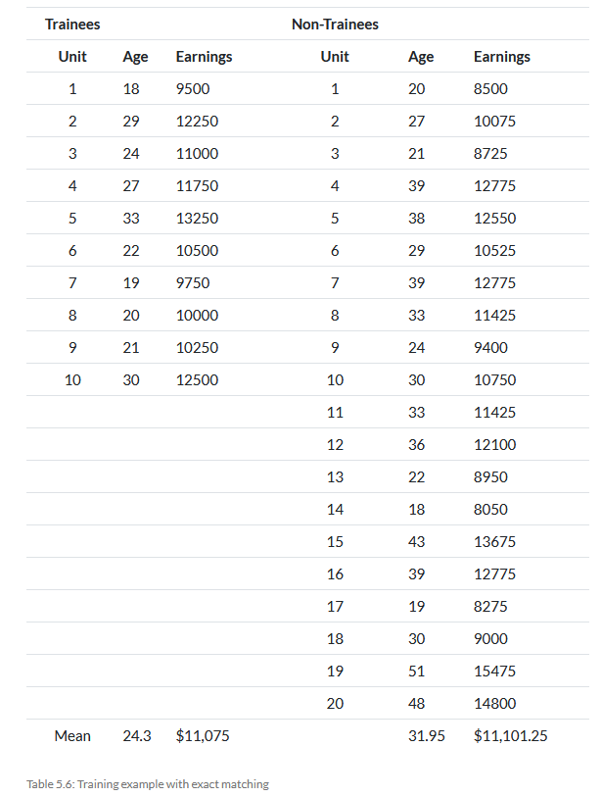
One Difference Example
Suppose we are interested in the effect of a training program on wages. We have data on the wages of trainees and non-trainees.
Naïve ATE
11075-11101.25=-26.24
But note that average age is higher in non-trainee sample and wages typically increase with age.
Let’s match on age to find the average treatment effect on the treated.
(from Cunningham’s Mixtape)

Slide 13
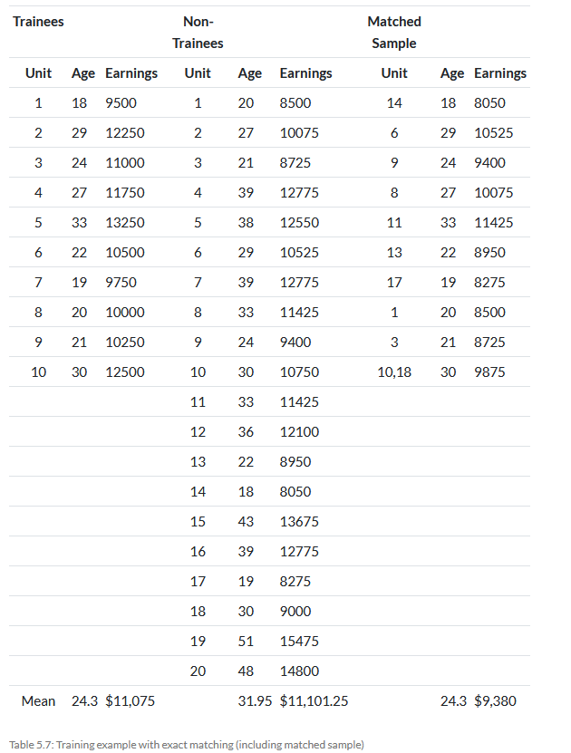
Matched sample.
Compare with Treated sample--note age means are identical.
ATET on matched sample
11075-9380=1695.

Slide 14
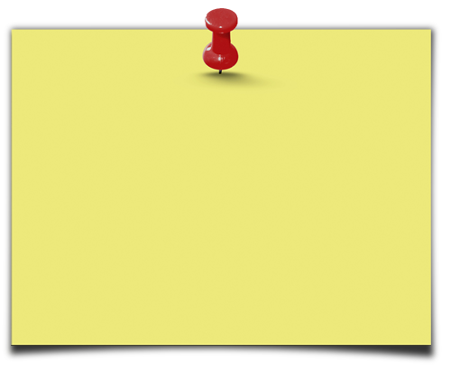
When can we use matching?
  Matching methods allow you to construct valid comparison groups when the assignment to the treatment is done on the basis of observable variables.
Warning: Matching doesn’t control for selection bias that arises when the assignment to the treatment is done on the basis of non-observables. (n.b. neither does regression. Need IV)
Slide from Gertler et al. World Bank

Slide 15
Matching with More Than One Conditioning Variable
If we have more than one conditioning variable, e.g. age and gender then in principle there is no problem, we form matches within each block, calculate a treatment effect within block and form the weighted sum (probability of each block) to get the ATE.
A slightly different procedure which fits within a regression context is to use fixed effects for each block (“quasi-matching”).

Slide 16

Peer Effects and Matching
Sacerdote, B. (Dartmouth), 2001, Peer effects with random assignment: Results for Dartmouth roommates. Quarterly Journal of Economics, 116(2), 681-704

Slide 17
Random within blocks
Five questions
  I smoke.
  I like to listen to music while studying.
  I keep late hours.
  I am more neat than messy.
  I am male.
5^2=32 blocks (25 non-empty).
Within block, assignment is random!
For a pure matching estimator, Sacerdote would estimate treatment within blocks. He wants to include some controls, however, and so for efficiency will use dummy variables which we will explain shortly. Similar philosophy to matching.

Slide 18
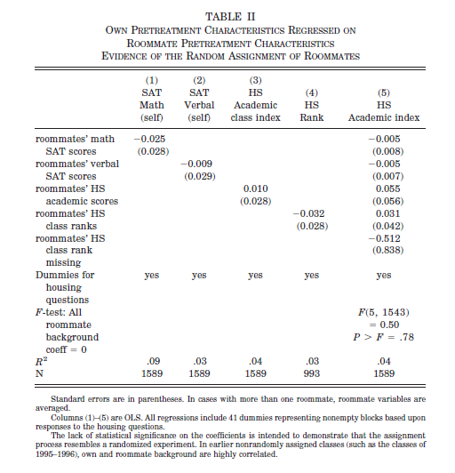
Show Pre-Treatment Variables are Randomized
Notes:
Note that messy, male smokers, who like to listen to music and stay up late could have a different SAT scores—probably they do but once we control for that group, i.e. within the Xs the assignment is random. Note that for a pure matching estimator, Sacerdote would run the regression within blocks. Here to increase efficiency he uses dummies which assumes that the GPA/Ability effect is the same across blocks and that the effect of the block is a simple change in intercept.

Slide 19
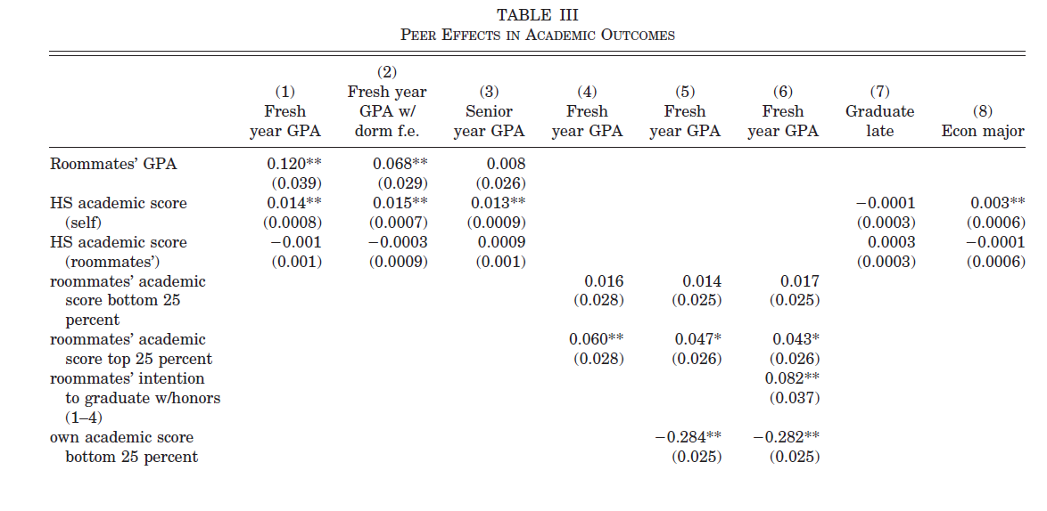
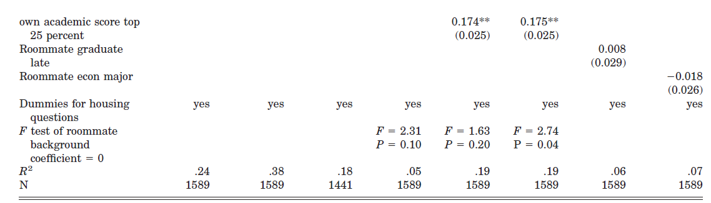

Slide 20
Peer Effects
For every 1 point increase (decrease) in the roommate’s GPA, a student’s GPA increased (decreased) about .12 points.
  If you would have been a 3.0 student with a 3.0 roommate, but you were assigned to a 2.0 roommate, your GPA would be 2.88.
Note that the peer effect in ability is 27% as large as the own effect!
Peer effects are even larger in social choices such as the choice to join a fraternity. (Dorm effects are large here as well.)

Slide 21
Random within blocks
In the case of the Dartmouth experiment we knew that residents were matched randomly within the blocks so we just had to control for the block. An exact match.
But typically, when there are multiple conditioning variables we won’t be able to find exact matches.

Slide 22
The Curse of Dimensionality
Matching breaks down when we add covariates.
  E.g. Suppose that we have two variables each with 10 levels, then we need 100 cells and we need treated and untreated members of each cell.
  Add one more 10 level variable and we need 1000 cells.
Regression “solves” this problem by imposing linear relationships e.g.
Y=α + β1 PSA + β2 Age + β3 Age × PSA + β4 T
  We have reduced (squashed!) a 100 variable problem to 3 variables but at the price of assuming away most of the possible variation.

Slide 23
Distance Measures
If we can’t do exact matching then we can match observations according to how “close” the are.
But how to measure closeness or distance?
  Mahalanobis
  Propensity Score
  Coarsened

Slide 24
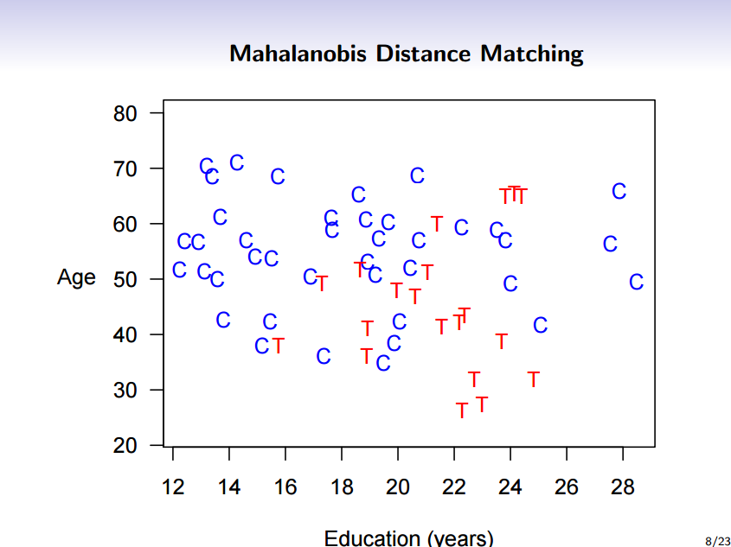
Slides from Gary King
Notes:
Is one year of education the same as one year of schooling? No. Mahalanobis can create distance measures based on standard deviations or other formula.

Slide 25
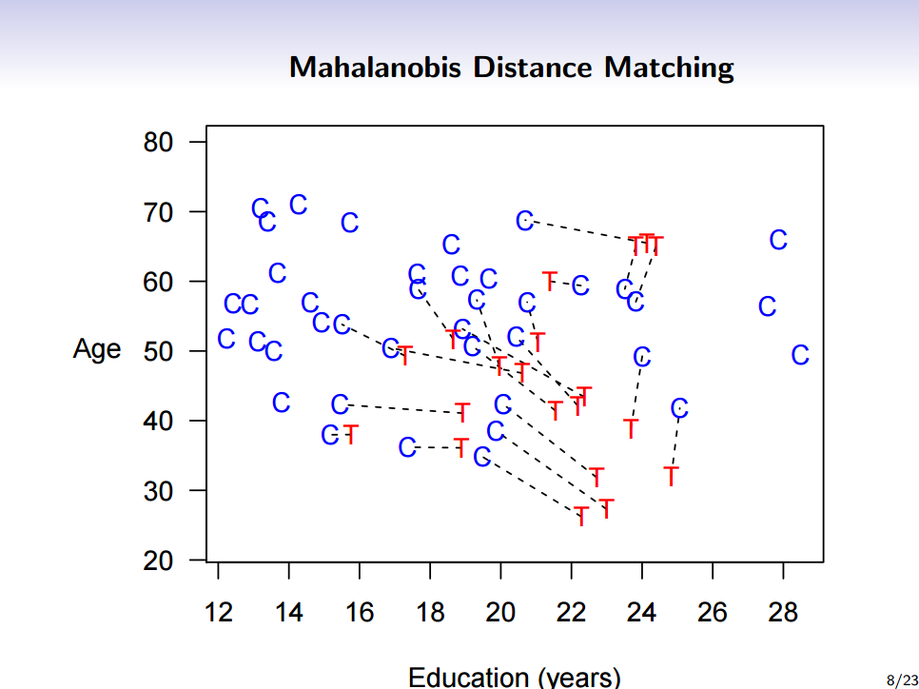

Slide 26
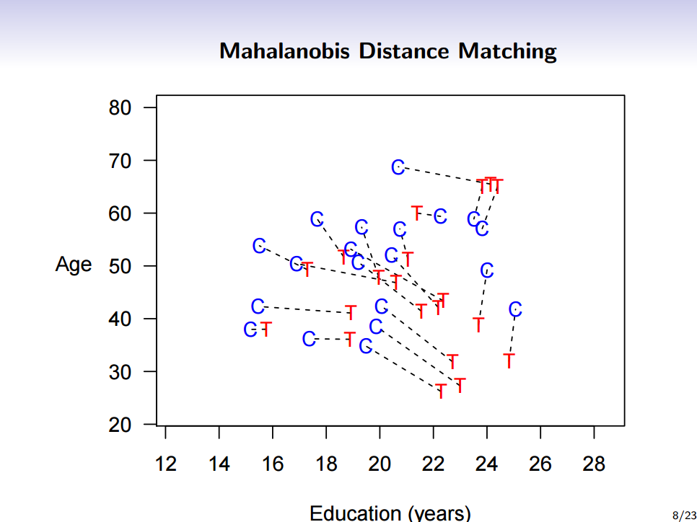

Slide 27
Note that matching could also be called pruning->eliminating variables not in the common support.

Slide 28
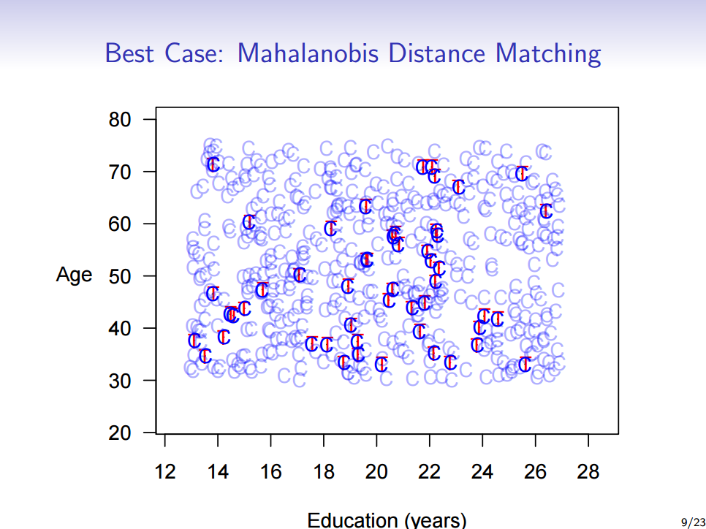

Slide 29
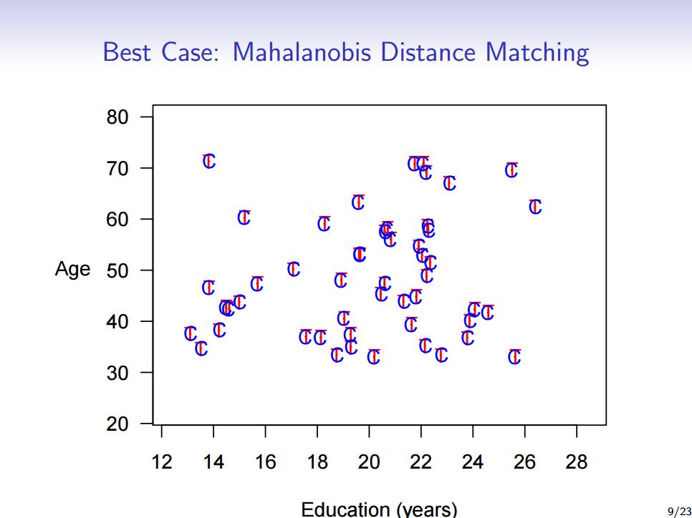

Slide 30
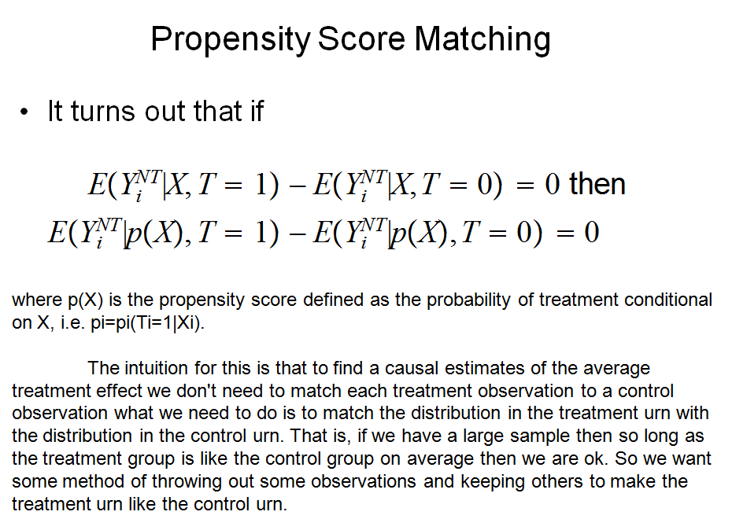

Slide 31
Matching based on the Propensity Score
Definition
  The propensity score is the conditional probability of receiving the treatment given the pre-treatment variables:
p(X) =Pr{T = 1|X} = E{T|X}
Lemma 1
If p(X) is the propensity score, then T ⊥ X | p(X)
“Given the propensity score, the pre-treatment variables are balanced between beneficiaries and non- beneficiaries”
Lemma 2
Y1, Y0 ⊥ T | X => Y1, Y0 ⊥ T | p(X)
“Suppose that assignment to treatment is unconfounded given the pre-treatment variables X. Then assignment to treatment is unconfounded given the propensity score p(X).”

Slide 32
Does the propensity score approach solve the dimensionality problem?
YES!
The balancing property of the propensity score (Lemma 1) ensures that:
    Observations with the same propensity score have the same distribution of observable covariates independently of treatment status; and
    for a given propensity score, assignment to treatment is “random” and therefore treatment and control units are observationally identical on average.

Slide 33
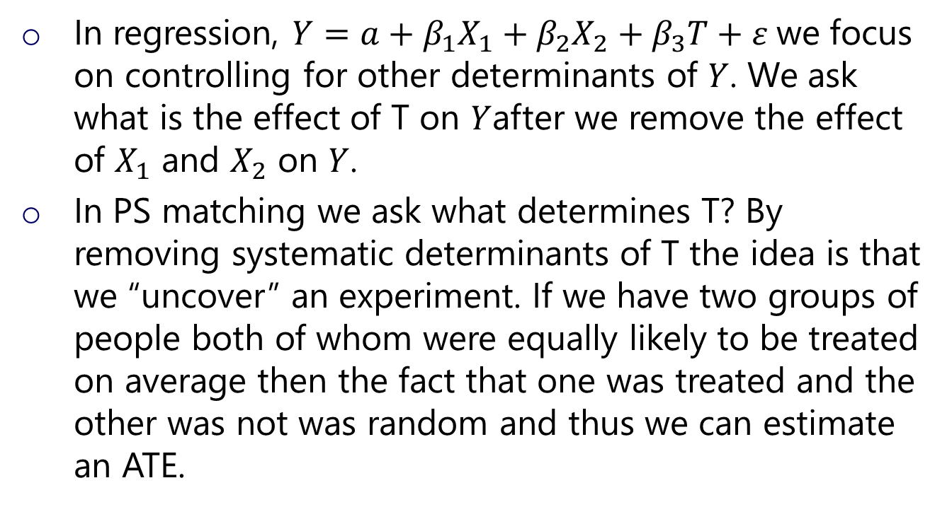
The Philosophy of PS Matching
    In regression, $Y={a+β}_{1}X_{1}+β_{2}X_{2}+β_{3}T+ε$we focus on controlling for other determinants of $Y$. We ask what is the effect of T on $Y$after we remove the effect of $X_{1}$ and $X_{2}$ on $Y$.
    In PS matching we ask what determines T? By removing systematic determinants of T the idea is that we “uncover” an experiment. If we have two groups of people both of whom were equally likely to be treated on average then the fact that one was treated and the other was not was random and thus we can estimate an ATE.

Slide 34
Implementation of the estimation strategy
Remember we’re discussing a strategy for the estimation of the average treatment effect on the treated, called δ
Step 1
  Estimate the propensity score (e.g. logit or probit)
Step 2
Estimate the average treatment effect given the propensity score
  match treated and controls with “nearby” propensity scores
  compute the effect of treatment for each value of the (estimated) propensity score
  obtain the average of these conditional effects

Slide 35
Step 2: Estimate the average treatment effect given the propensity score
The closest we can get to an exact matching is to match each treated unit with the nearest control in terms of propensity score
“Nearest” can be defined in many ways. These different ways then correspondent to different ways of doing matching:
  Stratification on the Score
  Nearest neighbor matching on the Score
  Weighting on the basis of the Score

Slide 36
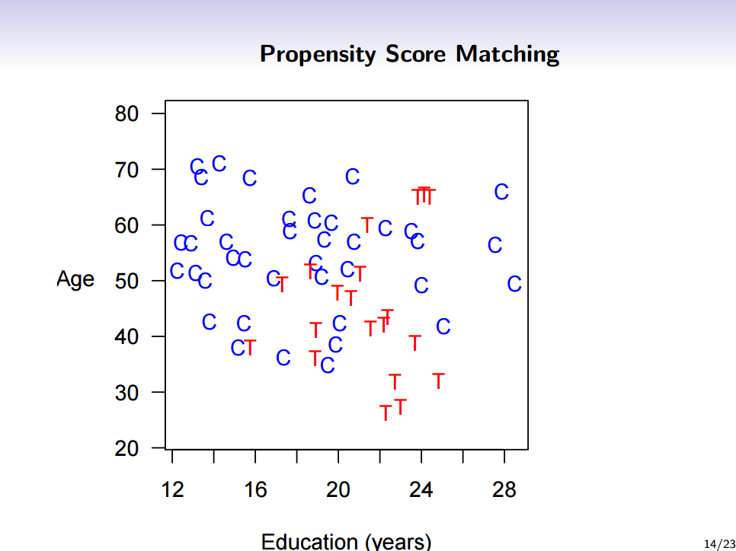

Slide 37
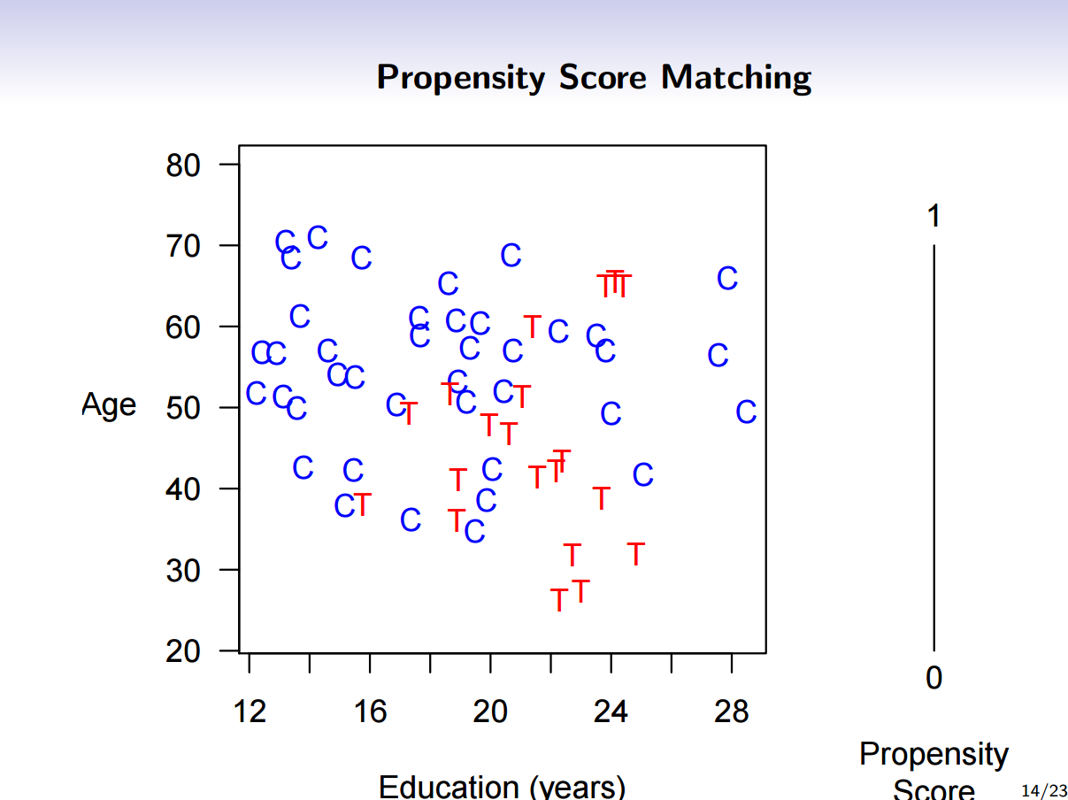

Slide 38
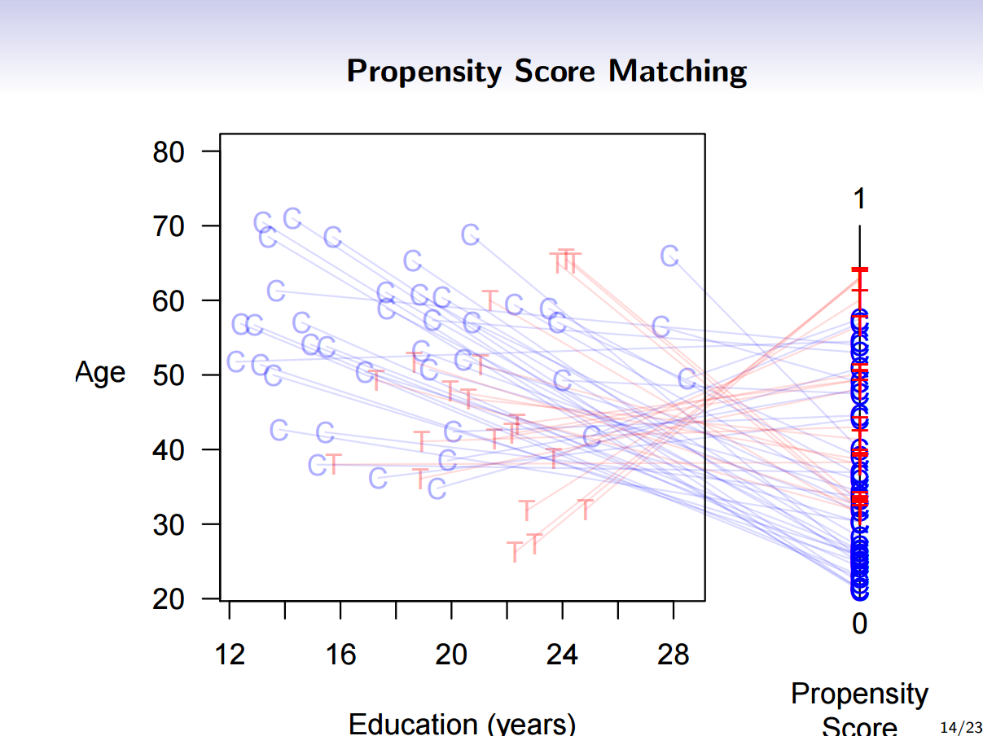

Slide 39
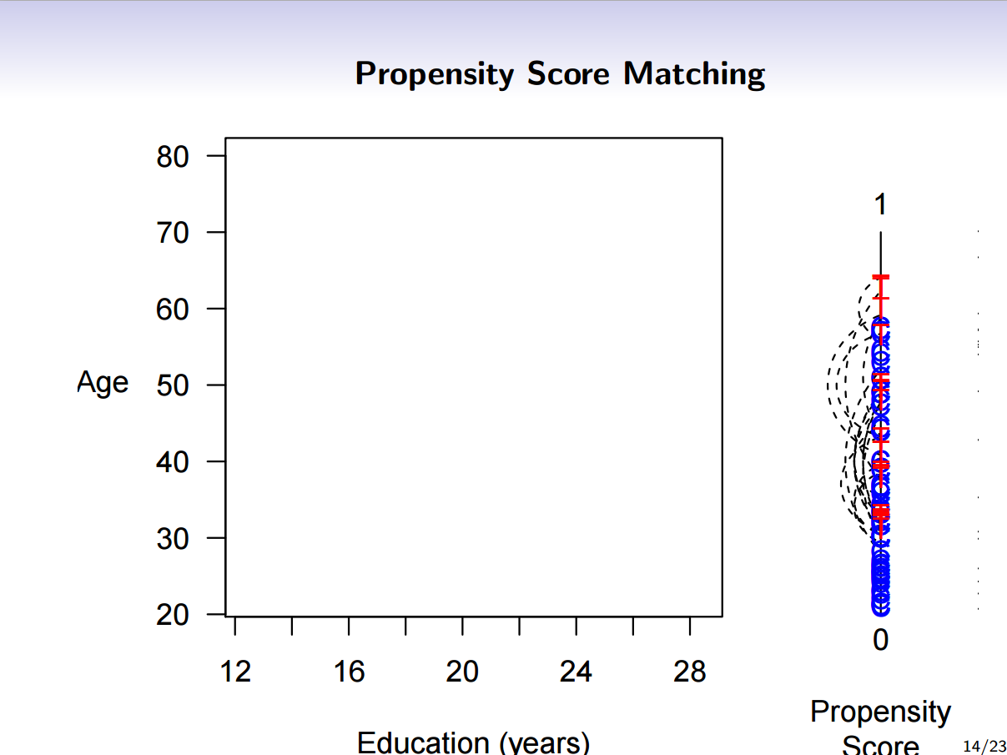
Side note: Squeezing everything into one dimension loses information so distance matching or coarsened matching work better in general (Gary King).

Slide 40
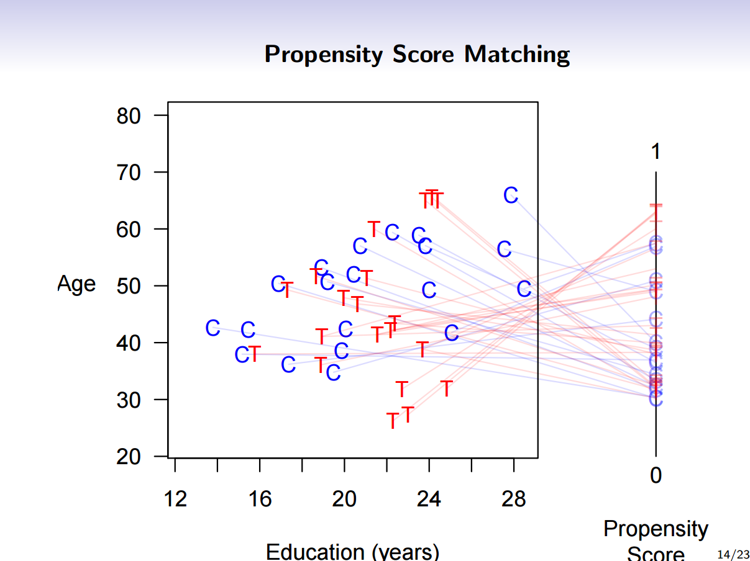

Slide 41
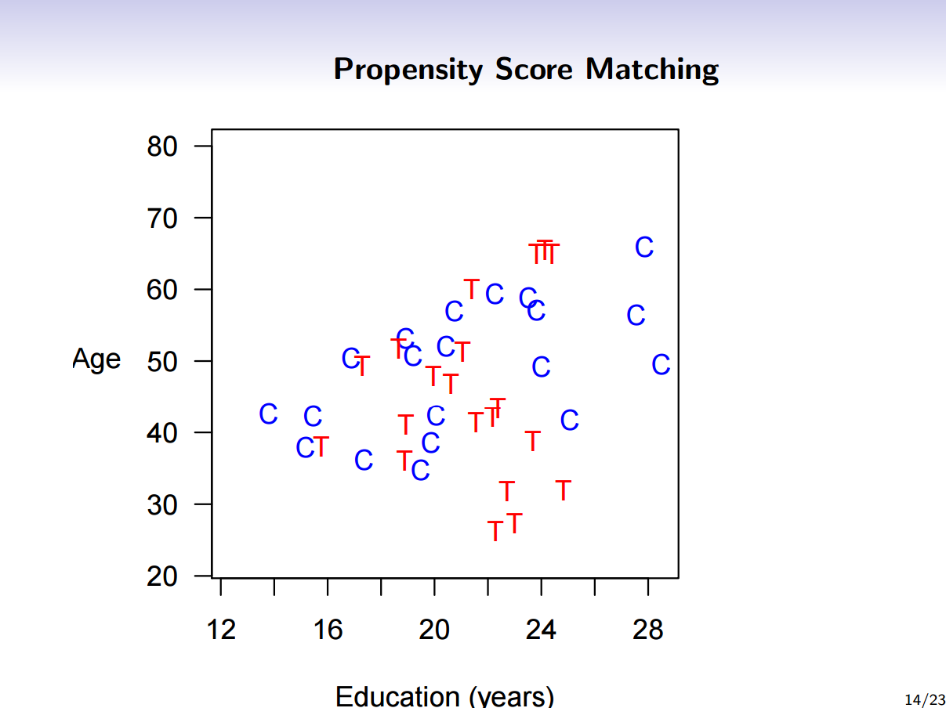
Again note that matching prunes the observations.

Slide 42
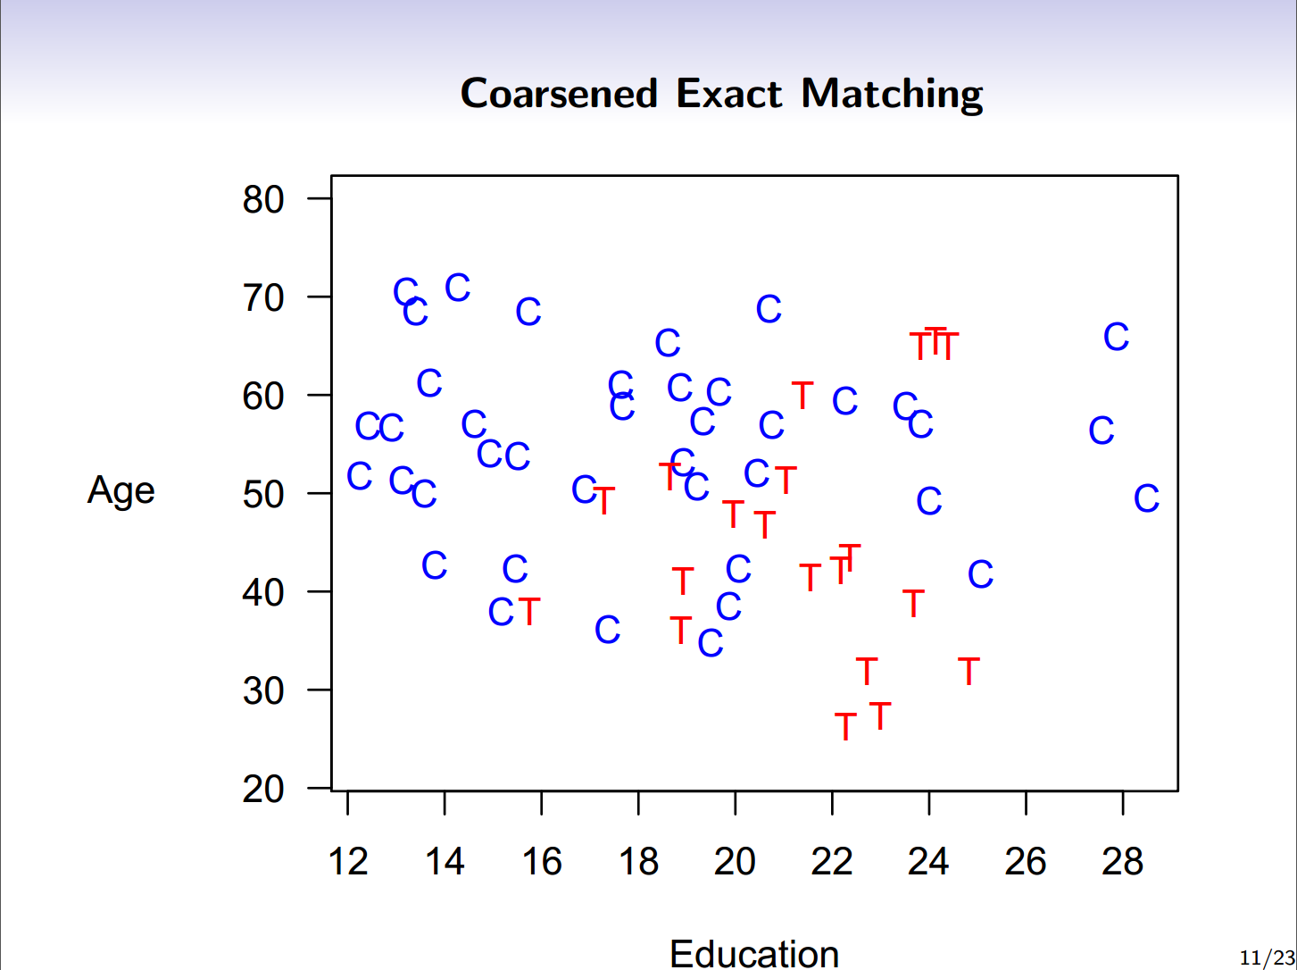

Slide 43
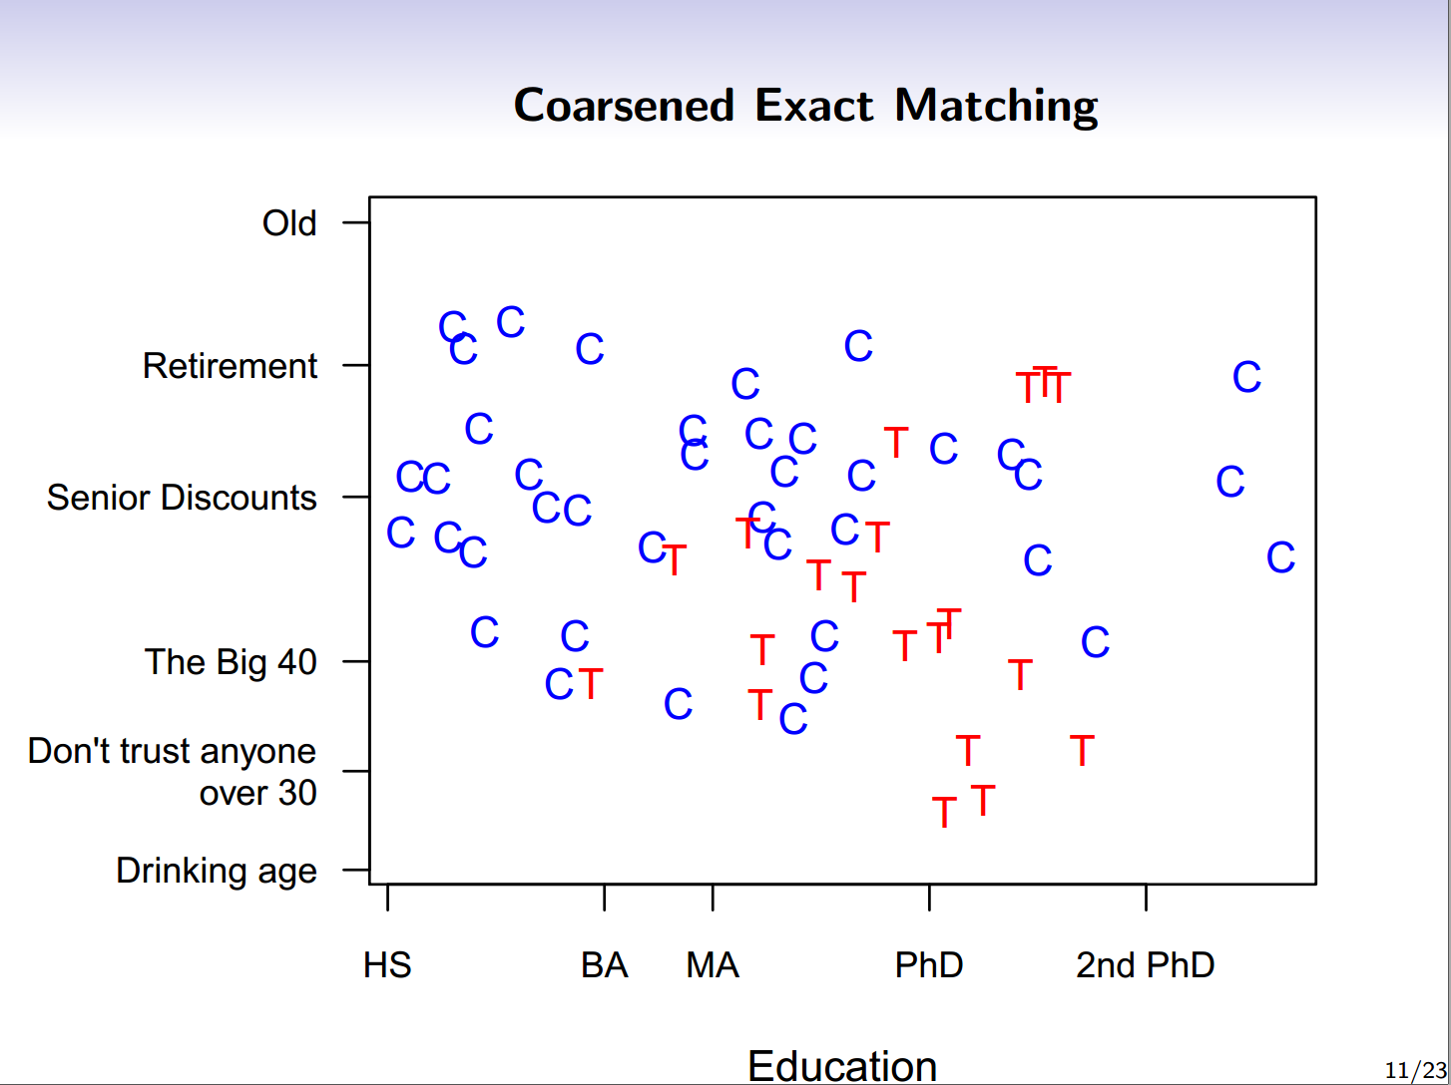

Slide 44
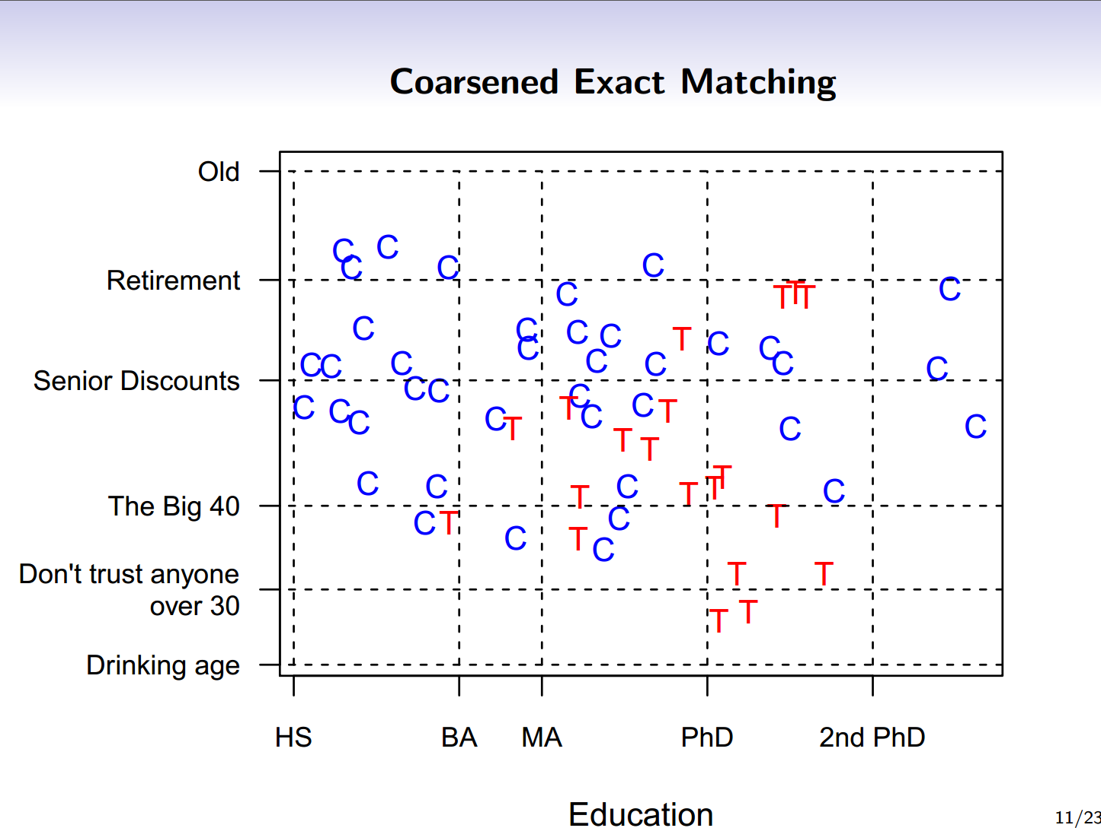

Slide 45
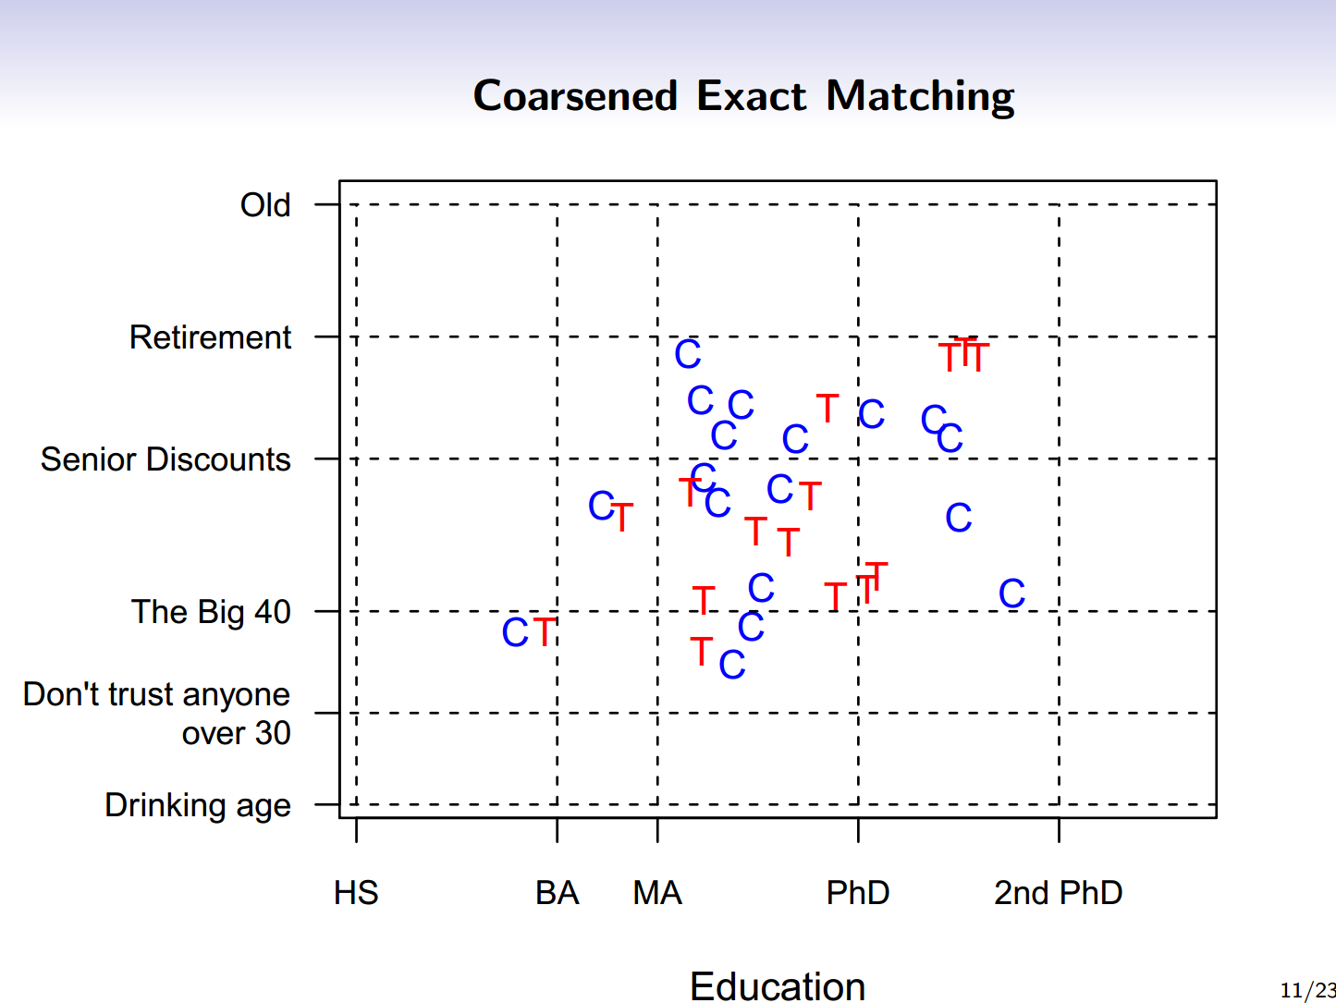

Slide 46
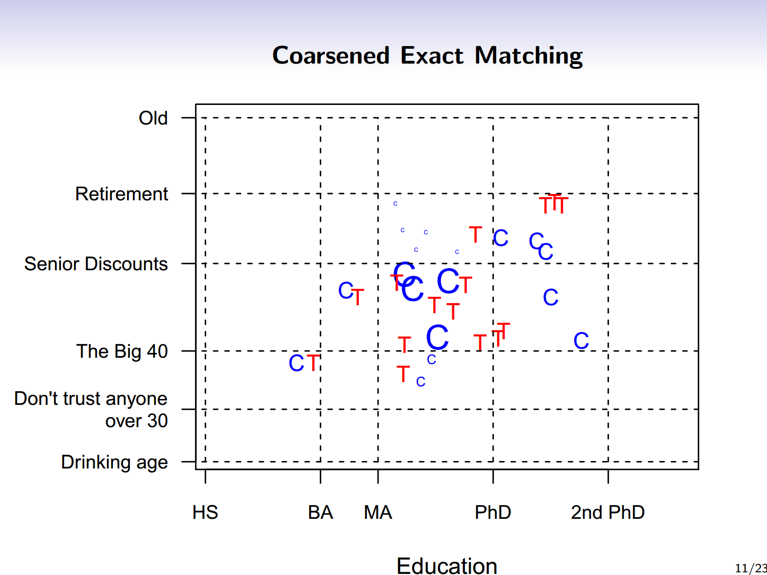

Slide 47
Matching Methods Stata
Nearest neighbor matching using Mahalanobis metric
teffects nnmatch (y x) (t), atet
Propensity score matching using logit
teffects psmatch (y) (t x, logit), atet
Propensity Score Matching using PSMatch2
psmatch2 t x, outcome(y)
Coarsened Exact Matching
cem x (cutpoints/cutalgorithm), treatment(t)
Notes:
In the case of CEM the command then returns a dataset including whether an observation was matched or not and then you run regression or difference in means etc. on the matched dataset. Note that the matched dataset uses the original observations, you only coarsen for matching.

Slide 48
Inverse Probability Weighting
Rather than matching 1 to 1 it is possible to match one treated to all untreated but adjusting the weights on the untreated to account for similarity. Uses more data and is also unbiased.
  When the objective is to estimate ATET, the treated person receives a weight of 1 while the control person receives a weight of p(X)/(1-p(X)).

Slide 49
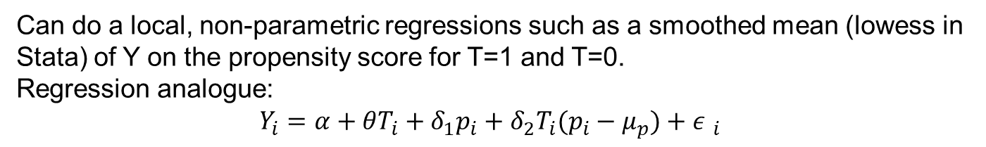
Propensity Score Matching as Diagnostic and Explanatory Tool
Can do a local, non-parametric regressions such as a smoothed mean (lowess in Stata) of Y on the propensity score for T=1 and T=0.
Regression analogue:
$$Y_{i}=α+θT_{i}+δ_{1}p_{i}+δ_{2}{T_{i}(p}_{i}−μ_{p})+{ε }_{i}$$
Notes:
Need to fix standard errors since p is estimated (Can use bootstrap by drawing from distribution of p scores 1000 times). Can also add covariates +Bxi.

Slide 50
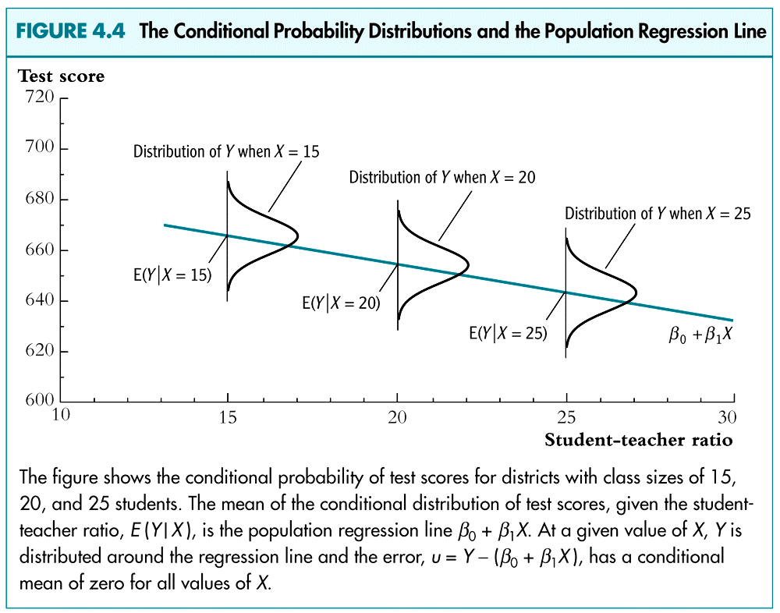

Slide 51
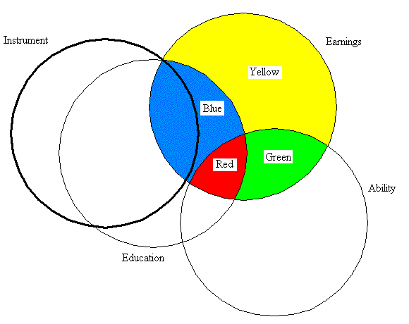
The circle labeled "earnings" illustrates variation in the variable to be explained. Education and Ability are correlated explanatory variables and Ability is not observed. The blue area within the instrument circle represents variation in education that is uncorrelated with Ability and which can be used to consistently estimate the coefficient on education. Note that the only reason the instrument is correlated with Earnings is through education.

Slide 52
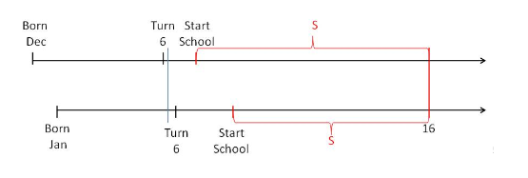
Angrist-Krueger IV
Cunningham, Mixtape.
Children born in December and children born in January are similar but at around age 6 the former goes to school and the latter is still in kindergarten.
Either, however, can quit at age 16 but the December quitter will have had more school at age 16 than the January (1’st QOB) quitter.

Slide 53
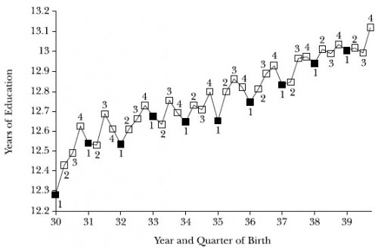
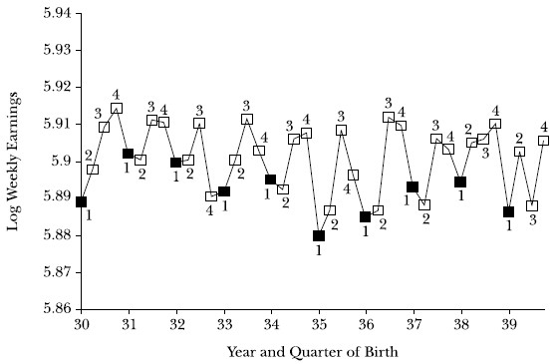
Instruments in Action
(Angrist and Krueger 1991)

Slide 54
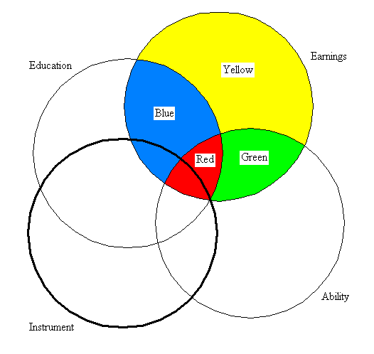
Instrumental variables with weak instruments and correlation with unobserved influences.
Bias in the IV estimator is determined by the covariance of the instrument with education (blue within instrument circle) relative to the covariance between the instrument and the unobserved factors (red within instrument circle). Thus IV with weak instruments can be more biased than OLS.

Slide 55
Voluntary job training program
  Say we decide to compare outcomes for those who participate to the outcomes of those who do not participate:
A simple model to do this:
y = α + β₁ P + β₂ x + ε
1 If person participates in training
P =
0 If person does not participate in training
x = Control variables (exogenous & observed)
Why is this not working?
2 problems:
  Variables that we omit (for various reasons) but that are important
  Decision to participate in training is endogenous.

Slide 56
Problem #1: Omitted Variables
Even if we try to control for “everything”, we’ll miss:
  Characteristics that we didn’t know they mattered, and
  Characteristics that are too complicated to measure (not observables or not observed):
    Talent, motivation
    Level of information and access to services
    Opportunity cost of participation
Full model would be:
y = γ₀ + γ₁ x + γ₂ P + γ₃ M₁ + η
But we cannot observe M₁ , the “missing” and unobserved variables.

Slide 57
Omitted variable bias
True model is:
y = γ₀ + γ₁ x + γ₂ P + γ₃ M₁ + η
But we estimate:
y = β₀ + β₁ x + β₂ P + ε
If there is a correlation between M₁ and P, then the OLS estimator of β₂ will not be a consistent estimator of γ₂, the true impact of P.
Why?
When M₁ is missing from the regression, the coefficient of P will “pick up” some of the effect of M₁

Slide 58
Problem #2: Endogenous Decision to Participate
True model is:
y = γ₀ + γ₁ x + γ₂ P + η
with
P = π₀ + π ₁ x + π ₂ M₂ +ξ
M₂ = Vector of unobserved / missing characteristics
(i.e. we don’t fully know why people decide to participate)
Since we don’t observe M₂ , we can only estimate a simplified model:
y = β₀ + β ₁ x + β₂ P + ε
Is β_{2, OLS} an unbiased estimator of γ₂?

Slide 59
Problem #2: Endogenous Decision to Participate
We estimate:
y = β₀ + β₁ x + β₂ P + ε
But true model is:
y = γ₀ + γ₁ x + γ₂ P + η
with
P = π₀ + π₁ x + π₂ M₂ +ξ
Is β_{2, OLS} an unbiased estimator of γ₂?
  Corr (ε, P) = corr (ε, π₀ + π ₁ x + π ₂ M₂ +ξ)
  = π ₁ corr (ε, x)+ π ₂ corr (ε, M₂)
  = π ₂ corr (ε, M₂)
If there is a correlation between the missing variables that determine participation (e.g. Talent) and outcomes not explained by observed characteristics, then the OLS estimator will be biased.

Slide 60
What can we do to solve this problem?
We estimate:
y = β₀ + β₁ x + β₂ P + ε
So the problem is the correlation between P and ε
How about we replace P with “something else”, call it Z:
  Z needs to be similar to P
  But is not correlated with ε

Slide 61
Back to the job training program
P = participation
ε = that part of outcomes that is not explained by program participation or by observed characteristics
I’m looking for a variable Z that is:
  Closely related to participation P
  but doesn’t directly affect people’s outcomes Y, other than through its effect on participation.
So this variable must be coming from outside.

Slide 62
Generating an outside variable for the job training program
Say that a social worker visits unemployed persons to encourage them to participate.
  She only visits 50% of persons on her roster, and
  She randomly chooses whom she will visit
If she is effective, many people she visits will enroll.
  There will be a correlation between receiving a visit and enrolling
But visit does not have direct effect on outcomes (e.g. income) apart from its effect through enrollment in the training program.
Randomized “encouragement” or “promotion” visits are an Instrumental Variable.

Slide 63
Characteristics of an instrumental variable
Define a new variable Z
1 If person was randomly chosen to receive the encouragement visit from the social worker
Z =
0 If person was randomly chosen not to receive the encouragement visit from the social worker
Corr ( Z , P ) > 0
  People who receive the encouragement visit are more likely to participate than those who don’t
Corr ( Z , ε ) = 0
  No correlation between receiving a visit and benefit to the program apart from the effect of the visit on participation.
Z is called an instrumental variable

Slide 65
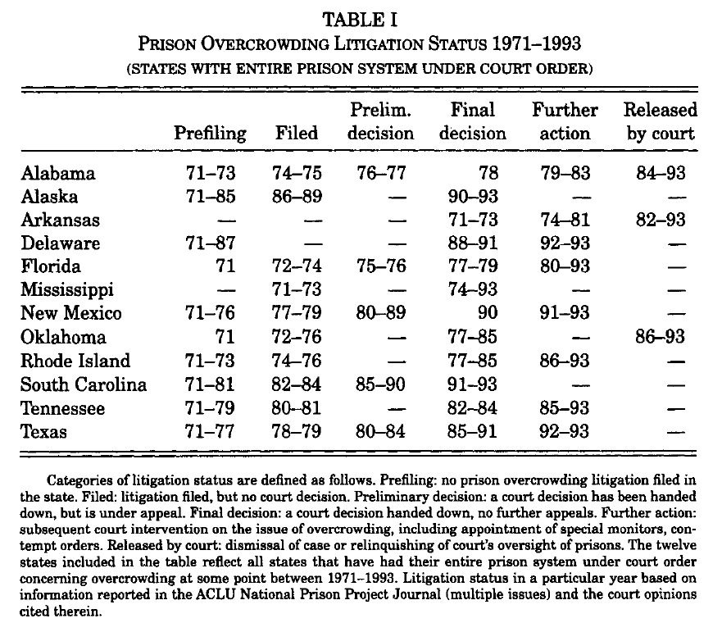

Slide 66
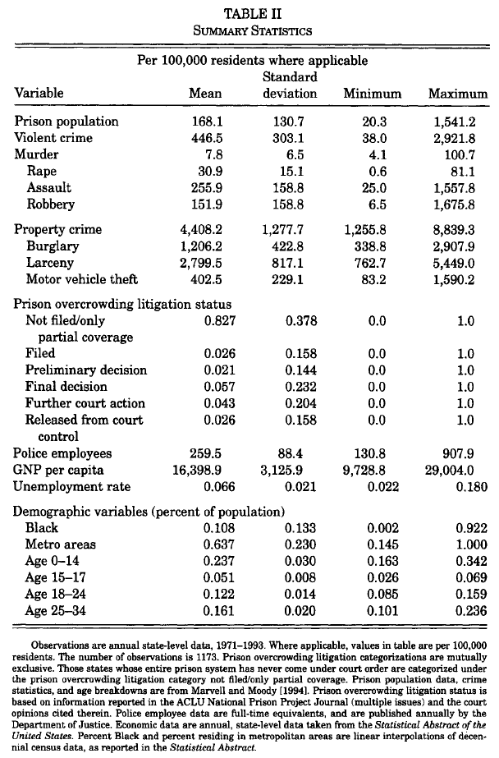

Slide 67
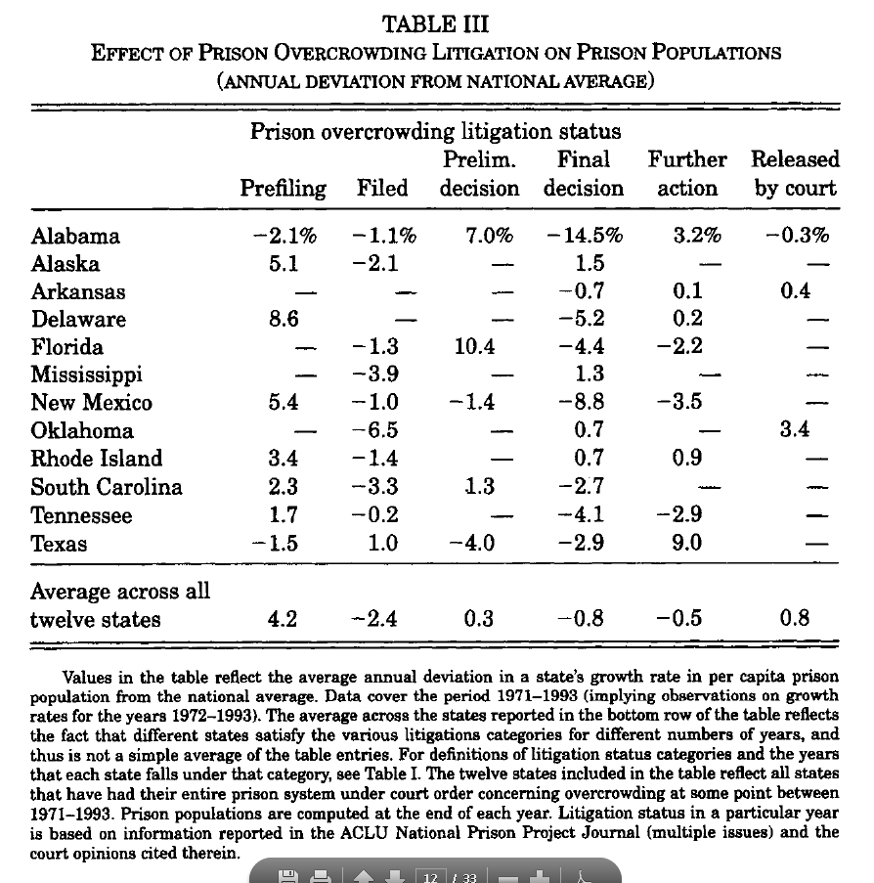

Slide 68
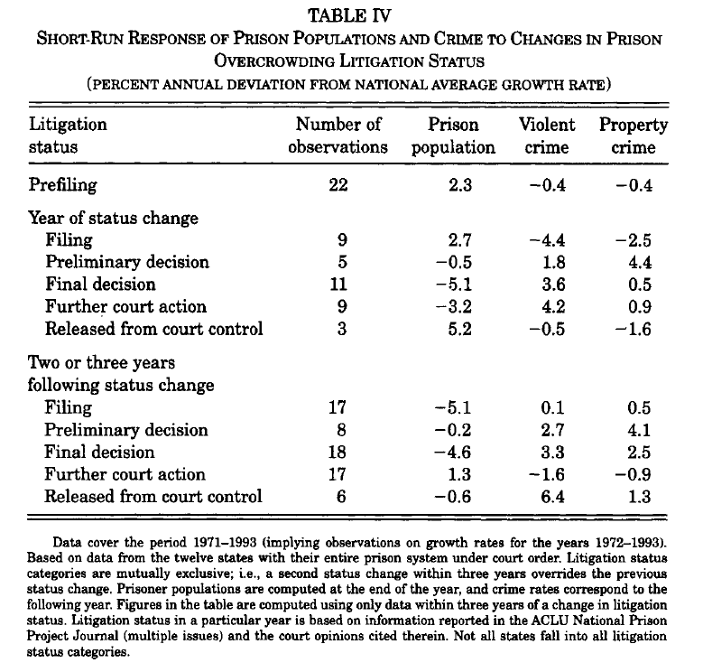

Slide 69
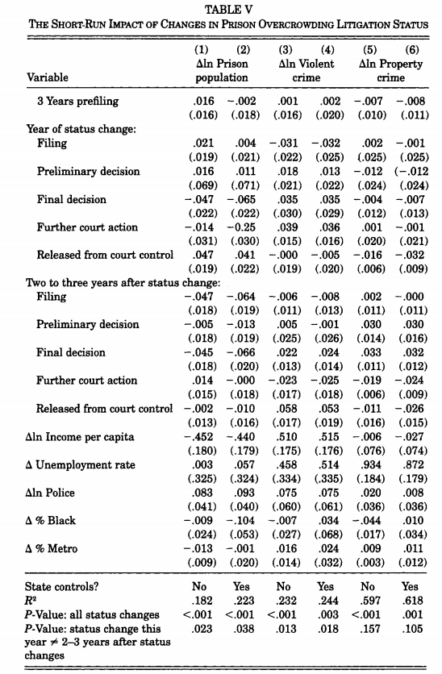

Slide 70
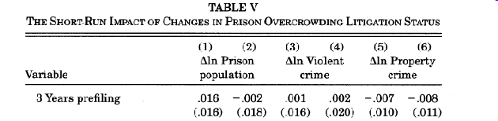


Slide 71
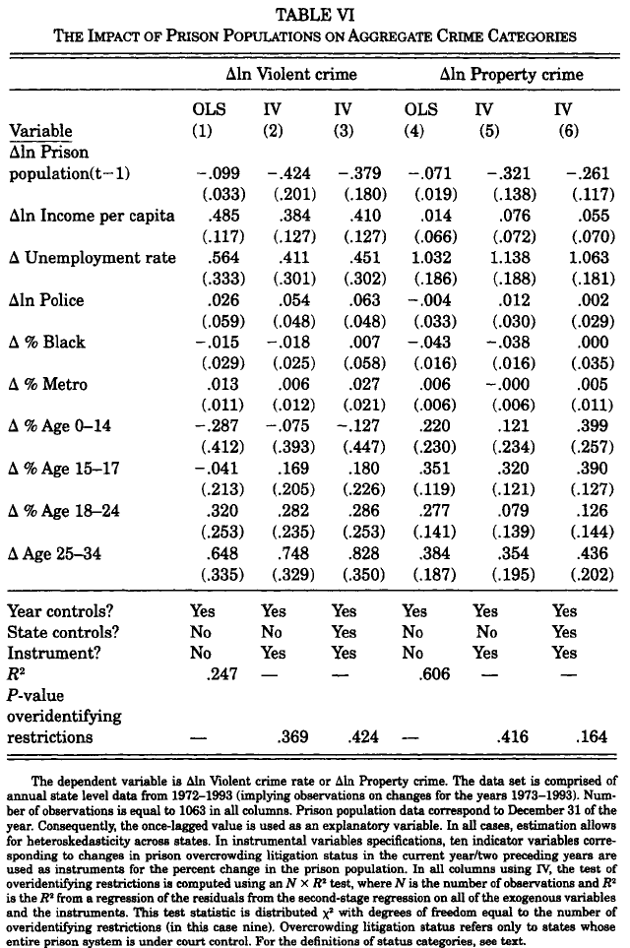

Slide 72
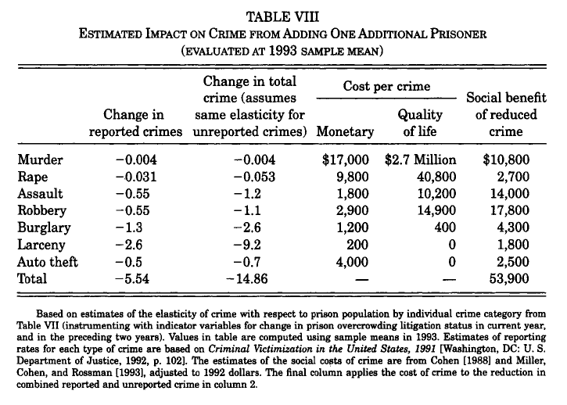

Slide 73
Extra

Slide 74
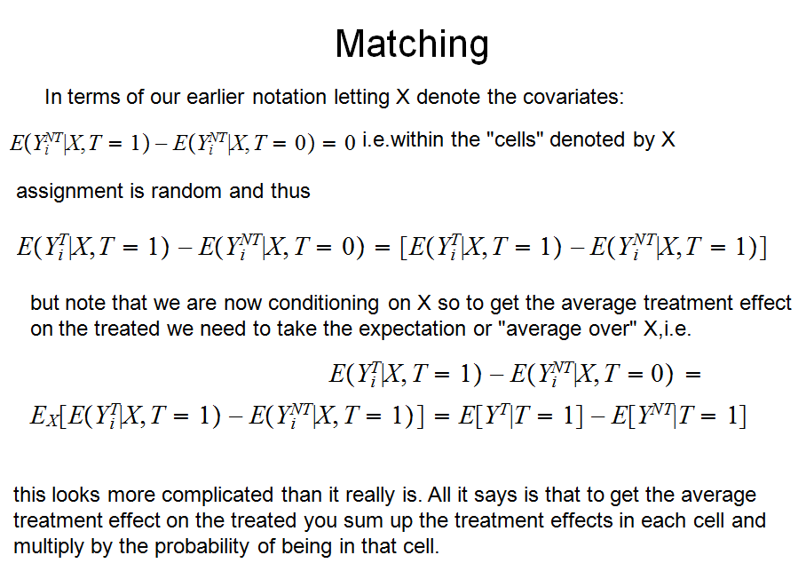
Matching

