Slide 1
Lesson Study- Stone MS October 7,2009
Emily Altadonna, Laura Gooding, Velma Greene, Karen Serroka

Slide 2
Research Aim & Lesson Goal
Develop Students’ Algebraic Thinking in the Middle Grades Students will communicate their mathematical ideas, make connections & generalizations.
Explore the use of tables, graphs, and algebraic expressions/equations to assist in problem-solving. Compare the different solution strategies that students may use.

Slide 3
VA SOL’s and Lesson Placement
Explore the use of tables, graphs, and algebraic expressions/equations to assist in problem-solving. Compare the different solution strategies that students may use.
SOLs addressed: A.1, A.2, A.5, A.8

Slide 4
Summary of SOL topics
A.1 - The student will investigate and analyze function
A.2- The student will use knowledge of transformations to write an equation given the graph of a function
A.5- The student will determine optimal values in problem situations
A.8- The student will design and conduct an experiment/survey (Data analysis)

Slide 5
PTA Fundraiser Problem
The PTA is selling candy in the cafeteria to raise money for the 8th grade field trip. They are selling mints for 5 cents apiece and lollipops for 10 cents apiece. Wes has 18 dimes in his wallet, and Scott has 22 nickels. Every day at lunch, Wes buys a lollipop and Scott buys a mint. After lunch one day, the boys discover that Scott has more money than Wes. At this point, how many days have they been buying candy?

Slide 6
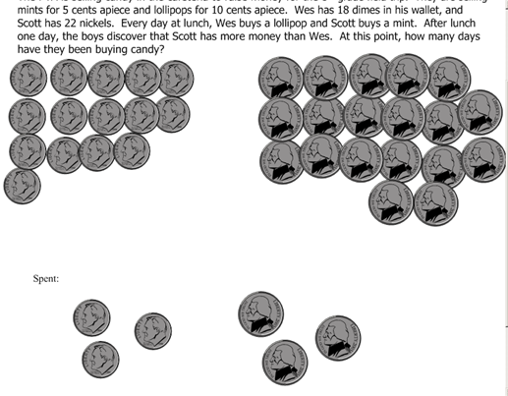
Anticipated Response

Slide 7
Anticipated Response
Day | Wes’ Money | Scott’s Money
0 | 180 cents | 110 cents
1 | 170 cents | 105 cents
2 | 160 cents | 100 cents
3 | 150 cents | 95 cents
4 | 140 cents | 90 cents
5 | 130 cents | 85 cents
6 | 120 cents | 80 cents
7 | 110 cents | 75 cents
8 | 100 cents | 70 cents
9 | 90 cents | 65 cents
10 | 80 cents | 60 cents
11 | 70 cents | 55 cents
12 | 60 cents | 50 cents
13 | 50 cents | 45 cents
14 | 40 cents | 40 cents
15 | 30 cents | 35 cents
16 | 20 cents | 30 cents
17 | 10 cents | 25 cents
18 | 0 cents | 20 cents
19 |  | 15 cents
20 |  | 10 cents
21 |  | 5 cents
22 |  | 0 cents
Wes and Scott’s Money
Amount of money(cents)
Day of buying candy
W=180-10x
S=110-5x

Slide 8
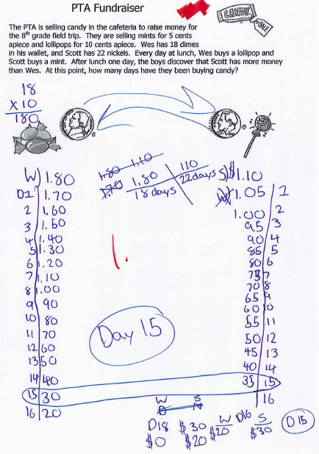
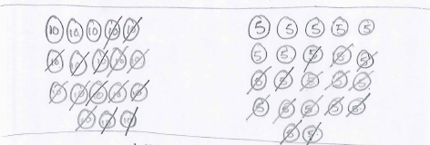
Student Response

Slide 9
Karen’s Lesson
Focus was Statistics: asked students to
“collect and, represent” the data
What are some other types of information we can determine from the data.
Introduction questions:
How much money do they each have?
Who starts with more money?
Will he always have more money?
I prepared a graph for them to use

Slide 10
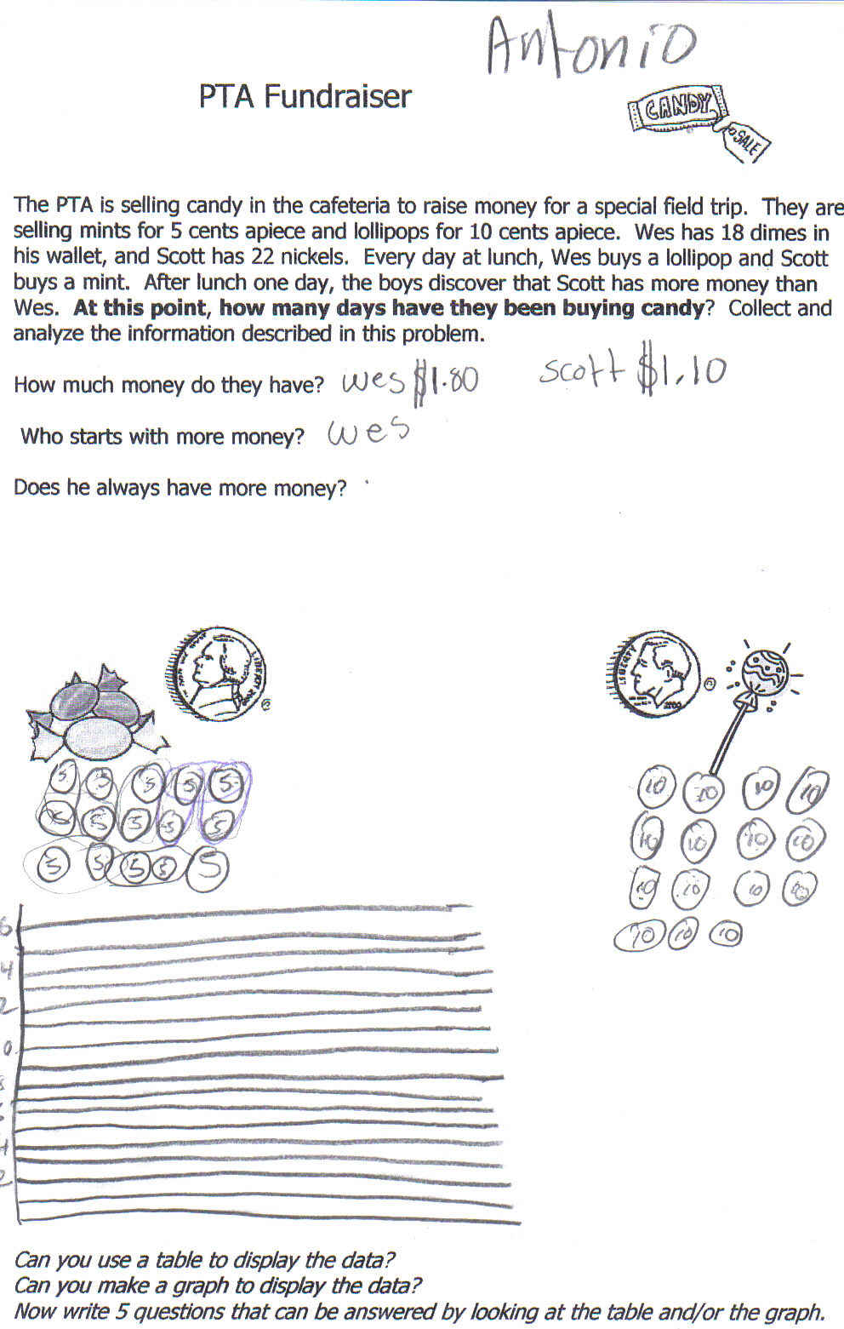
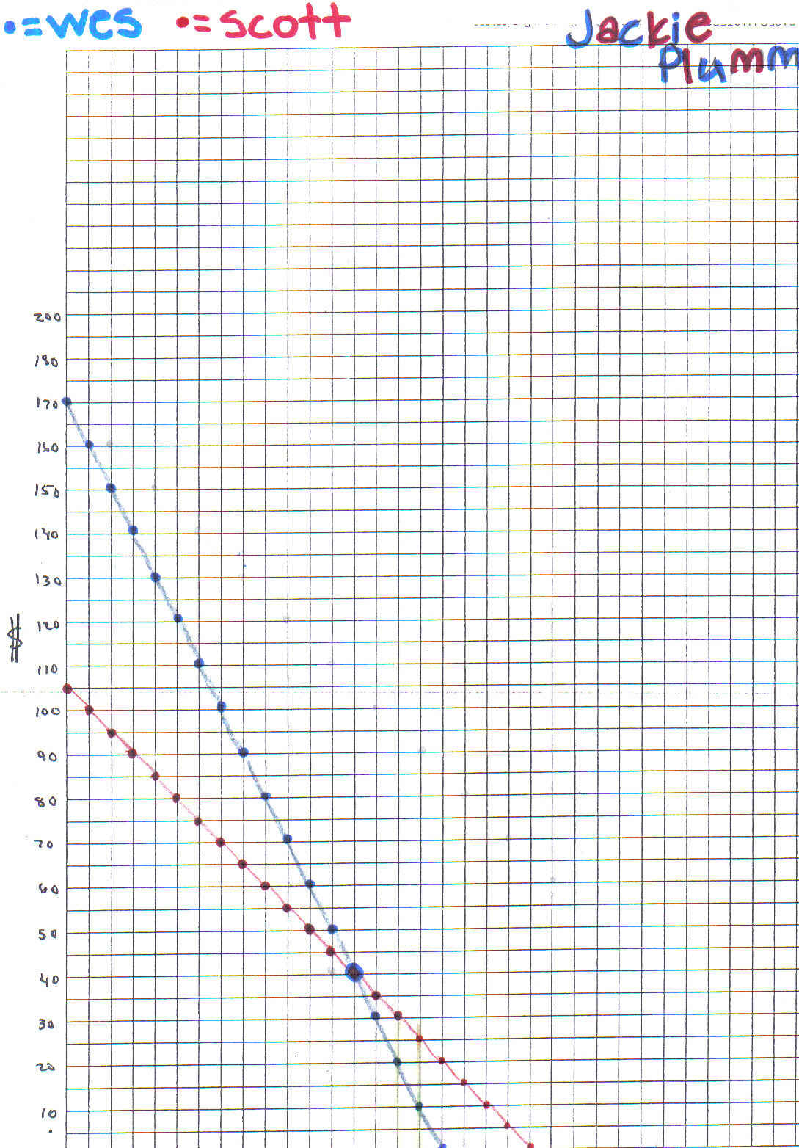
Results:

Slide 11
Key ideas that came out:
“one decreased faster and the other decreased slower”
“When did Nate (Dan) run out of money”
“What day were they both out of money, (or the money was equal again)”
“How many extra days did Nate get candy and Dan didn’t”

Slide 12
Laura’s Lesson
Set-Up
Same problem, just changed names to student names for engagement purposes
Presented to an Algebra Honors class
Placement was after linear equations graphing unit.
Homework was a decreasing function

Slide 13
Laura’s Lesson Continued
Responses we surprisingly almost identical to the original lesson study
Many students did come up with equations, but none of them tried to graph the equations
Conclusion:
Students are not comfortable with graphing as a problem solving method

Slide 14
Laura’s Lesson Continued
45 minutes not enough time for the lesson.
Students were not motivated to find alternate methods for finding solutions
Perhaps more problems needed in order to keep students on task
Need to rework lesson to insure time to reach comparison/contrast of solution methods

Slide 15
Velma’s Lesson
The lesson was taught to my 7th and 8th grade tutorial mat h class. Tutorial Math is for students that have failed the Va SOL the previous year. The class sizes are small ( max . 15 students) and equipped with computers for each student.

Slide 16
8th Graders
- Most of my students initially thought the lesson was easy.
- Some wanted to know if candy was bought on the first day.
- All but one team got the problem incorrect.
- They found when the money was even.
- I had to reread the problem with the students for them to comprehend .

Slide 17
8th Graders (cont.)
- All students used a chart to work the problem.
- One student who was in detention that day used an equation.
Conclusion
- They want the easy way out.
-They want the ends rather than the means.
- They want to do like everyone else.

Slide 18
7th Graders
- With the exception of one team all of their answers were correct.
- They had not been exposed to equations as my 8th graders had.
- They used pictures and charts to solve the problem.
Conclusions
-7th graders work harder, have less complaints and strive for perfection.

Slide 19
Ways to Extend the Lesson
Our classrooms are filled with a diverse population. Have students do the same lesson but use one currency from another country. It could be their native country, a country in which they are learning the language, or a country of their choice. (example the Euro) Because the dollar fluctuations daily it may be interesting do this lesson on two different days to see if the results change.
We as teachers often teach two to three preps. It may be interesting to give the lesson to different preps to see the following differences- how students arrive at answers, how much guidance is given, how many methods were used, etc.
Present the problem backwards. Students are told on that on the 18th day Wes had 0 cents and Scott had 20 cents and on the 22nd day Scott had 0 cents. How much did the have on day zero?
The lesson is being taught one month after school has started. Teach the lesson in the 4th quarter after relations, functions, etc. have been taught. Compare the results.
Change the problem by saying on every 5th day ( Fridays) the lollipops were half price. Wes continued to buy only one lollipop on Friday. Compare your results.

