Slide 1
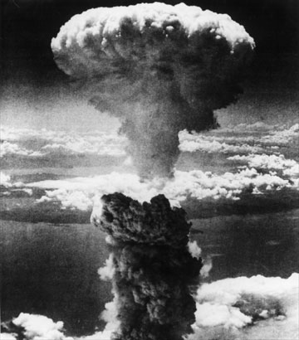
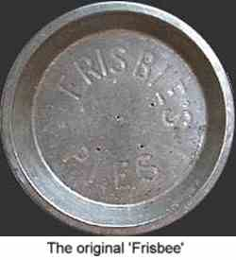
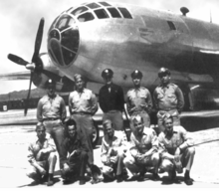
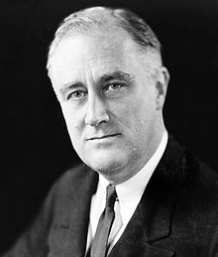
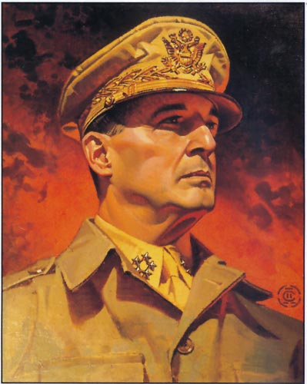
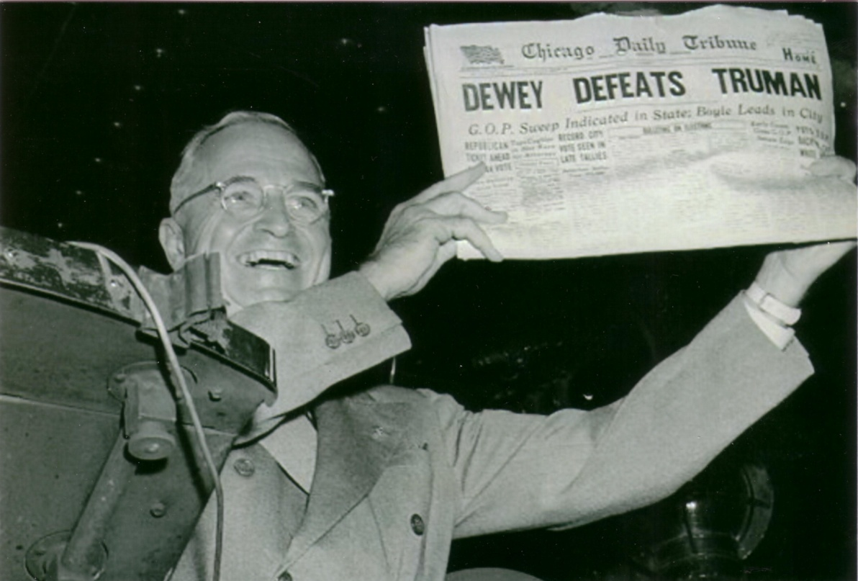
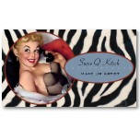
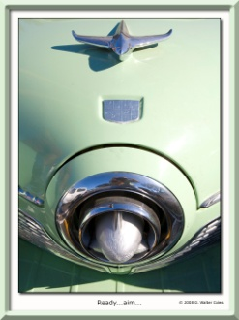
Key Political Leaders
President Harry Truman and the famously incorrect banner headline on the front page of the first edition of the Chicago Tribune on November 3, 1948.

Slide 2
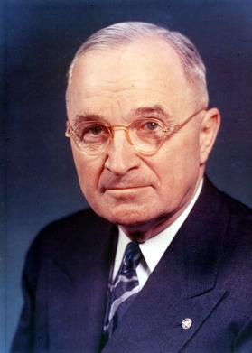
Truman Accomplishments
-Brought the aggressive wartime economy back to the norm.
-Set the policy on the Soviet Union for decades to come, and thus averted direct conflict with Russia
-Worked on civil rights made great strides, setting the roots for the future movement

Slide 3
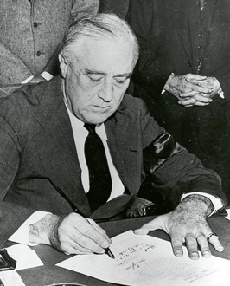
Speech or Quote
Bombing of Pearl Harbor: Roosevelt’s Declaration of War:
“Yesterday, December 7, 1941 -- a date which will live in infamy -- the United States of America was suddenly and deliberately attacked by naval and air forces of the Empire of Japan. “

Slide 4
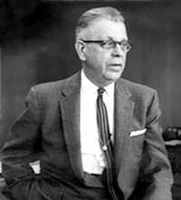
Three Significant Scientists:
Dr. Robert Oppenheimer, inventor of the atomic bomb
Percy Spencer, inventor of the microwave oven, 1946.

Slide 5
Significant Scientists (Cont):
Walter Morris, inventor of the Frisbee (“Pluto Platter,” 1948).
FUN Fact: Did you know that 2 million Frisbees have been sold in the last 50 years. That is more than baseballs, footballs, and basketballs combined!!!!

Slide 6
Significant Advancement in Science:
-1947, Raytheon demonstrated the world's first microwave oven and called it a "Radarange," the winning name in an employee contest.
-Housed in refrigerator-sized cabinets, the first microwave ovens cost between $2,000 and $3,000.
By 1975 Sales of Microwave Ovens Exceeded that of Gas Ranges!!!!

Slide 7
Three Important Industries:
Military-Broad category for the decade that lasted through Korean, Vietnam, Cold War, Iraq and Afganistan wars. Companies like Raytheon and Northrop Grumman helped fuel WWII, the late ’40’s and beyond.
Automotive—zero cars produced in 1942-1944, at the end of the decade went on to sell roughly 2/3rds of the worlds auto mobiles.
Industrial Electronics—Noted Editor W.T. Stuart predicted in 1946 that the “IE market will see more tubes replacing conventional electrical devices in industrial processes, commercial facilities, and home gadgets. Is now a $4 billion market — even greater than the automobile business at its peak.” The areas of “communications and secret military devices” will help expand the postwar era.

