Slide 1
The Measure of Vice and Sin
A Review of the Uses, Limitations and Implications of Crime Data
Alex Tabarrok, Paul Heaton, Eric Helland

Slide 2

Petty’s Call
In 1670 William Petty, founder of empirical economics, called for the collection of official statistics on “the number of people, the quality of inebriating liquors spent, the number of unmaryed persons between 15 and 55 years old, the number of Corporall sufferings and persons imprisoned for Crime” all so that that we might know “the measure of Vice and Sin in the nation.”
Sir William Petty
(1623-1687)
Source: Bowood House
Notes:
Thomas Hobbes personal secretary. First calculations of GDP, first quantity theory of money.
For Petty picture
http://www.bowood-house.co.uk/i/marquis/sir_william_petty.jpg

Slide 3
Sources of Crime Data
Uniform Crime Reports (UCR)
  Supplementary Homicide Reports
  Supplementary Property Reports
  Law Enforcement Employees and Law Enforcement Officers Killed or Assaulted (LEOKA)
National Incident-Based Reporting Systems (NIBRS)
The National Crime Victimization Survey (NCVS)
The Recidivism of Prisoners Released in 1994 (2005)
Law Enforcement Management and Administrative Statistics (LEMAS)
International Crime Victimization Survey
Geographic Crime Data: Crime Mapping and Spatial Analysis
Criminal Justice Administrative Records System (CJARS)

Slide 4
Uniform Crime Reports
The UCR program began in 1930 with 400 cities participating
The FBI collects crime data from police departments or agencies. Crimes are broken up into Part I (major crimes) offenses and Part II offenses.
Jurisdictions are not required to participate in the UCR program but in 2007 97% of the U.S. population is covered, (FBI UCR FAQs) albeit with reporting breaks and errors at the agency level.
Part I | Part II (sample)
Violent: Murder Forcible Rape Robbery Aggravated Assault Property: Burglary Larceny Motor Vehicle Theft Arson | Other Assault Forgery Fraud Embezzlement Stolen Property Vandalism Weapons (Carrying, Possessing) Prostitution/commercialized Vice Other sex offenses Drug Abuse Gambling DUI Liquor Laws Drunkenness Disorderly Conduct

Slide 5
Uniform Crime Reports
  For the Part One offenses, the UCR includes the number of offenses reported as well as the number of arrests by age, sex, and race of person arrested all by month. Clearance rates are also included.
    Percent cleared is offenses cleared/total offenses. An Offense can by cleared by arrest or “exceptional means”, meaning they have identified the offender through evidence but encountered a circumstance outside the control of law enforcement that prohibits the agency from arresting, charging, and prosecuting the offender (i.e. death of offenders or victims refusal to cooperate).
For Part II Offenses only arrests by month (by age, sex and race) are available. Agencies do not have to report Part II data and thus this data is more incomplete than Part I data.
Supplementary Homicide Reports add age, sex, and race of victims and (where-known) offenders, victim-offender relationships, weapons used, and circumstances surrounding the homicides.
Supplementary Property Reports include information on the value and type of property stolen during a murder, rape, robbery, burglary, motor vehicle theft or larceny as well as basic information about the crime (e.g. robbery is subdivided into highway, common house, gas station, bank. Etc.)

Slide 6
Aggregations
The atom of the UCR is the agency/month.
Agency data is aggregated to county, state, and national levels by the FBI and other agencies.
The National Archive of Criminal Justice Data (NACJD), a part of the Interuniversity Consortium for Political and Social Research (ICPSR), contains the most complete yet still relatively accessible subset of the UCR data in electronic form.
The NAJCD aggregates the agency level data to the county level. County level data is very useful if one wants to examine correlates of crime because a wide variety of demographic data is available from the Census by county.
The county data includes information on Part One and Part Two offenses and also arrests by under and over 18 but does not otherwise include age, sex, or race characteristics of offenders.
Not all agencies report every month so the NAJCD must impute missing data to aggregate to the county-level. The agencies imputation algorithm changed in 1994 and thus comparisons pre and post-1994 have to be done with care. County level data is available from 1977-continuing.
All of this data can be accessed conveniently from the NAJCD’s UCR Resource Guide.

Slide 7
Accessing the Data
The first place to look is the FBI’s Crime Data Explorer.
The FBI offers quick and easy access to Part One offense rates and numbers by agency (with population greater than 10,000) since 1985. Aggregated data by state or for the nation as a whole are available for the years (1960-continuing).
Also quick overview of NIBRS and LEOKA.
A variety of other information on offenses, arrests and demographics by various aggregations, including counties, can be also found at The Bureau of Justice Statistics including a data access tool for various databases (useful for a quick look).

Slide 8
Accessing the Data
Another source for quick access to various tabulations of the UCR data including aggregations to county, state and region is FBI’s annual report Crime in the United States (1995-continuing).
Simple online data analysis is also available for some series at the Office of Juvenile Justice and Delinquency Prevention.
If the BJS has what you want then it’s probably the easiest and best place to get what you want but often the BJS data will not have enough detail, a long enough time frame, or the right variables. For more detailed analysis, the National Archive of Criminal Justice Data contains the most complete yet still relatively accessible subset of the UCR data in electronic form.
Further data can be requested from the FBI UCR Communications Unit.

Slide 9
Uses
When aggregated to the state or national level the basic UCR Part One data on violent and property crime reports are one of the primary sources of data for understanding overall crime trends in the United States (the other primary source being the National Victimization Survey to be discussed below).

Slide 10
Figure 1, for example, shows the violent and property crime indexes from 1960-2012 based on UCR data. Between 1960 and 1980 crime rates in the United States doubled. For about ten years crime rates fluctuated before beginning to fall quite dramatically in the early 1990s. Understanding these trends is a key question for economist interested in crime and criminologists (e.g. Levitt).

Slide 11
The peak probability of offending for both blacks and whites is around age 20 but black homicide offenders are clustered around age 20 to a greater extent than white offenders – indicating, as is well known, the very high rate of offending among young black men. Victim ages tend to follow offender ages so Figure 2 also suggests high rates of victims among young blacks. A density function is a “sophisticated histogram.” The total area under the density function is equal to 1 and the area under the density function between any two points is the probability that a randomly drawn observation lies between those two points.

Slide 12
The percentage of white and black young (aged 14-24) males among the population and among homicide offenders from 1976-2005. In 1989, for example, young black males committed nearly 26% of all homicides while accounting for just 1.2% of the population. In the same year, young white males committed around 17% of all homicides while accounting for 7% of the population. Thus both young black and white males committed homicides in greater proportion than expected by population alone but the ratio was far higher among young, black males. Over the 1976-2005 period the ratio of offender percentage to population percentage for young black males averaged 20.7 and for young white males 2.5. Also evident in the figure is the large increase in black offending rates from 1985-1995 during the so-called crack epidemic (Fryer, Heaton, Levitt, Murphy 2005).

Slide 13
Problems and Issues
Hierarchy rule: when a single incident involves multiple Part One offenses, the agency report that crime, and only that crime which is highest on the list of Part One offenses (called the hierarchy list). The FBI’s UCR Handbook provides a useful example of the hierarchy rule:
  Situation: A burglar broke into a home, stole several items, and placed them in a car belonging to the owner of the home. The homeowner returned and surprised the thief, who in turn knocked the owner unconscious by hitting him over the head with a chair. The burglar drove away in the homeowner’s car.
  Applying the Hierarchy Rule: A Burglary—Forcible Entry (5a), Larceny-theft (6), Robbery—Other Dangerous Weapon (3c), Aggravated Assault—Other Dangerous Weapon (4d), and Motor Vehicle Theft—Auto (7a) occurred in this situation. After classifying the offenses, the reporting agency must score only one offense—Robbery— Other Dangerous Weapon (3c)—the crime appearing first in the list of Part I offenses.
The hierarchy rule applies only to single-incidents not to multiple offenses separated in time or place but committed by the same criminals. For example, (again from the UCR handbook) a gunman surprises a man and a woman parked in a car. He kills the man and abducts the woman driving her across town to a secluded spot where she is raped. The murder and the rape are separated in time and space and are considered two incidents – thus the hierarchy rule would not apply and both crimes would be reported.
Violent: Murder Forcible Rape Robbery Aggravated Assault Property: Burglary Larceny Motor Vehicle Theft Arson

Slide 14
Problems and Issues
The primary practical problem with UCR data is that a surprising amount of it is missing or inaccurate. The national, state and county data are aggregated using data from approximately 17 to 18 thousand reporting agencies (typically police departments). If we think of these reporting agencies as providing the atoms from which all the other data is built then an uncertainty principle applies. The closer we get to the atoms, the less certain things appear.
At the national level, random errors are likely to cancel.
As we disaggregate to the state level then missing data becomes important. Table X, for example, shows the states and years between 1980-2005 for which Supplementary Homicide Reports are not available or are so low as to require imputation.
Note that it’s not just Supplementary Reports which may be unavailable – this is just an illustration of the types of problems that exist in the UCR data.

Slide 15
Problems and Issues
If we disaggregate further to the county level then more data is missing and the NAJCD imputes as necessary.
Regarding the county level offense data, Maltz and Targanski (2002, 2003) argue ‘‘that in their current condition, county-level UCR crime statistics cannot be used for evaluating the effects of changes in policy.’’ Lott and Whitley 2003, offer a more optimistic argument but recognize that account must be made of the sometimes poor quality of the county data.
As we disaggregate further to the atom we find plenty of missing data – Maltz (1999), for example, found that between 1992 and 1994 only 64 percent of agencies filed reports for each of the 36 months and 19 percent filed no reports at all during this period. It should also be noted that everything that has been said about the offense data applies to an even greater extent to the arrest data (Maltz 1999).
Maltz has cleaned up and flagged the agency data (1960-2004) for issues and problems.
Notes:
http://sociology.osu.edu/mdm/UCR1960-2004.zip

Slide 16
Problems and Issues
When using the agency-level data, especially for smaller agencies, we must bear in mind the wisdom of the British economist Sir Josiah Stamp (1929, 258) who said:
  “The government are very keen on amassing statistics. They collect them, add them, raise them to the nth power, take the cube root and prepare wonderful diagrams. But you must never forget that every one of these figures comes in the first instance from the village watchman, who just puts down what he damn pleases.”

Slide 17
Uniform Crime Reports
Pros | Cons
Covers all states in the U.S. for over 50 years Uniform definitions across time and space – this allows for comparisons across locations and time. Ability to disaggregate the data over different geographic entities (agencies, cities, and states). Police cannot observe and record all crime that takes place, however police reports are more comprehensive than reports of prosecutions and/or numbers of inmates in prison (not all reports lead to arrests, not all arrests lead to prosecutions, not all prosecutions lead to jail time) | Possibilities of political manipulation of crime statistics Different interpretations of classifications of crime across agencies Data missing from entire jurisdictions is extrapolated from jurisdictions with similar populations, could lead to sampling bias. If only a few months of data are reported those figures are used to calculate the statistics for the rest of that year While offenses reported are conveyed in UCR for Part I crimes, only arrests are reported for Part II crimes, which can be difficult to analyze.

Slide 18
How Many Homicides in the United States in 2010?
Easy. Let's just do some Googling:
  12,966, FBI, Crime in the United States 2010.
  13,164, FBI, Crime in the United States 2011 (2010 figure).
  14,720, Bureau of Justice Statistics (Table 1, based on FBI, Supplementary Homicide Statistics).
  16,259, CDC (based on death certificates in the National Vital Statistics System).
Between the smallest and largest figures there is a difference of 3,292 deaths or 25%!
The differences are striking but not entirely arbitrary or without explanation. I assume the second figure adds late additions to the 2010 data and so should be considered more authoritative.
The difference between 1 & 2 and 3 is puzzling and seems to be that the lower figure is from data from the SHR when extra victim information is collected and not every agency reports to the SHR while 3 is when any report exists from the larger UCR.
The FBI collects data on crimes. If a killing is ruled justified, i.e. not a crime, it doesn't go into the FBI homicide statistics. The CDC collects data from death certificates which list as homicide any death caused by “injuries inflicted by another person with intent to injure or kill, by any means.” Thus, the CDC data includes justifiable homicide. In 2010 according to the FBI there were 387 justifiable homicides by law enforcement and 278 by private citizen for a total of 665 justifiable homicides, so that accounts for some but not all of the difference.
The FBI and NVSS figures track each other closely over time but its important to be aware of the differences.

Slide 19
NIBRS
The National Incident Based Reporting System (NIBRS) is an expansion of the UCR which is meant to collect more data and make up for some of the deficiencies in the original UCR program.
UCR aggregates by month. Under NIBRS there is a record for each crime.
NIBRS includes a detailed description of the offense and where known the offender, victim, and the arrest data for each crime incident.
NIBRS
  Victim data: age, race, gender, relationship to offender.
  Offender data: age, gender, race.
  Crime data: where, when crime happened, what weapons used.
  Arrest data allowing e.g. time to arrest analysis, type of arrest etc.

Slide 20
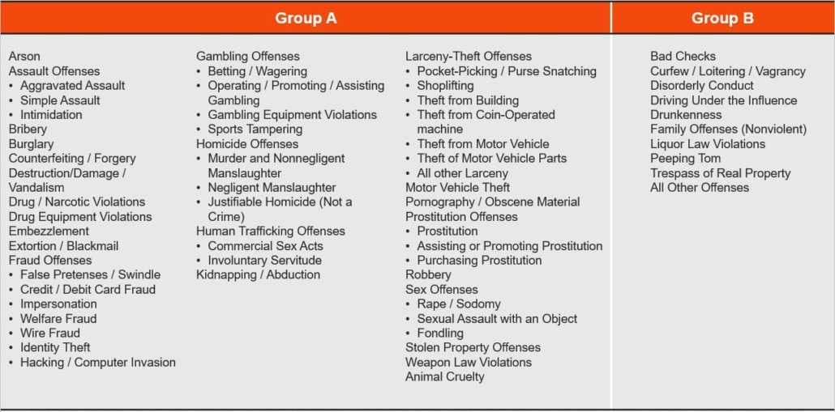
NIBRS
NIBRS incudes many more types of offenses and breakdowns.
Notes:
Drug offenses, for example, can be broken down into possession, sale, manufacturing.
Choices must be made unlike for UCR.
Group B crimes only have arrestee data.

Slide 21
NIBRS
So why not always use NIBRS! It’s incomplete. The FBI says, however, that by 2021, NIBRS will replace UCR. It is the crime dataset of the future
The first pilot demonstration of NIBRS was done in 1987, and the system was approved in 1988.
Not all states report to NIBRS and sometimes only some agencies within a state report so one cannot run cross-sectional analyses, e.g. you can’t run cross-state regressions since the number of agencies reporting in each state differs.
E.g. Virginia 100% of agencies report to NIBRS but in Connecticut only about half and in Mississippi zero.
Until more agencies begin participating, the FBI continues to report statistics in the traditional format by converted NIBRS data into summary format.
Notes:
FBI Director Comey said everyone should use NIBRS by 2021, today about 30%.

Slide 22
NIBRS
NIBRS data since 1995 is available from National Archive of Criminal Justice housed in the Inter-University Consortium for Political and Social Research at the University of Michigan. The NIBRS Program Guide offers useful information.
The NIBRS Book by Jacob Kaplan is excellent. See also Kaplan’s cleaned up UCR and NIBRS data. Kaplan’s FAQ is also very useful.
NIBRS databases are very big and difficult to work with.

Slide 23
National Crime Victimization Surveys
Not all crimes are reported to police, and thus the Uniform Crime Reports, even with the NIBRS expansion, underreport the actual amount of crime that is taking place.
Victimization survey can tell us about unreported crime and also more about age, sex, race, income etc. of victims, even marriage status and crime.
The National Crime Victimization Surveys (NCVS), administered by the U.S. Census Bureau, was started in 1972 and has been ongoing since then. The household is the main unit of analysis. The sample size has being growing smaller due to budget cuts, began around 72,000 now around 40,000.
NCVS is available through NACD the NCVS Resource Guide offers useful information.
Quick data access tool (1993-recent) is available from the BJS.

Slide 24
Victimization Rates versus Prevalence Rates
In 2015 there were 5,006,620 victimizations of violent crime, i.e. 5 million incidents for a rate of 18.6 per 1000 persons aged 12 years or older.
How many victims of violent crime were there in 2015?
The victimization rate is victimizations/pop the prevalence rate is victims/pop.
Why the big differences?
2.65 million
Notes:
(for some reason victimization rate is often given per 1000 and the prevalence rate as a percentage)
Domestic violence is repeated. But also where you live, what you do etc.

Slide 25
National Crime Victimization Surveys
Data on the number and rates from crimes reported via the NCVS from 1995-continuing can be obtained from National Archive of Criminal Justice housed in the Inter-University Consortium for Political and Social Research at the University of Michigan
Pros | Cons
More accurate measures of true rates of crime, especially for violent crimes (minus homicide) More information about the crime is collected (day, time, location, relationship of victim and perpetrator, etc…) | Results are aggregated at the national level and not typically available at subnational level (but this is changing!) Some crimes such as prostitution are considered victim-less and thus are not included in victimization surveys Some crimes have no victims to interview (homicide) Sampling error/bias issues Possibilities of different definitions of crimes across different social groups (e.g. college educated report more assaults.)

Slide 26
National Crime Victimization Surveys
Working with the data:
  NCVS is a survey so survey weights are very important to get national averages.
  Data comes in incident, person, household files so you often have to work with all three.
A useful learning guide (homework!)

Slide 27
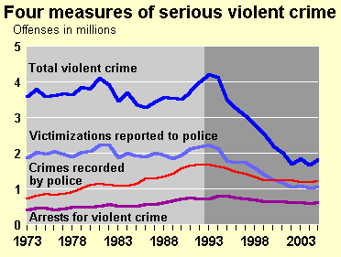
Comparing UCR and NCVS
According to data from the NCVS most crimes are not reported to police. In 2006 38% of property crimes and about 50% of violent crimes were reported.
In 2004 the UCR indicated that there were 2.91 aggravated assaults per 1,000, where as the NCVS indicated 4.3 per 1,000. Similarly the UCR indicated 4.21 motor vehicle thefts per 1,000 while the NCVS indicated 8.4 motor vehicle thefts per 1,000.
The two measures often show trends that move in the same direction, but not always (Rand and Rennison 2002)
The UCR includes homicide, but the NCVS does not; the NCVS includes simple assault which the UCR does not.
The top two lines are from NCVS, the bottom two from UCR

Slide 28
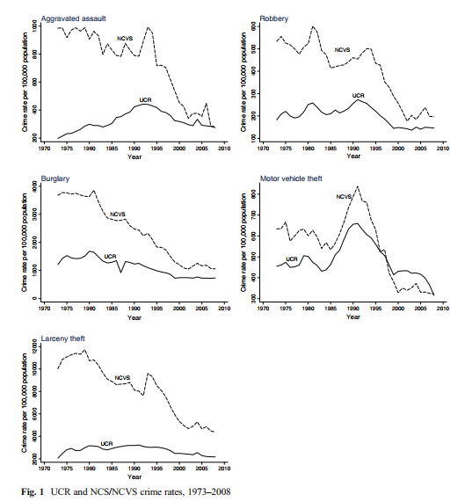
Comparing UCR and NCVS
Convergence?
The differences between UCR and NCVS are not constant but show signs of converging over time.
Why is MVT similar?
Ansari, Sami, and Ni He. 2017. “Explaining the UCR-NCVS Convergence: A Time Series Analysis.” Asian Journal of Criminology 12 (1): 39–62. https://doi.org/10.1007/s11417-016-9236-3.

Slide 29
International Crime Data (ICVS)
The International Crime Victimization Survey (ICVS) became operational in 1989, with subsequent installments in 1992, 1996, 2000, and 2004-5. It is the most ambitious and comprehensive attempt to minimize the myriad of difficulties associated with making cross-country comparisons of crime victimization. Data are available in SPSS and SPSS Portable formats and can be downloaded from here.
The 1989 sweep included 14 industrialized countries; several city-specific surveys were also administered in the first installment. . The most recent installment included responses from individuals in 30 countries as well as 33 city-specific surveys. The ICVS uses a standard sample population size of 2000 individuals for each country.
Over the course of the survey, more than 300,000 individuals from 78 countries have participated in the ICVS. Five countries, Canada, England & Wales, Finland, Netherlands, and USA, have participated in all five rounds of the ICVS.

Slide 31
Homcide Rates by Country
The ICVS does not compare homicide across countries and the definition of homicide can vary. Unfortunately, there is no central source of comparable homicide data but on any reasonable comparison the United States does have a high homicide rate relative to other industrialized nations as shown in Figure 7. Thus, it is the U.S. homicide rate not the U.S. crime rate which stands as the outlier.

Slide 32
Recidivism of Prisoners Released in 1994, 2005
In 1997 the BJS collected data from 15 departments of corrections and compiled the complete criminal history of a sample of prisoners released in 1994.
The data on each released prisoner comes from the officially recorded history captured in the FBI and State RAP Records of Arrests and Prosecutions) sheets.
Thus constructed, the data contains information from the releasees first arrest to the end of the sample period in 1997.
The file is arranged by released prisoner and contains up to 99 “arrest cycles.” Each cycle is determined by the date of arrest and includes details on the crimes committed (i.e. arrested for assault and burglary if the arrest occurred at the same time) the adjudication (i.e.. plead guilty and given 6 months). The data on arrest and adjudication are very detailed as each charge of the arrest has multiple codings for the crime committed, whether the charge was a felony or a misdemeanor as well as information about the victims.
Very difficult data to work with.
Tracked Prisoners by State from Recidivism of Prisoners Released in 1994
State | Released Prisoners
Arizona | 2,000
California | 7,183
Delaware | 721
Florida | 2,893
Illinois | 2,615
Maryland | 2,117
Michigan | 2,315
Minnesota | 1,929
New Jersey | 2,289
New York | 2,639
North Carolina | 2,314
Ohio | 2,664
Oregon | 2,292
Texas | 2,550
Virginia | 2,103
Total | 38,624

Slide 33
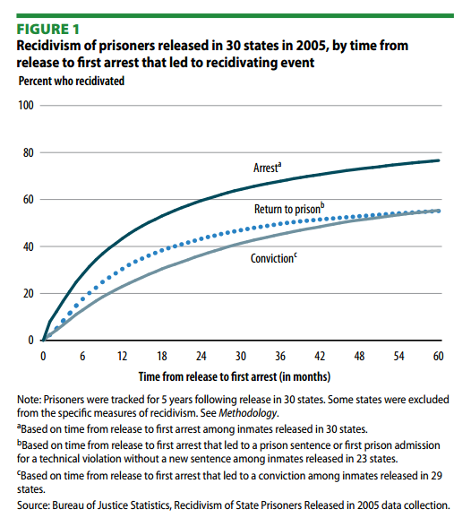

Slide 34
Other data sources
From the Bureau of Justice statistics you can also find data about:
  Law Enforcement: Law Enforcement Management and Administrative Statistics Survey (LEMAS). Conducted in 2000
    Covers primary state law enforcement agencies, and local police agencies with 100 or more sworn officers and 50 or more uniformed officers
    Includes budget, number of employees (broken down by demographics and gender), types of patrols, salaries, special units, vehicles, and community policing activities.
    NACJD LEMAS Program Guide.
  Corrections. Including:
    Reports of number of prisoners in State and Federal prisons. Reports called Prisoners in xxxx and are available from 1994-2005 on the BJS website
    Drug Use and Dependence in State and Federal Prisons, 2004
    Mental Health Problems: self-reported information on mental health of prisoners
    Sexual Violence Reported by Correctional Authorities, 2005
    Recidivism of Prisoners Released in 1994
  Courts and Sentencing. Including:
    National Judicial Reporting Program: biannual survey of felony trial courts. Includes information on demographic characteristics of felons, conviction offenses, type of sentences, sentence lengths, and time from arrest to conviction. Data from 1983-2002 available on BJS website
    State Court Processing Statistics: provides data on the criminal justice processing of persons charged with felonies in 40 jurisdictions representative of the 75 largest counties. 1988-2009.
    See also the Court Statistics Project.

Slide 35
NLSY
The National Longitudinal Survey of Youth (NLSY) is another survey useful for crime data. This survey is meant to document the transition from adolescence to adulthood.
NLSY periodically surveys a representative sample of youths ages 12-17 about various aspects of their life such as income and jobs, family history, expectations, attitudes and behaviors, and use of time (including in criminal activities).
Thus, unlike the NCVS, the NLSY uses self-reports of offending rather than victimization. Respondents are asked about their drug use, handgun use, type of crimes committed, and amount of illegal drugs sold or used.
Data is reported at the individual level rather than at the household level.
Data from the NLYS 1979 and 1997 are available from the Bureau of Labor Statistics.
Again, this data is also available from National Archive of Criminal Justice housed in the Inter-University Consortium for Political and Social Research at the University of Michigan

Slide 36
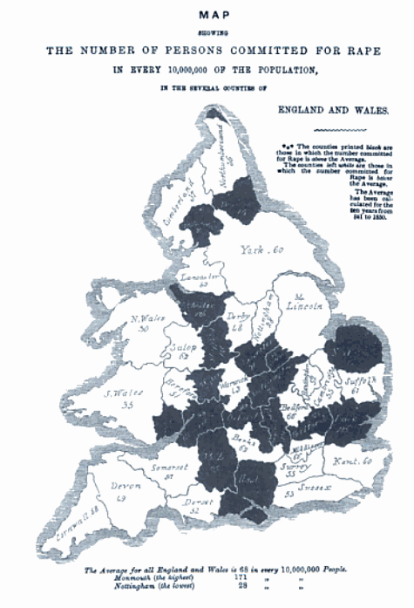
Geographic Crime Data
Crime Mapping and Spatial Analysis
Crime mapping has a long history, going back to the Cartographic school Quetelet (1831) and Mayhew (1861), but crime mapping did not become an important tool in crime fighting until the 1990s when police departments, led by the NYPD, made the weekly collection and analysis of data the central organizing principle of police strategy.
Source: Encyclopedia of Crime and Punishment: Volumes I-IV
By David Levinson, SAGE, 2002. Originally in Mayhew, Henry. 1861-1862 [1968] London Labour and the London Poor, volume 4. New York: Dover, p. 467.

Slide 37
Geographic Crime Data
Many large police departments now have statistical units that collate, manage, and analyze crime databases. With the rise of the internet it became a natural and simple procedure to export crime data to the web for use by the public. The LA, Chicago, Washington, Oakland, and Baltimore police departments, among others, offer online mapping of crime incidents, usually from the past several months.
Websites such as SpotCrime collate data from many police departments around the United States and produce maps on request using online tools such as Google Maps.

Slide 38
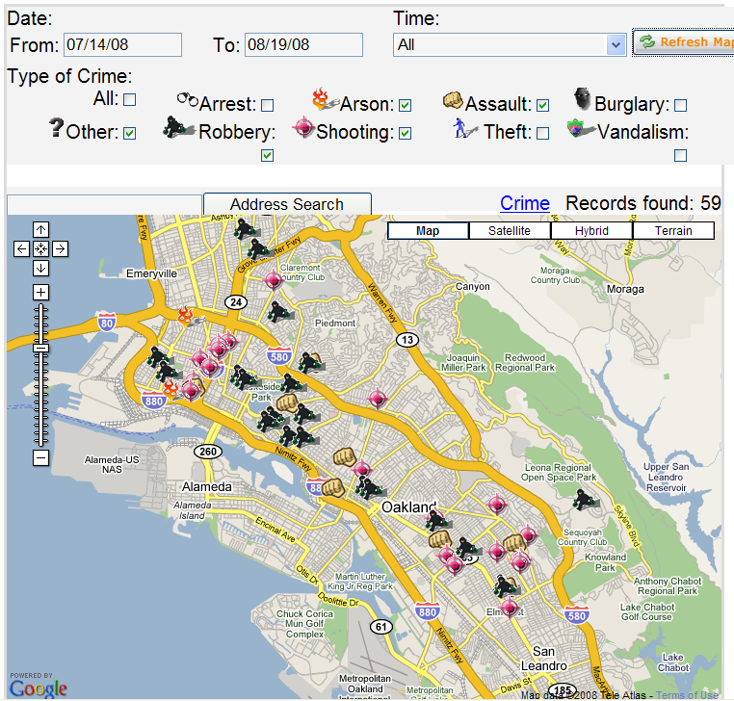

Slide 39
Geocoding
Crime data from police departments will typically come in the form of addresses (typically redacted to the block level). The first step in analysis is to geocode the addresses, that is assign geographic identifiers to each address.
For example, we obtained data on over 285,000 crimes from January of 1997 to July of 2003 from the Metropolitan Police Department of the District of Columbia. For each address, we geocoded the data to link the address to longitude and latitude coordinates, zip code, and most importantly Census tract and block group codes.
Census block groups are the smallest geographical unit for which the bureau publishes sample data. The census aims for a population of 1500 in each census block group. (In Washington, DC there are 433 Census block groups with a mean population of 1321.)
Using the Census block group codes one can merge geocoded crime data with data from the Census. Census Data is available from the U.S. Bureau of the Census in many different forms. One of the most convenient for quick look is the online download tool.

Slide 40
Mapping
The U.S. Bureau of the Census encodes geographic information in TIGER/Line® files. Conveniently if the Census breaks data down by a type of region it will typically also be possible to use Tiger/Line data to map the regions. Tiger files, for example, encode geographic information such as boundaries for Census Block Groups, Census Blocks, Census Tracts, Counties, Congressional Districts, School Districts and Voting Districts. Tiger/Line files can also include information on railroads, roads, landmarks and other geographic features.
Data from Tiger Line files can be exported as “shape files.” Shape files are a set of formats for geographic data developed by ESRI, a leading producer of software for spatial analysis. Tiger Line shape files can be access from the U.S. Bureau of the Census or more conveniently through ESRI where you can download Census 2000 Tiger Line data by state and according to a wide variety of layers such as Census Block Groups, Census Blocks, Census Tracts, and so forth. We obtain boundary data on Census Block Groups for Washington, DC in the form of shape files from ESRI.
STATA has no built in functions for producing maps or using shape files. But two packages provide considerable functionality. SHP2DTA converts shape files to STATA dta files in a format that SPMAP can to produce maps. Both packages can be easily installed in STATA using the ssc install command. The key to using these packages is to ensure that the location identifier in the map data is the same as the location identifier in the Census data that you wish to map.
Useful information can be found regarding STATA maps here.

Slide 41
Mapping
The DC metropolitan police department collects data on all crimes reported to police. This data includes offense type (Homicide, Robbery, Theft from auto, etc..), date of offense, hour of offense (0-24), and location.
Data currently includes all offenses reported to the DC police from 1/1/1997 to 7/30/2003. It may be possible to update this to the present date by contacting the Metropolitan Police Department.
This data was used in Jon Klick and Alex Tabarrok. 2005. Using Terror Alert Levels to Estimate the Effect of Police on Crime. Journal of Law and Economics:48(1)
Similar problems can exist with this data as did with the UCR data, and as noted before not all crimes are reported to police and this dataset only includes those reported.

Slide 42
Mapping
The data can be used to analyze the impact of policies or events on locations, rates, or times of crime, as in Klick and Tabarrok (2005).
It can also be used for spatial analysis using graphing, spatial econometrics, or hot spot analysis.
An example of figures that can be obtained from the data:
These figures compare locations of homicides to homicide rates per 1,000 in the population

Slide 44
Spatial Econometrics
It is clear from the maps that crime and its demographic correlates are not distributed randomly over space. Thus, regressions which do not take into account spatial clustering or spatial autocorrelation can be misleading.
Spatial clustering of errors is used fairly often in economics although in geographic data the clusters are not always obvious, Census block? City? Region?
Spatial correlation, analogous to temporal correlation, recognizes that events in space may not be independent. An increase in crime in one region, for example, may predict an increase in crime in neighboring regimes through a variety of spillover processes. Temporal correlation is relatively easy to model but spatial correlation is much more difficult.

Slide 45
Spatial Econometrics
Key difficulty is that defining the “neighborhood” over which correlation occurs is not obvious.
Distance measure?
Contiguity measure?
Gravity Model?
Time-Space measures?
Spatial econometrics requires special techniques and is a rapidly growing field of research.

Slide 46
CJARS
Almost all the data we have on crime is gathered at “points” in the criminal justice process: e.g. victimization, arrest, imprisonment. We have very little data that is longitudinal.
For example, how many people have or will ever be arrested? Incarcerated?
What is the effect of arrest on income or educational attainment?
For the first time, CJARS will provide linked data to look at individual interactions with the criminal justice system over a lifetime. Connected through the Census to administrative data like unemployment insurance, tax and health data. Accessed through Federal Statistical Research Data Centers.
Arrest will be linked to adjudication to imprisonment to parole to income to education….
Can even connect adult criminal records to children in the home.

Slide 47
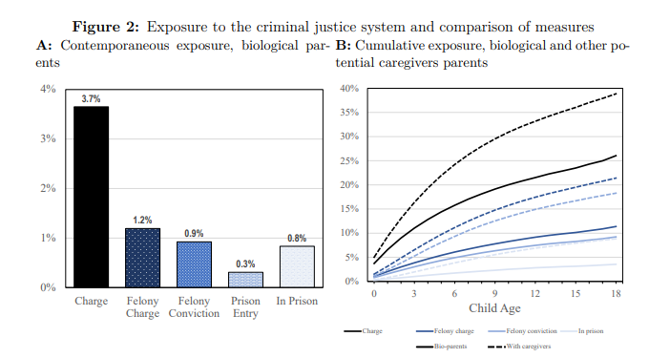
Child Exposure to Caregivers Who Are Charged, Convicted, Imprisoned: Contemporaneous and Cumulative
Cumulative over
Childhood
Finlay, Mueller-Smith, Street (2022). Measuring Intergenerational Exposure to the U.S. Justice System: Evidence from Longitudinal Links between Survey and Administrative Data. https://sites.lsa.umich.edu/mgms/wp-content/uploads/sites/283/2022/06/CJARS_KidExposure_20220609.pdf

Slide 48
Petty would be Pleased
Today we can measure vice and sin across time and space, we can map it, correlate it, and crunch it as never before.
The amount of crime data is growing.
Local crime data, including geographic information, for example, is exploding at a rapid pace and will be a key area for criminology and econometric research.
We hope that this paper will help to guide researchers to the data that is most useful to answering their questions.
Sir William Petty
(1623-1687)
Source: Bowood House

